Slide 1
What means web development?
Web development is the work involved in developing a website for the Internet (World Wide Web) or an intranet (a private network).^{[1]} Web development can range from developing a simple single static page of plain text to complex web applications, electronic businesses, and social network services.

Slide 2
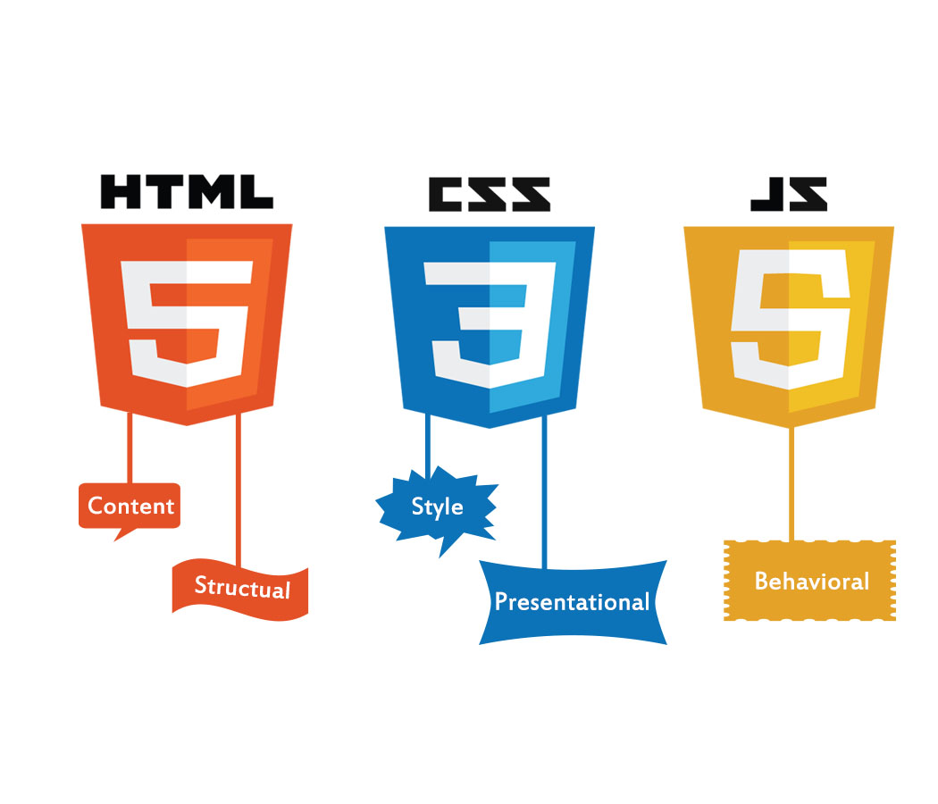

Slide 3

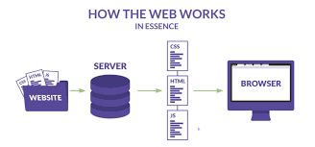
How does the web work
The web browser connects to the web server and sends an HTTP request (via the protocol stack) for the desired web page. The web server receives the request and checks for the desired page. If the page exists, the web server sends it.

Slide 4
What do you need to be a web developer?
You should ideally have an aptitude for - or experience of - elements such as:
User experience (UX)
User interface (UI)
Visual design
Coding languages including HTML and CSS
Frontend web programing languages and skills such as JavaScript and web animation techniques

Slide 5
Why you choose to learn web developement ?
Web development give me the opportunity to express myrself creatively on the internet. If I have an idea I would like to try as I discover the web developement skills, try it out. Web developement is a fun, creative experience.

