Slide 1
Fedi App
UX Audit -- February 2026
Version 26.2.4 | Android | Nielsen Norman Group heuristics
Notes:
Fedi App UX Audit -- February 2026
Version 26.2.4 | Android emulator | Nielsen Norman Group heuristics
Audit conducted via live emulator walkthrough.

Slide 2
Executive Summary
Fedi is trying to do something genuinely ambitious -- combine chat, payments, and mini apps inside a federated community model. That's a hard brief, and you can feel the vision behind it.
But right now, the app is designed for people who already understand how it works.
The onboarding drops users straight into federation jargon without explanation. Navigation is almost entirely unlabelled. The wallet -- Fedi's core feature -- is locked behind a joining process that can leave someone completely stranded.
The visual design is clean and the intent is clear. But the gap between what the team understands and what a new user experiences is significant.
These findings are organised in the order a real user would encounter them.
Notes:
The core tension: Fedi is a technically sophisticated product trying to serve users who are not technically sophisticated. The onboarding wall (federation jargon, unlabelled navigation, wallet locked behind joining) creates a first-experience failure that undermines everything downstream. The findings are ordered by user encounter, not severity, to make the narrative coherent for stakeholders who haven't used the app.

Slide 3
UX Audit Findings
Organised in the order a real user encounters them

Slide 4
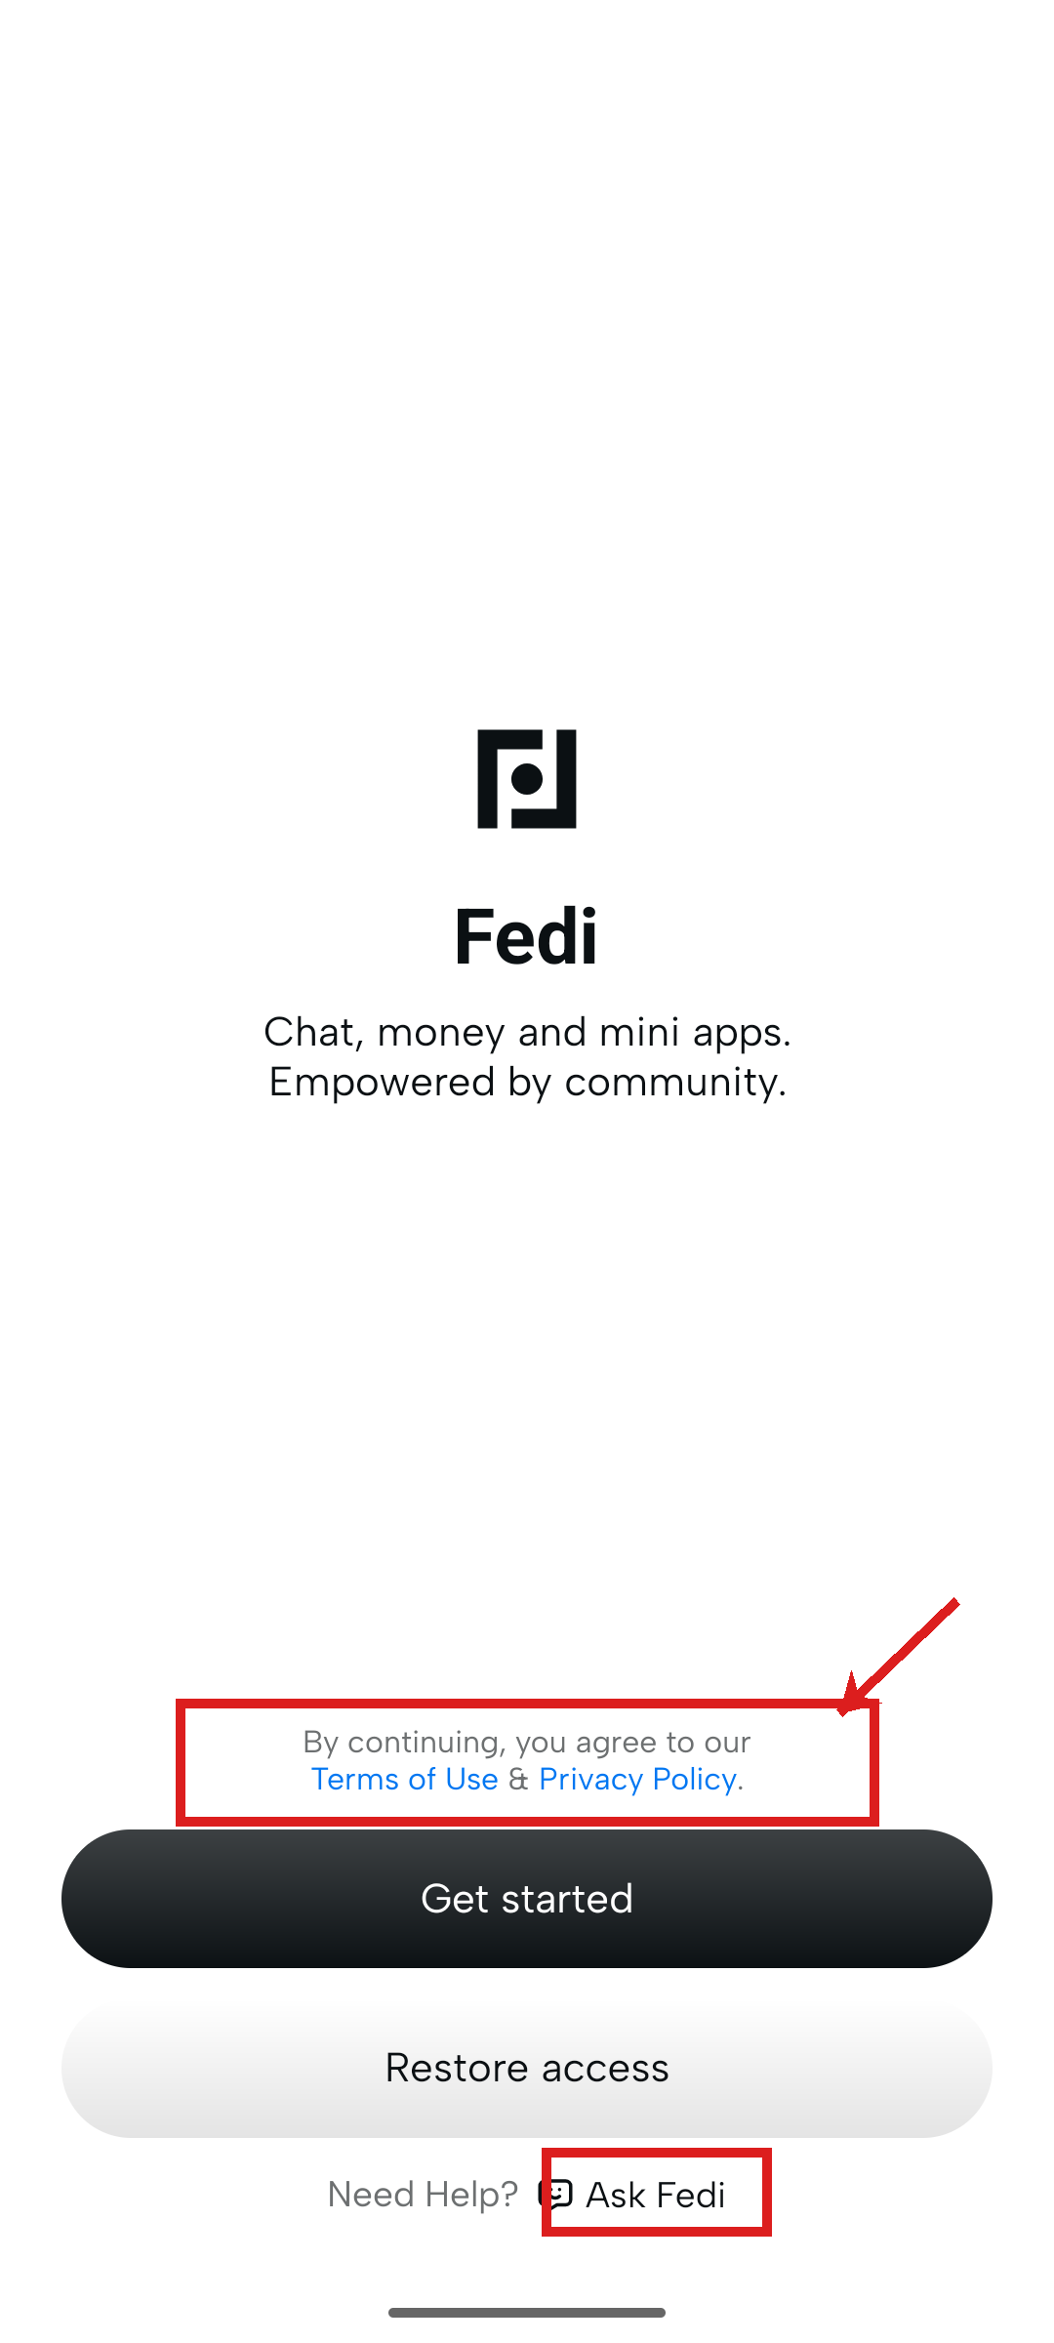
1. First Launch
A calm, well-designed splash screen.
Findings
△
Legal copy ("By continuing, you agree...") is low contrast and easy to miss. For a financial app, this matters.
△
"Ask Fedi" help link is so peripheral most users will not notice it.
✓
Clear visual hierarchy, intuitive two-button layout.
✓
Avatar bubbles communicate social-network context without words.
Notes:
First impressions are broadly positive. The splash screen does its job -- clean, calm, minimal cognitive load. The two issues are both fixable without design rework:
- Legal copy: increase contrast, move below the CTA button (standard pattern)
- Ask Fedi: consider surfacing as a persistent help icon (?) in the nav rather than a buried footer link
Heuristic: H5 (error prevention), H10 (help and documentation)

Slide 5
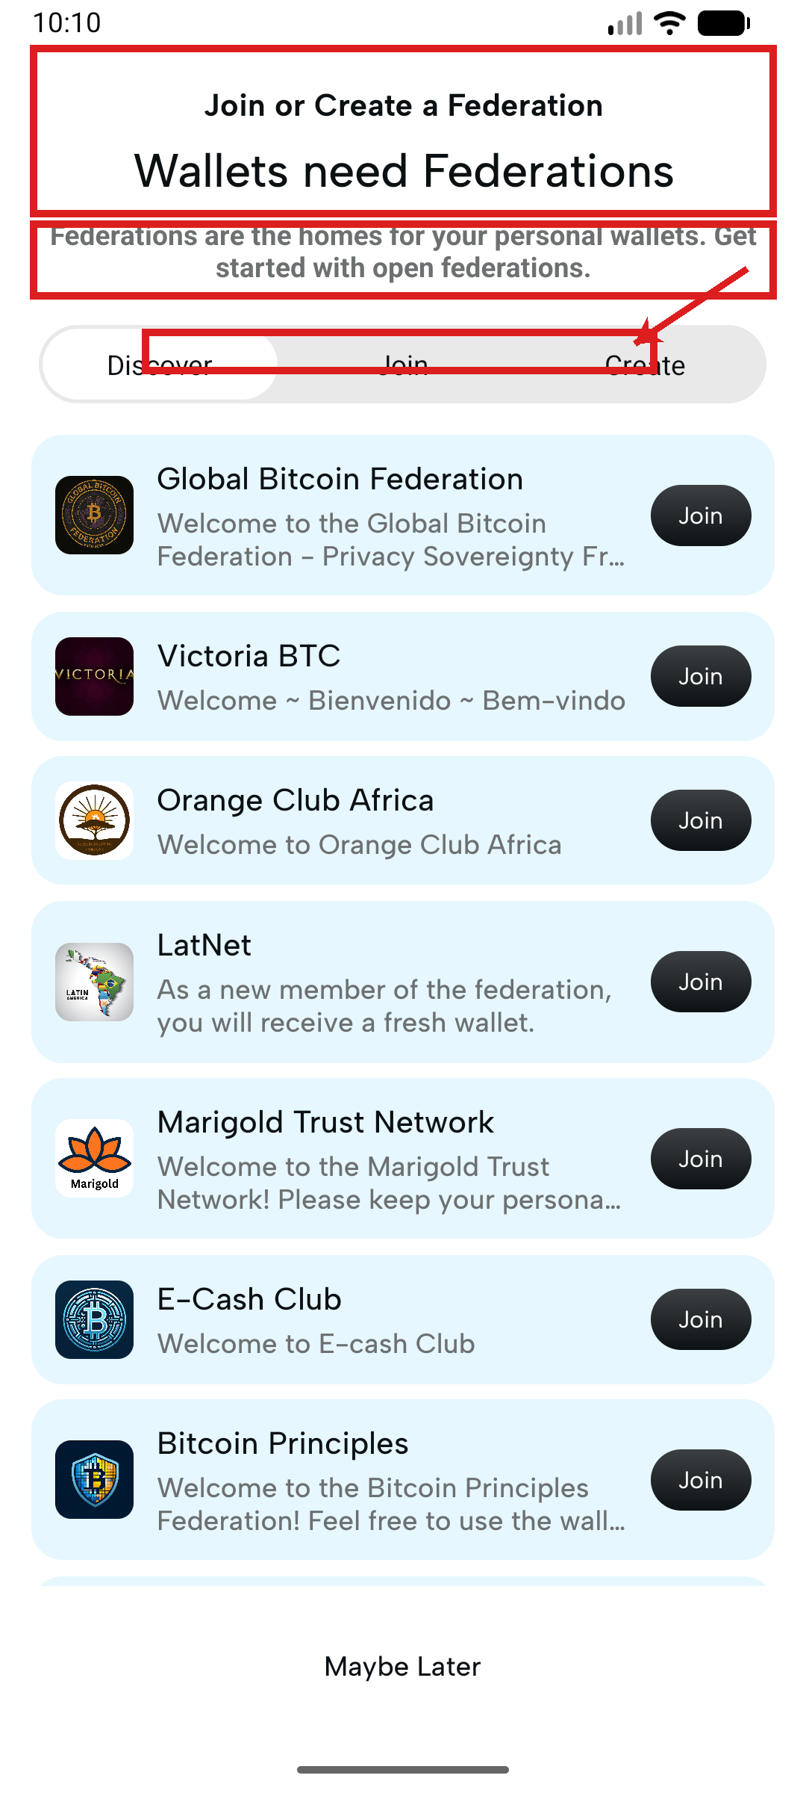
2. Federation Discovery -- The First Wall
They tap Get Started and land on Join or Create a Federation. No one has explained what a federation is.
Findings
●
The word federation appears repeatedly before the user has any idea what it means.
●
Federation list cards are not tappable -- no detail view before committing to join.
△
Description text truncated mid-sentence ("Privacy Sovereignty Fr...").
△
Three tabs (Discover, Join, Create) have no active state and no explanation.
✓
"Maybe Later" at the bottom gives users a safe exit.
Notes:
This is the highest-friction moment in the entire flow. The user has just downloaded a financial app and is immediately asked to join something called a federation -- with no explanation of what that is or why they need to.
Priority fixes:
1. Add a 2-3 sentence explainer above the list: "A federation is a group that manages your wallet and keeps your money safe. Think of it like choosing your bank."
2. Make federation cards tappable with a detail view: description, guardian info, member count, terms summary.
3. Fix text truncation (technical, easy).
Heuristics: H2 (match with real world), H5 (error prevention)

Slide 6
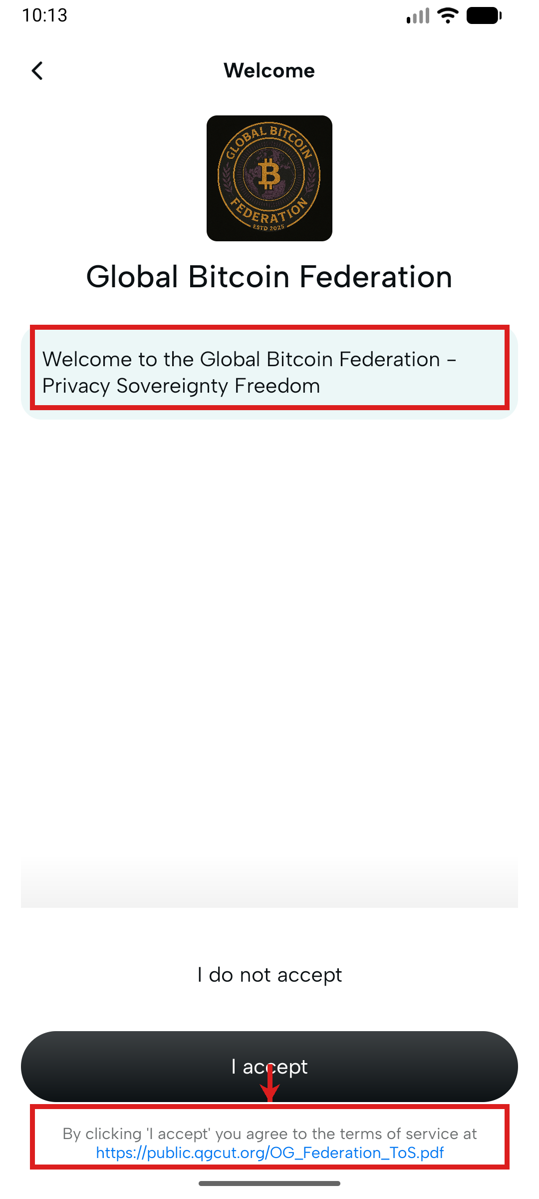
3. Joining a Federation -- Errors, Loops & a Disappearing Exit
They tap Join. A Terms of Service screen appears, titled simply Welcome, with ToS as an external PDF.
Findings
●
Screen title is "Welcome" -- no signal this is a legal consent moment. ToS not shown in-app.
●
Error banner is generic, has no retry button, and persists across multiple screens.
●
"View public federations" on QR scanner loops back to the same list.
●
"Maybe Later" disappears mid-flow. Back button exits the app entirely.
△
Camera permission screen doesn't clarify whether Continue grants or defers permission.
△
QR scanner has no instruction text -- what should the user point their camera at?
Notes:
This section contains the most dangerous UX failures -- the ones that can strand a user with no path forward:
- The ToS moment: label it clearly ("Before you join"), show key terms in-app (scrollable), link to full PDF as secondary action.
- Error banner: add a Retry button. Dismiss automatically on success. Don't let it persist across screens.
- The "walled in" problem: if joining fails, users must always be able to get back to the home screen or the federation list. Back button should never exit the app from within a flow.
- QR scanner: one line of instructional copy ("Scan a federation QR code from an admin or the Fedi website") would eliminate the confusion entirely.
Heuristics: H1 (system status), H3 (user control), H5 (error prevention), H9 (error recovery)

Slide 7
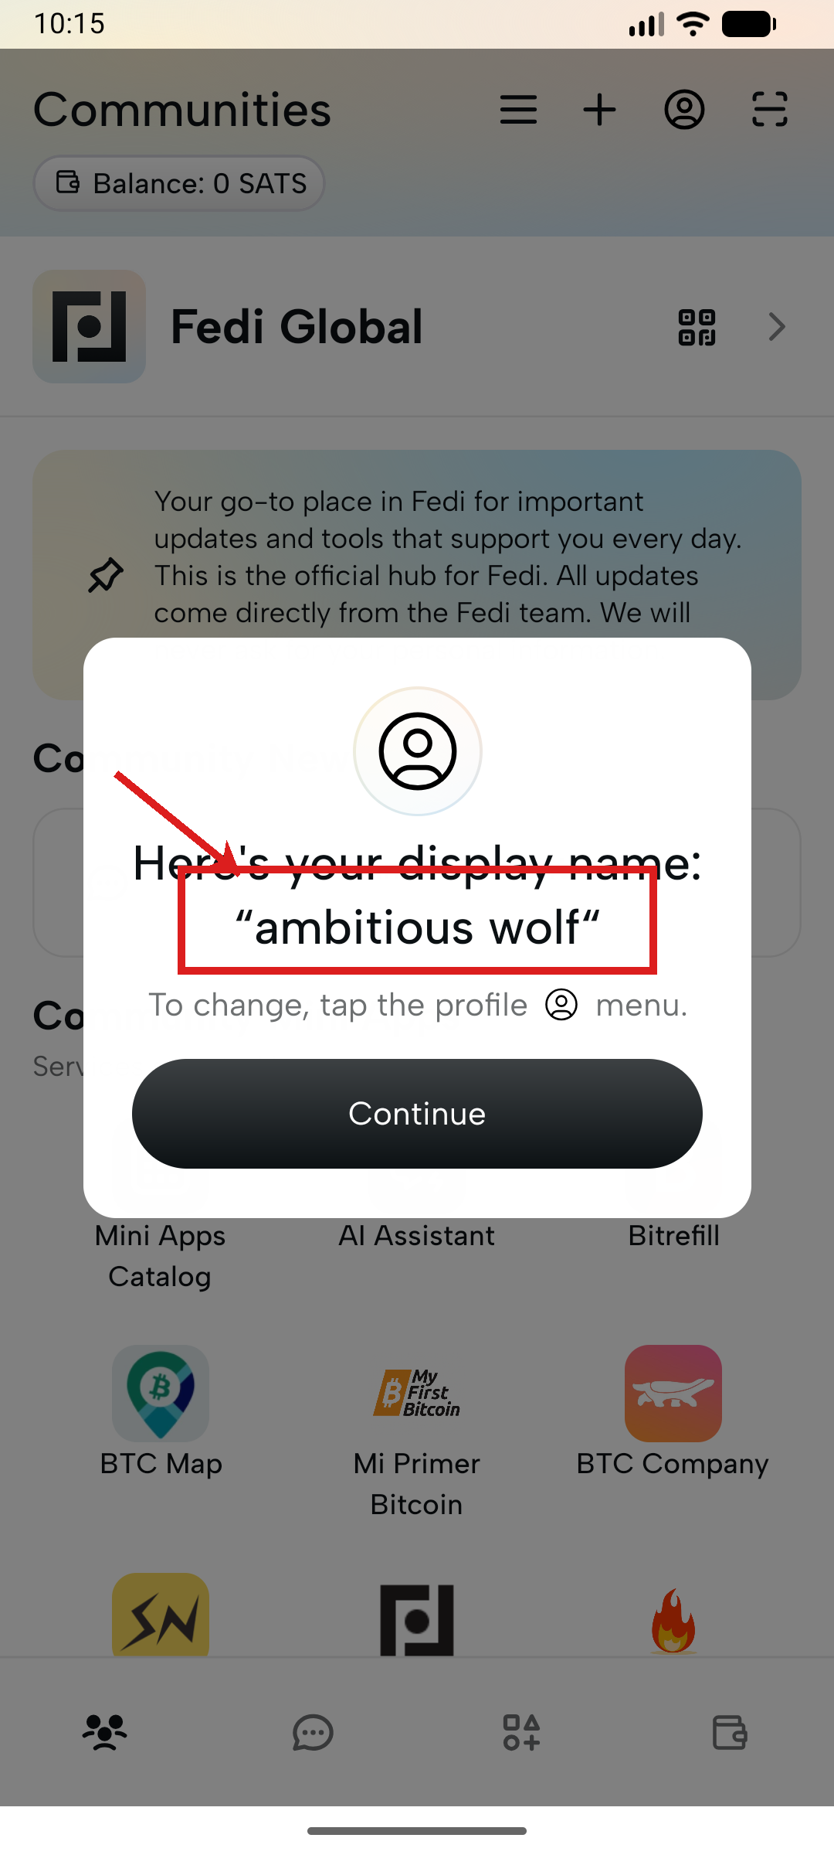
4. Arriving in the App
If they make it through -- they land on home with a modal already waiting.
Findings
●
Display name auto-assigned as "ambitious wolf" without asking. Jarring for a chat + payments app.
△
"ambitious wolf #267f" -- the hash suffix is technical noise with no explanation.
△
Home screen mixes three content types at equal visual weight.
△
Fedi Global banner has an unlabelled QR icon -- not obviously tappable.
Notes:
The auto-assigned display name is a significant trust and identity issue for a payments app. Users are about to receive and send real money -- having an embarrassing or random display name undermines confidence.
Fix: prompt for a display name during onboarding, before entering the app. Even a simple "What should people call you?" screen.
Home screen hierarchy: the three content zones (federation banner, Community News, Mini Apps) need visual separation -- section headers, spacing, or background differentiation.
Hash suffix (#267f): this is a Nostr public key fragment. It should not be surfaced to users without an explanation, or should be hidden entirely behind a "technical details" toggle.
Heuristics: H2 (match with real world), H8 (aesthetic and minimalist design)

Slide 8
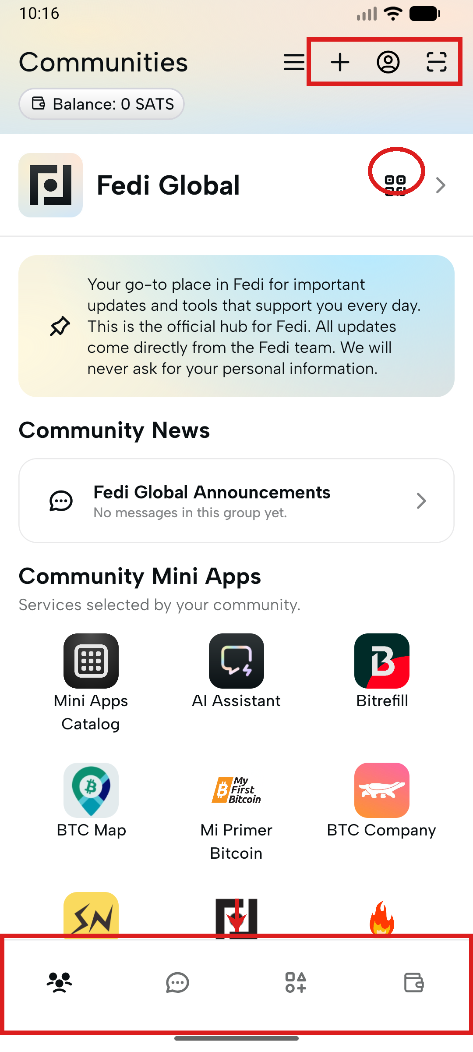
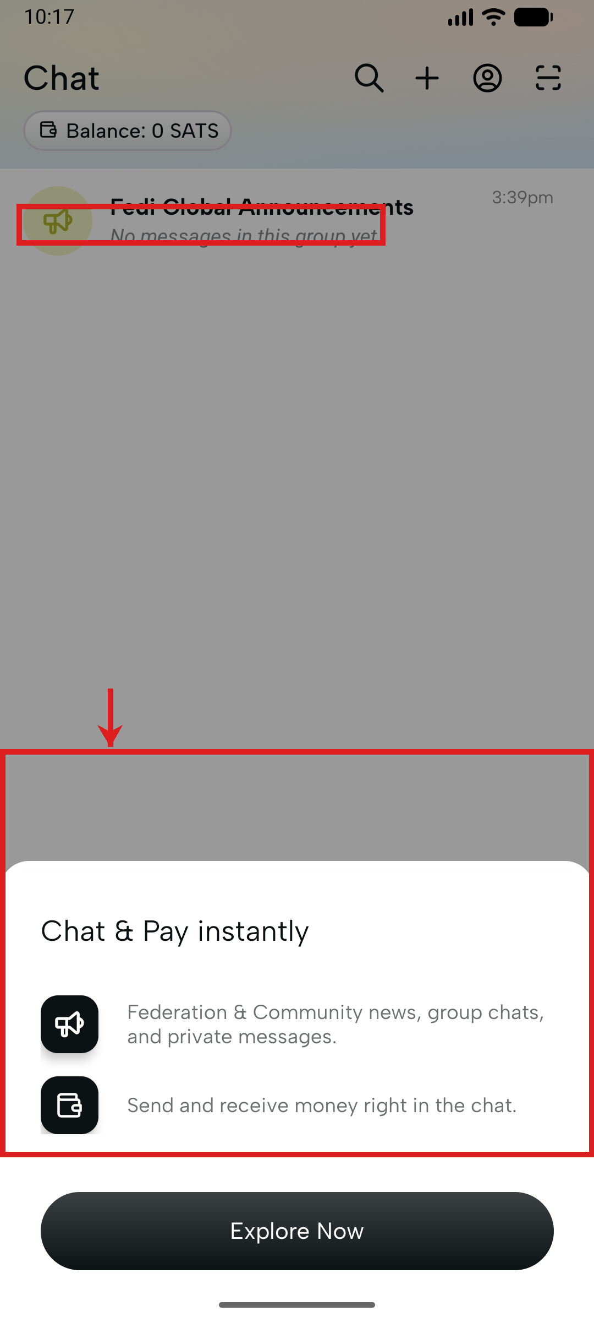
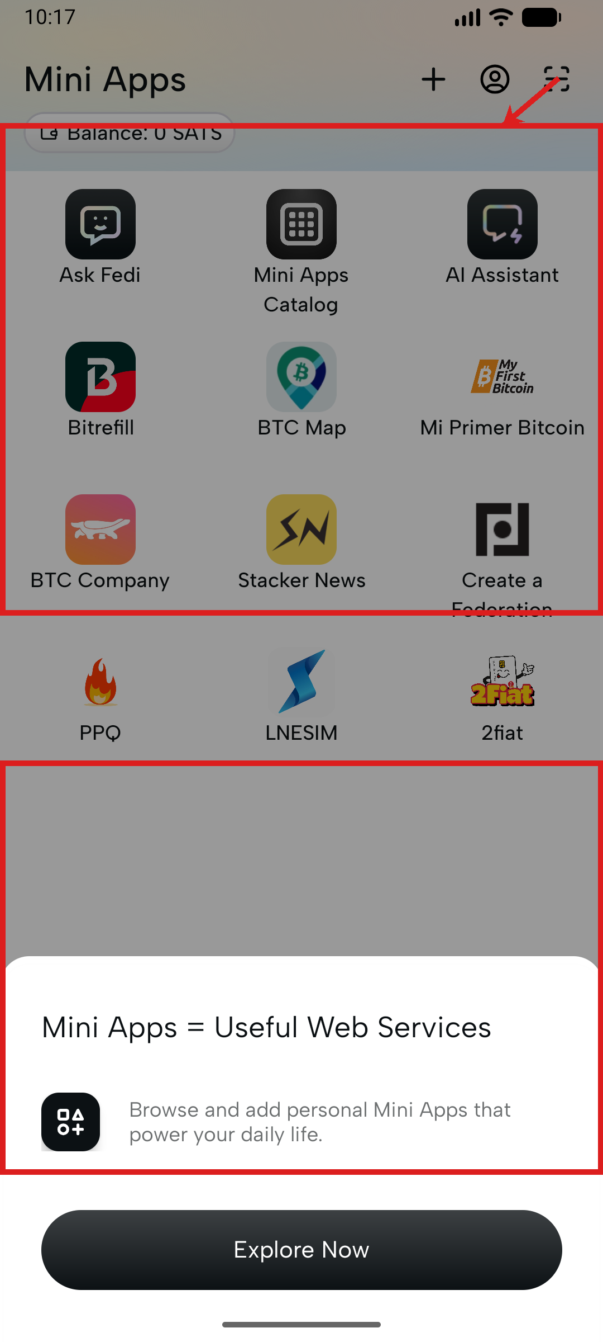
5. Core Navigation
Four unlabelled bottom-nav icons. Every tab blocked by a promo sheet on open.
●
Four unlabelled icons -- users must guess each tab's purpose.
●
Promo bottom sheet blocks content on every tab switch.
●
Wallet tab redirects to federation wall with no explanation.
△
Unlabelled QR icon on Fedi Global banner -- not obviously tappable.
△
Four unlabelled header icons appear on every screen.
△
Chat empty state is bare text -- no illustration or next step.
△
Mini apps icon grid: wildly inconsistent icon styles.
Chat
Mini Apps
Notes:
The unlabelled bottom navigation is a systemic issue, not a cosmetic one. Android Material Design guidelines recommend labels on bottom nav items precisely because icons alone require learned knowledge. For a new user, four mystery icons mean four things to trial-and-error.
Promotional bottom sheets on every tab open are particularly damaging: the first thing a user sees on switching to any section is a sales message they must dismiss. This pattern trains users to dismiss quickly without reading, which is dangerous if a future sheet contains important information.
The Wallet tab redirect is a critical wayfinding failure: if you cannot use the wallet without a federation, the tab should be disabled with an explanation, not silently redirect.
Heuristics: H1, H3, H4, H8

Slide 9
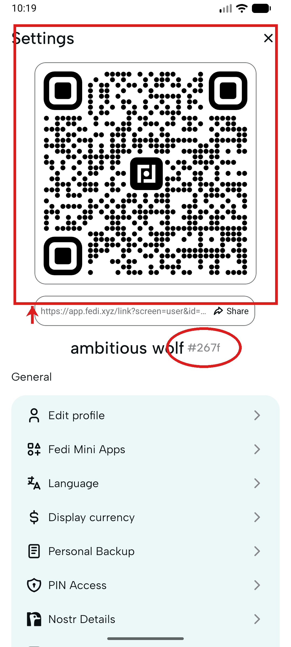
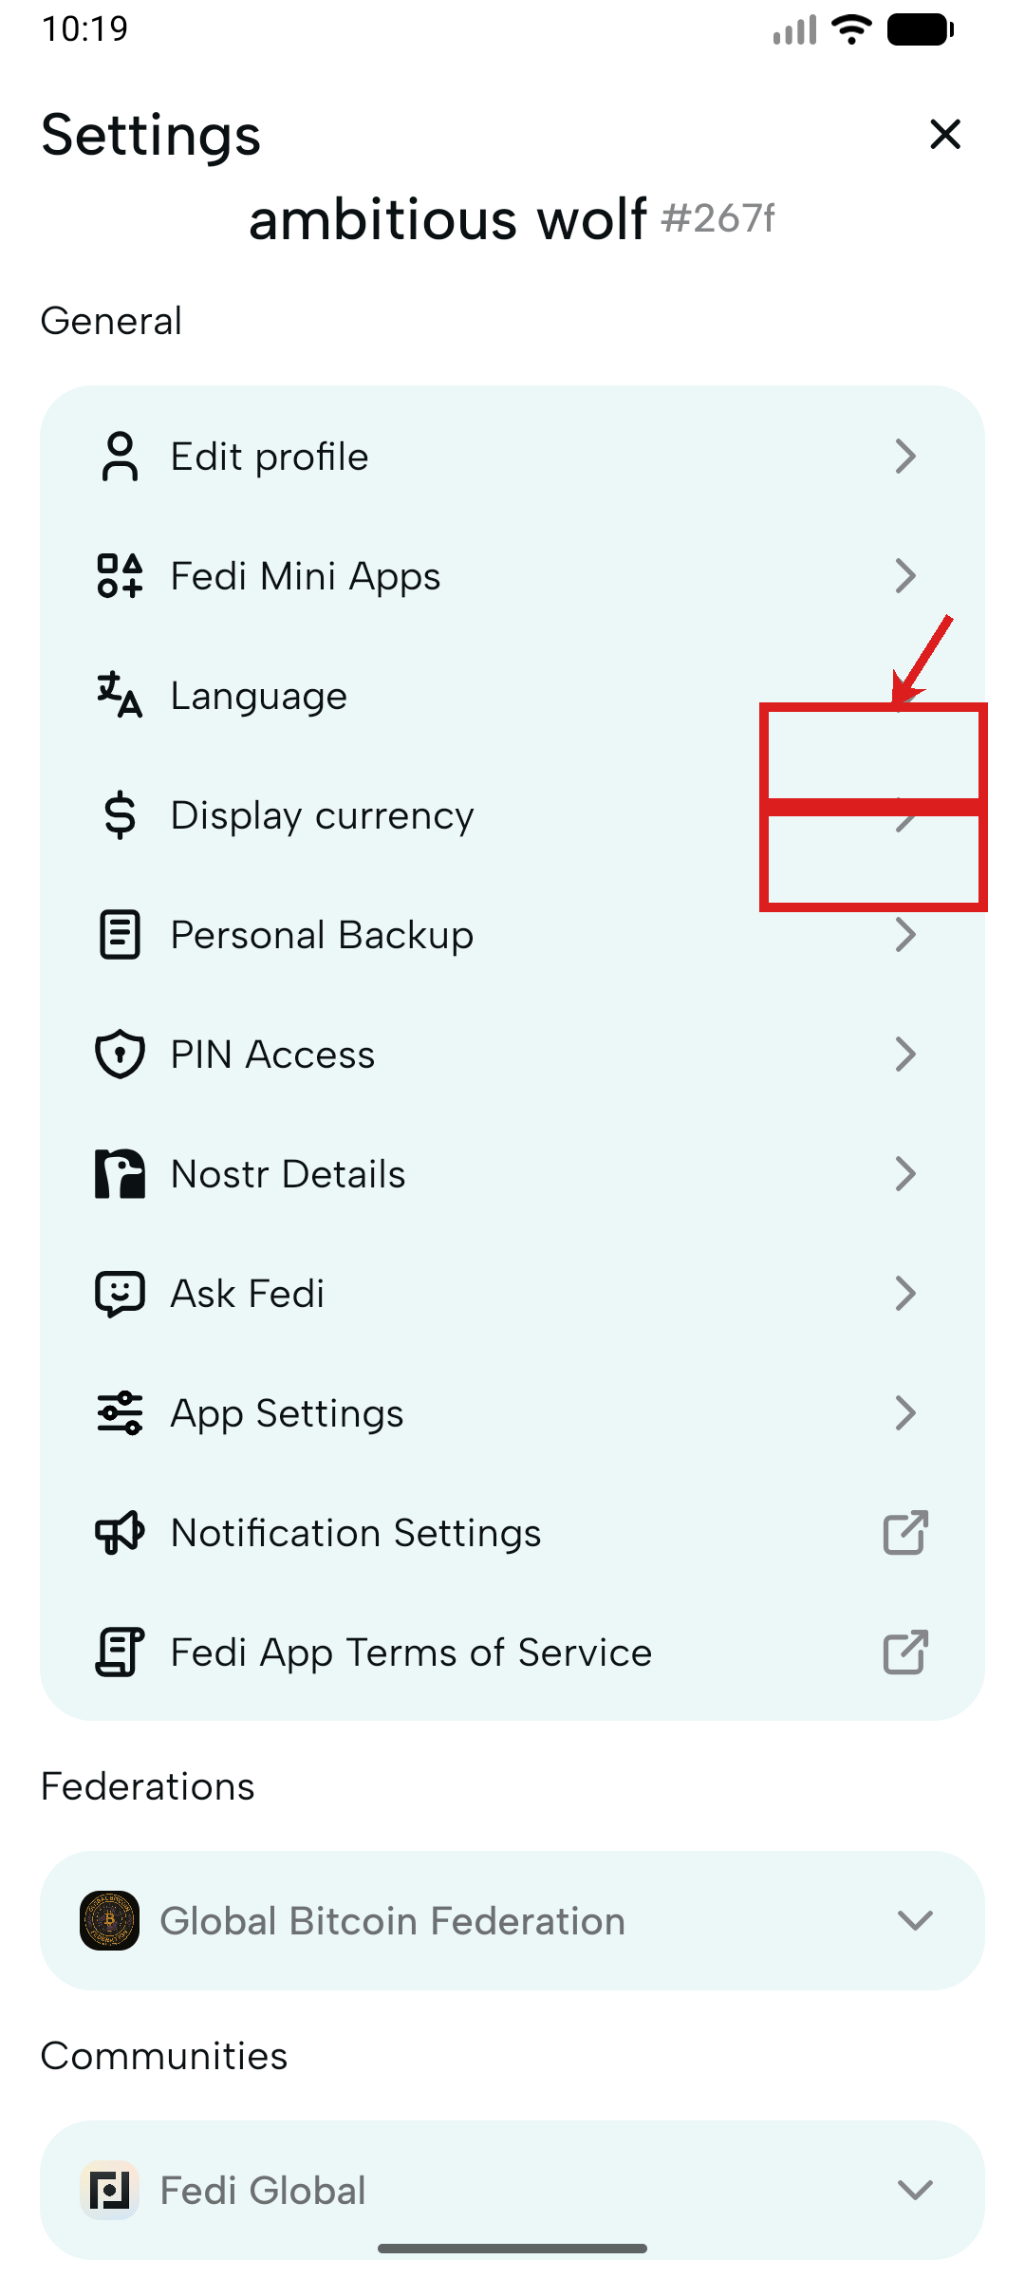
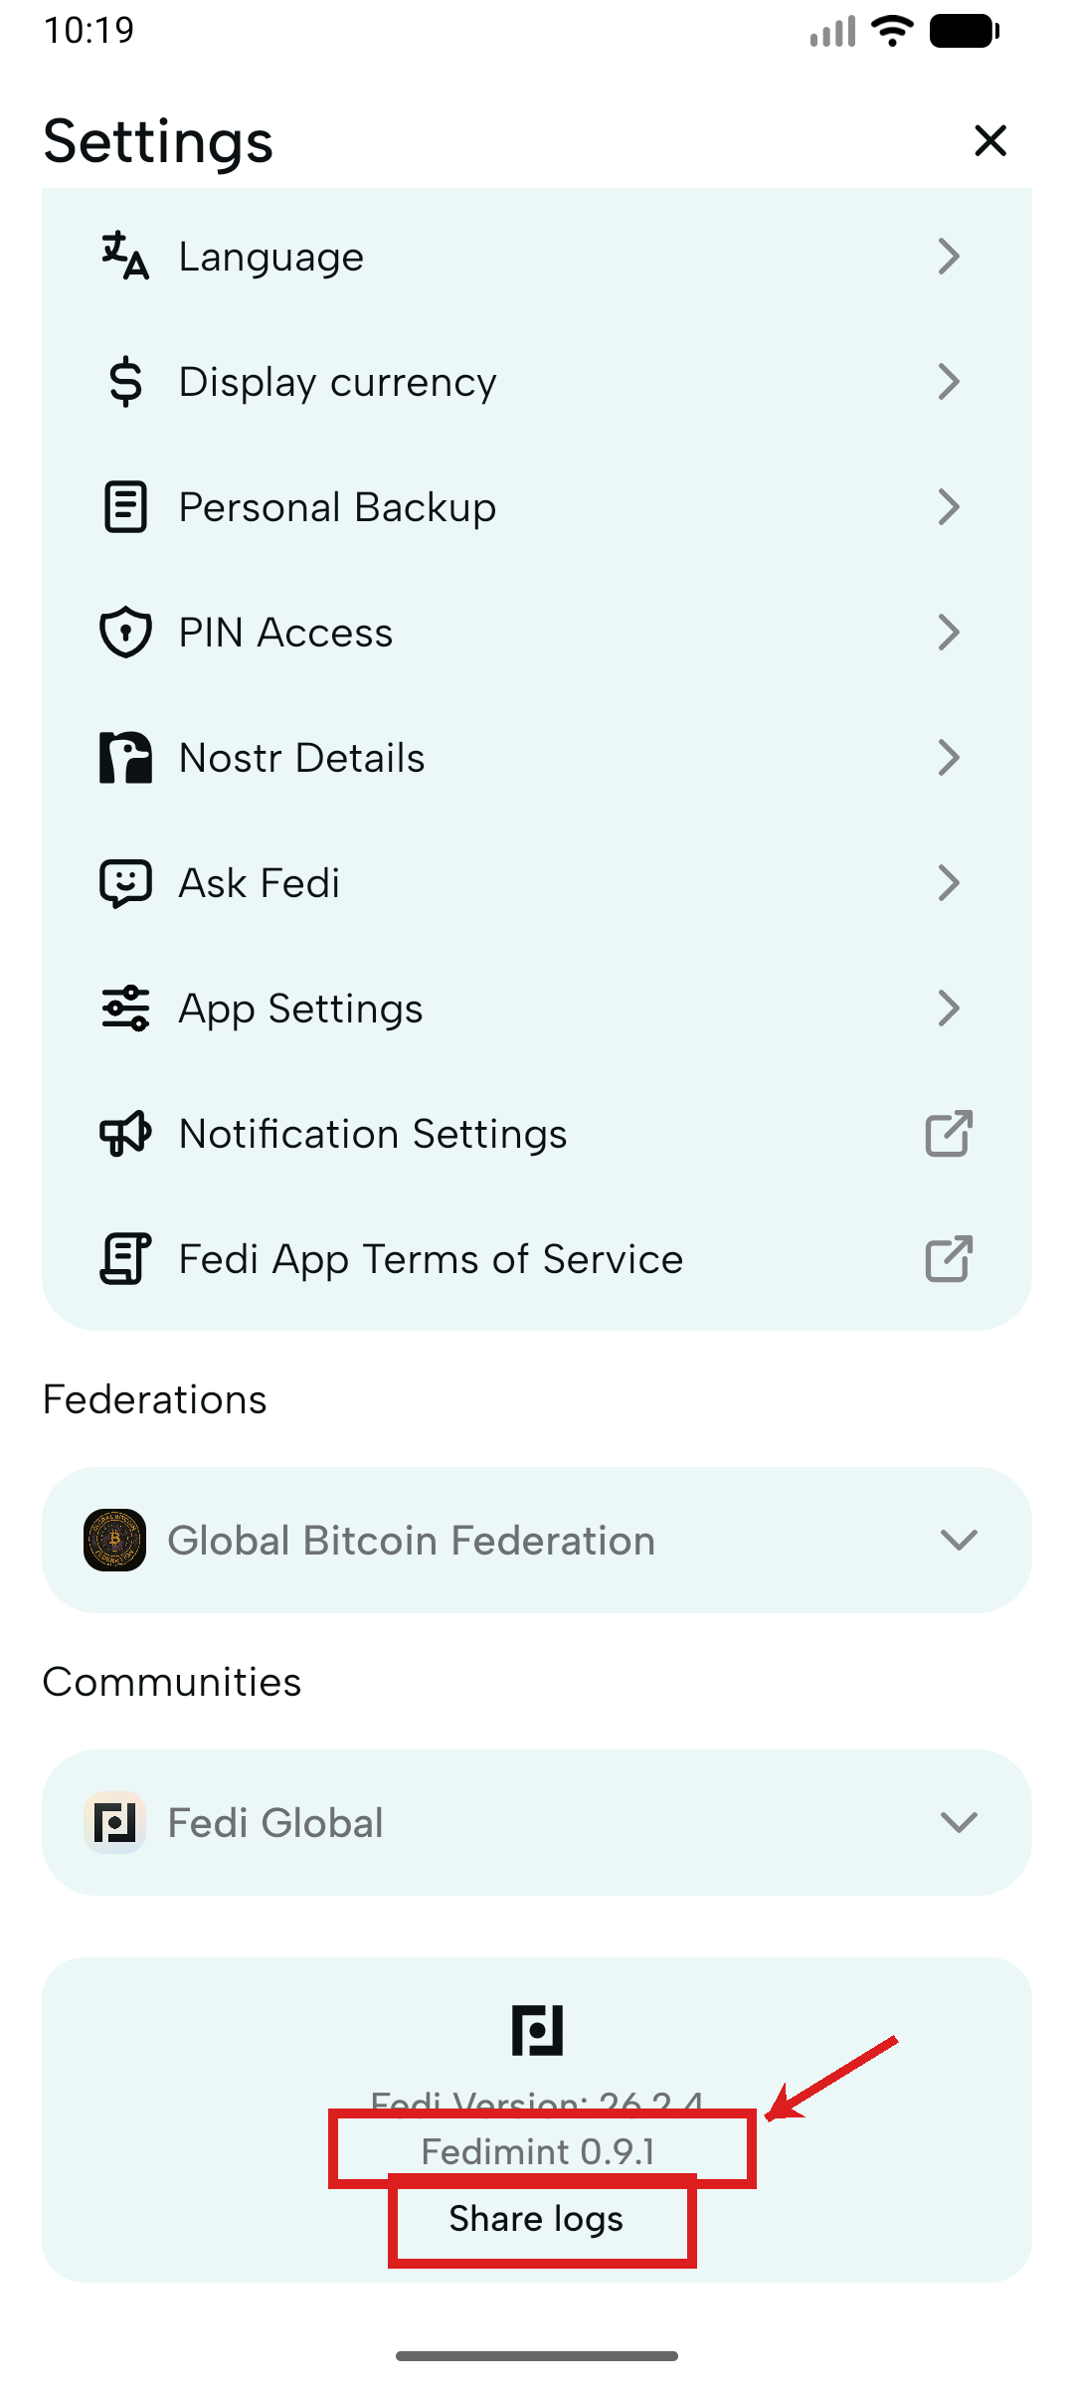
6. Settings & Profile
A QR code with no label sits above everything else.
●
QR code at top has no label -- wallet address? Login code? No way to know.
△
"#267f" hash suffix on display name -- technical noise for users.
△
"Nostr Details" listed with no explanation of what Nostr is.
△
External link icons used inconsistently instead of chevrons.
△
"Share logs" looks like plain text -- no affordance it is tappable.
△
"Fedimint 0.9.1" -- internal version noise for regular users.
✓
Settings are well-structured: Backup, PIN, Language, Currency.
✓
"Ask Fedi" help entry is present in settings.
✓
Icon + label + chevron list pattern is clear and scannable.
Notes:
Settings is structurally sound -- the content is the right content. The problems are presentation issues:
- Unlabelled QR code at the top: this is almost certainly a wallet receive address or a profile link. Label it. "Your receive QR code" or "Share your profile" -- one line.
- "#267f" hash suffix: hide or explain (see slide 4 notes).
- "Nostr Details": this term is meaningful to a small subset of users. For everyone else, rename to "Social identity" or tuck under an Advanced section.
- "Share logs": this is a support/debugging feature. It should look tappable (chevron, icon) and sit in a clearly marked Support section.
Positives: the settings content itself is well-chosen and well-organised. The bones are good.

Slide 10
Priority Matrix
All findings ranked by heuristic and severity
Area | Finding | H# | Sev.
Federation Discovery | No explanation of federation before asking users to join | H2 | ●
Federation Discovery | Federation cards not tappable -- no detail before committing | H5 | ●
Joining Flow | Error banner persists across multiple screens | H1 | ●
Joining Flow | "View public federations" loops back to same screen | H3 | ●
Joining Flow | "Maybe Later" disappears after first navigation | H3 | ●
Joining Flow | Back button exits app -- no route to main UI if joining fails | H3 | ●
Arriving in App | Display name auto-assigned without asking | H2 | ●
Wallet Tab | Redirects to federation wall with no explanation | H1 | ●
Core Nav | All four bottom nav tabs are unlabelled | H4 | ●
Core Nav | Every tab triggers promo bottom sheet on first open | H8 | ●
Settings | QR code at top of settings has no label | H6 | ●
Joining Flow | Camera permission screen ambiguous (Continue = grant or defer?) | H5 | △
Joining Flow | QR scanner has no instruction text | H6 | △
Joining Flow | Error banner has no retry action | H9 | △
Federation Discovery | Description text truncated mid-sentence | H8 | △
Federation Discovery | Three tabs have no active state or explanation | H4 | △
Arriving in App | "#267f" hash suffix shown with no explanation | H2 | △
Arriving in App | Home screen gives equal weight to three content types | H8 | △
Chat Screen | Empty state is bare text -- no illustration or CTA | H7 | △
Mini Apps | App icon grid has inconsistent icon styles | H4 | △
Settings | "Nostr Details" unexplained | H2 | △
Settings | External link icons vs chevrons inconsistent | H4 | △
Splash Screen | Legal consent text is low contrast | H5 | △
Splash Screen | Two-button layout is clear and familiar | H4 | ✓
Camera Permission | "This can be updated later" reduces anxiety | H5 | ✓
Settings | Good range of settings options | H7 | ✓
Settings | "Ask Fedi" help entry present | H10 | ✓
Notes:
Reading the matrix:
- Filled circle = critical: these should be in the next sprint.
- Triangle = moderate: address in the following 1-2 sprints.
- Check = works well: preserve these patterns in future design decisions.
Top 3 critical fixes by effort-to-impact ratio:
1. Add a federation explainer before the discovery screen (copy change, low effort, high impact)
2. Add labels to bottom navigation (design change, low-medium effort, high impact)
3. Fix the "walled in" back-button behaviour (engineering fix, medium effort, critical safety issue)

Slide 11
Reference: Severity & Heuristics
Severity Legend
Nielsen Norman Group -- 10 Usability Heuristics
●
Critical -- significant impact, prioritise immediately
H1
Visibility of system status
△
Moderate -- noticeable friction, worth addressing
H2
Match between system and the real world
✓
Works well -- effective design to preserve
H3
User control and freedom
H4
Consistency and standards
H5
Error prevention
H6
Recognition rather than recall
H7
Flexibility and efficiency of use
H8
Aesthetic and minimalist design
H9
Help users recognise, diagnose, and recover from errors
H10
Help and documentation
Notes:
Nielsen Norman Group 10 Usability Heuristics (1994, updated 2020) are the industry standard framework for expert UX evaluation. Each finding is tagged to the heuristic it violates, providing a principled basis for prioritisation rather than subjective preference.
Full reference: nngroup.com/articles/ten-usability-heuristics/

Slide 12
Assumptions + Research Questions
What we're betting on -- and how to test each bet
Notes:
Transition note: the UX audit tells us what is broken today. The assumptions section tells us what we need to validate before we know how to fix it correctly for the target audience.
16 assumptions are mapped across 4 categories: mental model/comprehension, trust & safety, onboarding & flows, and strategy & governance. Each has an explicit risk level, evidence status, and research method recommendation in the Assumption Register.

Slide 13
Assumptions + Research Questions
16 testable claims -- each should be validated before committing to design decisions
These assumptions represent the team's current mental model of how users think and behave. Each one is a testable hypothesis -- not a given.
Mental model
Trust & safety
Onboarding & flows
Strategy & governance
A1
Federation vs Community mental model
A2
Onboarding and time-to-value
A3
Social Backup trust
A4
Recovery and panic moments
Users understand the difference between Federation (money/bank) and Community (social/town square) quickly enough to use it correctly.
New users can reach their first successful moment (setup > join > receive/send) without external help.
Social Backup feels safer (or at least acceptable) vs self-custody for non-technical users.
In loss or panic scenarios (lost phone, reinstall), users can recover confidently without catastrophic errors.
A5
Offline transactions
A6
Stable Balance (volatility protection)
A7
Mini apps value
A8
In-app money and chat
Offline payments are both usable and trusted in patchy-connectivity contexts.
Users want a stable-value option and correctly understand the trade-off (stability vs bitcoin amount).
Mini apps provide genuine daily utility rather than clutter or confusion.
Sending money in chat is intuitive and increases usage vs separate wallet actions.
A9
Trust and scam resistance
A10
Language, literacy and comprehension
A11
Device sharing and privacy
A12
Community governance and support
Users can avoid common scam patterns and understand safety boundaries without becoming paranoid.
The product concepts can be understood by users with varying literacy and education levels.
The app remains safe and usable in device-sharing households (common in some contexts).
Communities and federations can provide support and governance without causing confusion about accountability.
A13
Cross-region generalisation
A14
Western vs Global South segmentation
A15
Evidence threshold
A16
Roadmap alignment
Some UX patterns generalise across regions; others must be localised.
Western users and Global South users need different onboarding, terminology, or defaults -- but not two totally different products.
The org can define validated-enough evidence thresholds per decision so shipping is not blocked by perfection.
Research effort must align to Product and Engineering plans; some work is in-flight and needs harm-reduction rather than discovery.
Notes:
Overview of all 16 assumptions. Colour coding:
- Blue: mental model / comprehension assumptions
- Red: trust & safety assumptions
- Green: onboarding & flows assumptions
- Yellow: strategy & governance assumptions
All 16 currently have no or weak evidence. The assumption register (later in this deck) prioritises them by risk and maps each to a specific research method and timebox.

Slide 14
Assumptions + Research Questions (A1--A4)
Each assumption is a testable hypothesis. Questions show how to validate or falsify it.
A1
Federation vs Community mental model
A2
Onboarding and time-to-value
A3
Social Backup trust
A4
Recovery and panic moments
Users understand the difference between Federation (money/bank) and Community (social/town square) quickly enough to use it correctly.
New users can reach their first successful moment (setup > join > receive/send) without external help.
Social Backup feels safer (or at least acceptable) vs self-custody for non-technical users.
In loss or panic scenarios (lost phone, reinstall), users can recover confidently without catastrophic errors.
Research Questions
Research Questions
Research Questions
Research Questions
- What do users think each concept is?
- What is the first confusing step?
- What do users think Social Backup does?
- What is the user mental model in panic?
- Where do they misclassify actions?
- What prevents first deposit or receive?
- What are their nightmare scenarios (theft, coercion, family conflict)?
- Which recovery steps are misinterpreted?
- What minimum explanation makes it click?
- What is the median time-to-first-value?
- Which social structures make it viable (elders, church, co-op, family)?
- What reassurance reduces churn and support contacts?
- Which labels or metaphors reduce confusion fastest?
- What triggers dropout?
- What proof or trust cues do they need before enabling it?
- Which safeguards prevent irreversible actions?
- What errors happen when they misunderstand (lost funds, wrong help channel)?
- What single piece of reassurance increases completion most?

Slide 15
Assumptions + Research Questions (A5--A8)
Each assumption is a testable hypothesis. Questions show how to validate or falsify it.
A5
Offline transactions
A6
Stable Balance (volatility protection)
A7
Mini apps value
A8
In-app money and chat
Offline payments are both usable and trusted in patchy-connectivity contexts.
Users want a stable-value option and correctly understand the trade-off (stability vs bitcoin amount).
Mini apps provide genuine daily utility rather than clutter or confusion.
Sending money in chat is intuitive and increases usage vs separate wallet actions.
Research Questions
Research Questions
Research Questions
Research Questions
- When do users actually need offline payments?
- Do users understand what stays constant vs what changes?
- Which mini apps are must-have by region?
- Do users understand who is being paid and from which balance?
- What failure modes are acceptable (delayed sync, pending state)?
- When do they choose Stable vs Bitcoin balance?
- How do users assess trustworthiness of apps?
- What mistakes happen (wrong person, wrong amount)?
- How do users resolve disputes over offline payments?
- Does it increase day-to-day use or add cognitive load?
- Does the catalog feel safe or sketchy?
- Does chat increase trust or increase scam risk?
- What UI cues prevent false confidence?
- Does it create two-money confusion?
- What is the smallest set of apps that drives weekly retention?

Slide 16
Assumptions + Research Questions (A9--A12)
Each assumption is a testable hypothesis. Questions show how to validate or falsify it.
A9
Trust and scam resistance
A10
Language, literacy and comprehension
A11
Device sharing and privacy
A12
Community governance and support
Users can avoid common scam patterns and understand safety boundaries without becoming paranoid.
The product concepts can be understood by users with varying literacy and education levels.
The app remains safe and usable in device-sharing households (common in some contexts).
Communities and federations can provide support and governance without causing confusion about accountability.
Research Questions
Research Questions
Research Questions
Research Questions
- What are the top scam vectors in each region?
- Which terms fail comprehension (federation, backup, guardian)?
- Do users share phones?
- When something goes wrong, who do users believe is responsible?
- Which UI friction is acceptable before it harms adoption?
- What metaphors work locally?
- What content should be hidden by default?
- What support path do they naturally take?
- What social proof signals are credible?
- Do icons help or confuse?
- What privacy modes are needed?
- What UX makes where-to-get-help unambiguous?
- Which safety education moments stick?
- What is the minimum viable explanation for each high-stakes concept?
- What threats exist from family or community power dynamics?

Slide 17
Assumptions + Research Questions (A13--A16)
Each assumption is a testable hypothesis. Questions show how to validate or falsify it.
A13
Cross-region generalisation
A14
Western vs Global South segmentation
A15
Evidence threshold
A16
Roadmap alignment
Some UX patterns generalise across regions; others must be localised.
Western users and Global South users need different onboarding, terminology, or defaults -- but not two totally different products.
The org can define validated-enough evidence thresholds per decision so shipping is not blocked by perfection.
Research effort must align to Product and Engineering plans; some work is in-flight and needs harm-reduction rather than discovery.
Research Questions
Research Questions
Research Questions
Research Questions
- Which behaviours are universal (trust cues, fear triggers)?
- Which steps differ most by segment?
- Which decisions require high confidence (recovery, custody)?
- What is already committed vs shapeable?
- Which are regional (financial rails, norms)?
- What defaults should change (privacy, backup prompts, education)?
- Which can ship as experiments?
- Where can research still reduce risk mid-flight?
- What is the minimum sample strategy to identify universal vs local?
- Can a single flow adapt with progressive disclosure?
- What counts as success (task success, comprehension, trust rating)?
- What research will unlock near-term roadmap decisions fastest?
- How do we avoid overfitting to one market?
- Where do segments share core needs?
- How do we express confidence levels to engineers and leadership?

Slide 18
Assumption Register
Prioritised research backlog: risk, evidence status, method & timebox
Notes:
The Assumption Register is the live artefact that should be maintained in Notion or Sheets after this conversation. It answers the question "what are we currently betting on and what is the plan to validate it?" for any stakeholder at any time.
Risk levels:
- H (High): getting this wrong has significant product or user safety consequences
- M (Medium): getting this wrong creates friction or missed retention
- L (Low): relatively safe to ship and iterate on
Evidence status will evolve from None/Weak toward Moderate/Strong as studies run.

Slide 19
Assumption Register (A1-A8)
Prioritised research backlog: risk, evidence status, method & timebox
ID | Theme | Assumption | Risk | Evidence | Region | Decision | Method | Timebox
A1 | Core mental model | Users understand Federation vs Community well enough to act correctly. | H | None | Global | IA, labeling, onboarding, navigation | Comprehension + task-based usability on prototype | 5-7 days
A2 | Onboarding | Users can reach first successful moment without external help. | H | None | Global | Onboarding steps, defaults, prompts | Funnel review + 6-10 usability sessions | 1-2 weeks
A3 | Social Backup trust | Social Backup feels safe + socially acceptable to target users. | H | None | Regional | Recovery design, messaging, rollout strategy | Concept test + scenario probes | 1-2 weeks
A4 | Recovery / panic | In a panic moment, users can recover without catastrophic errors. | H | None | Global | Recovery flow, safeguards, copy, support | Disaster drill usability (lost phone scenario) | 1-2 weeks
A5 | Offline transactions | Offline payments are usable and trusted in real contexts. | H | None | Regional | Offline UX, sync states, dispute handling | Field/diary + scenario usability | 2-3 weeks
A6 | Stable Balance | Users want stable value and understand the trade-off. | M/H | None | Regional | Balance UX, education, default settings | Concept comprehension + choice tasks | 1-2 weeks
A7 | Mini apps value | Mini apps drive weekly utility, not clutter. | M | None | Regional | Catalog IA, prioritization, governance | Jobs-to-be-done + card sort | 2 weeks
A8 | Money in chat | Paying in chat is clear + reduces friction. | M | None | Global | Chat-pay UX, confirmations, error prevention | Usability + mis-send prevention test | 1 week

Slide 20
Assumption Register (A9-A14)
Prioritised research backlog: risk, evidence status, method & timebox
ID | Theme | Assumption | Risk | Evidence | Region | Decision | Method | Timebox
A9 | Scam resistance | Users can avoid common scams without UX becoming oppressive. | H | Weak | Regional | Warnings, confirmations, education, trust cues | Threat-model workshop + rapid user validation | 1-2 weeks
A10 | Language & literacy | Key concepts can be understood across literacy levels. | H | None | Regional | Terminology, iconography, education | Comprehension testing w/ low-literacy variants | 2 weeks
A11 | Privacy / device sharing | App remains safe in device-sharing environments. | H | None | Regional | Privacy defaults, lock modes, content visibility | Context interviews + privacy prototype test | 2-3 weeks
A12 | Support & accountability | Users know who to blame / where to get help. | M/H | None | Global | Support UX, escalation paths, messaging | Journey mapping + support flow usability | 1-2 weeks
A13 | Cross-region generalisation | Some patterns generalise; others need localisation. | H | None | Global | Research strategy, product strategy | Comparative synthesis across region cycles | Ongoing
A14 | Evidence threshold | Org can define validated-enough thresholds per decision type. | H | Weak | Global | Shipping governance | Define validation ladder + align with PM/Eng | 1 week

Slide 21
30 / 60 / 90 Day Plan
Solo researcher + fast shipping environment
Notes:
This plan is designed for a researcher who is:
- The only UX researcher in the org
- Working in a fast-shipping, resource-constrained environment
- Responsible for covering multiple regions and a complex product
The phased approach prioritises: credibility first, then coverage, then compounding value. It mirrors the structure Anwar has successfully executed at previous orgs.

Slide 22
30 / 60 / 90 Day Plan -- Overview
Designed for solo researcher + fast shipping environment
Day 30
Day 60
Day 90
Build credibility + install the OS
Prove multi-region research at pace
Turn research into compounding advantage
▸ Roadmap-to-Research map
▸ Regional thin-slice cycles (6-8/region)
▸ Quarterly Research Roadmap v1
▸ Assumption Register + RQ Bank
▸ Recruitment flywheel with community admins
▸ Decision-grade evidence benchmarks
▸ 1-2 fast tactical studies
▸ Monthly 30-min evidence review with PM/Eng
▸ Self-serve enablement for PMs/designers
▸ Research Ops starter kit
Notes:
This slide gives the hiring panel a single-page summary of the phased approach.
The underlying logic: Fedi needs research to be both rigorous and fast. A solo researcher can achieve this by:
- Front-loading the operating system (register, roadmap, ops kit) so each study costs less
- Using thin-slice regional cycles to build comparative insight without exhaustive sampling
- Defining evidence bars upfront so 'good enough' is answerable, not debatable
- Enabling self-serve at the margin so the researcher focuses on the hard strategic work
This is the same shape as Anwar's previous UXR practice builds -- phased, pragmatic, balancing rigour with real constraints.

Slide 23
First 30 Days: Build credibility + install the operating system
Goal: be trusted, be organised, and deliver one fast win
1
Roadmap-to-Research Map (v0)
2
Assumption Register + RQ Bank (v0)
3
1-2 Fast Tactical Studies
4
Research Ops Starter Kit
One page mapping initiatives → assumptions → key decisions → proposed study types.
Lightweight but real. The "where research comes from" source of truth.
Pick something currently painful -- onboarding, recovery, mini-app discovery -- and ship 3-5 actionable fixes fast.
Templates: discussion guide, usability script, consent, note-taking, insight write-up.
Notes:
30-Day framing for the hiring conversation:
1. Roadmap-to-Research Map: before running any study, build a one-pager that connects Fedi's product initiatives to the 16 assumptions in the register and the decisions those assumptions inform. This becomes the negotiation tool with PM/Eng about priority.
2. Assumption Register v0: the lightweight version is already done (this deck). The live version gets owned in Notion/Sheets and updated after every study.
3. Fast tactical win: Anwar has already identified the onboarding wall and the federation mental model as the most painful. One 6-session usability study with a mid-fi prototype can ship 3-5 specific copy/flow fixes within 2 weeks of starting.
4. Research Ops starter kit: Anwar has built this from scratch at previous orgs (0 to 50+ structured studies). At Fedi this means: a reusable discussion guide template, consent form, note-taking sheet, and a 1-page insight write-up format -- so studies can be run or observed by PMs without bottlenecking the researcher.

Slide 24
Days 31-60: Prove multi-region research without burning the calendar
Goal: build comparative insight across regions; make recruitment self-sustaining
Regional Thin-Slice Cycles
Recruitment Flywheel
Monthly Evidence Review (30 min)
▸ Remote-first, community-assisted format
▸ Partner with federation/community admins
▸ Standing slot with Product + Eng leads
▸ 6-8 interviews per region archetype
▸ Continuous warm pipeline -- no cold starts
▸ Format: what we learned / what changed / what we still don't know
▸ + 1 evaluative prototype test where relevant
▸ Screener + incentive framework in place
▸ Research shapes sprint priorities, not post-hoc
▸ Builds the universal vs context-specific map
▸ Target: 0 weeks recruitment lag by Day 60
▸ Creates accountability without bureaucracy
Notes:
Days 31-60 framing:
Regional thin-slice cycles: the key insight here is that Fedi's target markets (Latin America, Africa, South/Southeast Asia) share some UX failure modes but not all. A thin-slice approach -- 6-8 interviews per region archetype rather than exhaustive sampling -- lets you build the universal/regional map within a quarter, not a year. Pair with one prototype test per region where a specific flow is in scope (e.g. onboarding, recovery). Remote-first with community-assisted recruitment means costs stay low and ecological validity stays high.
Recruitment flywheel: the biggest time sink for a solo researcher is participant recruitment. Partnering with federation and community admins to maintain a warm pipeline solves this. Screener + incentive framework should be standardised by Day 45 so studies can spin up within days.
Monthly evidence review: 30-minute standing slot with PM and Eng leads. Not a report -- a conversation. Format: 3 sections, what we learned this month, what we changed as a result, what we still don't know. This prevents research from becoming a post-hoc justification and turns it into a sprint input.

Slide 25
Days 61-90: Turn research into compounding advantage
Goal: research shapes the roadmap, not the other way around
Day 1
Day 30
Day 60
Day 90
Quarterly Research Roadmap (v1)
Decision-Grade Benchmarks
Self-Serve Enablement
Aligned to Product/Eng sprint cycles. Explicit tradeoffs: what you're studying, what you're parking and why. Living doc, updated monthly.
For highest-risk assumptions (A1, A2, A3, A4), define evidence bars: e.g. 80% task success, comprehension threshold, trust signal threshold. Makes "is this good enough?" answerable.
Train PMs and designers to run safe studies (concept sorting, lightweight usability checks) while you focus on high-stakes strategic work. Multiplies research output without multiplying headcount.
Notes:
Days 61-90 framing:
Quarterly Research Roadmap: by Day 90 you should own a living research roadmap that sits alongside the product roadmap. It shows which assumptions are being tested this quarter, which are parked (and why), and what the expected outputs are. This is the artefact that makes research a strategic input rather than a reactive service.
Decision-grade benchmarks: for the highest-risk assumptions (mental model confusion, onboarding completion, Social Backup trust, recovery panic), define explicit evidence bars before running the study. Examples: 80% task success on a recovery flow = validated; below 60% = redesign required. This makes the 'prove it' question answerable in advance, so shipping decisions aren't blocked by open-ended debate.
Self-serve enablement: a solo researcher cannot cover everything. The leverage move is training PMs and designers to run 'safe' studies -- concept sorting, 5-second tests, lightweight usability checks -- while the researcher focuses on complex, high-stakes, multi-region work. This is the exact model Anwar has executed at previous orgs, scaling from 0 to 50+ structured studies while maintaining quality gates.

