Slide 1

Pre-Trained Machine Learning Model COCO-SSD: Object Detection and Language Traslator
Submitted to, TEAM - 10
Richard Rabbitz
Submitted By,
MEGHANA IDIREDDY
VARDHANA SEETALA
ANWARA ERA

Slide 2
INTRODUCTION
Object detection locates and classifies objects in images or video frames.
Crucial for various computer vision applications.
Key applications include:
- Surveillance and Security
- Healthcare
- Autonomous Driving
- Retail and E-commerce
Enhances other tasks like:
- Object Tracking: Provides initial bounding box information.
- Semantic Segmentation: Aids in pre-processing for precise segmentation.

Slide 3
A while back, leveraging advancements in computer vision enabled by Convolutional Neural Networks (CNNs), researchers introduced Region-based Convolutional Neural Networks (R-CNNs) to address object detection, localization, and classification tasks. Essentially, an R-CNN is a specialized form of CNN designed to identify and locate objects within images.
Deep neural networks consist of two main components: the base network and the detection network.
The primary distinction between the SSD and YOLO architectures lies in their approach to network design. YOLO incorporates two fully connected layers, whereas SSD employs convolutional layers with different sizes.

Slide 4
COCO-SSD
The abbreviation "COCO-SSD" stands for Common Objects in Context Single Shot MultiBox Detector.
COCO-SSD stands out as a well-known object detection algorithm utilized for object identification and localization within images.
It was developed by the TensorFlow team, drawing from the Single Shot MultiBox Detector (SSD) framework.
COCO-SSD is tailored to operate with the COCO dataset, a comprehensive collection supporting object detection, segmentation, and captioning tasks.
It is adept at placing bounding boxes around various objects it has been trained to detect.

Slide 5
Algorithm and Techniques Used
COCO Dataset: An extensive image recognition dataset, COCO contains over 330,000 images annotated with 80 object categories and 5 scene descriptions, supporting object detection, segmentation, and captioning tasks.
Convolutional Neural Networks (CNNs): CNNs, a type of artificial neural network, excel in image recognition and processing by discerning patterns within images.
Single Shot MultiBox Detector (SSD): SSD streamlines object localization and classification tasks by executing them in a single forward pass of the network.
Non-Maximum Suppression: NMS is a post-processing technique vital in object detection, eliminating redundant detections and retaining the most pertinent bounding boxes corresponding to detected objects.
Training and Fine-Tuning: In machine learning, fine-tuning involves adapting pre-trained model weights to new data, facilitating transfer learning.

Slide 6
Algorithms
Anchor Boxes: Within COCO-SSD, anchor boxes serve to suggest regions of interest where objects may reside. These boxes are predefined bounding boxes of varying sizes and aspect ratios. During training, the algorithm learns to refine the positions and sizes of these anchor boxes to better align with ground truth objects.
Softmax Classifier: Employing a softmax classifier, COCO-SSD assigns object class probabilities to detected bounding boxes. This classifier yields probabilities for different object categories within each box, enabling the algorithm to classify detected objects accurately.
Loss Functions: COCO-SSD employs specific loss functions during network training. These include confidence loss, measuring object detection accuracy, and localization loss, assessing the precision of predicted bounding box coordinates. Minimizing these losses throughout training optimizes the model's performance.

Slide 7
Coco Dataset
Datasets play a crucial role in the realm of machine learning.
Various datasets cater to different tasks such as facial recognition, action recognition, and object detection.
Image datasets contribute significantly to scene comprehension and semantic depiction.

Slide 8
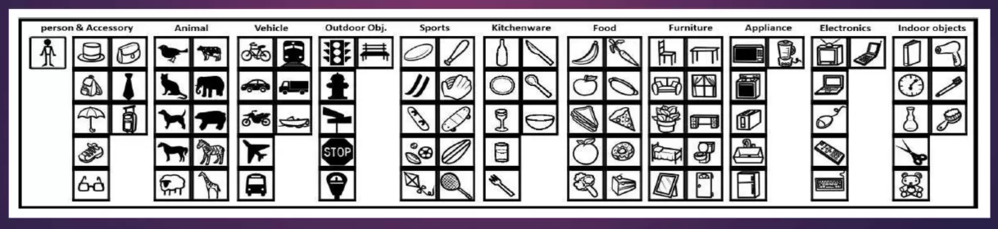
A comprehensive dataset encompassing object detection, segmentation, and captioning or labeling tasks. This dataset comprises 328,000 images containing 2.5 million labeled instances across 91 object categories, grouped into 11 super categories.

Slide 9
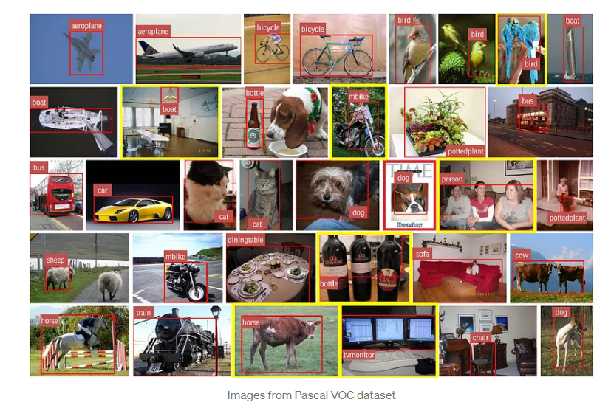
Examples of dataset

Slide 10
One-Shot Multi-Box Detector
SSD operates as a single-shot detector, devoid of a separate region proposal network. It directly forecasts boundary boxes and classes from feature maps in a single pass, enhancing accuracy through the integration of small convolutional filters for object class prediction and offsets to default boundary boxes.
"Single Shot" implies that object localization and classification occur within a single forward pass of the network.
"MultiBox" refers to a bounding box regression technique devised by Szegedy et al.
As a "Detector," the network not only identifies but also classifies the detected objects.

Slide 11
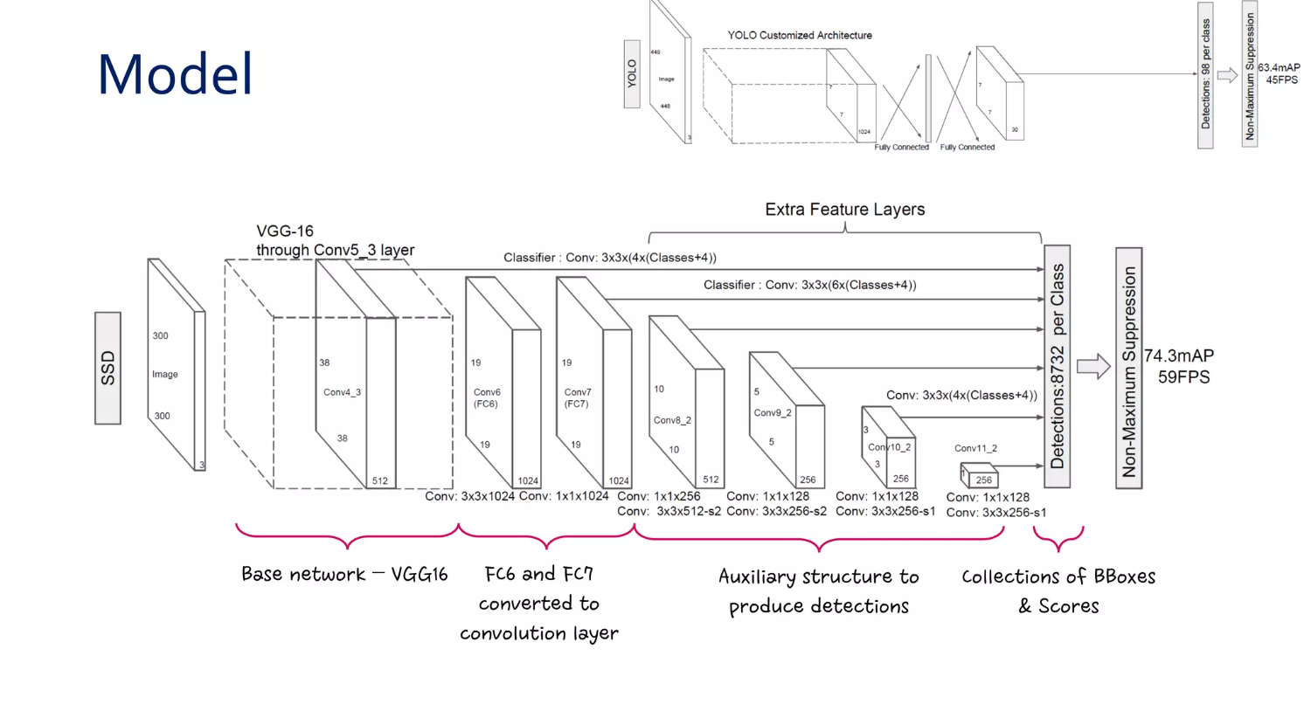
ARCHITECTURE
As depicted in the diagram, SSD's architecture extends the well-established VGG-16 architecture by eliminating the fully connected layers. VGG-16 was chosen as the base network due to its robust performance in high-quality image classification tasks and widespread usage in scenarios where transfer learning aids in enhancing outcomes.

Slide 12
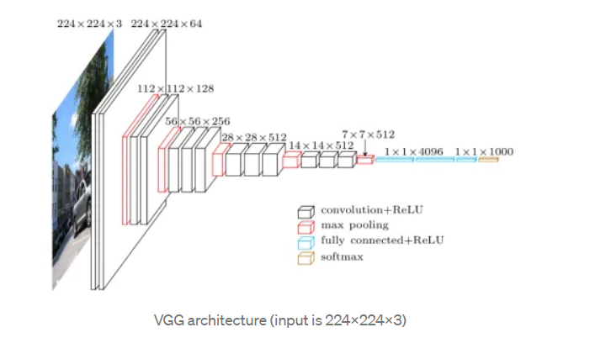

Slide 13
MultiBox
SSD's bounding box regression method draws inspiration from Szegedy's MultiBox technique, which offers swift class-agnostic bounding box coordinate suggestions. Notably, the MultiBox approach utilizes an Inception-style convolutional network.

Slide 14
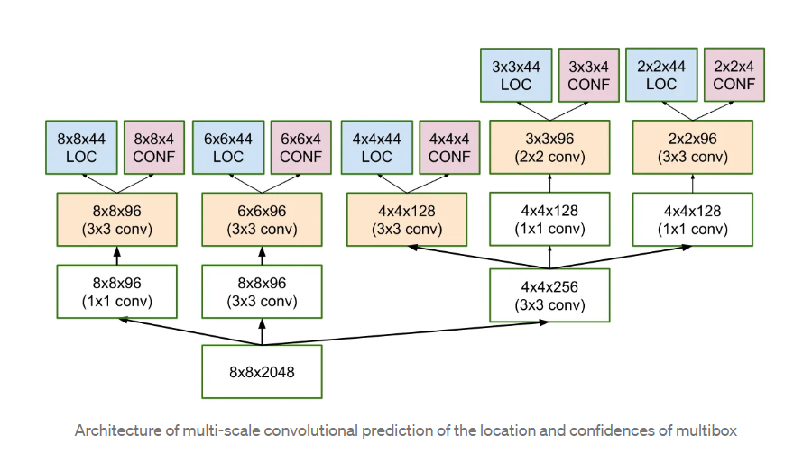

Slide 15
Source code

Slide 16
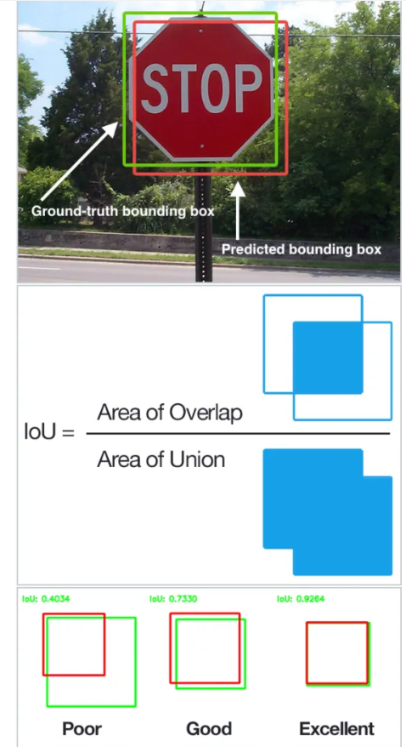

Slide 17
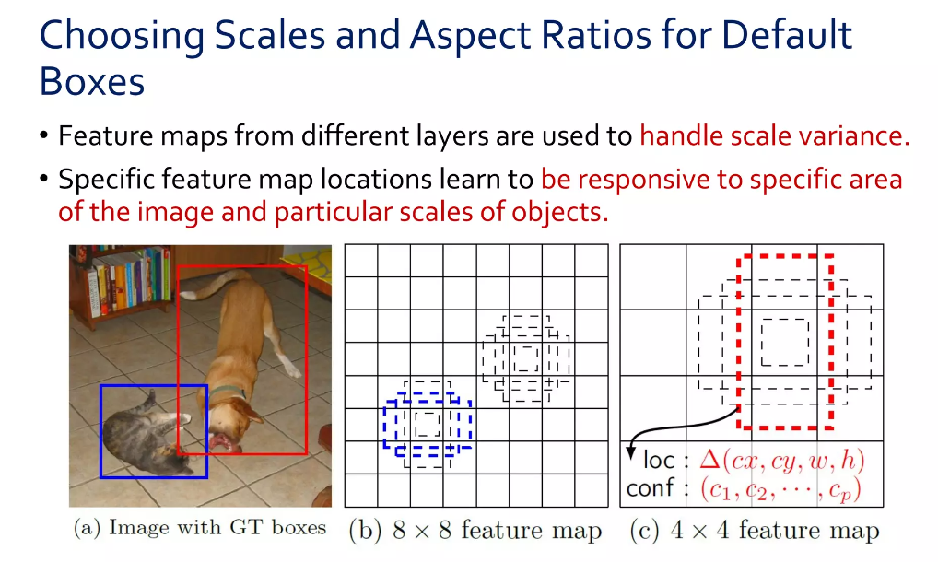
SSD default boxes

Slide 18
Non-Maximum Suppression (NMS)
Due to the substantial volume of boxes produced during SSD's forward pass at inference time, it becomes crucial to streamline the bounding boxes by employing a technique referred to as non-maximum suppression.

Slide 19
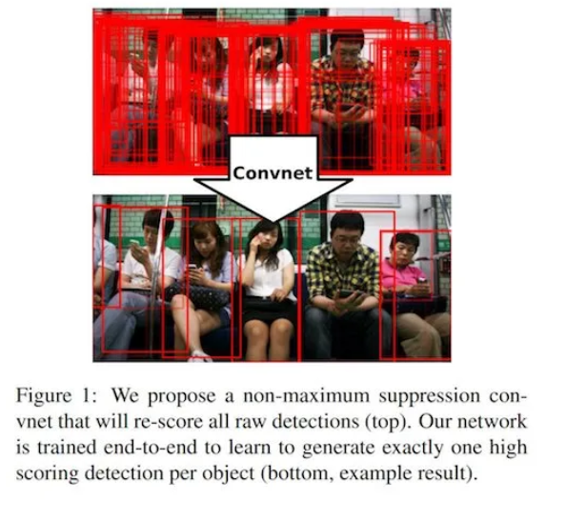
Example

Slide 20
APPLICATIONS
Object detection within autonomous vehicles
Video surveillance systems
Retail analytics solutions
Augmented reality (AR) platforms
Medical imaging technologies
Applications in agriculture

Slide 21
Obstacles
Scale and Diversity: Objects exhibit variations in scale, orientation, and appearance, posing challenges for detection.
Occlusion: Partial occlusion by other objects or background elements necessitates robust detection techniques.
Real-Time Operation: Numerous applications mandate real-time object detection, calling for efficient algorithms and hardware.

Slide 22
Prospects for the Future
Innovations in Model Designs: COCO-SSD stands to gain from progress in model architectures, such as the integration of more efficient backbone networks (e.g., MobileNet, EfficientNet) to expedite and enhance feature extraction.
Real-Time Detection Capability: There is potential for further refining COCO-SSD to achieve real-time object detection on resource-constrained devices like embedded systems, drones, or edge devices.
Healthcare Application: COCO-SSD holds promise in pinpointing specific organs within medical images, thereby supporting surgical planning and navigation. Additionally, it can be leveraged to identify anomalies in medical scans, such as fractures or abnormalities.

Slide 23
Conclusion
COCO-SSD stands as a robust object detection algorithm within computer vision, boasting notable advantages in accuracy, efficiency, and versatility. Leveraging deep learning methodologies, COCO-SSD excels in pinpointing and delineating multiple objects within images or videos with remarkable precision.
Its aptitude for recognizing common objects in context renders COCO-SSD invaluable across diverse applications, spanning autonomous vehicles, surveillance systems, augmented reality, and robotics.

Slide 24
Conclusion
However, like any object detection algorithm, COCO-SSD may have limitations, such as difficulty in detecting small or occluded objects. It may also face challenges in handling complex scenes with overlapping or cluttered objects. Therefore, it is essential to understand its strengths and weaknesses when deploying it in specific use cases.
Overall, COCO-SSD's effectiveness, efficiency, and applicability make it a valuable tool in computer vision, contributing to numerous applications that require robust and real-time object detection.

Slide 25
References
https://www.analyticsvidhya.com/blog/2023/11/real-time-object-detection-with-ssds-single-shot-multibox-detectors/
https://youtu.be/QEzRxnuaZCk?si=P9IpOdyEjuuf8hMj

Slide 26


