Slide 1
Log Management, APM and Metrics Using Pivotal Cloud Foundry
June 3rd, 2015
Kyle Travis

Slide 2
Agenda
Log Management
Overview
Cloud Foundry Integration
Loggegrator
CLI Examples
Third Party Products
Demo
APM
Overview
Cloud Foundry Integration
APM (cont’d)
Third Party Products
Demo
Metrics
Overview
Cloud Foundry Integration
Collector
Pivotal Ops Metrics
Firehose
Third Party Products
Demo
Notes:
Assume at this point that customer/prospect/audience has a basic understand of Cloud Foundry and component architecture at a high level.
Also familiarity with pushing apps and where service brokers fit in

Slide 3
Log Management

Slide 4
Log Management: Overview
Modern approach to dealing with large volumes of computer or device generated log messages
Legacy applications typically write to a custom log using custom format or /var/log on *nix using syslog protocol
Key tenants of modern log management solutions:
Centralized collection
Long term retention
Analysis and visualization
Search and reporting

Slide 5
Log Management: Why Use It?
Log data volume grows rapidly as application instances scale – can be hundreds of GB or more per day
Difficulties arise in management and monitoring logs when deploying thousands of application instances
Developers need a centralized location to rapidly search and analyze diverse format of log entries in real time to identify bugs, analyze issues and develop new features

Slide 6
Log Management: Integration with Cloud Foundry
CF System Component Logs
Endpoint can be configured to send CF platform logs to centralized drain
TCP, UDP or RELP (rsyslogd) protocols supported
User Application Logs
Every new application instances writes logs to STDOUT/STDERR and starts streaming logs instantly
12 Factor App
Notes:
Broken down into two categories

Slide 7
Log Management: Integration with Cloud Foundry
Loggregator (aka Doppler) Overview
User application logging subsystem of Cloud Foundry
Tail application logs
Dump a recent set of application logs
Drain application logs to third party service
No longer single point of failure; can be configured to survive AZ failure

Slide 8
Log Management: Integration with Cloud Foundry
Loggregator Components
Sources: Process logs from the CF components
Metron: Agents co-located with sources, collecting logs
Doppler: Gather logs from Metron agents, storing them in buffers and forwarding to 3rd party syslog drains
Traffic Controller: stateless; handles client (HTTP & WebSocket) requests for logs by proxying to doppler(s)

Slide 9
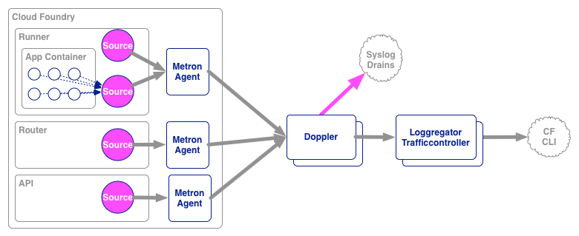
Cloud Foundry Loggregator Architecture
Notes:
Loggregator started with a single cluster of "loggregator" processes and without the Metron agent (that currently resides on each node). Therefore emitting to Loggregator involved the Cloud Foundry components having a dependency on an in-process library. Now, the Metron agent sits on every node, so it is easily discoverable on the local machine by components emitting logging and metrics. Metron itself finds the Loggregator (now named "Doppler") servers using service discovery facilitated by etcd. When a Doppler server comes online it registers itself with etcd to tell the cluster it is available and which zone it resides in. Metron agents listen to etcd for changes to the Doppler cluster and then directs logging and metrics to the available Doppler servers.
Added early last year (2014) was the ability to bind syslog drains for applications. TLS and HTTPS drains are also supported.

Slide 10
Cloud Foundry CLI – Accessing App Logs
Tailing - provides real time tail of output from loggregator
> cf logs <<app_name>> (note this only provides applications logs)
Consolidated Summary – provides summary of application logs
>cf logs <<app_name>> --recent

Slide 11
Log Management: Popular Third Party Products
logstash
http://logstash.net/
Free! Very popular with developers
Splunk:
http://www.splunk.com/
Most popular enterprise log management platform
Papertrail
https://papertrailapp.com/
Low cost, very similar to “tail” command in Linux/Unix

Slide 12
DEMO
Log Management

Slide 13
Distributed Tracing
Next Gen APM
(Apache Zipkin / Spring Sleuth)

Slide 14
APM: Overview
Acronym for “Application Performance Management”
It is the monitoring and management of performance and availability of software applications
Traditionally companies such as BMC, CA and HP provided this functionality for legacy applications in the enterprise
ex. HP OpenView (RDBMS like GPDB utilizing SNMP traps for events)
Setup can be pretty cumbersome
Third platform apps and modern languages & frameworks have driven the need for more modern, flexible APM solutions

Slide 15
APM: Why Use It?
Allows developer and operations teams to have “always-on” instrumentation of their applications, proactively detecting performance issues to maintain expected SLA
Two primary sets of metrics monitored
Application Performance
ex: application end user response, transactions per second, etc.
Computational Resources
ex: CPU, RAM, Network, etc.

Slide 16
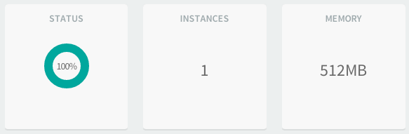
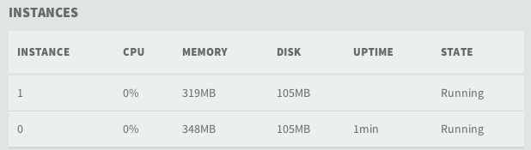
APM: Integration with Cloud Foundry
Pivotal CF currently provides health monitoring and foundational monitoring (CPU, memory, disk usage) and auditing for apps
3rd party APM tools can be easily integrated as services
Buildpacks can be leveraged for automatically deploying agents co-located to application instances

Slide 17
APM: Popular Third Party Products
NewRelic
http://newrelic.com/
AppDynamics
http://www.appdynamics.com/
Hyperic
https://www.vmware.com/products/vrealize-hyperic/

Slide 18
DEMO
Spring Sleuth

Slide 19
Metrics

Slide 20
Metrics: Why Are They Important?
Developers have the need for a real time, detailed view into system measures
Compare typical activity to peak load and historical data for performance tuning
Very important to understand when to scale your app or DEA
Example
Number of requests sent but not completed == pending activity
Pending activity increases under load
Good indicator that application and/or DEA scaling may be required

Slide 21
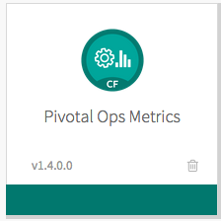
Pivotal Ops Metrics Tile
Ops Metrics provides a JMX interface to access metrics from different Pivotal CF components
Cloud Controller
Router
DEAs
All VMs

Slide 22
Ops Metrics: Integration with Cloud Foundry
JMX (Java Management Extensions) endpoint for Elastic Runtime
http://docs.pivotal.io/pivotalcf/customizing/use-metrics.html
Collects and exposes system measures from CF components
Cloud Controller
Completed vs Pending API calls
Router
Received vs Completed requests + HTTP status
DEA
Metrics reported per DEA instance
Efficient way to validate that CF has enough memory and disk to deploy/run your apps
VM – monitor health
CPU
Memory
Swap
Disk
Notes:
Use the Cloud Controller metrics to ensure that the Cloud Controller is processing API requests in a timely manner. If the pending activity in your system increases significantly past the typical maximum and stays at an elevated level, Cloud Controller requests may be failing and additional troubleshooting may be necessary.
Use router metrics to ensure that the Router is passing requests to other components in a timely manner.

Slide 23
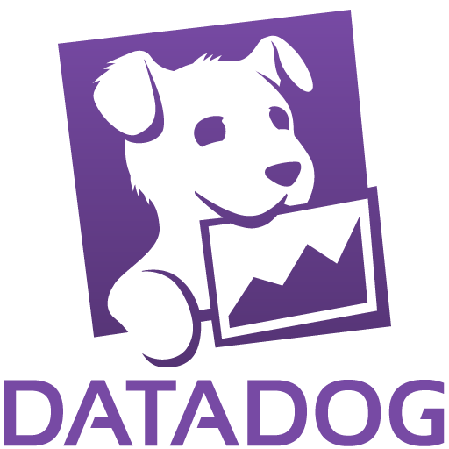
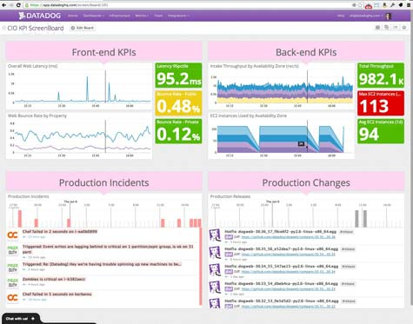
Cloud Foundry Collector Architecture
Customer Monitoring JMX-compatible tool of choice
Health Monitor
/varz
Collector
JMX (1.1)
Cloud Controller
/varz
Datadog (~1.0)
Messaging (NATS)
/varz
Pivotal CF Elastic Runtime
DEA
/varz
Notes:
The collector will discover the various components on the message bus and query their /healthz and /varz interfaces.
Once installed, component metrics automatically report to the JMX endpoint
JMX client uses credentials supplied to connect to IP addy of Pivotal Ops Metrics JMX provider port 44444
Metric data is also published to the collector plugins: OpenTSDB, CloudWatch, DataDog, Graphite

Slide 24
New Feature: Cloud Foundry Firehose
Operators and administrators can access the combined stream of logs from all apps plus metrics data from CF components
Exposed by the Traffic Controller component of loggregator via web socket endpoint
Can be accessed by
CF admin
developer (restricted to logs and metrics of their app only)

Slide 25
Metrics: Popular Third Party Products
Graphite
http://graphite.wikidot.com/
Free; easily integrated with CF collector
Datadog
https://www.datadoghq.com/
Low cost; used internally by PWS
CloudWatch
http://aws.amazon.com/cloudwatch/
Amazon’s offering

Slide 26
DEMO
Metrics

