Slide 1
CRUD on CI-3

Slide 2
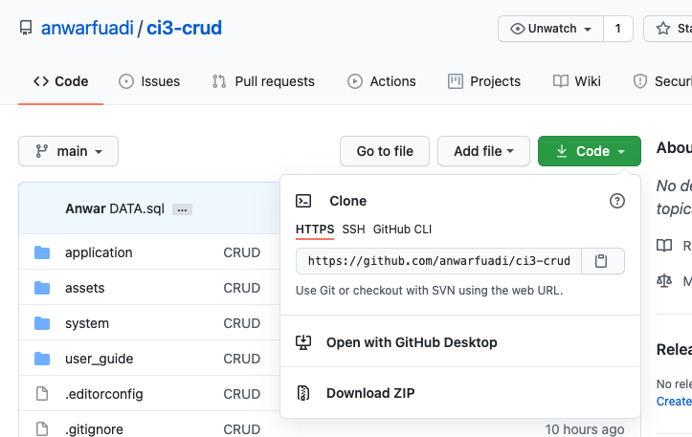
Complete Project Download
https://github.com/anwarfuadi/ci3-crud

Slide 3
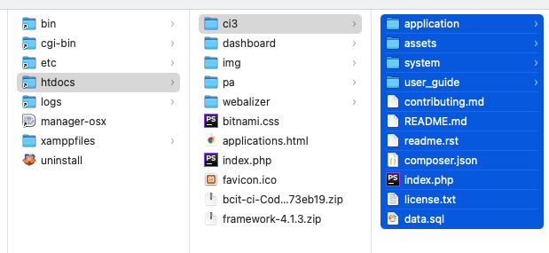
Extract to a Folder in htdocs of XAMPP
PROJECT NAME
htdocs

Slide 4
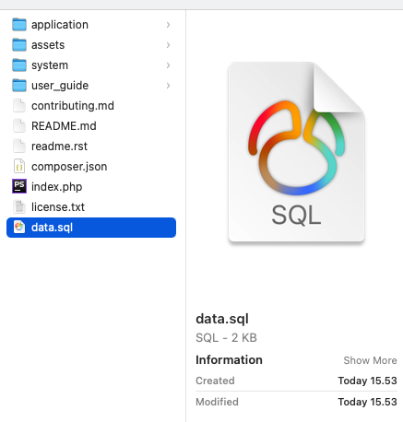
Import Data.sql to MySQL
MYSQL
Import

Slide 5
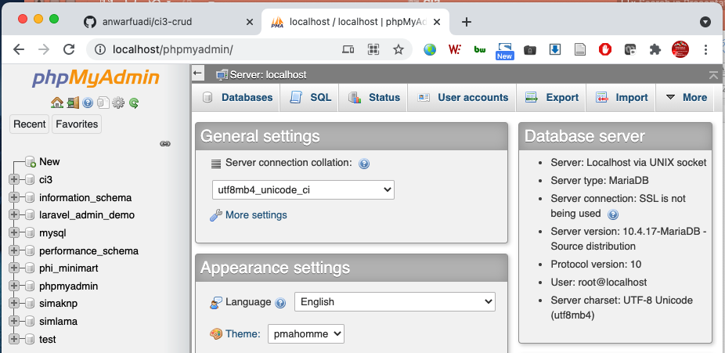
Import Data.sql to MySQL
Start MYSQL and Apache
Go to : http://localhost/phpmyadmin/

Slide 6
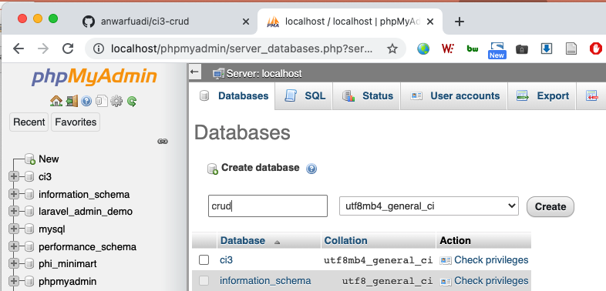
Import Data.sql to MySQL
Create Database

Slide 7
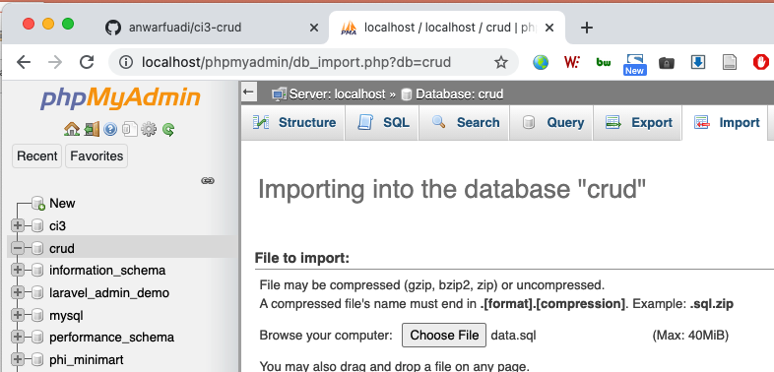
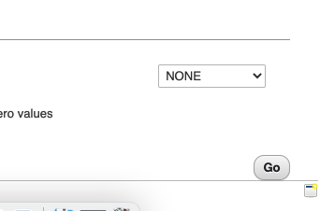
Import Data.sql to MySQL
Import

Slide 8
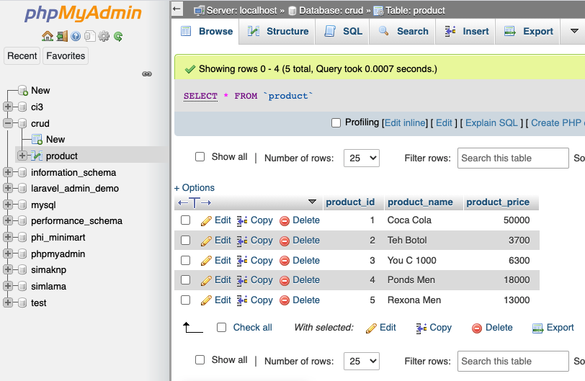
Import Data.sql to MySQL
Verify Product Table

Slide 9
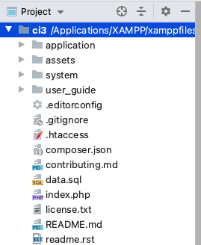
Open Project
Integrated Development Environtment (Sublime, VSCode, Notepad++, Geany, PHPStorm)

Slide 10
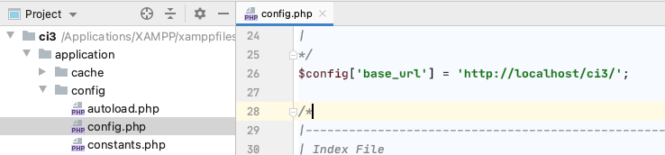
CONFIG
[ProjectFolder]/application/config/config.php
$config['base_url'] = 'http://localhost/ci3/';

Slide 11
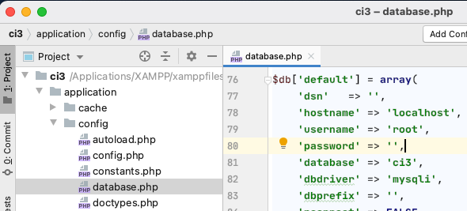
CONFIG
[ProjectFolder]/application/config/database.php
hostname
username
password
database

Slide 12
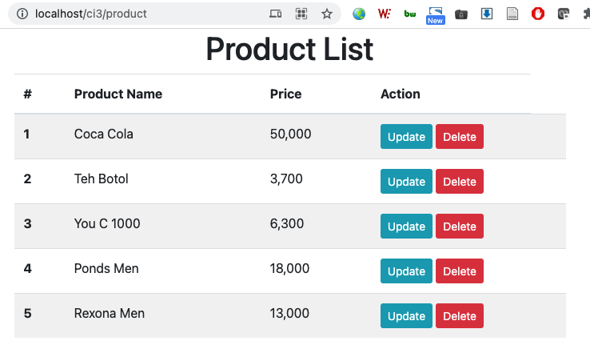
Test Run
http://localhost/ci3/product

Slide 13
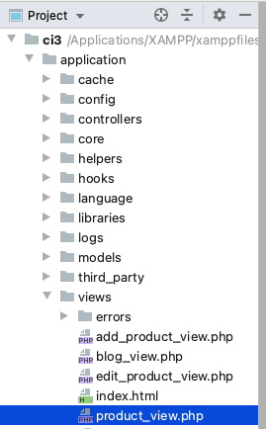
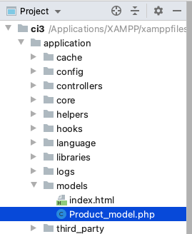
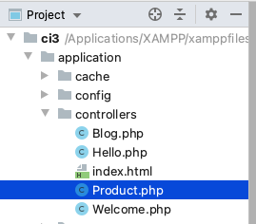
Model View Controller

Slide 14
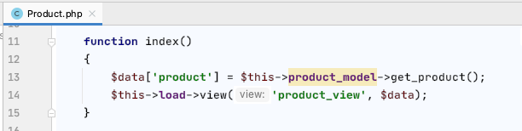
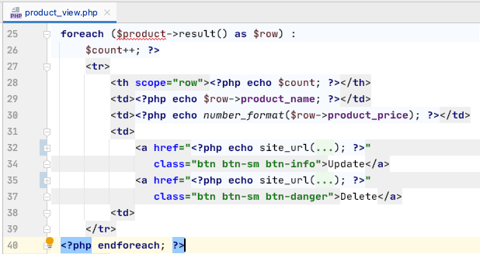
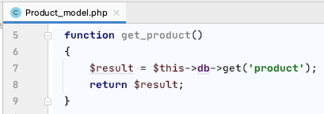
MVC - Read
http://localhost/ci3/product
C
V
M

Slide 15
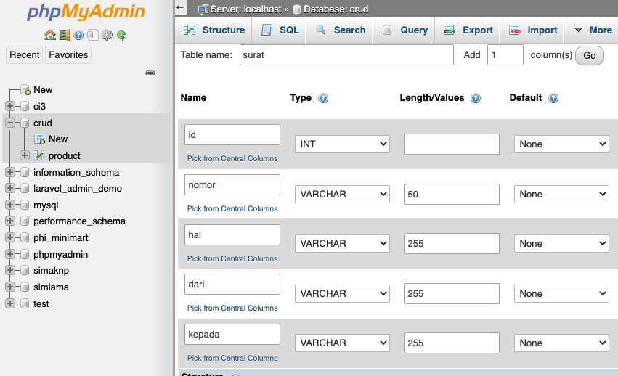

Create Table

Slide 16
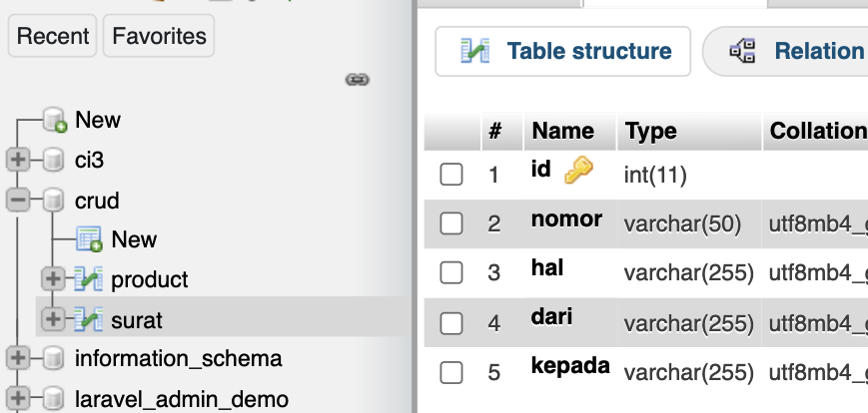

Slide 17
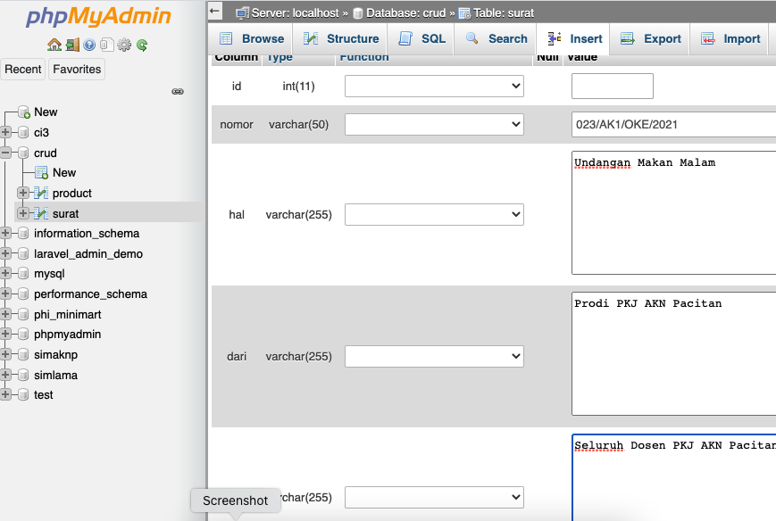


Slide 18
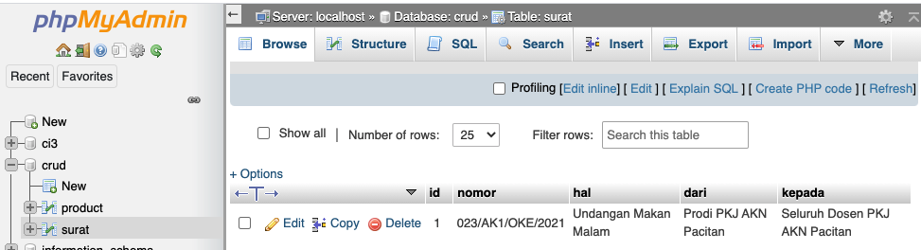

Slide 19
MVC - Read
http://localhost/ci3/surat
C
V
M

Slide 20
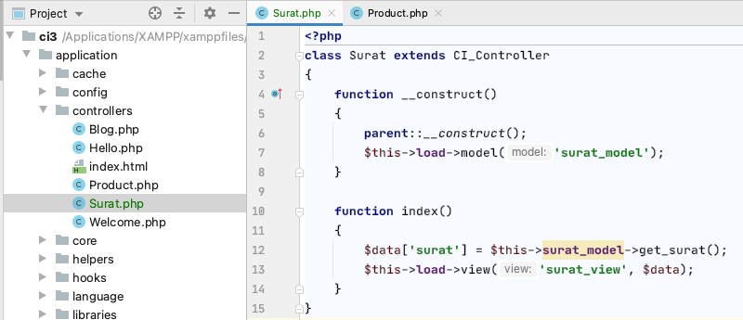

Slide 21
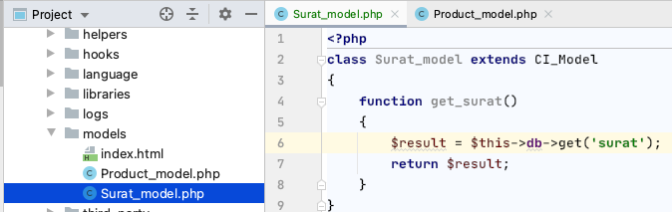

Slide 22
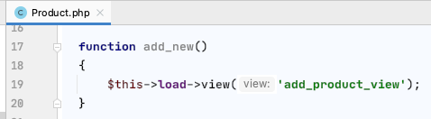
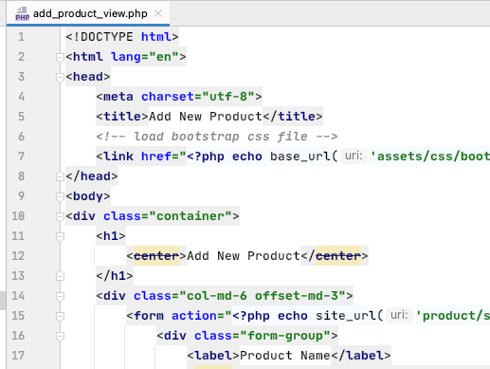
MVC - Create
http://localhost/ci3/product/add_new
C
V

Slide 23
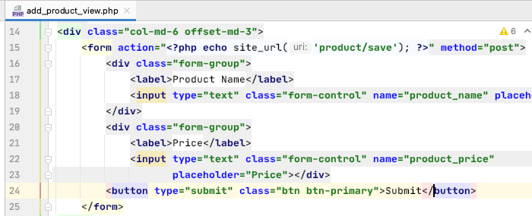
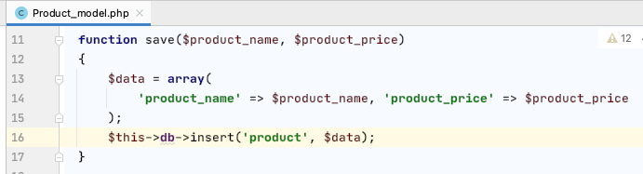
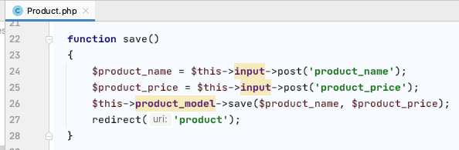
MVC - Create
Press SUBMIT
V
M
C

Slide 24
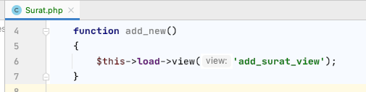

Slide 25
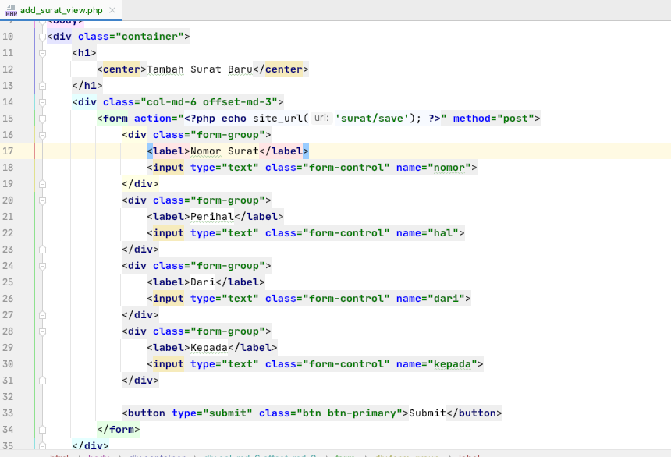

Slide 26
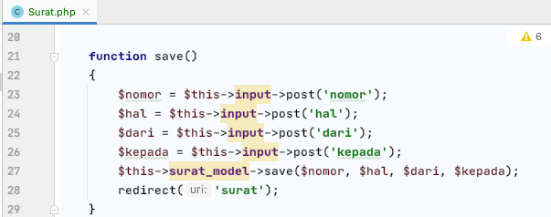

Slide 27
