Slide 2
Output Layer
Fully Connected Layer
Max Pooling Layer 1D
Convolutional Layer 1D
Max Pooling Layer 1D
Convolutional Layer 1D
Max Pooling Layer 1D
Convolutional Layer 1D
Embedding Layer

Slide 3
Input Layer
Convolutional Layer
Dense Layer
Embedding Layer
Max Pooling Layer
Output Layer
Convolutional Layer
Max Pooling Layer
Convolutional Layer
Max Pooling Layer

Slide 4
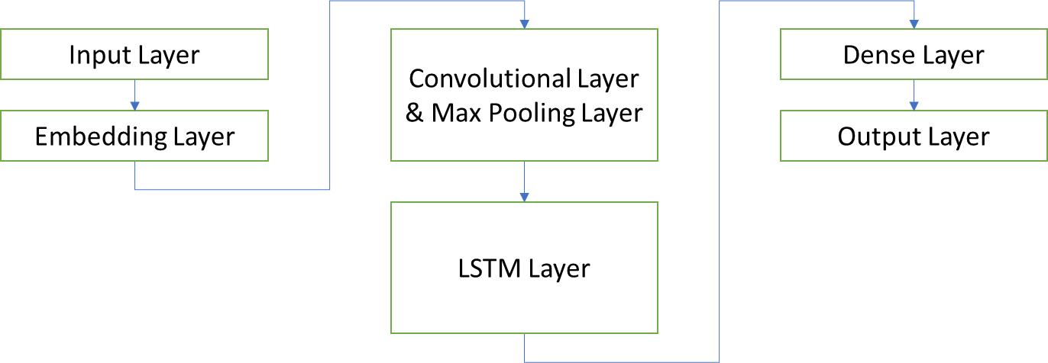
Input Layer
Convolutional Layer & Max Pooling Layer
Dense Layer
Embedding Layer
Output Layer
LSTM Layer

Slide 5
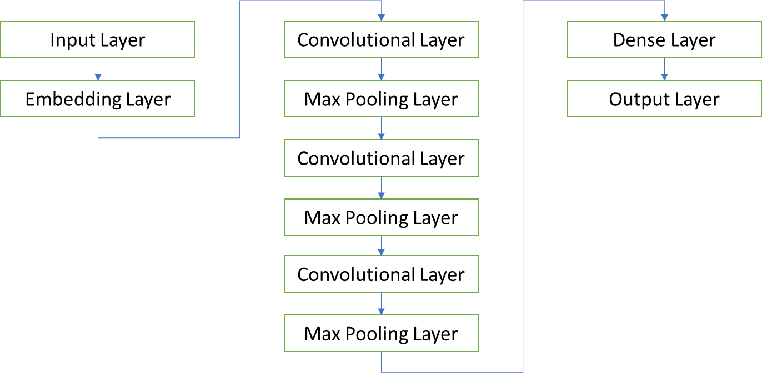

Slide 6
Convolutional Layer
Max Pooling Layer
Input Layer
Convolutional Layer
Dense Layer
Embedding Layer
Max Pooling Layer
Sigmoid Output Layer
Convolutional Layer
Max Pooling Layer

Slide 7
