Slide 1
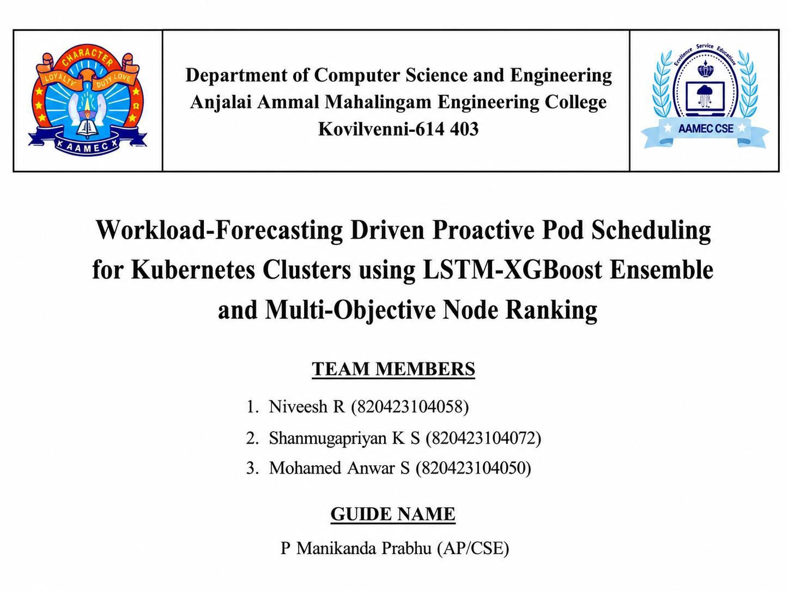

Slide 2
1.PROBLEM DEFINITION
Cloud applications receive different amounts of user traffic. The default Kubernetes scheduler reacts only after CPU or memory
usage becomes high. This may increase response time and reduce performance. This project predicts workload using an LSTM-
XGBoost model and selects the best worker node using Multi-Objective Node Ranking. This helps schedule pods before traffic increases and improves resource utilization.
2. ABSTRACT
Kubernetes manages containerized applications. The default scheduler works after workload increases, causing delays.
Our project combines LSTM and XGBoost to predict future workload. Based on the prediction, nodes are ranked using CPU,
memory and workload information. The pod is placed on the best node before traffic increases. This improves resource utilization, reduces response time and balances the workload.

Slide 3
3. LITERATURE REVIEW
Paper 1: CPU Usage Forecasting using LSTM showed LSTM predicts CPU usage accurately.
Paper 2: Forecast-Based Autoscaling used LSTM for proactive autoscaling. Paper 3: Adaptive AI-based Autoscaling improved resource allocation.
Paper 4: Neural Networks for Cloud Optimization used LSTM for server workload prediction.
Research Gap: Existing systems mainly use one prediction model or focus only on autoscaling. Our project combines LSTM, XGBoost and Multi-Objective Node Ranking.

Slide 4
4. EXISTING SYSTEM
The existing Kubernetes scheduler and Horizontal Pod Autoscaler work only after resource usage increases.
Limitations.
Reactive scheduling
No workload prediction
Higher response time
Poor resource utilization
Uneven workload distribution

Slide 5
5. PROPOSED SYSTEM
The proposed system predicts future workload using LSTM and XGBoost. After prediction, all worker nodes are ranked
based on CPU, memory and workload. Pods are scheduled on the best-ranked node before traffic increases. Objectives:
Predict workload
Improve scheduling
Reduce response time
Balance workload
Improve resource utilization

Slide 6
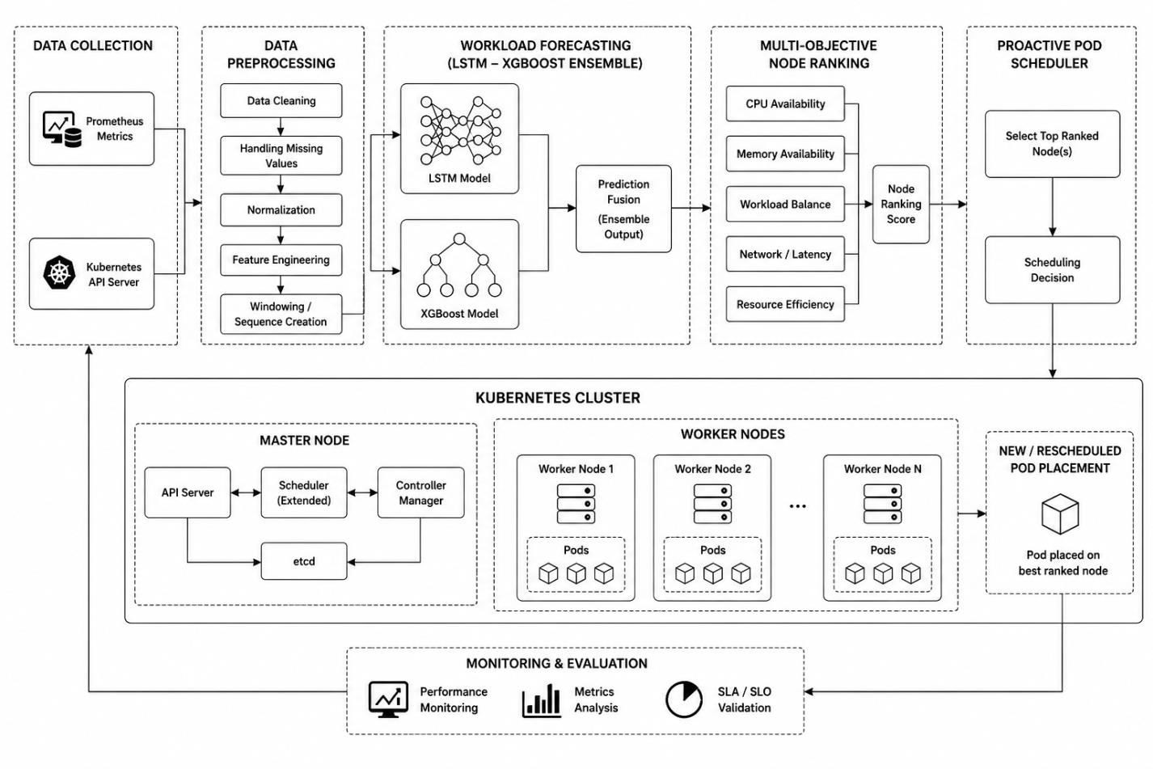
6. ARCHITECTURE DIAGRAM

Slide 7
7. MODULE SPECIFICATION
Data Collection
Collect CPU, memory and workload data.
Data Preprocessing
Clean and prepare data.
Workload Prediction
Predict workload using LSTM and XGBoost.
Node Ranking
Rank worker nodes.
Pod Scheduling
Schedule pods to the best node.
Monitoring
Monitor performance.

Slide 8

8. TECHNOLOGY STACK
Technology | Purpose in the Project
Python | Python is the main programming language used to develop the project. It is used for data processing, workload prediction, machine learning model implementation, and integrating all project modules.
Kubernetes | Kubernetes is the container orchestration platform used to deploy, manage, and schedule application pods automatically across multiple worker nodes. It is the core platform where the proposed scheduling algorithm is implemented.
Docker | Docker is used to package the application and its dependencies into lightweight containers. These containers are then deployed and managed by Kubernetes.
LSTM (Long Short- Term Memory) | LSTM is a deep learning model used for time-series forecasting. It analyzes historical CPU, memory, and workload data to predict future resource demand, helping the scheduler make proactive decisions.
XGBoost | XGBoost is a machine learning algorithm used along with LSTM to improve prediction accuracy. It captures complex relationships in workload data and helps produce more reliable forecasting results.
TensorFlow / Keras | TensorFlow and Keras are deep learning frameworks used to design, train, and evaluate the LSTM model. They provide built-in functions for creating neural networks efficiently.
Pandas | Pandas is used for data collection, cleaning, filtering, and preprocessing. It organizes workload data into tables for easier analysis and model training.
NumPy | NumPy is used for mathematical calculations, numerical operations, and handling multidimensional arrays during data processing and machine learning.
Prometheus | Prometheus continuously collects real-time Kubernetes cluster metrics such as CPU usage, memory usage, network traffic, and request rate. These metrics are used as input for workload prediction.
Grafana | Grafana is used to visualize the collected metrics through dashboards. It helps monitor cluster performance, resource utilization, and scheduling efficiency using graphs and charts.
Visual Studio Code (VS Code) | VS Code is the Integrated Development Environment (IDE) used for writing, editing, debugging, and running the project source code.

Slide 9
9. Conclusion
The proposed system provides proactive pod scheduling using workload prediction. It
improves cluster performance, balances workloads, reduces response time and increases resource utilization compared with the existing reactive approach.

