Slide 1
RUNTIME DEFENSE AGAINST CODE INJECTION ATTACKS USING REPLICATED EXECUTION

Slide 2
PROBLEM SPECIFICATION
We have to develop an Intrusion Detection System (IDS)
IDS – An application that monitors a process in its execution
It raises an alarm in case of any malicious activity trying to take over the process
Our technique – Multi-Variant Execution
variants – slightly different versions of the process
They are generated from the source code at the compilation step

Slide 3
PROBLEM SPECIFICATION(cont.)
Variants are expected to have identical behaviour under normal execution
Notable differences in their execution behaviour in case of an attack
Multi-Variant Monitor : A user process which spawns and monitors the variants
It compares the behaviour of variants at certain execution points (synchronization points)
Comparison takes place at the level of system call
Behaviour – certain parameters associated with a system call
Alarm to be raised by the monitor in case of any discrepancy

Slide 4
INTRODUCTION
Software vulnerabilities have always been a major threat.
There are still many software packages written in C and C++.
High performance and low-level programming provisions have made use of C/C++ inevitable for many applications
Writing safe and secure programs using these languages is often difficult.

Slide 5
INTRODUCTION(cont.)
As a result, software vulnerabilities continue to exist
None of the methods developed provide an ultimate solution
Lack of run-time information limits the capabilities of modern static tools
Dynamic and run-time tools are often not effective either
Multi-variant code execution is a run-time monitoring technique that prevents malicious code execution and addresses the problems mentioned above

Slide 6
DESIGN STAGES
1. Variant Generation
Multiple versions of the same program are generated.
Slight differences among the variants can be observed during execution
Exhibit identical behaviour under normal circumstances
2. Multi-variant Monitoring Process
It is a user process which executes the variants, generated as output of stage I.
Input : Path of the directory containing executable variants of a process
Output : Output of the original source code if there is no divergence among the behavior of variants and an alarm is raised if there is any divergence.

Slide 7
WORK DONE(Overview)
Multi-variant monitor implemented with the following functionalities :
Execute the files in a directory as if only one process is running
Compare system calls made by executables at synchronization points
Raise an alarm in case of divergence of behaviour among variants

Slide 8
Overview(cont.)
An alarm is raised at a synchronization point if any of the following conditions is not met :
All the executables are trying to make the same system call
The arguments passed to the call by each of the executables are identical (if they are values) or their contents are identical (if they are indirect arguments)

Slide 9
Overview(cont.)
A sample set of source codes is constructed.
For each source code from the set, two variants are generated from the code at the compilation stage.
These are passed to the monitor for execution.
Successful detection of stack overflow attack during the testing phase.

Slide 10
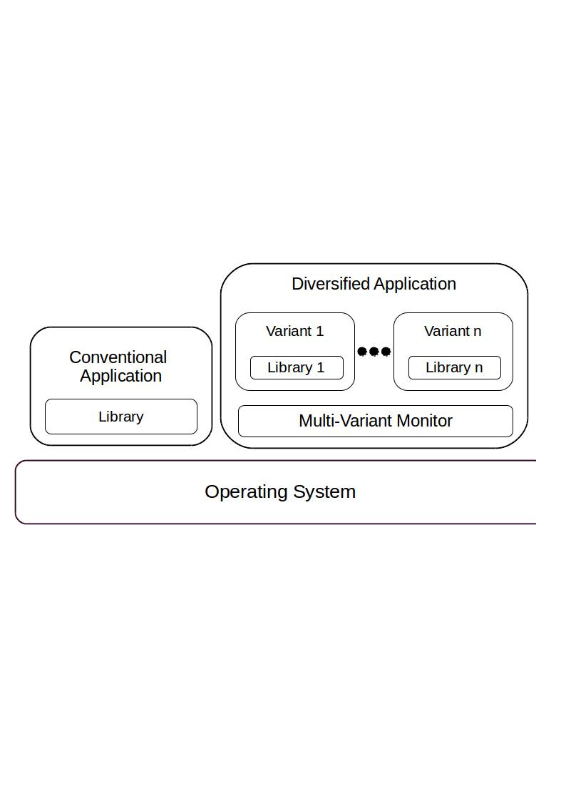
Overview(cont.)

Slide 11
System Call Execution
System must act as if only one variant is running on the host OS conventionally
Multi-variant monitor is responsible for this property
System calls are examined to study their effects and results
System calls need to be classified

Slide 12
System Call Execution(cont.)
Following categories have been considered:
System calls like write, mkdir, rmdir, chmod, create are executed only by the monitor and return value is passed to variants.
In case of calls like chdir, the monitor as well as variants have to execute them.
Calls like getppid are executed only by the variants
For system calls like getpid, the call has to be executed by one of the variants and the monitor must pass the result to each of the remaining variants.

Slide 13
Skipping System Calls
ptrace is used to implement monitoring mechanism.
A traced process is paused on certain events, depending on the first argument of ptrace.
PTRACE_SYSCALL is passed as the first argument in our case which causes the variants to be paused at system calls.

Slide 14
Skipping System Calls(cont.)
Monitor is notified twice per system call :
At the beginning of call
Monitor checks system call and its arguments
Alarm is raised in case of any mismatch
Call is executed if there is no mismatch
If it is to be executed only by the monitor, variants skip this call
In our implementation, this is done by placing the system call number corresponding to getppid in RAX

Slide 15
Skipping System Calls(cont.)
2. When the kernel has finished executing the system call handler
Variants execute the call and control reaches the monitor for the second time
In case of calls to be executed only by monitor, the return value is passed to the variants by placing it in RAX

Slide 16
Monitor-Variant Communication
The monitor creates and executes the variants as its own children and then traces them.
The register values of the children are obtained using ptrace with GET_REGS as argument
SET_REGS is passed to set the register values
Monitor may need to access a variant’s memory space
ptrace with PEEK_DATA as argument is currently used to read from process’ memory space
The method has problem with efficiency

Slide 17
White List for exec
A text file which contains the names of executables (with complete path), which have the permission to be executed by user variant programs.
Any attempt to run an executable from outside the list raises an alarm

Slide 18
Variant Generation
Takes place at compilation step
Two executables(variants) are obtained from the source code after compilation
They are passed on to the monitor for execution

Slide 19
Variant Execution
Variants are executed by enabling address space randomization
During execution, these variants differ in the positions of the stack, heap and libraries in their address spaces.
Output of the source code is produced under normal circumstances

Slide 20
Stack Overflow and its Detection
An attacker attempts to corrupt the return address of a function and set the same to a value of his choice
Attack can be successful under conventional execution environment, once he gets the knowledge about the process’ address space
In our environment, two variants have to be dealt with
Successful attack can be launched through input only on one of the variants

Slide 21
Stack Overflow and its Detection(cont.)
The address used in corruption points to a different location in the other variant
Results in system call mismatch(by name or arguments)
Leads to divergence among the behaviour of variants
Detected by monitor

Slide 22
OVERHEAD ANALYSIS
An analysis on the overhead generated as a result of multi-variant execution
Write system calls taken into account
Involved comparison of overall CPU times in two environments
Normal Environment
Monitored Environment
Obtained plots of CPU times against number of system calls

Slide 23
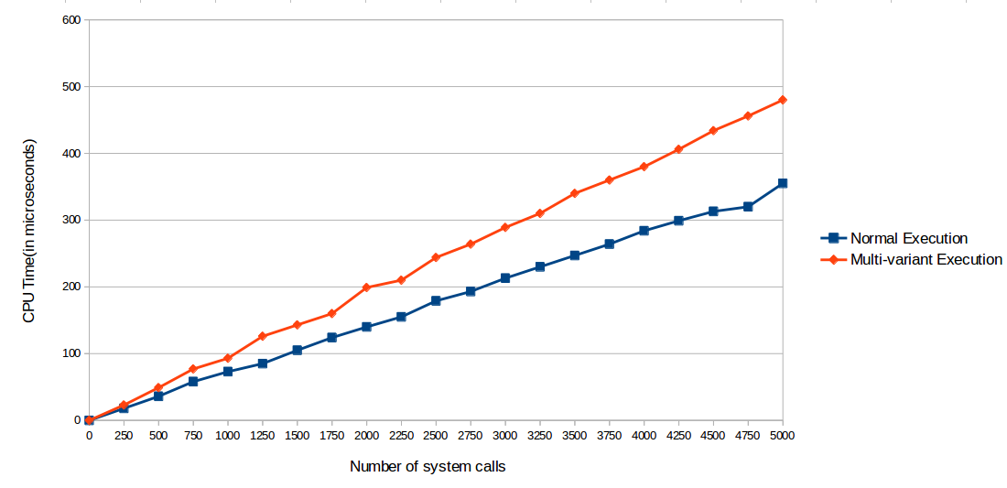
Experimental Results

Slide 24
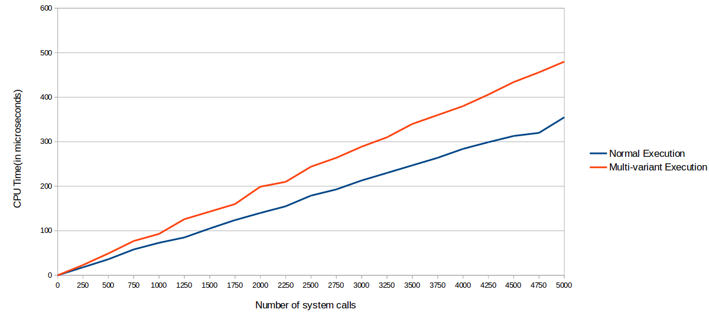
Experimental Results(cont.)

Slide 25
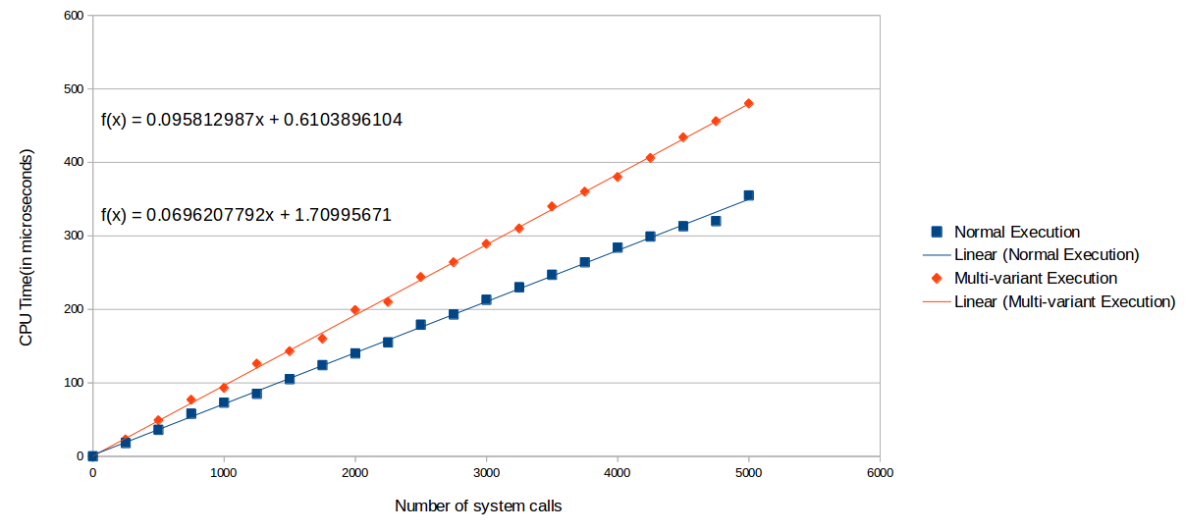
Experimental Results(cont.)

Slide 26
Experimental Results(cont.)
Slope implies CPU time per system call in microseconds
Normal execution – 0.070
Multi-variant execution – 0.096
Comparison of slopes gave details on the additional overhead in multi-variant execution
Additional overhead of 37%

Slide 27
Reasons for overhead
The waiting time encountered by the monitor while it waits for a system call to be invoked by both the variants
Monitor-variant communication – writing the output string to monitor memory in our case

Slide 28
PROBLEMS AND CHALLENGES FACED
Variant Generation : with reversed stack growth
Shared memory in monitor – variant communication
Wide study on system calls

Slide 29
FUTURE WORK
Improving Communication Efficiency: Implementing shared memory
Demonstration in Real World Scenarios : Client-server architecture
Increasing Number of Variants

Slide 30
CONCLUSION
A version of the monitoring mechanism has been successfully implemented
The current version is able to execute the two generated variants in the directory given as input as if only one process is running.
Stack overflow attack successfully detected

Slide 31
CONCLUSION(cont.)
The monitor may be tested against a client-server architecture
Statistical analysis on overhead has been carried out with an explanation of results
Reduction of overhead in future results in improved performance

Slide 32
THANK YOU

