Slide 1
OFFICIAL EDUCATORS RENAISSANCE CAMPUS
SMART GAS MONITORING SYSTEM
MADE BY SIR ANWAR SIRAJ DS AND AI ROBOTICS
MQ-2 Sensor | I2C LCD | LPG, CO & Smoke detection in PPM

Slide 2
2
PROJECT OVERVIEW & KEY FEATURES
An environmental safety project. The MQ-2 sensor detects hazardous LPG, Carbon Monoxide (CO) and Smoke. The Arduino processes the analog signal and shows live readings in PPM on a 16x2 I2C LCD - a compact safety monitor for homes and labs.
Triple Detection
Real-time PPM
I2C Efficiency
Dual Alert
Clear Display
LPG, CO and Smoke monitored at once.
Shows gas concentration in Parts Per Million.
LCD wiring cut from 16 pins to just 4.
Analog (precise) + Digital (threshold) signals.
Structured data for easy reading.
AI ROBOTICS | Made by Sir Anwar Siraj DS | The Educators Renaissance Campus

Slide 3
3
LIBRARIES USED IN THIS PROJECT
Libraries act as translators between the Arduino and the sensor / display.
1. Wire.h
2. LiquidCrystal_I2C
3. MQ2.h
Built into the Arduino IDE - nothing to install.
Handles I2C communication (SDA/SCL) between the Arduino and the LCD.
Controls the 16x2 LCD through only 2 data pins.
Key calls: init(), backlight(), setCursor(), print(), clear()
Specialized library for the MQ-2 gas sensor.
Converts raw voltage into PPM using readLPG(), readCO() and readSmoke().
AI ROBOTICS | Made by Sir Anwar Siraj DS | The Educators Renaissance Campus

Slide 4
4
INSTALL LIBRARIES - STEP BY STEP
1
2
3
4
Open Arduino IDE
Library Manager
Install LCD library
Install MQ2 library
Launch the Arduino IDE on your PC.
Sketch > Include Library > Manage Libraries...
Search "LiquidCrystal I2C" (by Frank de Brabander) and click Install.
Search "MQ2" (MQ2 sensor library) and click Install. Wire.h needs no install.
Tip: if the LCD stays blank, change the address from 0x27 to 0x3F.
AI ROBOTICS | Made by Sir Anwar Siraj DS | The Educators Renaissance Campus

Slide 5
5
HARDWARE COMPONENTS
Arduino Uno
MQ-2 Sensor
I2C 16x2 LCD
Central processing unit. Processes sensor data and controls the LCD.
Gas sensing element. Detects smoke, LPG and CO.
Visual display. Shows readings on a 2-line screen.
LM393 Comparator
Jumper Wires
5 simple parts = one life-saving safety system!
Voltage control. Built into the MQ-2 module for digital threshold logic.
Connectors. Route signals between sensor, board and display.
AI ROBOTICS | Made by Sir Anwar Siraj DS | The Educators Renaissance Campus

Slide 6
6
COMPONENT: MQ-2 GAS SENSOR
What is it?
Module Pins
A gas sensor with an internal heater and a sensing element whose conductivity changes when combustible gases are present. The more gas, the higher the output voltage.
Detects: LPG, Carbon Monoxide (CO) and Smoke.
It needs a short pre-heating (warm-up) time for stable readings.
VCC > 5V GND > GND
A0 > Arduino A0 (analog PPM data)
D0 > optional digital pin (LED alert)
Analog vs Digital
A0 gives precise readings. D0 uses the LM393 comparator to switch HIGH/LOW at a threshold set by the on-board knob.
AI ROBOTICS | Made by Sir Anwar Siraj DS | The Educators Renaissance Campus

Slide 7
7
COMPONENT: I2C 16x2 LCD DISPLAY
What is it?
Pin Connections
A character LCD with 16 columns x 2 rows and an I2C backpack. A normal LCD needs 16 pins; with I2C only 4 wires are used: VCC, GND, SDA and SCL.
In this project it shows branding at start, then live readings:
L: LPG C: CO
Smoke: value PPM
GND > GND VCC > 5V
SDA > Analog A4
SCL > Analog A5
Good to know
Default address is 0x27 (some use 0x3F). Adjust the contrast screw on the back if text is faint.
AI ROBOTICS | Made by Sir Anwar Siraj DS | The Educators Renaissance Campus

Slide 8
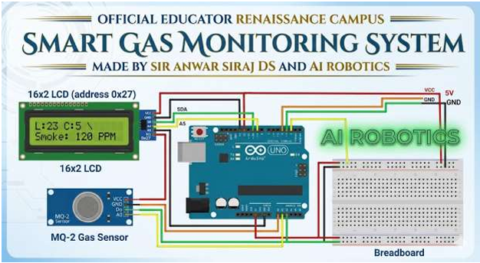
8
CIRCUIT DIAGRAM (PIN MAPPING)
MQ-2 Wiring
VCC > 5V
GND > GND
A0 > A0
D0 > optional LED
I2C LCD Wiring
GND > GND VCC > 5V
SDA > A4
SCL > A5
Official diagram by Sir Anwar Siraj DS and AI Robotics
AI ROBOTICS | Made by Sir Anwar Siraj DS | The Educators Renaissance Campus

Slide 9
9
HOW IT WORKS - STEP BY STEP
1
2
3
4
5
Pre-heating
Sensing
Signal Conversion
Processing
Output
Short warm-up of the internal heater for stable readings.
Conductivity changes when combustible gas is present.
Arduino reads the variable voltage on pin A0.
MQ2.h converts raw voltage into PPM for LPG, CO, Smoke.
Values sent via I2C (SDA/SCL) to the LCD.
AI ROBOTICS | Made by Sir Anwar Siraj DS | The Educators Renaissance Campus

Slide 10
10
PROJECT CODE (KEY PARTS)
#include <Wire.h>
#include <LiquidCrystal_I2C.h>
#include <MQ2.h>
LiquidCrystal_I2C lcd(0x27, 16, 2);
int pin = A0;
MQ2 mq2(pin);
void setup() {
lcd.init(); lcd.backlight();
mq2.begin();
}
void loop() {
mq2.read(true);
lpg = mq2.readLPG();
co = mq2.readCO();
smoke = mq2.readSmoke();
delay(1000);
}
setup()
Starts LCD, shows RENAISSANCE / AI ROBOTICS for 3 s, then calibrates the sensor.
loop()
Reads LPG, CO and Smoke in PPM, prints them on the LCD, and refreshes every second.
AI ROBOTICS | Made by Sir Anwar Siraj DS | The Educators Renaissance Campus

Slide 11
11
EDUCATIONAL BENEFITS
Safety Awareness
Protocols
Environmental Science
Logic Development
Detect invisible hazards like Carbon Monoxide.
Practical I2C and Serial protocols.
Understand gas concentrations and PPM.
Map chemical reactions into digital data.
THANK YOU!
Empowering the Next Generation of AI & Robotics Engineers
AI ROBOTICS | Made by Sir Anwar Siraj DS | The Educators Renaissance Campus

