Slide 1
MADE BY SIR ANWAR SIRAJ DS & AI ROBOTICS
ARDUINO HEART RATE MONITOR
Pulse Sensor + I2C LCD | Real-time BPM | Chapter 5, Project 1
THE EDUCATORS RENAISSANCE CAMPUS

Slide 2
PROJECT OVERVIEW & KEY FEATURES
2
An embedded system that measures your pulse in real time. A PPG sensor detects blood-volume changes in the fingertip, an Arduino UNO processes the signal, and an I2C LCD shows the BPM instantly.
Real-Time BPM
LED Feedback
I2C Display
Serial Plotting
High Accuracy
Instant Beats Per Minute calculation.
On-board LED blinks with every heartbeat.
Only 2 pins (SDA/SCL) saves wiring.
Send data to PC for graph analysis.
Interrupts give precise pulse detection.
AI ROBOTICS | Sir Anwar Siraj DS | The Educators Renaissance Campus

Slide 3
LIBRARIES USED IN THIS PROJECT
3
Libraries act as "translators" between the Arduino and the sensor / display. Install both in the Arduino IDE.
1. PulseSensor Playground
2. LiquidCrystal_I2C
Converts the raw analog signal from the heart sensor into a clean BPM value.
Header: PulseSensorPlayground.h
Key calls: begin(), getBeatsPerMinute(), sawStartOfBeat()
Lets the Arduino control the 16x2 LCD using just two data pins (SDA/SCL).
Header: LiquidCrystal_I2C.h
Author: Frank de Brabander
Also uses Wire.h (built in)
AI ROBOTICS | Sir Anwar Siraj DS | The Educators Renaissance Campus

Slide 4
INSTALL LIBRARIES - STEP BY STEP
4
1
2
3
4
Open Arduino IDE
Open Library Manager
Install PulseSensor
Install LCD library
Launch the Arduino IDE on your PC.
Sketch > Include Library > Manage Libraries...
Search "PulseSensor Playground" and click Install.
Clear search, type "LiquidCrystal I2C" (by Frank de Brabander), click Install.
Tip: if the LCD stays blank, change the I2C address from 0x27 to 0x3F.
AI ROBOTICS | Sir Anwar Siraj DS | The Educators Renaissance Campus

Slide 5
HARDWARE COMPONENTS
5
Arduino UNO x1
Pulse Sensor x1
I2C 16x2 LCD x1
The brain of the project. Reads the sensor and runs the code.
Detects the pulse using light and a photo sensor.
Displays the BPM value and system status.
Jumper Wires 7-10
USB Cable x1
Total: 5 component types - simple, cheap and beginner friendly!
Connect all modules together.
Powers the Arduino and uploads the code.
AI ROBOTICS | Sir Anwar Siraj DS | The Educators Renaissance Campus

Slide 6
COMPONENT 1: PULSE SENSOR (PPG)
6
What is it?
Wire Colours
A Photoplethysmogram (PPG) sensor. It shines light into the fingertip, and as the heart pumps blood the tissue reflects different amounts of light. A photo sensor turns this into an analog voltage that rises and falls with every beat.
Place your finger gently on the sensor - no pressing hard!
Red = VCC (5V)
Black = GND
Purple = Signal (Analog A0)
Why it works
Blood volume changes with each heartbeat, so reflected light changes - the Arduino counts these peaks to get BPM.
AI ROBOTICS | Sir Anwar Siraj DS | The Educators Renaissance Campus

Slide 7
COMPONENT 2: I2C 16x2 LCD DISPLAY
7
What is it?
Pin Connections
A 16-column x 2-row character LCD with an I2C backpack. Normally an LCD needs 6+ wires; the I2C module reduces this to only 4: VCC, GND, SDA and SCL.
In this project it shows the title "HEART RATE MON." on line 1 and "BPM: xx" on line 2.
GND > GND VCC > 5V
SDA > Analog A4
SCL > Analog A5
Good to know
Default I2C address is 0x27 (some modules use 0x3F). Adjust the contrast screw on the back if text is faint.
AI ROBOTICS | Sir Anwar Siraj DS | The Educators Renaissance Campus

Slide 8
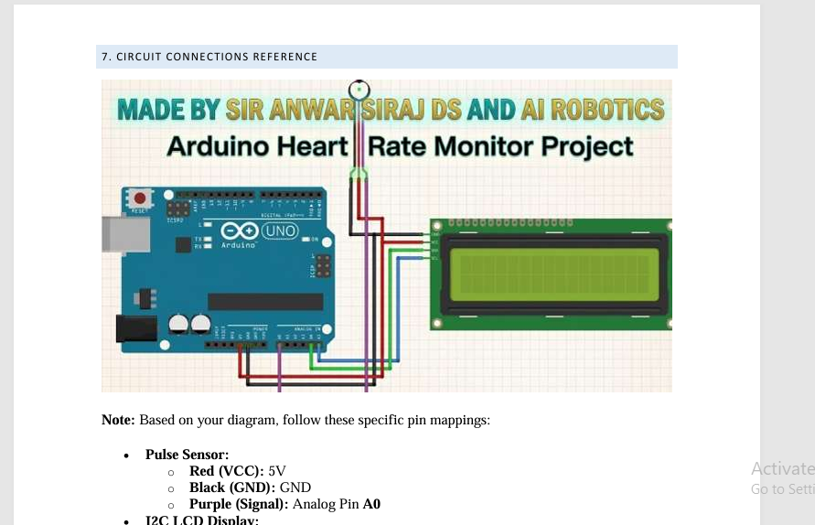
CIRCUIT CONNECTIONS
8
Pulse Sensor
Red > 5V
Black > GND
Purple > A0
I2C LCD
GND > GND
VCC > 5V
SDA > A4 SCL > A5
AI ROBOTICS | Sir Anwar Siraj DS | The Educators Renaissance Campus

Slide 9
HOW IT WORKS - STEP BY STEP
9
1
2
3
4
5
Sensing
Signal Processing
Thresholding
Calculation
Output
Light is shone into the finger; blood flow changes the reflected light.
Arduino reads the analog voltage on pin A0.
Signal crossing THRESHOLD (550) counts as a beat.
Time between beats gives Beats Per Minute.
BPM shows on the LCD; LED on pin 13 blinks with the pulse.
AI ROBOTICS | Sir Anwar Siraj DS | The Educators Renaissance Campus

Slide 10
PROJECT CODE (KEY PARTS)
10
#define USE_ARDUINO_INTERRUPTS true
#include <PulseSensorPlayground.h>
#include <Wire.h>
#include <LiquidCrystal_I2C.h>
LiquidCrystal_I2C lcd(0x27, 16, 2);
const int THRESHOLD = 550;
void setup() {
lcd.init(); lcd.backlight();
pulseSensor.analogInput(0);
pulseSensor.blinkOnPulse(13);
pulseSensor.setThreshold(THRESHOLD);
pulseSensor.begin();
}
setup()
Starts the LCD, shows "Initializing", then configures the sensor pin, LED and threshold.
loop()
Reads BPM, prints it to Serial and the LCD every 20 ms. Tune THRESHOLD if too sensitive.
AI ROBOTICS | Sir Anwar Siraj DS | The Educators Renaissance Campus

Slide 11
EDUCATIONAL BENEFITS
11
Biomedical Basics
I2C Communication
Signal Processing
Learn how optical sensors measure biological data.
Understand how microcontrollers talk to displays.
Filter noise from analog sensors to get clean data.
THANK YOU! Made by Sir Anwar Siraj DS & AI Robotics
AI ROBOTICS | Sir Anwar Siraj DS | The Educators Renaissance Campus

