Slide 1
Setting up and using the Biomotum Spark
Anway Pimpalkar

Slide 2
Connect to the Biomotum Spark

Slide 3
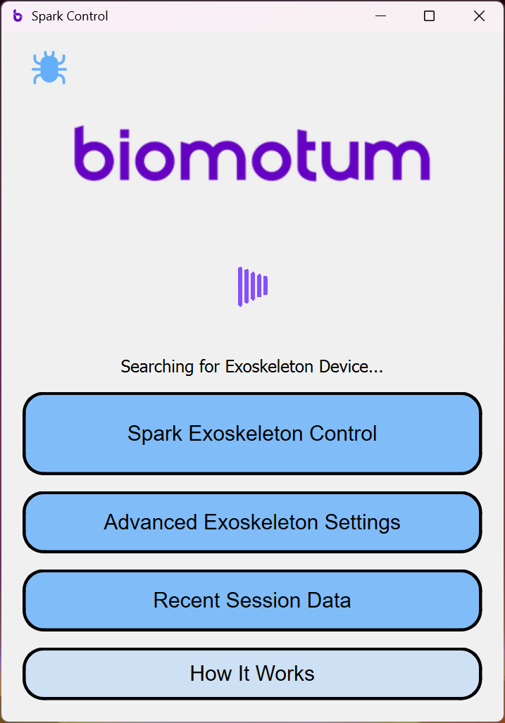
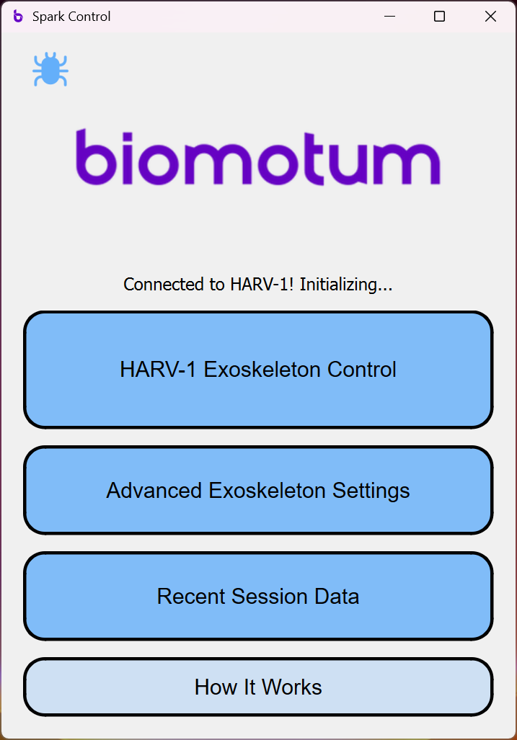
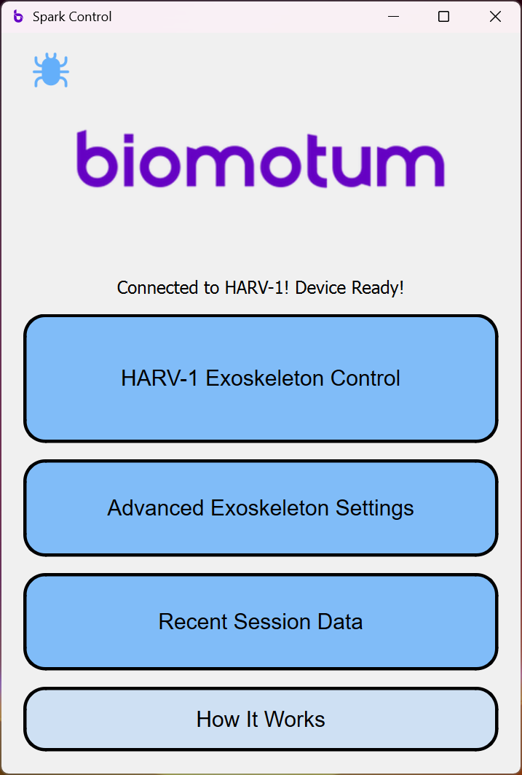
Connect to the Biomotum Spark
Power on the Spark waist unit
Turn on Bluetooth on the host

Slide 4
Enable Scripting Control

Slide 5
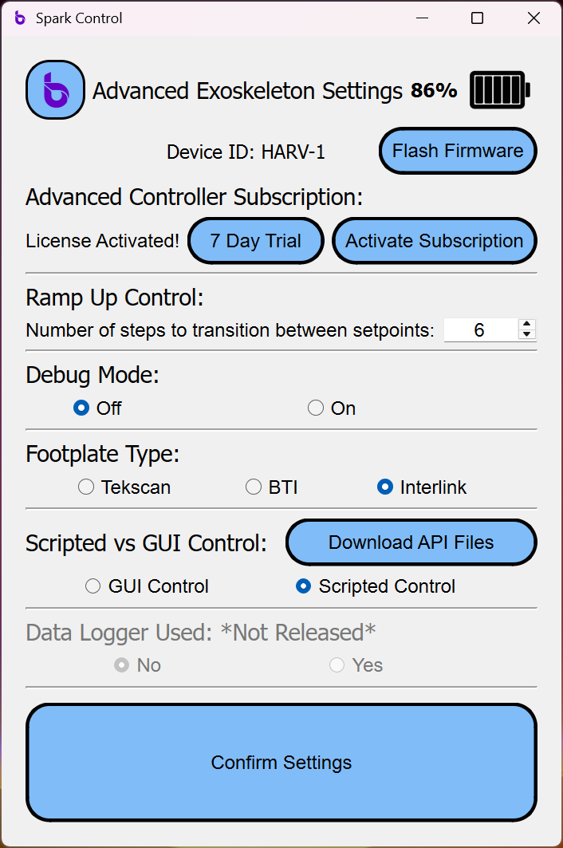
Enable “Scripting Control” to use the Python API

Slide 6
Add a new user

Slide 7
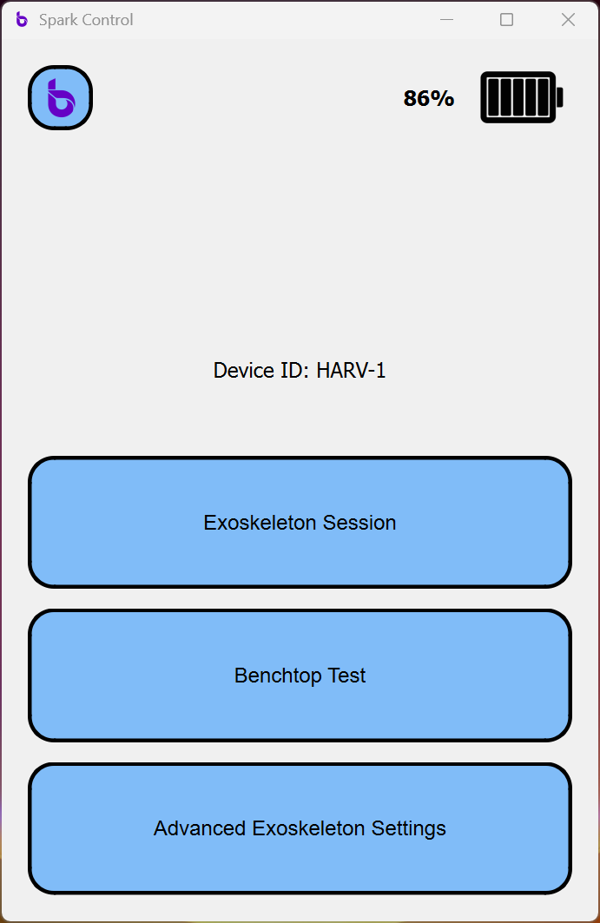
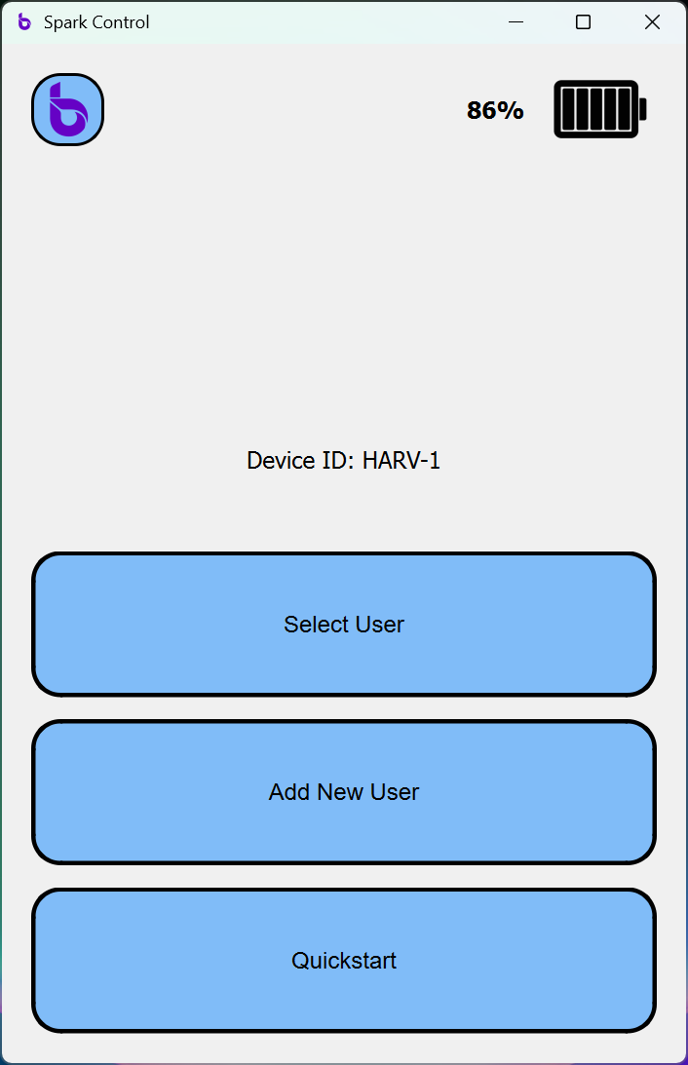
Add a new user (1 of 2)

Slide 8
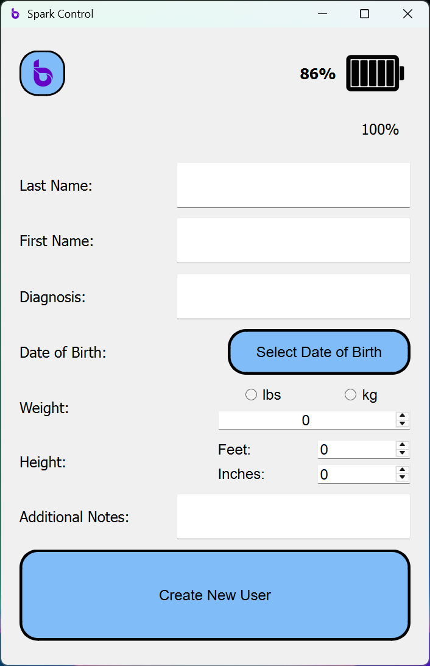
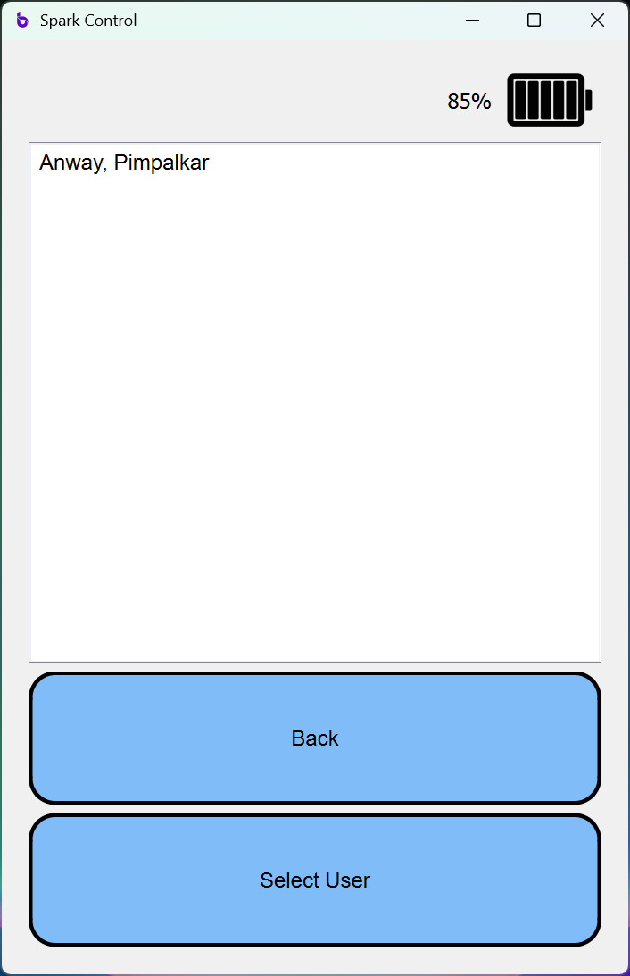
Add a new user (2 of 2)

Slide 9
Starting a proportional control session

Slide 10
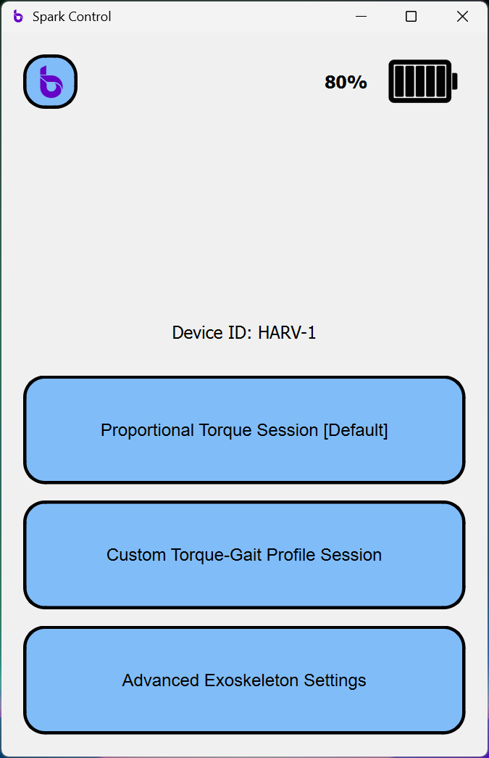
Starting a gait profile-based session (1 of 4)

Slide 11
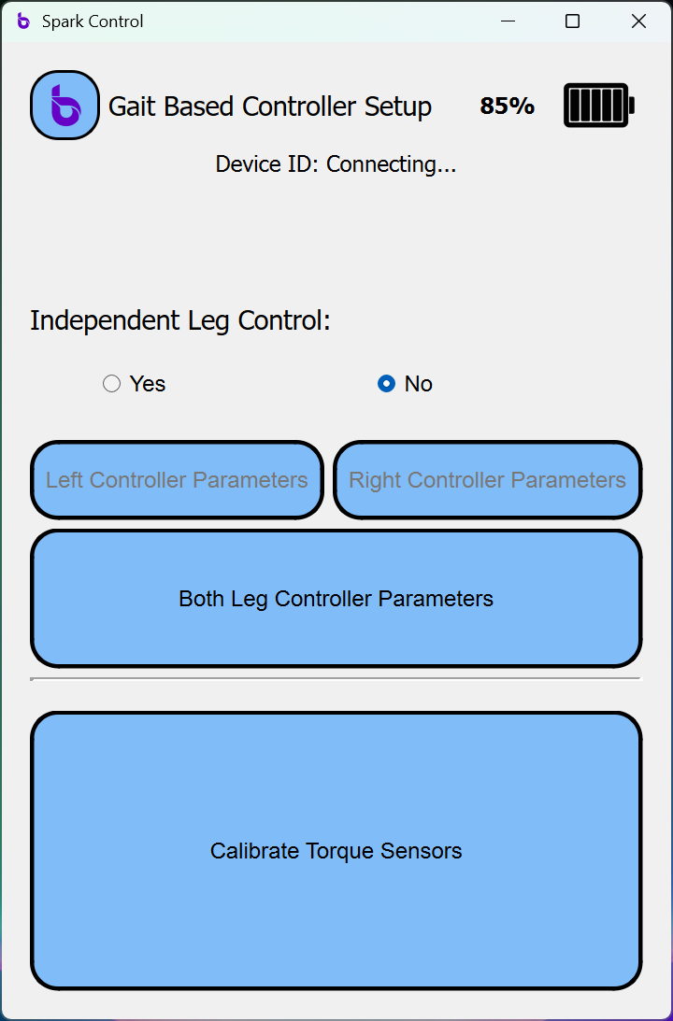
Starting a proportional control session (2 of 4)

Slide 12
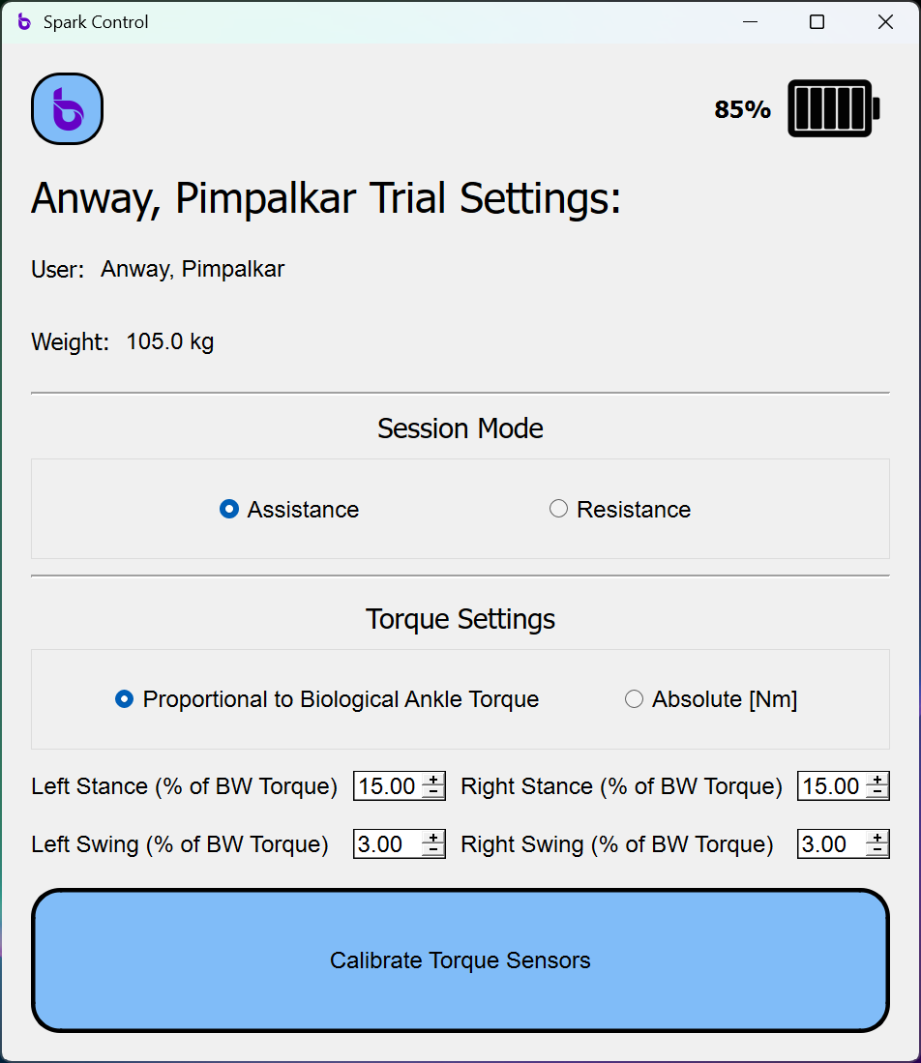
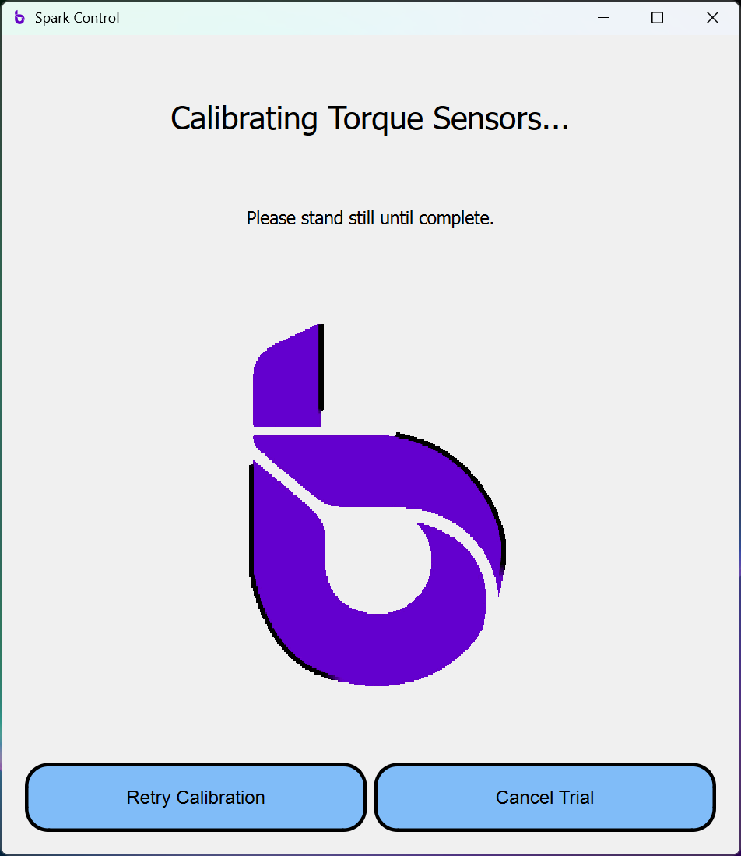
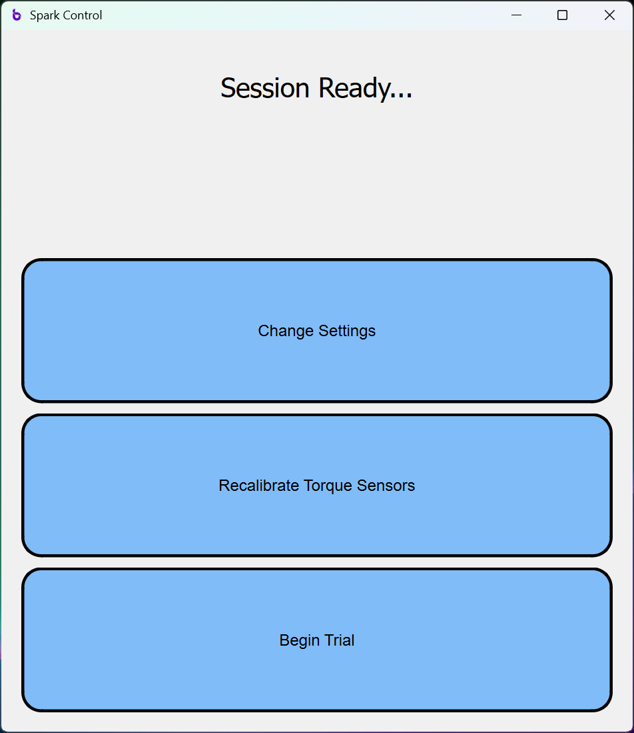
Starting a proportional control session (3 of 4)

Slide 13
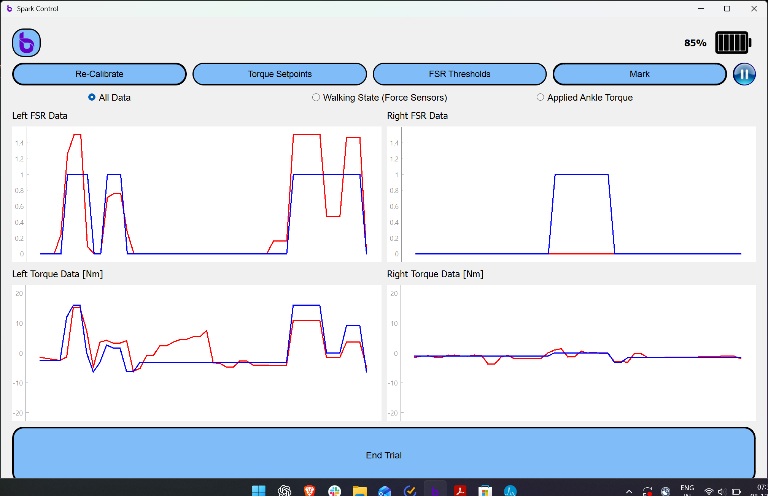
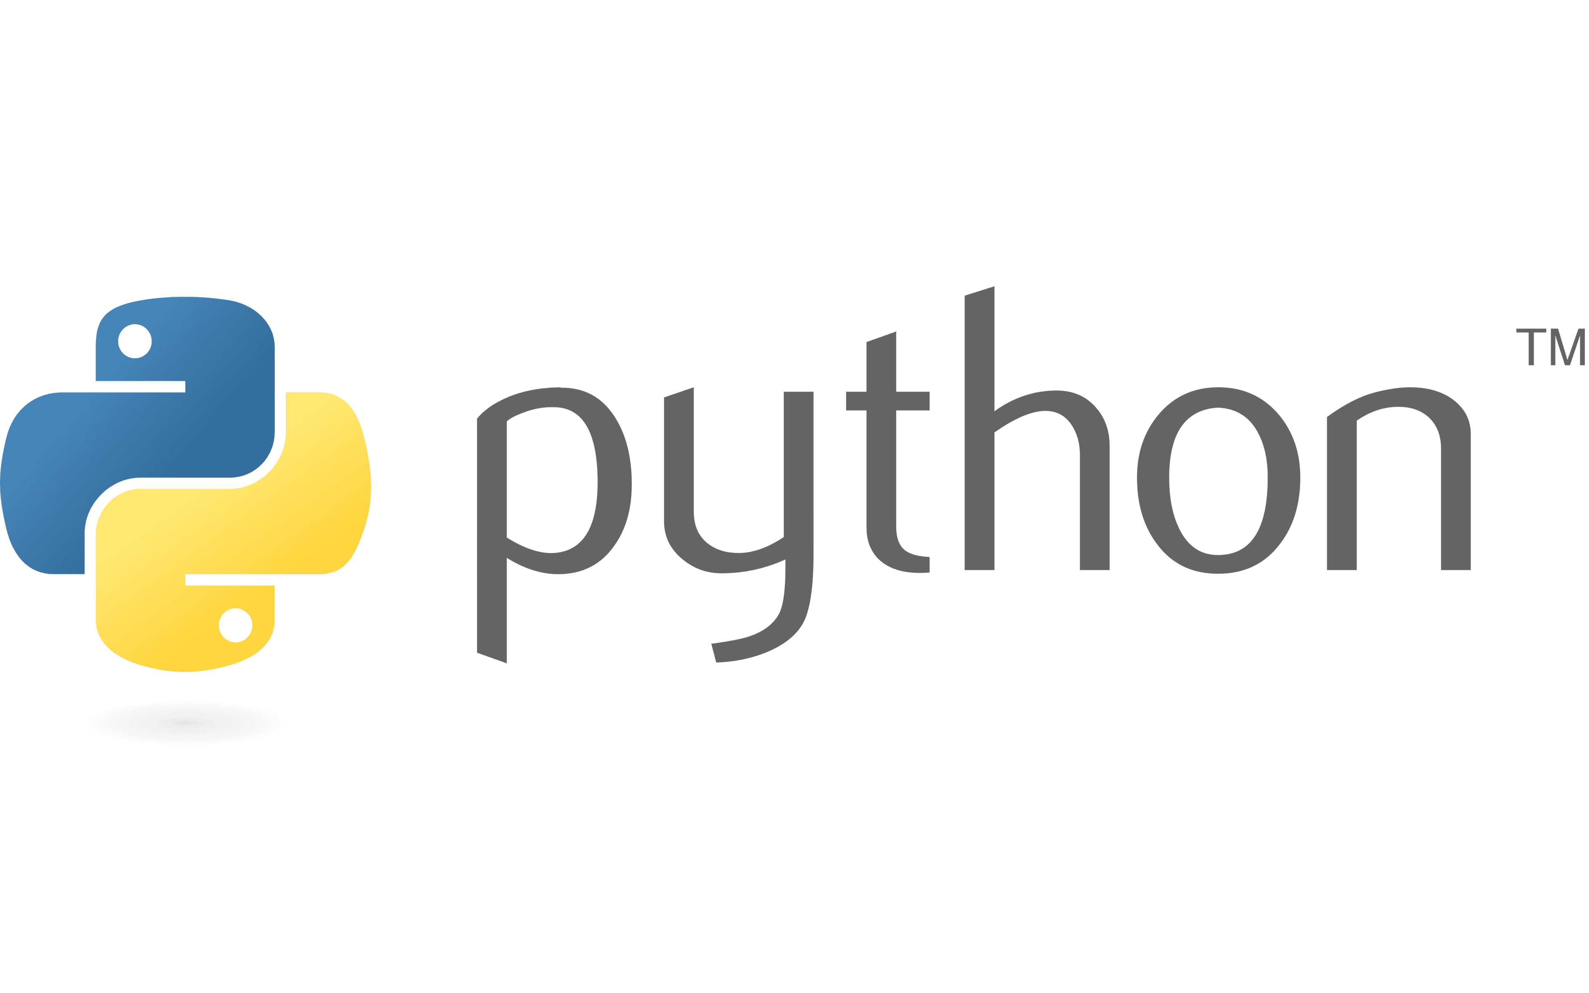
Starting a proportional control session (4 of 4)
Once the trial has started, you can run your Python Script.

Slide 14
Starting a gait profile-based session

Slide 15
Starting a gait profile-based session (1 of 5)

Slide 16
Starting a gait profile-based session (2 of 5)

Slide 17
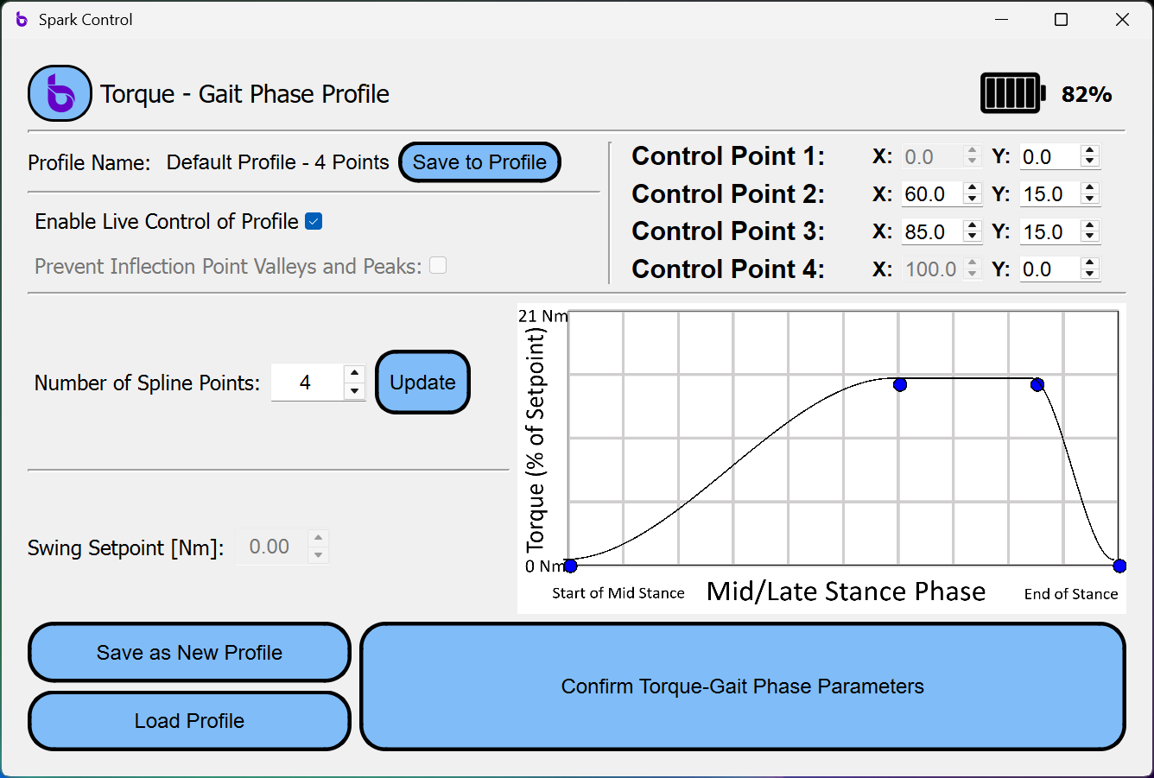
Starting a gait profile-based session (3 of 5)
No changes necessary here

Slide 18
Starting a gait profile-based session (4 of 5)

Slide 19
Starting a gait profile-based session (5 of 5)
Once the trial has started, you can run your Python Script.

Slide 20
Saving data as .csv

Slide 21
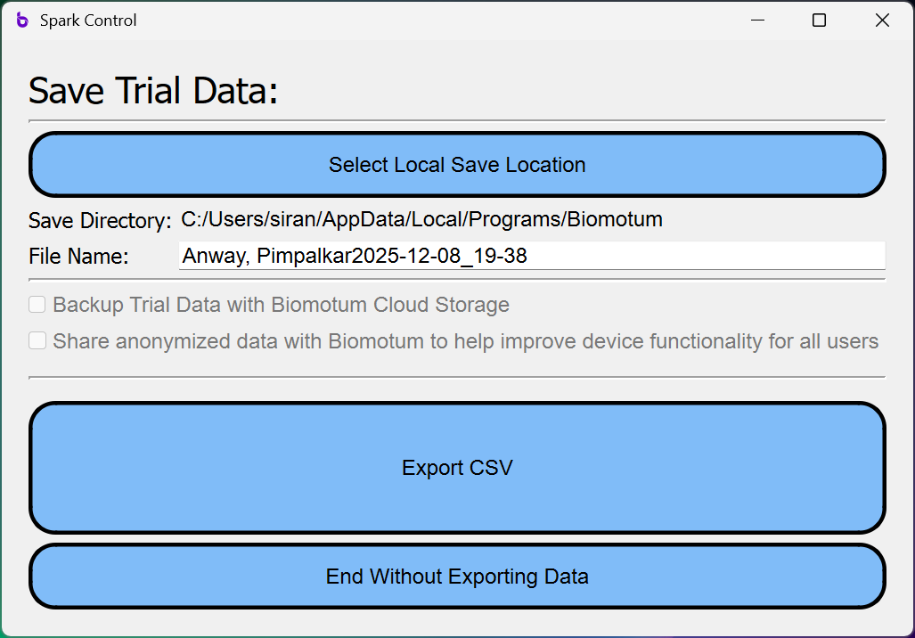
Saving data as .csv

