Slide 1

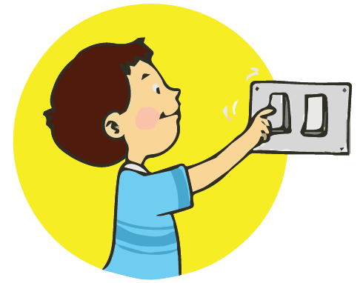

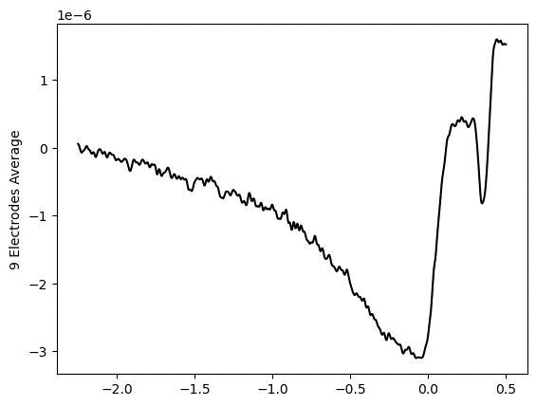
Sees the bulb turn on
Action
Takes some time for it to turn on
Button Press
Light Turning On
EEG
Perceived Time of Button Press
time
Are you predicting the outcome of your action before it even happens?

