Slide 1


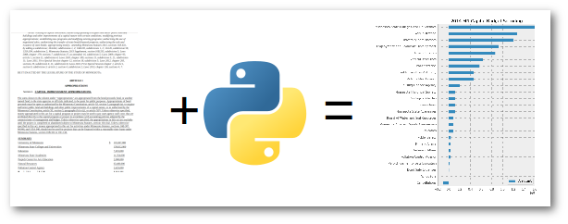
Lyrics Web Scraping and Text Mining Analysis
ECE 143: Group 2
Zhaoyuan He Yihua Yang Qinyan Li Anwesan Pal

Slide 2
Introduction | Web Scraping | Data Cleaning | Data Visualization | Text Mining | Conclusion
Contents
Introduction
Data Visualization
Web Scraping
Text Mining
Data Cleaning
Conclusion

Slide 3
Introduction | Web Scraping | Data Cleaning | Data Visualization | Text Mining | Conclusion
Introduction
Goal:
To study top 100 songs on billboard year-end charts from year 1959 to 2018
Dataset:
Wiki – Billboard year-end 100: https://en.wikipedia.org/wiki/Billboard_Year-End
Years - 1959-2018
Number of songs - 60x100 = 6000
Methodology:
Extract data from various websites
Choose relevant variables, such as artist nationality, lyrics, genre, etc.
Perform Data Cleaning, Analysis and Text Mining

Slide 4
Introduction | Web Scraping | Data Cleaning | Data Visualization | Text Mining | Conclusion
Web Scraping - 4 main components
Part I: Rank, Song, Artist - obtained from Wikipedia
Part II: Nationality - obtained from Wikipedia
Part III: Genres - obtained from DBpedia resources
Part IV: Lyrics - obtained from the Genius database

Slide 5
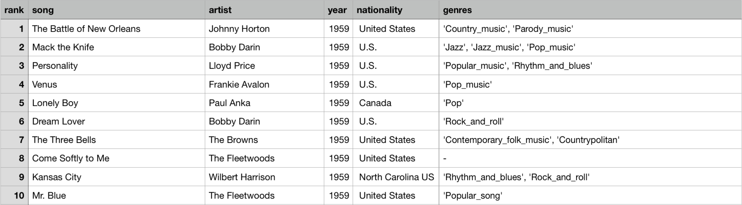
Introduction | Web Scraping | Data Cleaning | Data Visualization | Text Mining | Conclusion
Web Scraping
Data Cleaning Needed!

Slide 6
Introduction | Web Scraping | Data Cleaning | Data Visualization | Text Mining | Conclusion
Data Cleaning
Nationality: Total 128 different nationalities listed by wiki - categorized into 37 nationalities
Genre: Total 489 genres listed by DBpedia - categorized into 17 main genre classes
Lyrics: Removal of periods, punctuations, incomplete words

Slide 7
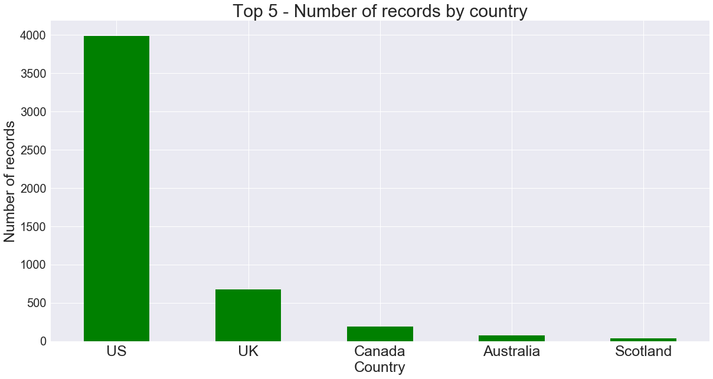
Introduction | Web Scraping | Data Cleaning | Data Visualization | Text Mining | Conclusion
Number of songs
By Country:
US tops the chart!
Notes:
The y-label should have capital C for country
Use green color for plots
spelling of country is wrong in title

Slide 8
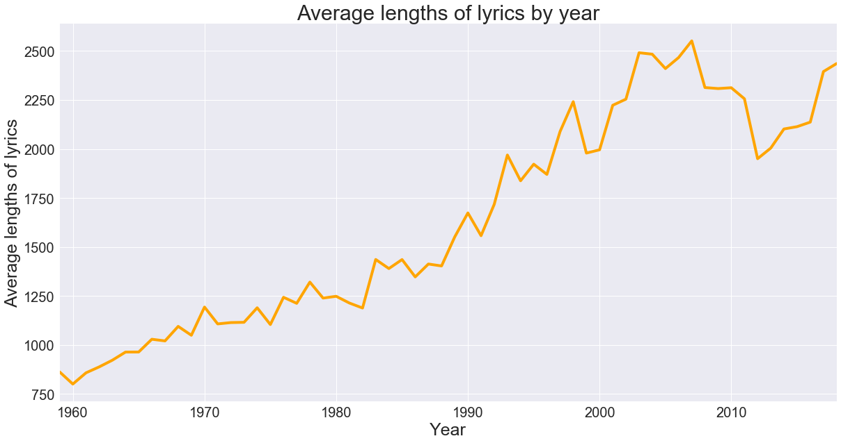
Introduction | Web Scraping | Data Cleaning | Data Visualization | Text Mining | Conclusion
Average length of lyrics
By Year:
Increasing trend!
Notes:
remove number of co

Slide 9
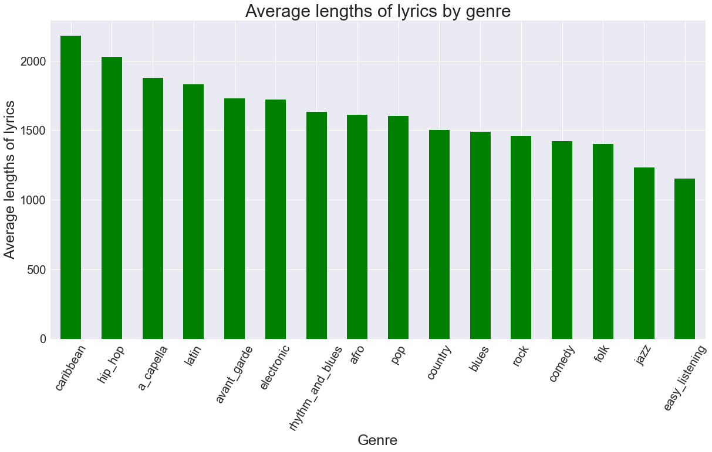
Introduction | Web Scraping | Data Cleaning | Data Visualization | Text Mining | Conclusion
Average length of lyrics
By Genre:
Caribbean music are longest!
Notes:
Average instead of Avg
Color of plots should be green

Slide 10
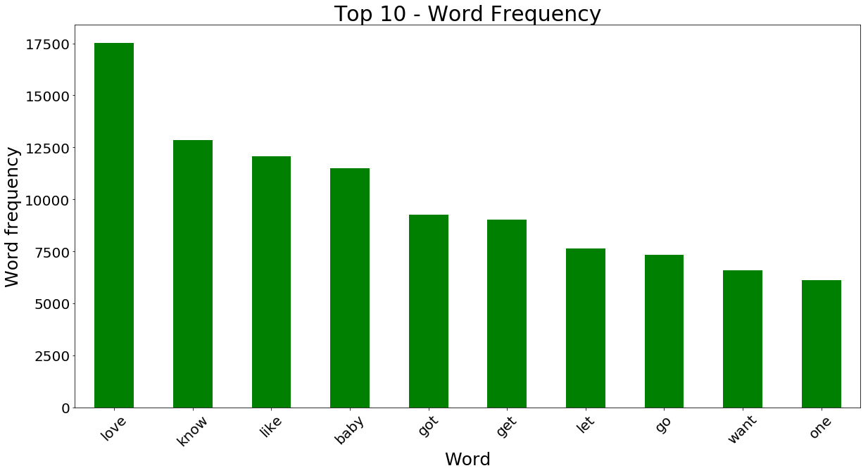
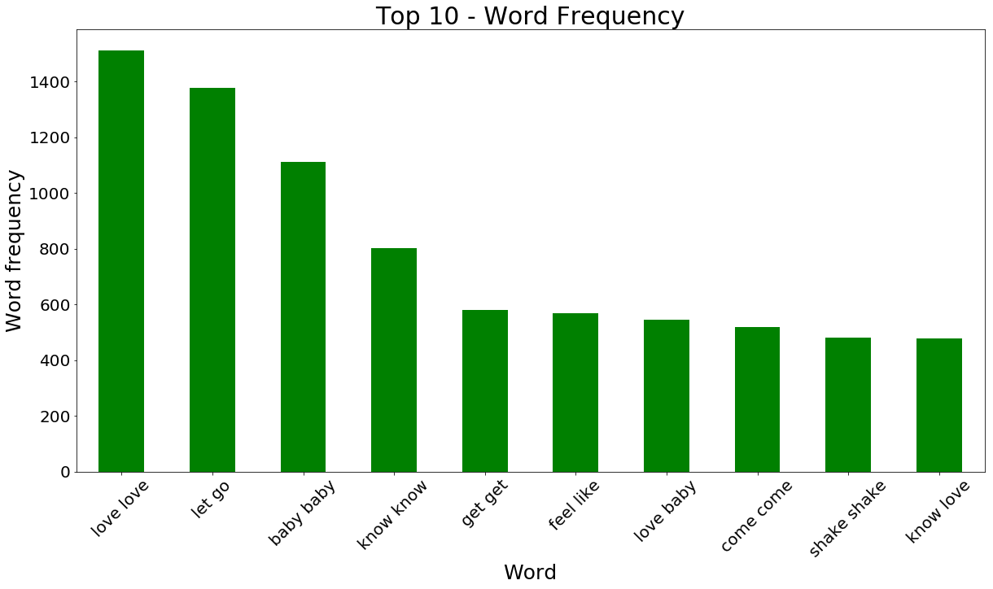
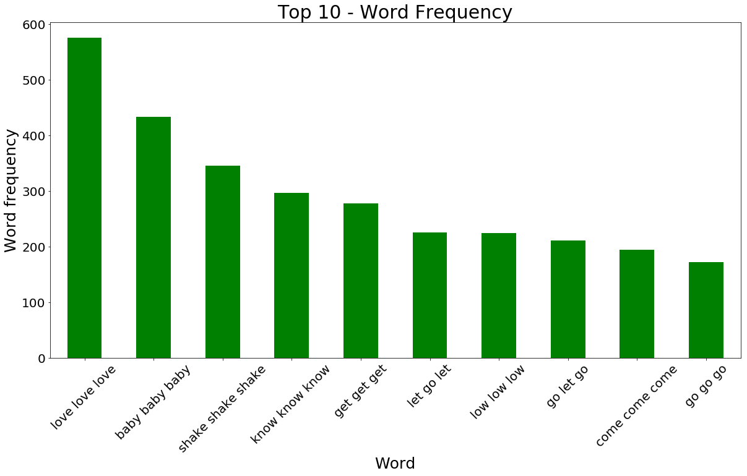
Introduction | Web Scraping | Data Cleaning | Data Visualization | Text Mining | Conclusion
Text Mining
Part I: N-grams -- Most frequent set of words that occur next to each other
Unigram
Bigram
Trigram
love
love love
love love love
Love is the way forward!
Notes:
Color of plot - green
show only top 10

Slide 11
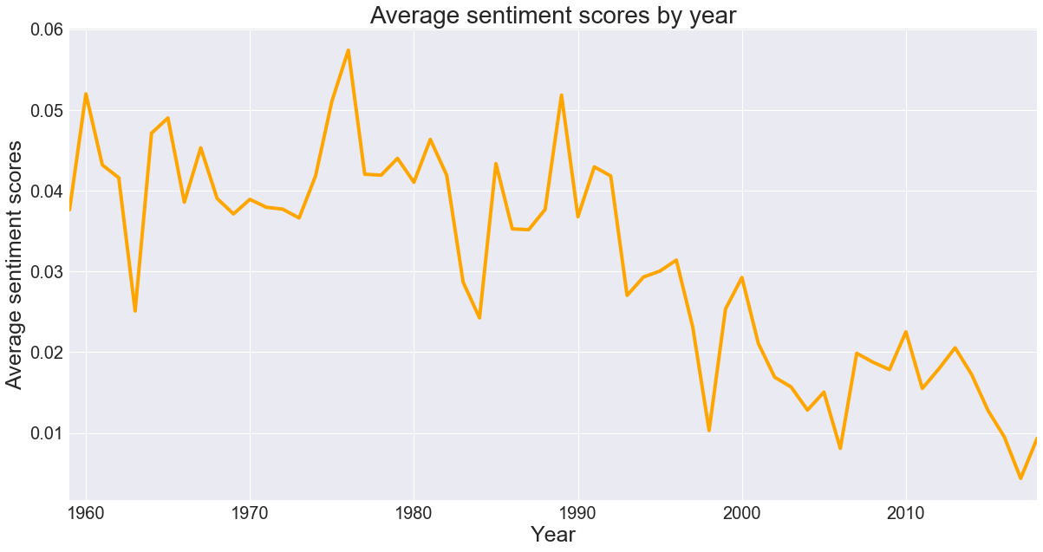
Introduction | Web Scraping | Data Cleaning | Data Visualization | Text Mining | Conclusion
Text Mining
Part II: Sentiment Analysis - Sentiment Intensity Analyzer library
Negative sentiments creeping in!
Notes:
Average instead of Avg
Similar properties to the Visualization by year slide

Slide 12
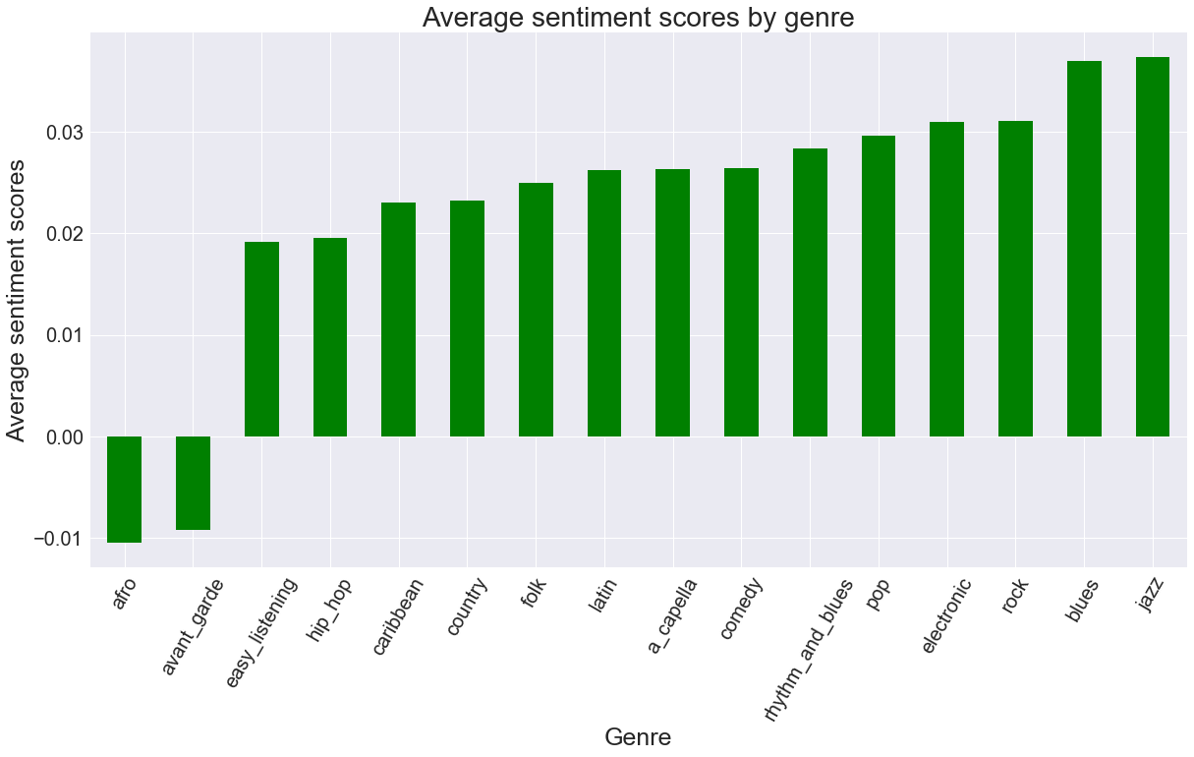
Introduction | Web Scraping | Data Cleaning | Data Visualization | Text Mining | Conclusion
Text Mining
Part II: Sentiment Analysis
Notes:
Average instead of Avg

Slide 13
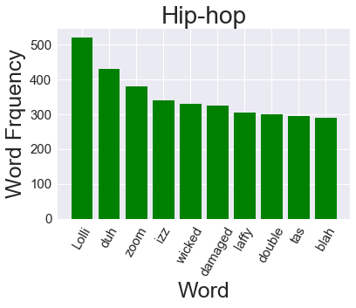
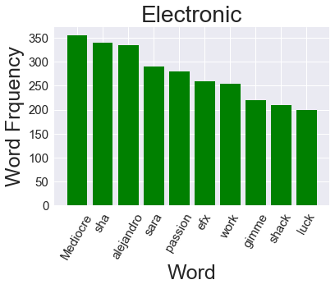
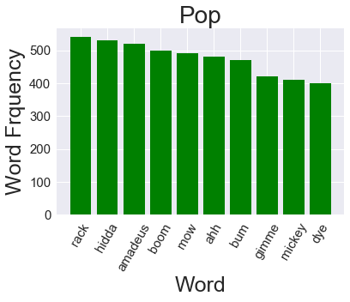
Introduction | Web Scraping | Data Cleaning | Data Visualization | Text Mining | Conclusion
Text Mining
Part III: TF-IDF - Top words encountered for top-3 genres
Hip-hop and Pop have more colloquial word usage!
Notes:
normal plot - not rainbow
only show top 10. scale y axis labels

Slide 14
Introduction | Web Scraping | Data Cleaning | Data Visualization | Text Mining | Conclusion
Conclusion
Data gathered about Top 100 Billboard songs from 1959-2018
Data Cleaning for Lyrics, Nationality, Genre of song
Text Mining - N-gram, Sentiment Analysis, TF-IDF
More Text Mining - Word Cloud, Parts of Speech Analysis

Slide 15
THANK YOU FOR LISTENING!
Any questions?

