Slide 1
Insights to Hadoop Security Threats
______________________________________
Presenter:
Anwesha Das
Peipei Wang

Slide 2
Hadoop
HDFS – Hadoop Distributed File System
Combines cluster's local data into a single namespace
Data replicated to multiple machines
Locality Information to clients
NameNode, DataNodes
MapReduce Engine
Batch Computation Framework
Tasks re-executed on failure
Optimizes for data locality of input
JobTracker, TaskTracker
Oozie Workflow system – Auxillary Service
*
Notes:
*

Slide 3
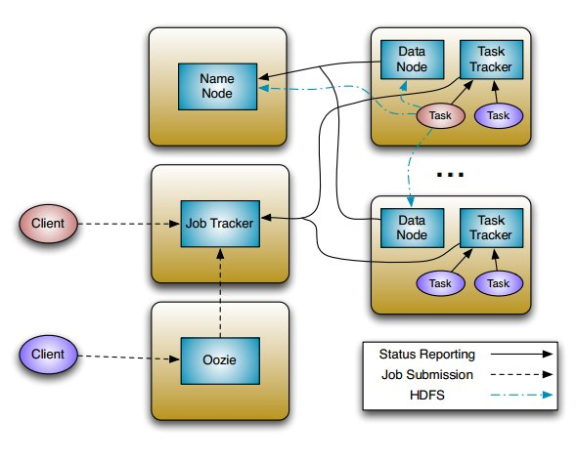
Hadoop High Level Overview

Slide 4
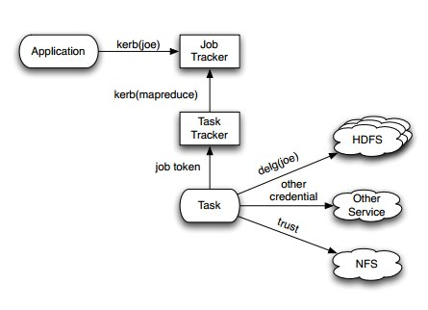
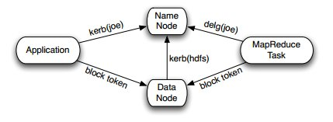
Hadoop High Level Overview

Slide 5
Security Loopholes
LoopHoles
Poor default SASL (Simple Authentication Security Layer)
quality of protection
Incomplete authentication
Lack of data security that flows between the nodes
Security Threats
Unauthorized Release of information
Unauthorized Modification of information
DDOS – denial of services, eavesdropping, replay attack
<number>
Notes:
<number>

Slide 6
Solutions
Authentication
Kerberos
Token (Secret Key)
Delegation, Block access, Job
Security Protocol
RPC, Data Transfer Protocol
Rate Limit
Tokens
SecretKey generated by NameNode, JobTracker
Shared with clients, TaskTracker, DataNodes
BlockAccess, Job token time-stamped for validity
Assume secure channel token passing (Trusted n/w)
<number>
Notes:
<number>

Slide 7
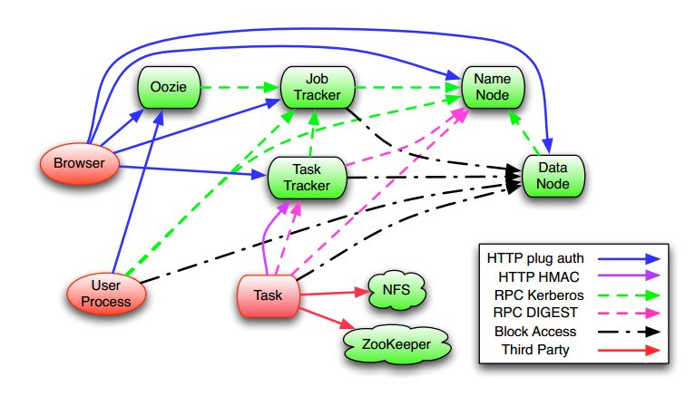
Authentication Flow

Slide 8
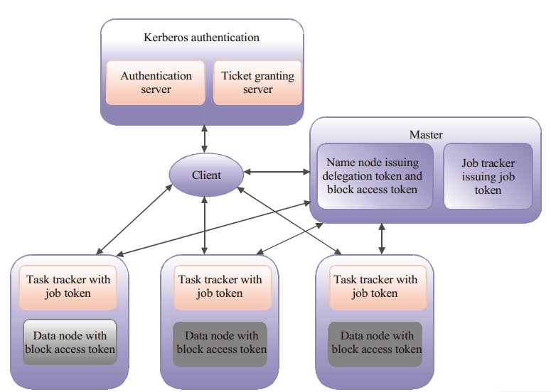
Token Flow
<number>
Notes:
<number>

Slide 9
Attacks ??
DataNodes donot enforce access control
Anyone with block_id can access data blocks
BlockAccess Token shared between all DataNodes
Symmetric Hashing HMAC-SHA1 technique
Attacker with shared key can affect all DataNodes
Affect Integrity
Insecure Channel
Intruder access JobTokens
Modify results of map or reduce tasks
Affect confidentiality

Slide 10
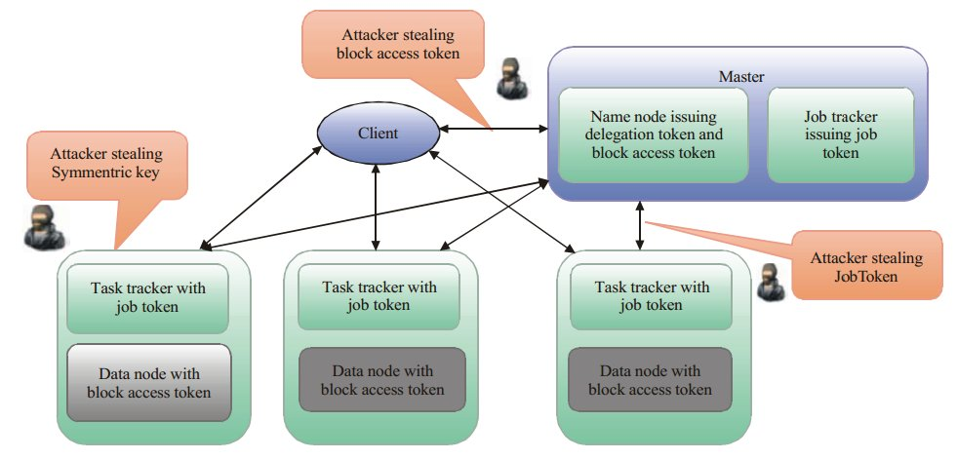
Attack ??
<number>
Notes:
<number>

Slide 11
Circumvention
Solution
Replace HMAC-SHA – Cryptographic Token Encryption
Asymmetric Encryption – Public-Private Key(RSA)
Symmetric Encryption – Private Keys
Refined HMAC-SHA1 technique
Share same secret key, unique secret for every node
instead of the same key

Slide 12
Hadoop Security Work
Hadoop Storage Security
encryption
data-at-rest encryption
encryption on the wire
data in transit-protection
isolation
SELinux
example: secHDFS,VPN-Cubed

Slide 13
Hadoop Security Work
Hadoop Computation Security
authentication
customized mapper and reducer
differential privacy
trusted computing
example:Airavat, TPM-based attestation

Slide 14
Our Plan of Work
Secure Deployment of Source code version 0.21x
Identify security breaches ??
DOS – resource exhaustion
DOS – Node availability
Issues with usage of tokens, access control, rate-limit?
Help from bug repository !!
Does the attack exist across multiple versions of Hadoop?
Evaluation

Slide 15
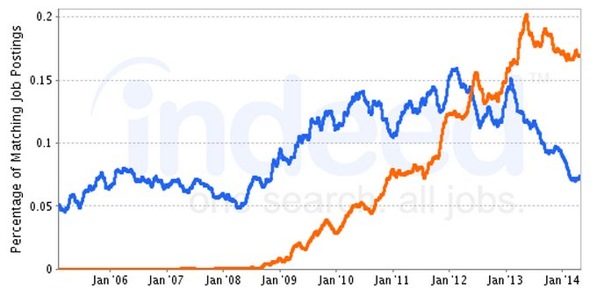
Relevance of our research
Encryption hot topic in hadoop
Third party innovation for security integration
Lot more to be done, future Roadmap exists !!
Security least (secondary) concern but booming usage
Absence of comprehensive evaluation of threats !!
*

Slide 16
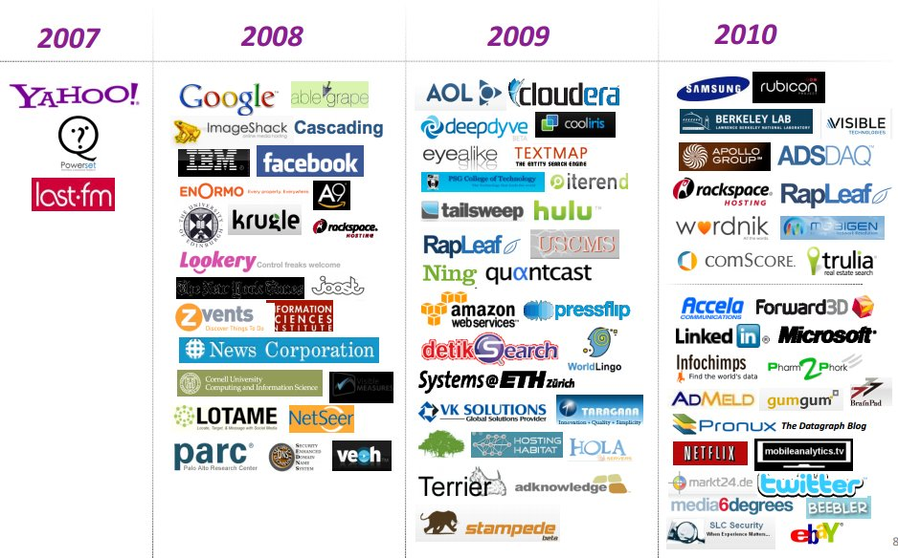
Is our work Important ??

Slide 17
Is our work Important ??
Risk in Investments in hadoop based products ?
Current degree of vulnerabilities?
Estimate of current status and existing code bugs ??

Slide 18
References
A New Solution of Data Security Accessing for Hadoop Based on CP-ABE
A security framework in G-Hadoop for big data computing across distributed Cloud data centres: http://www.sciencedirect.com/science/article/pii/S002200001400018X
A survey on security issues in service delivery models of cloud computing:
http://www.sciencedirect.com/science/article/pii/S1084804510001281
Access Control for Sensitive Data in Hadoop Distributed File Systems: www.thinkmind.org/download.php?articleid=infocomp_2013_4_10_10050.pdf
Access Security on Cloud Computing Implemented in Hadoop System: http://www.slideshare.net/jgabriellima/access-security-on-cloud-computing-implemented-in-hadoop-system
Addressing cloud computing security issues: http://www.sciencedirect.com/science/article/pii/S0167739X10002554
Airavat: Security and Privacy for MapReduce. http://static.usenix.org/events/nsdi10/tech/full_papers/roy.pdf
Security in Data Intensive Computing Systems: http://link.springer.com/chapter/10.1007%2F978-1-4614-1415-5_16

Slide 19
References
Danger in the clouds: http://www.sciencedirect.com/science/article/pii/S1353485808701405
HIGH LEVEL VIEW OF CLOUD SECURITY: ISSUES AND SOLUTIONS: http://airccj.org/CSCP/vol4/csit42005.pdf
Horus: Fine-Grained Encryption-Based Security for Large-Scale Storage: https://www.usenix.org/conference/fast13/technical-sessions/presentation/li_yan
Implement a reliable and secure cloud distributed file system:
Implementation of identity based distributed cloud storage encryption scheme using PHP and C for Hadoop File System:
Managing Data Access on Clouds: A Generic Framework for Enforcing Security Policies:
Privacy in Map Reduce Based Systems: A Review: http://ijcsmc.com/docs/papers/February2014/V3I2201475.pdf
Secure Hadoop with Encrypted HDFS: http://link.springer.com/chapter/10.1007%2F978-3-642-38027-3_14
Security and privacy for storage and computation in cloud computing: http://www.sciencedirect.com/science/article/pii/S0020025513003320
Security and privacy in cloud computing: A survey

Slide 20
References
SpongeFiles: Mitigating Data Skew in Mapreduce Using Distributed Memory: http://doi.acm.org/10.1145/2588555.2595634
The security of cloud computing system enabled by trusted computing technology:
Toward Data Confidentiality via Integrating Hybrid Encryption Schemes and Hadoop Distributed File System
Towards a More Secure Apache Hadoop HDFS Infrastructure: http://link.springer.com/chapter/10.1007%2F978-3-642-38631-2_64
Towards a trusted {HDFS} storage platform: Mitigating threats to Hadoop infrastructures using hardware-accelerated encryption with TPM-rooted key protection: http://www.sciencedirect.com/science/article/pii/S2214212614000155

Slide 21
References
Hadoop Security Design
http://carfield.com.hk:8080/document/distributed/hadoop-security-design.pdf
Adding Security to Apache Hadoop
http://br.hortonworks.com/wp-content/uploads/2011/10/security-design_withCover-1.pdf
Improving Security of Parallel Algorithm Using Key Encryption Technique: http://scialert.net/qredirect.php?doi=itj.2013.2398.2404&linkid=pdf
Integrating Hadoop with Kerberos: http://www.kerberos.org/events/2010conf/2010slides/2010kerberos_owen_omalley.pdf
Securing Big Data Hadoop:
http://www.ijcsit.com/docs/Volume%205/vol5issue02/ijcsit20140502263.pdf
Hadoop Based Defense Solution to Handle Distributed Denial of Service (DDoS) Attacks: http://file.scirp.org/Html/4-7800161_34629.htm
HDFS Encryption: http://blog.cloudera.com/blog/2014/06/project-rhino-goal-at-rest-encryption/
Oozie: http://dl.acm.org/citation.cfm?id=2443420

Slide 22
References
Just Add Kerberos? Really?
https://media.blackhat.com/bh-us-10/whitepapers/Becherer/BlackHat-USA-2010-Becherer-Andrew-Hadoop-Security-wp.pdfl
Big Data Security: The Evolution of Hadoop Security Model: http://www.infoq.com/articles/HadoopSecurityModel
Hadoop CDH – Cloudera: http://www.cloudera.com/content/cloudera/en/products-and-services/cdh.html
Hadoop: https://hadoop.apache.org/docs/r2.4.1/hadoop-project-dist/hadoop-hdfs/HdfsUserGuide.html
Big Data Security Gap: Protecting the Hadoop Cluster: http://www.zettaset.com/wp-content/uploads/2014/04/zettaset_wp_security_0413.pdf
Security Implementation in Hadoop:
http://search.iiit.ac.in/cloud/presentations/28.pdf
Hadoop Security Today and Tomorrow:
http://hortonworks.com/blog/hadoop-security-today-and-tomorrow/
LoopHoles in Hadoop: http://readwrite.com/2014/08/13/hadoop-slow-security-issues-still-popular

Slide 23
References
Towards a More Secure Apache Hadoop HDFS Infrastructure: http://link.springer.com/chapter/10.1007/978-3-642-38631-2_64
Big Data Security: http://www.sciencedirect.com/science/article/pii/S1353485812700636
A Novel Authentication Service for Hadoop in Cloud Environment: http://ieeexplore.ieee.org/xpls/abs_all.jsp?arnumber=6354591
Cloud Security in MapReduce: http://hackedexistence.com/downloads/Cloud_Security_in_Map_Reduce.pdf
Taking hadoop Security to the next level: http://www.securityweek.com/bigger-data-smaller-problems-taking-hadoop-security-next-level

Slide 24
Thank you

