Slide 1

PARSHVANATH CHARITABLE TRUST’S
A.P. Shah Institute of Technology
Thane, 400615
Academic Year: 2022-23
Department of Computer Engineering
CLOUD COMPUTING MINI PROJECT
PROJECT TITLE: Online Library Management System
BY
135– Aastha Patil (20102083)
127– Anwesha Pani (20102063)
85– Soham Kulkarni (20102018)

Slide 2
Abstract :
The Library Management System project is a web-based application developed using PHP and MySQL, which enables the automation of the entire library management process. This system provides a user-friendly interface that allows library staff to manage books, members, and circulation efficiently.
The Online Library Management System provides features such as a user-friendly interface, online cataloging, book reservation, book issuing, book return, and fine management.

Slide 3
Cloud services used :
GCCP VM Instance
GCCP IAM.
Google Cloud Storage
Google Cloud SQL

Slide 4
GCCP VM Instance
Google Cloud VM instance is a cloud computing service offered by Google Cloud Platform that allows you to create and manage virtual machines in the cloud.
A VM instance is a virtual machine that runs in Google Cloud Platform and provides you with computing resources such as CPU, memory, and storage.

Slide 5
GCCP IAM
Google Cloud Identity and Access Management (IAM) is a service that provides centralized management and control of user access to Google Cloud Platform resources. With IAM, users can assign roles and permissions to users, groups, and service accounts to grant access to specific resources in a secure and compliant manner.
IAM supports fine-grained access control, role-based access control (RBAC), and identity federation. IAM can help organizations to improve security, simplify access management, and reduce costs.

Slide 6
Google Cloud Storage
Google Cloud Storage is a cloud-based object storage service offered by Google Cloud Platform. With Cloud Storage, users can store and access data from anywhere in the world through a simple web interface or API. The service provides automatic redundancy and durability, and also supports data versioning, lifecycle management, and access control using IAM.
Cloud Storage can be used for a variety of use cases, such as storing backups, archiving data, serving static content for websites, and storing multimedia content.

Slide 7
Google Cloud SQL
Google Cloud SQL is a fully-managed relational database service offered by Google Cloud Platform. With Cloud SQL, users can create, manage, and scale MySQL, PostgreSQL, and SQL Server databases in the cloud. The service provides automatic replication, backups, and patches, and also supports high availability with automatic failover. Cloud SQL can be integrated with other Google Cloud Platform services such as Compute Engine, App Engine, and Kubernetes Engine.
The service provides security features such as encryption at rest and in transit, and supports fine-grained access control using IAM. Users can monitor and optimize database performance with built-in monitoring and alerting features.

Slide 8
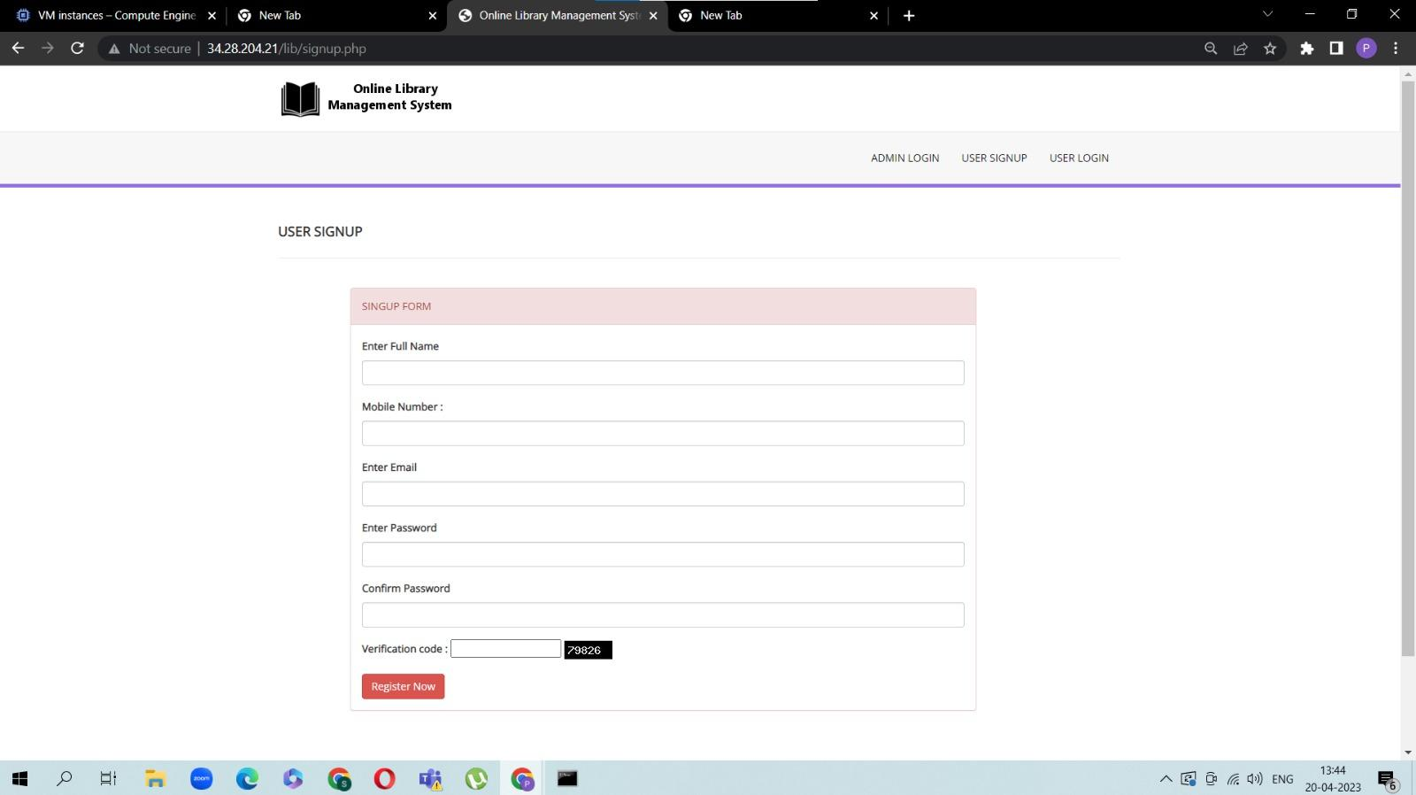
Implementation :

Slide 9
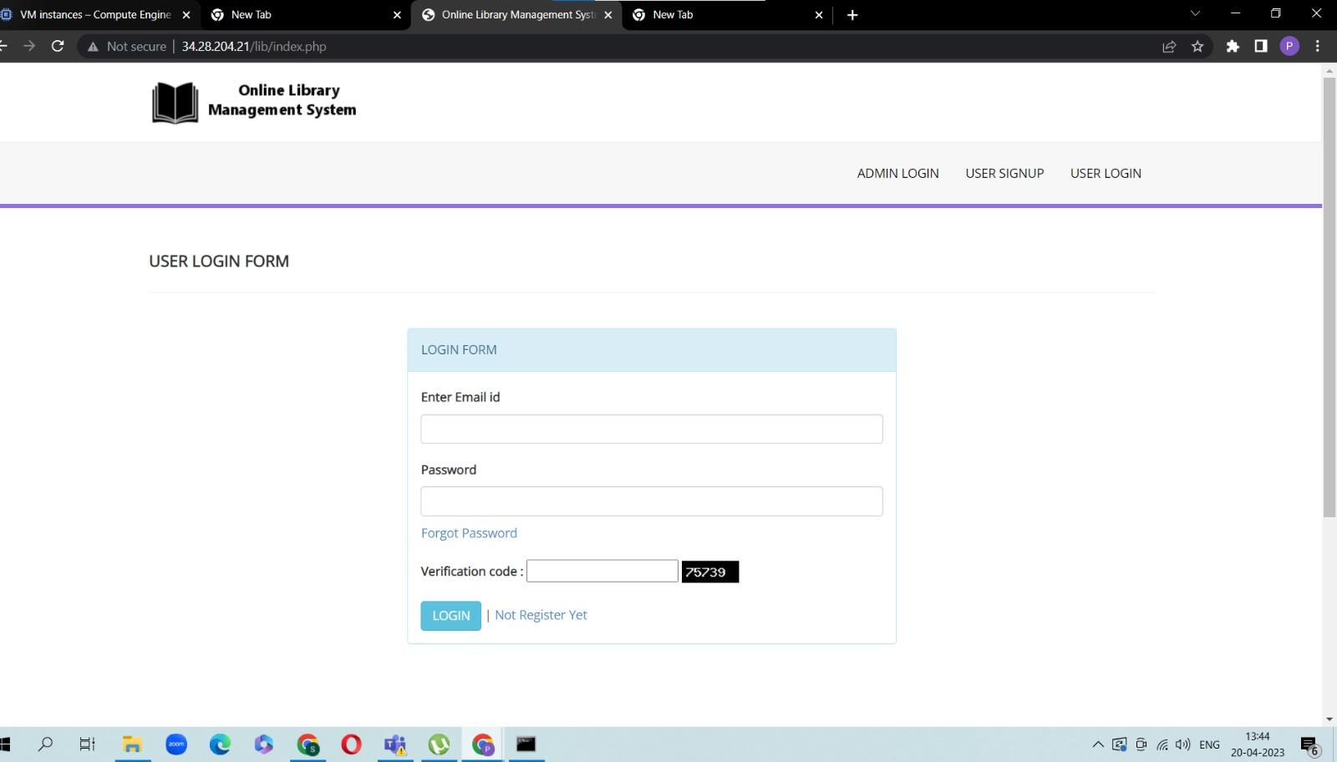
Implementation :

Slide 10
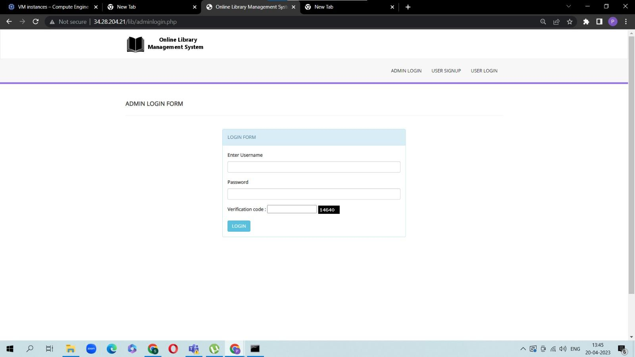
Implementation :

Slide 11
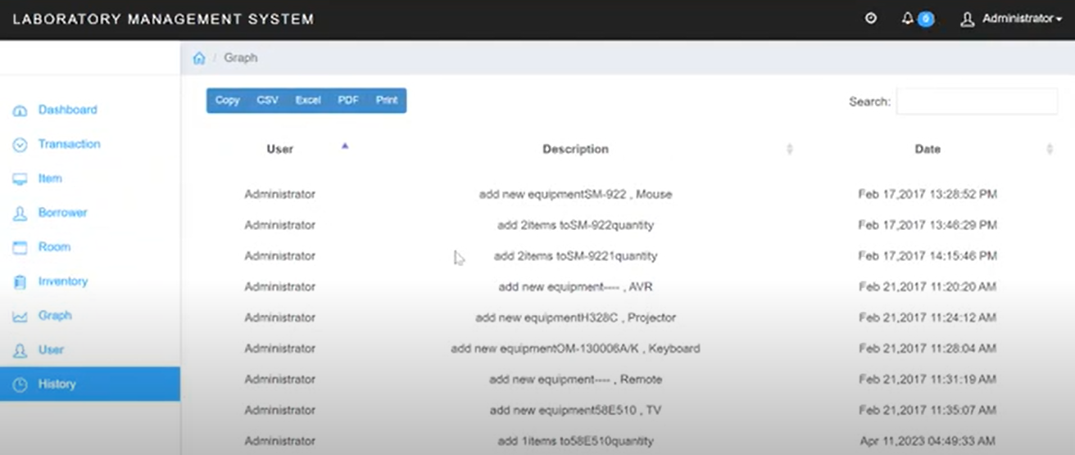

Slide 12
Conclusion -
The Online Library Management System project deployed on Google Cloud is an opportunity for individuals to learn about cloud computing and its various components. The project provides hands-on experience in building a complex system using virtual machines, database servers, and cloud storage. Individuals can learn how to create a virtual machine instance, set up a database server, and optimize the system for better performance.

