Slide 1

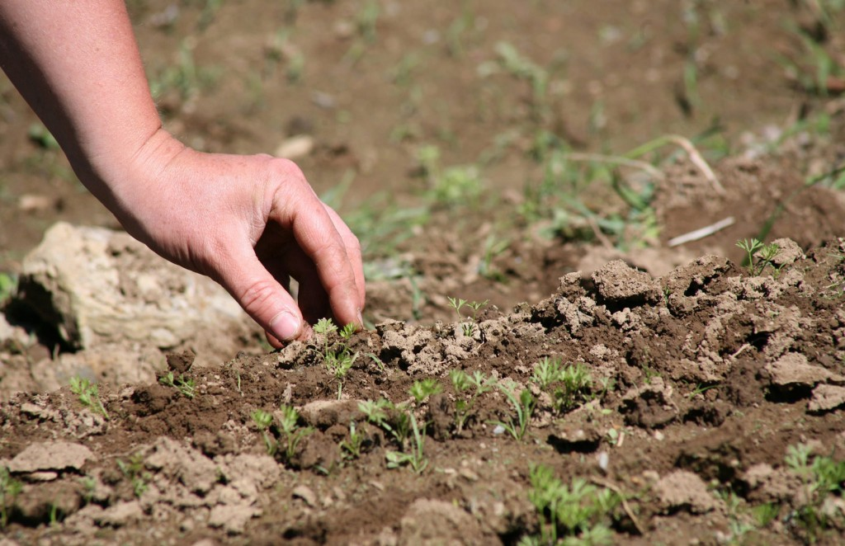
SUSTAINABLE AGRICULTURAL GROWTH ACHIEVED WITH ADVANCED COMPUTING TECHNOLOGIES
BY ANWESHA SINHA J K LAKSHMIPAT UNIVERSITY 2015BTECHCSE029

Slide 2
CONTENTS
INTRODUCTION
COMPUTER AND AGRICULTURE
SUSTAINED GROWTH FOR AGRICULTURAL SECTOR
INDEPENDENCE ON WATER
REUSE OF WASTE WATER
LAND ISSUES
CONTRIBUTION OF AGRICULTURE TO INDIAN ECONOMY
CONCLUSION

Slide 3
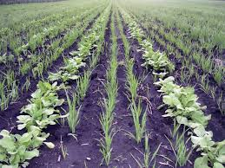
INTRODUCTION
THEME OF SUSTAINABLE AGRICULTRAL GROWTH
WHY WE NEED IT
COMPUTER AND AGRICULTURE
HOW CAN WE ACHIEVE IT

Slide 4
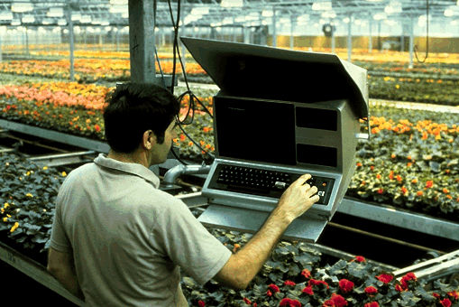
COMPUTER AND AGRICULTURE
Computer Aided Design(CAD)
Geographic Information System(GIS)
Global Positioning System (GPS)
Support Vector Machine (SVM)
E-Agriculture (e-NAM)
Express Nitrogen Guru(ENG)
Drones

Slide 5
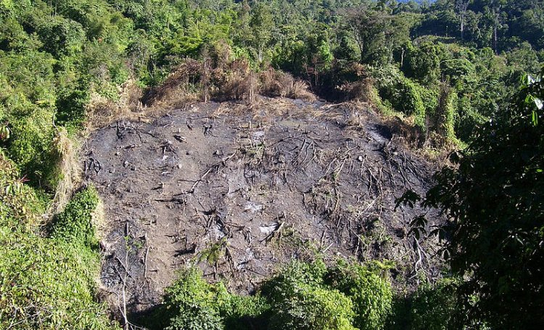
SUSTAINED GROWTH FOR AGRICULTURE SECTOR
By Avoiding Soil Erosion, Water Pollution, Depletion Of Nutrients From The Soil
Monoculture
Shifting Cultivation
Pesticides, fertilizers

Slide 6
INDEPENDENCE ON WATER
The lands which have low water table may use deep rooted crops like tomatoes, squash, melons.
Use of some crops which do not use much water like tapery-beans which can adopt to drought conditions, black-eyed pea, okra, snap beans, pole beans which can be set to small amounts of moisture.
In general, vegetables ought to be given no more water than they need rather than as much as they can withstand.

Slide 7
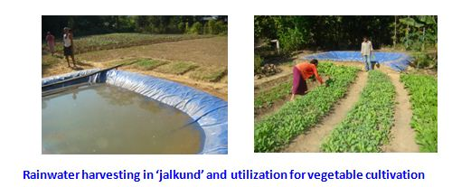
REUSE OF waste WATER
Purification Of water
Rainwater Harvesting
Pradhan-Mantri-Krishi-Sin chai-Yojana

Slide 8
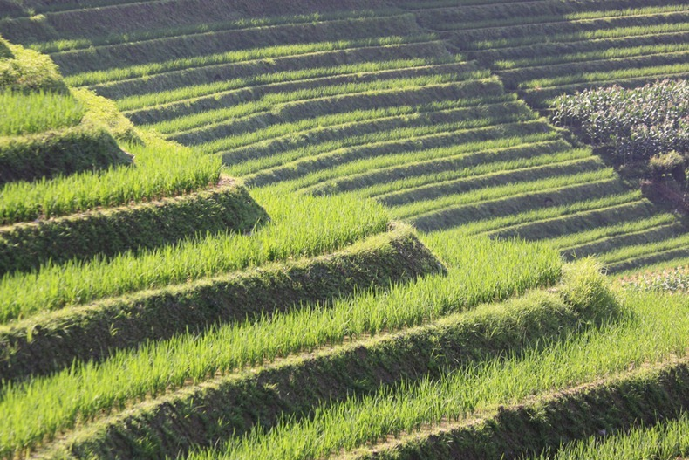
LAND ISSUES
Crop Rotation
Multiple Cropping
Terrace Farming
Cover Crops
Monoculture
Shifting Cultivation

Slide 9
CONTRIBUTION OF AGRICULTURE IN INDIAN ECONOMY
India ranks 2nd worldwide in farm output. Yet GDP from agriculture in India decreased to 3743.90 IND billon in the 2nd quarter of 2016 from 4235.42 IND billion in the 1st quarter of 2016 as reported by the Central Statistical Organization, India. India saw a boom rise in agriculture during Green Revolution around 1967 to 1978.

Slide 10
CONCLUSION
ICAR is educating 24 lakh farmers(biogas, vermicomposting, polyhouse construct)
New schemes (soil health card)
“Need 2nd Green Rev. without any delay, should start from eastern India”

Slide 11
THANK YOU

Slide 12
Any Question ?

