Slide 1
PROJECT MANAGEMENT APP (REPLICA)
BY: ANWESHA SINHA
2015BTECHCSE029
SEMESTER-V

Slide 2
MOTIVATION OF THIS APP (WHY?)
I felt the need of such an app when I was leading my team for a competition.
Project Management helps in reminding us all our projects and everything related to it like connecting and contacting member groups. It also supports gantt chart.
It is simple to manage and use.
For students who have excuse of forgetting their assignments.
For teachers who have lot of work to manage at a time.

Slide 3
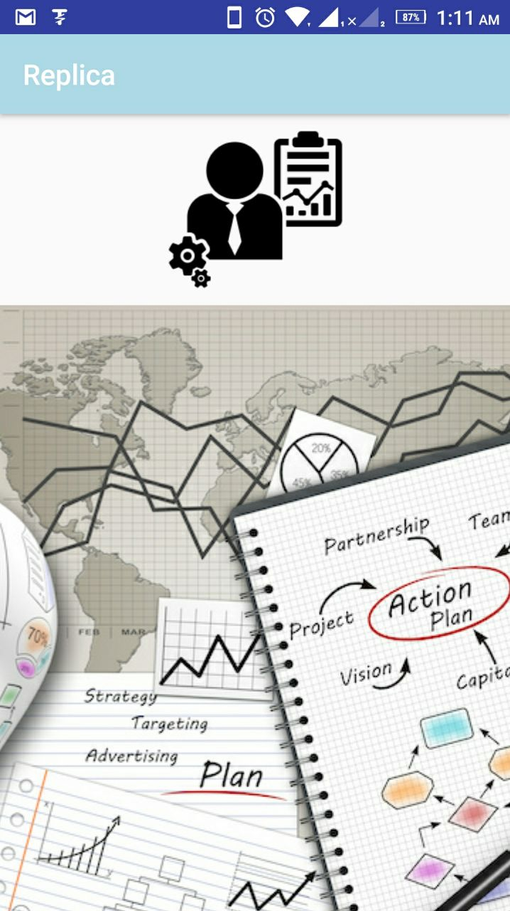

Let The App Talk For Itself
1st glance
1st page

Slide 4
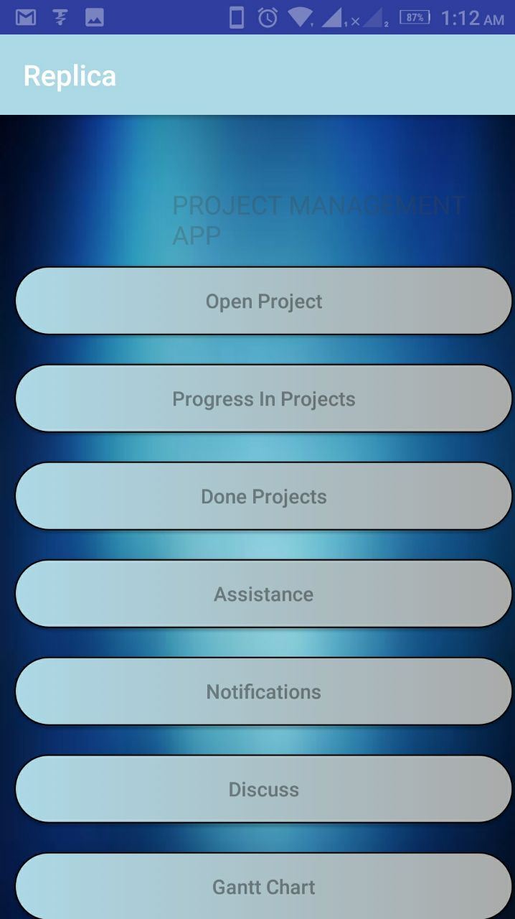
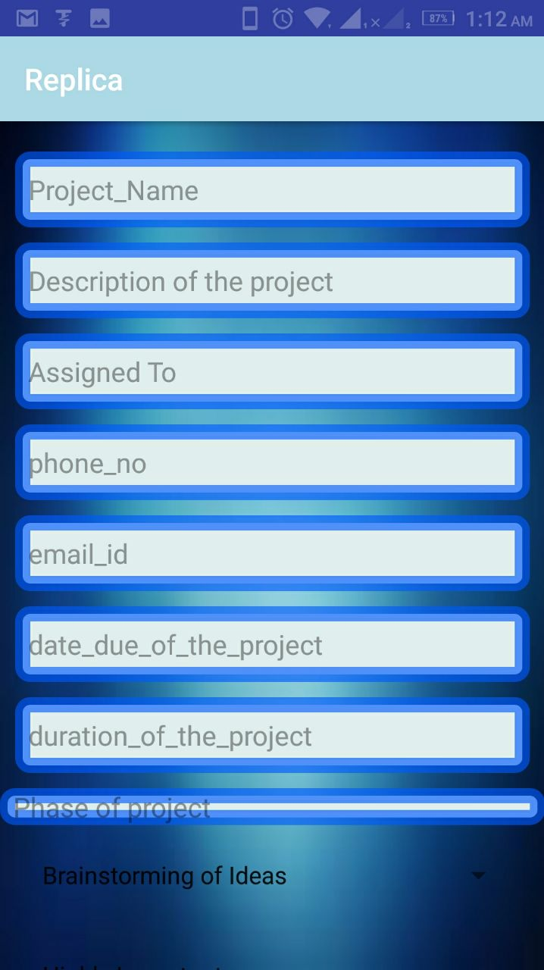
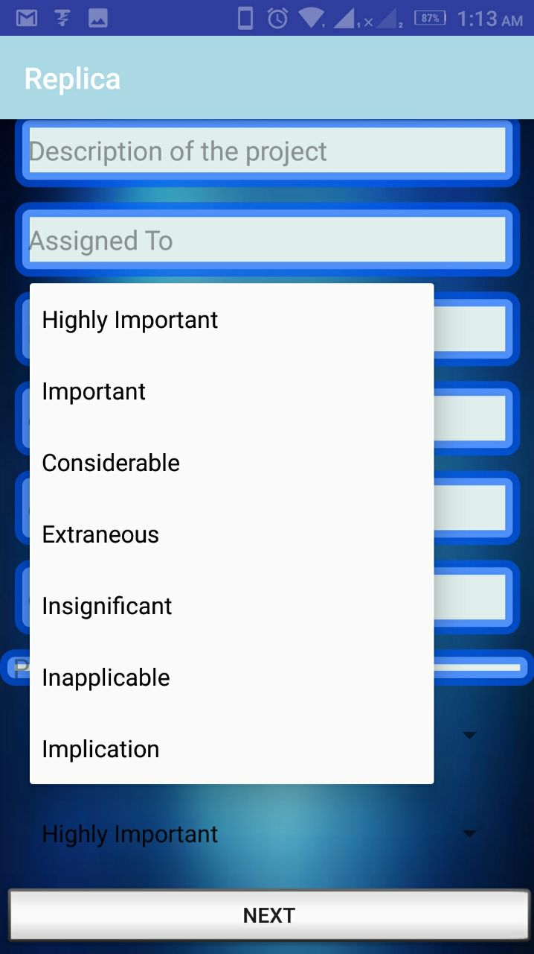

Slide 5
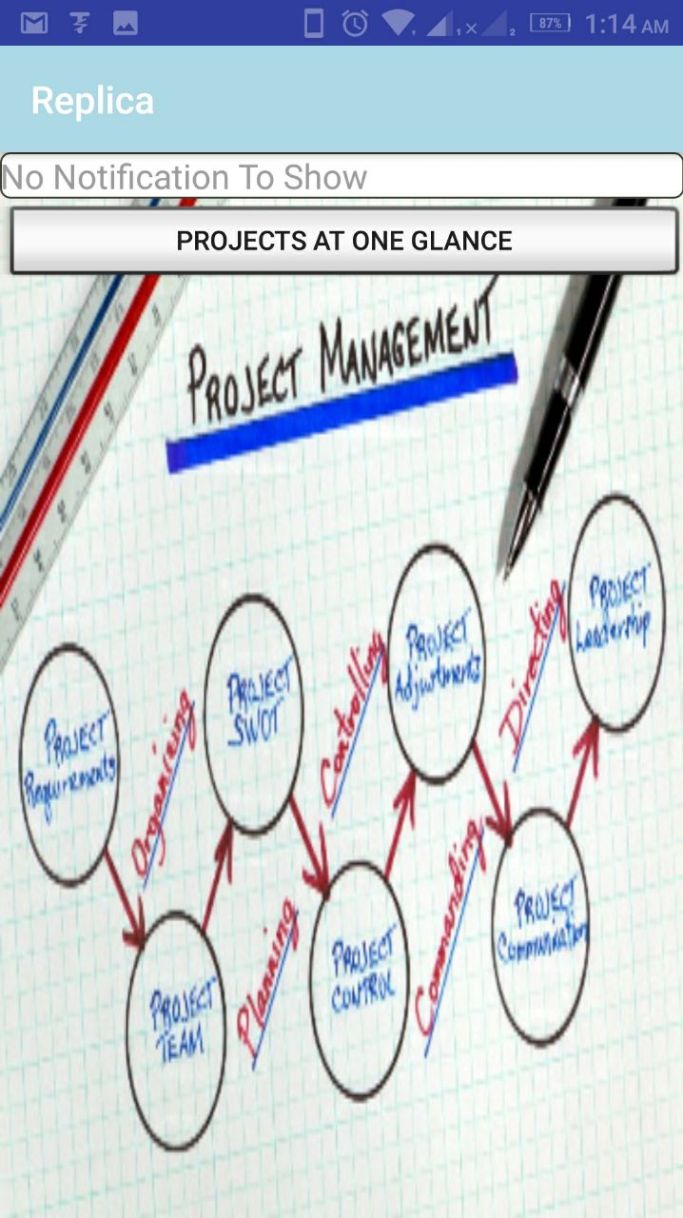
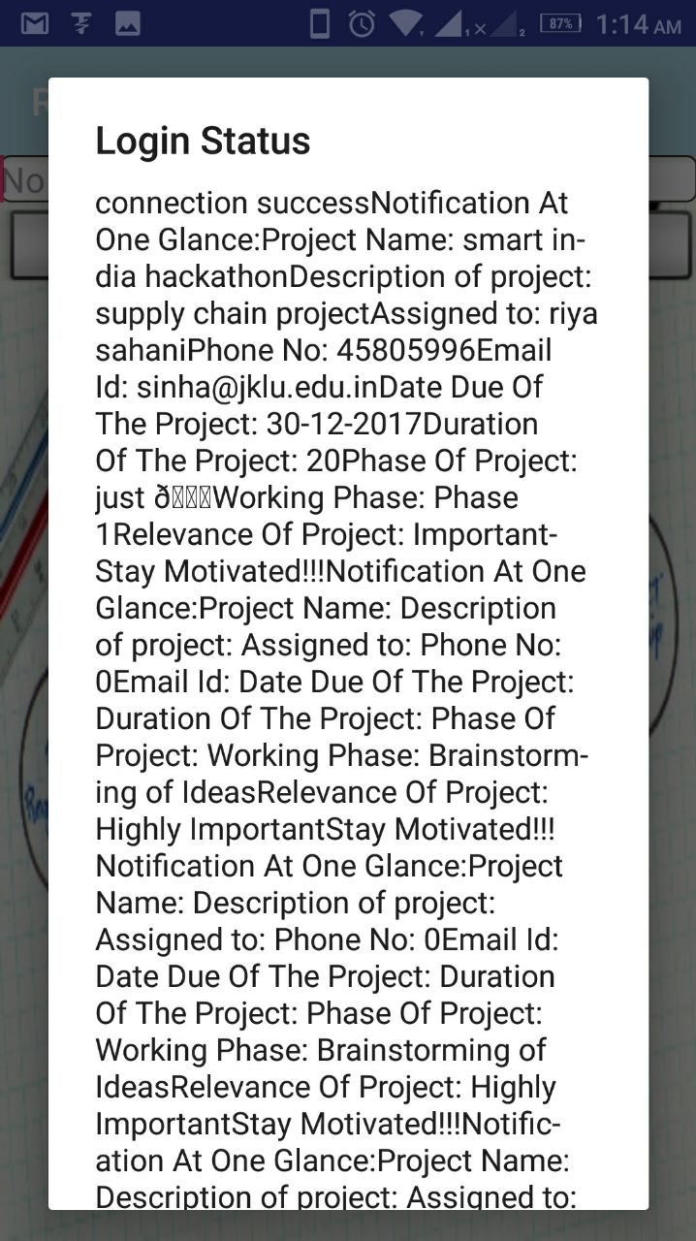

Slide 6
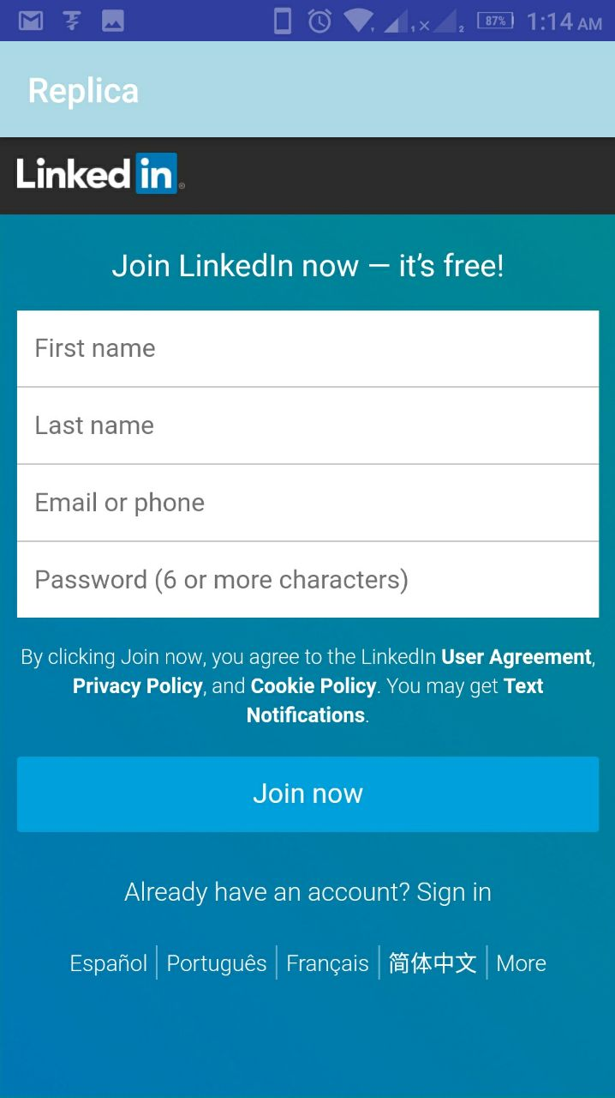
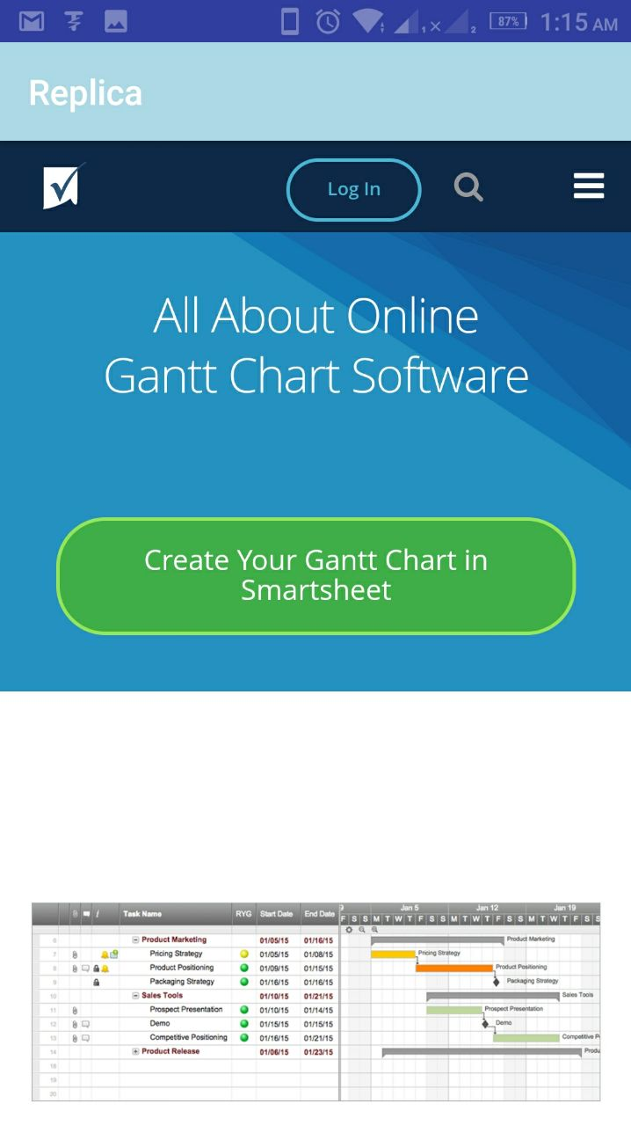
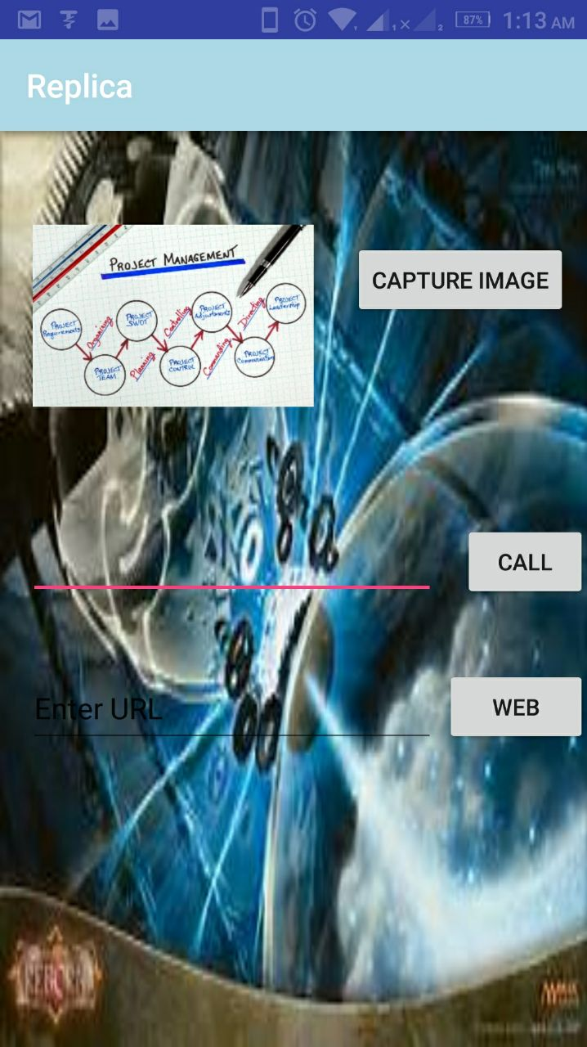
Linking With Necessary Supports

Slide 7
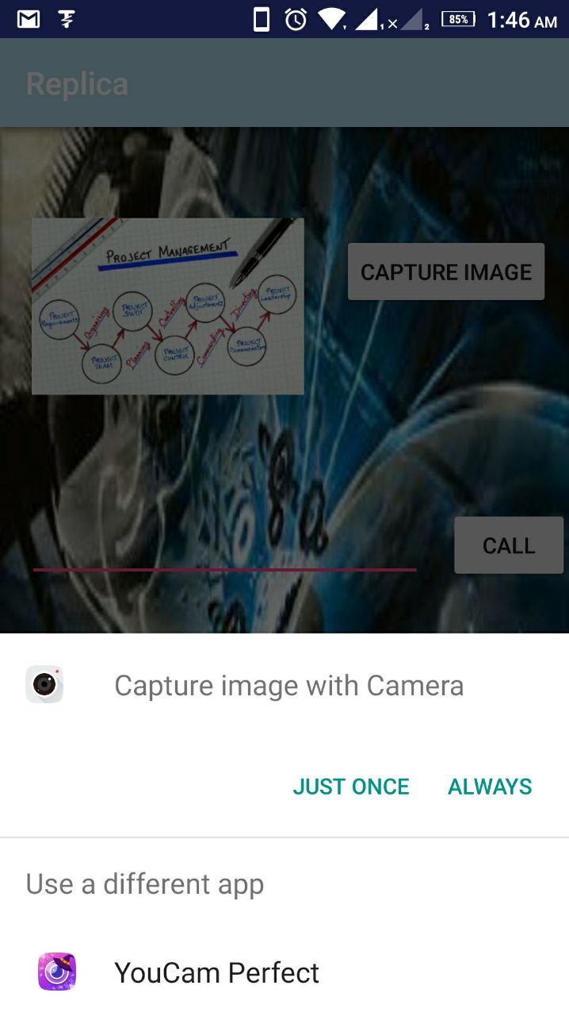
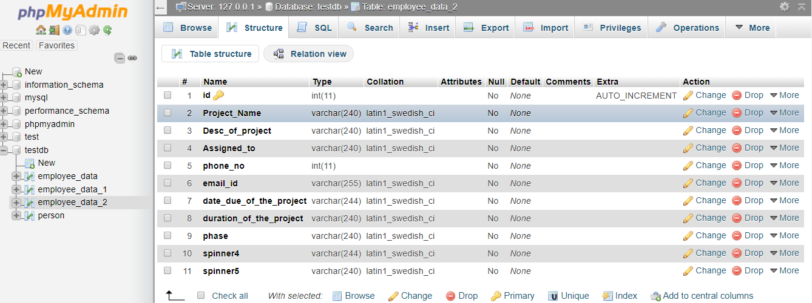
Replica Backend

Slide 8
Future Scope
Make the app more smooth and efficient to work to help people manage their work efficiently by adding features like alarm clocks, notification to that particular assignee through mail.

Slide 9
THANK YOU

