Slide 1
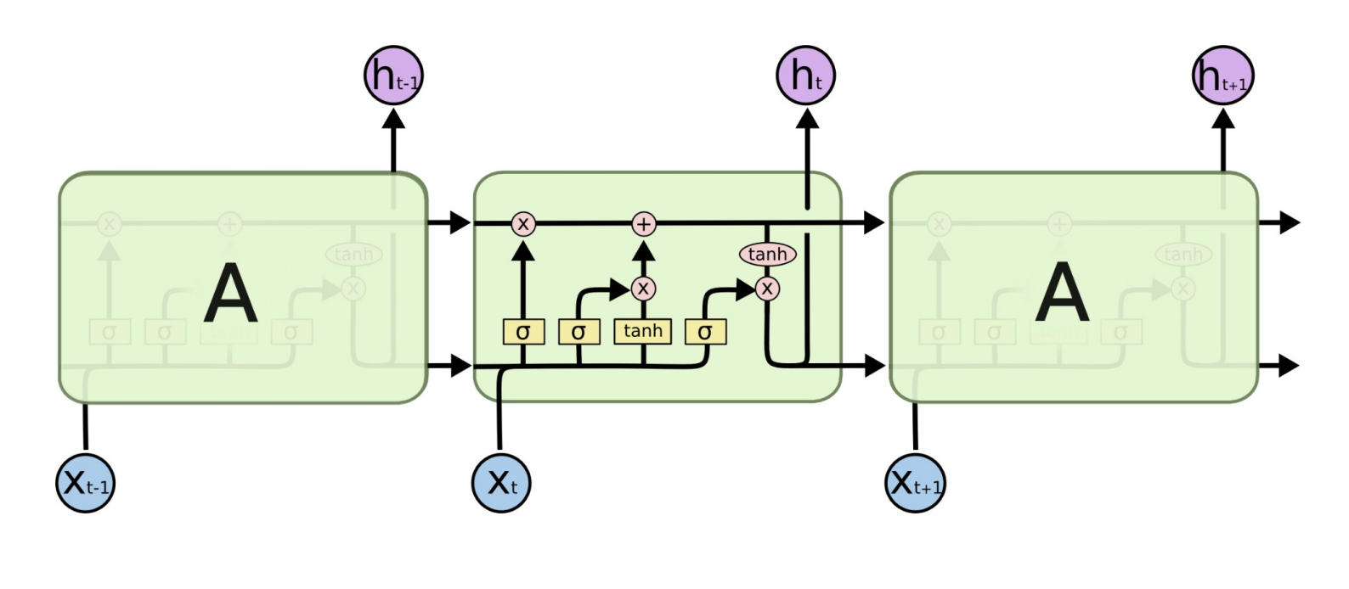
Input
Embedding
Sparse Dropout
LSTM w/ Dropout
Fully Connected Layer (Sigmoid)
Output

