Slide 1
RELATIONAL DATABASE DESIGN
MediTrack
Hospital patient management, modeled as a connected MySQL database.

Slide 2

One database for the patient journey
A relational system keeps clinical and operational context together.
One connected system
Connects patients, doctors, appointments, prescriptions, and billing in one relational system.
One operational view
Supports scheduling, treatment records, payment tracking, and management reporting.
PATIENT JOURNEY · ONE SYSTEM

Slide 3





The schema is organized around five core tables
Appointments is the operational connector between identity, care, and payment.
Appointments
Patients
Billing
Identity and contact details
Doctors
Prescriptions
Payment and invoice records
Specialties, fees, experience
Clinical follow-through

Slide 4
Relationships keep the data consistent
Primary and foreign keys make the patient journey traceable.
TABLE · PK
TABLE · PK
Patients
CENTRAL TABLE · FK
Doctors
1 patient can book many appointments
Appointments
1 doctor can attend many appointments
Operational link between patients and doctors
DOWNSTREAM RECORDS · FK
DESIGN INTENT
Appointments → Prescriptions: one visit can produce multiple medicines
Appointments → Billing: intended as one bill per appointment
The one-bill rule is design intent, not enforced by a UNIQUE key.

Slide 5
Normalization reduces duplication as the system grows
REPEATED DATA
NORMALIZED DESIGN
Appointment records
Reference the source tables
Patient and doctor details appear again and again.
Primary keys identify records; foreign keys connect related tables.
Store facts once. Reference them where they are needed.
Result
Apply normalization to simplify updates and protect reporting accuracy.
A normalized design keeps updates local and reporting dependable.

Slide 6
SQL turns the schema into operational answers
Start with a question, then choose the query pattern that matches it.
01
02
03
04
Filter
Join
Group
Extend
Find appointments after a date or payments by method.
Trace medicines from a patient through an appointment.
Compare revenue by payment method or specialization.
Surface above-average bills and cumulative revenue.
WHERE date > ...
JOIN prescriptions
GROUP BY method
OVER (...)

Slide 7
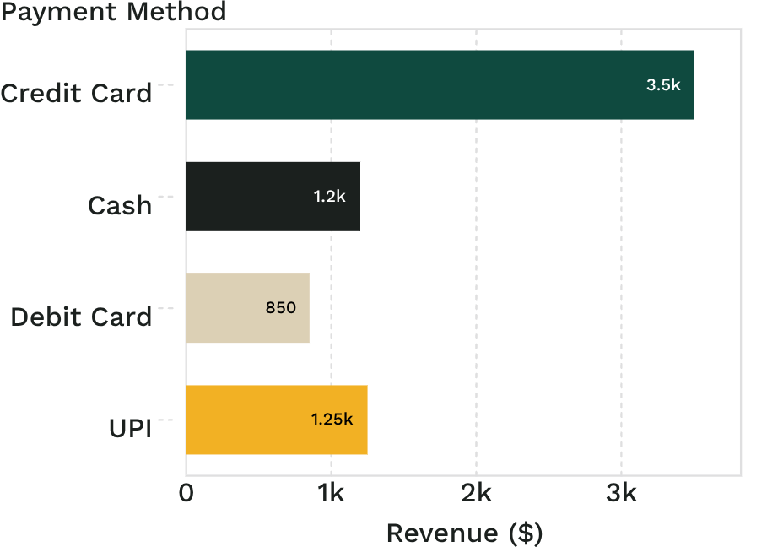
The sample dataset supports realistic analysis
20
15
PATIENTS
DOCTORS
10
13
REVENUE BY PAYMENT METHOD
COMPLETED APPOINTMENTS
PRESCRIPTION RECORDS
Billing records total $6,800. Average billing amount: $680.

Slide 8
Queries reveal patterns beyond simple lookups
The same records support comparisons, rankings, and multi-row findings.
01
02
03
04
Specialization
Patient
Prescriptions
Payment
Oncology generated the highest specialization revenue: $1,000.
Patient 10 had the highest total billed amount: $1,000.
Three appointments resulted in more than one medicine.
Credit Card processed the most transactions: 4.

Slide 9
Indexes and views make the database easier to use
Performance and reuse belong in the design, not only in the queries.
INDEX
UNIQUE INDEX
Appointments.Patient_ID
Patients.Email
Speeds up patient-based appointment searches.
Protects email uniqueness.
VIEW
VIEW
HighValueBills
RevenueSummary
Exposes bills above $700 as a reusable view.
Packages payment-method totals for reporting.

Slide 10

MediTrack demonstrates a practical relational design
The system stays understandable as its questions become more useful.
Separate tables keep operational data understandable.
Relationships support scheduling, prescriptions, and billing in one workflow.
SQL queries turn raw records into management insight.
Next step: enforce the one-bill-per-appointment rule with a UNIQUE constraint and extend the dataset for broader testing.
MEDITRACK · RELATIONAL DESIGN

Slide 11


