Slide 1
Kiva Crowdfunding: A Machine Learning Analysis
Andrea Piolini, Caroline Sklaver, Anwesha Tomar, Sandra Valdes Salas

Slide 2
Background
"Kiva.org is an online crowdfunding platform to extend financial services to poor and financially excluded people around the world. Kiva lenders have provided over $1 billion dollars in loans to over 2 million people."
Dataset of loans issued over the last two years:
https://www.kaggle.com/kiva/data-science-for-good-kiva-crowdfunding

Slide 3
Data
Column descriptions:
idUnique - ID for loan
funded_amount - The amount disbursed by Kiva to the field agent(USD)
loan_amount - The amount disbursed by the field agent to the borrower(USD)
activity - More granular category
sector - High level category
useExact - usage of loan amount
country - Full country name of country in which loan was disbursed
region - Full region name within the country
posted_time - The time at which the loan is posted on Kiva by the field agent
disbursed_time - The time at which the loan is disbursed by the field agent to the borrower
funded_time - The time at which the loan posted to Kiva gets funded by lenders completely
term_in_months - The duration for which the loan was disbursed in months
lender_count - The total number of lenders that contributed to this loan
borrower_genders - Comma separated M,F letters, where each instance represents a single male/female in the group
repayment_interval – monthly, bullet,
loan_theme_id - Unique ID for loan theme
loan_theme_type - General description of the loan theme category
Merged MPI data
MPI – Multidimensional Poverty Index

Slide 4
Goals
Determine the most important features
Build a model to predict the loan amount
Build a model to predict repayment interval

Slide 5




Data Cleaning and Processing
Countries: grouped 87 countries into 14 groups dividing them by world region​. Eventually we decided to focus on Latin America.
Activities: grouped over 160 activities into 14 groups dividing them by sector (i.e. education, healthcare). ​
Borrowers’ gender: the "borrowers_gender" column includes the gender of all the people who benefitted from a specific loan – hence many entries contains both males and females.
Split the column into two columns that count the number of males and females that benefitted from each loan.

Slide 6



Data Cleaning and Processing (continued)
Unnecessary columns: dropped 13 columns that were not relevant for the analysis.
Identifiers : dropped all the identifiers in the dataset.
Missing data: the datasets does not have many NaNs. We dropped them for all the categorical variables.
Categorical variables: converted categorical data into numerical data using One-Hot-Encoder.

Slide 7
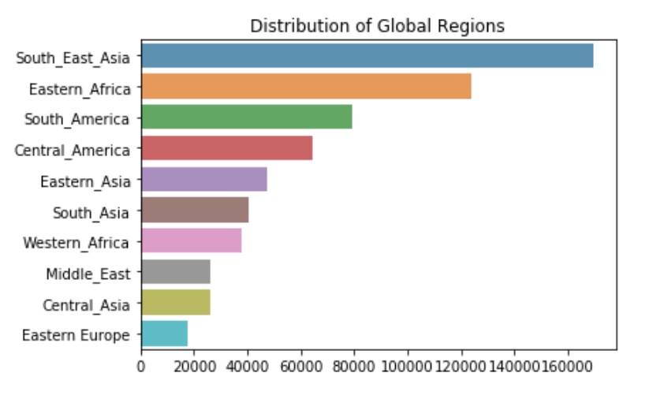
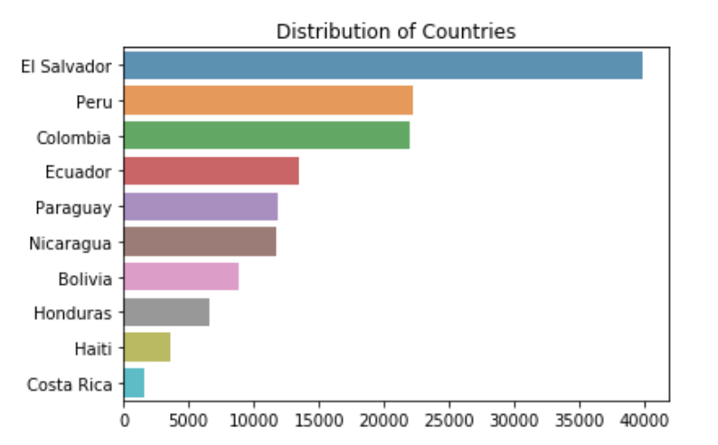
Exploratory Data Analysis

Slide 8
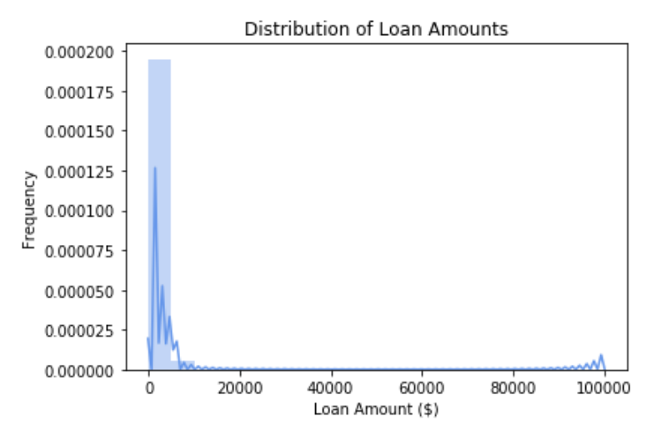
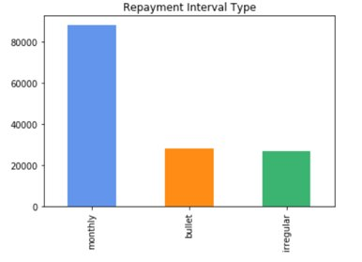
EDA
Target Variables

Slide 9
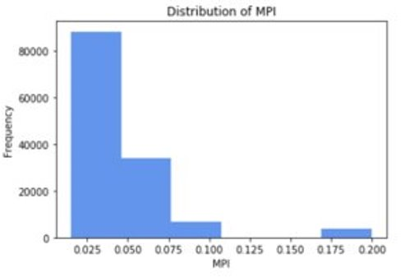
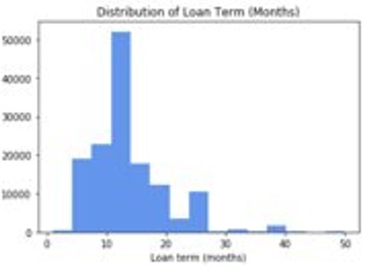
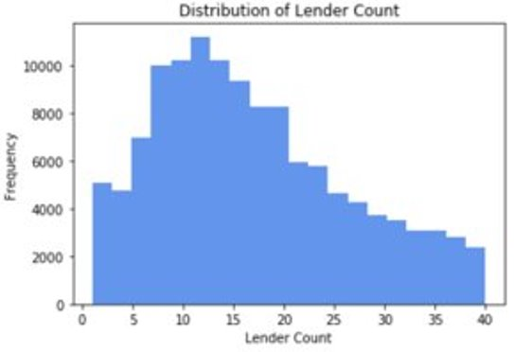
EDA
Feature Variables

Slide 10
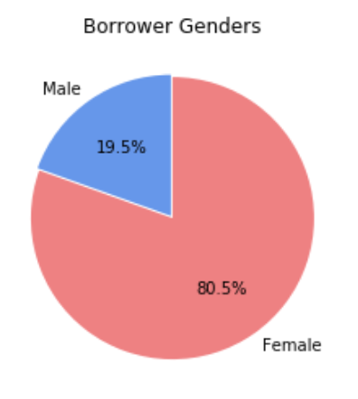
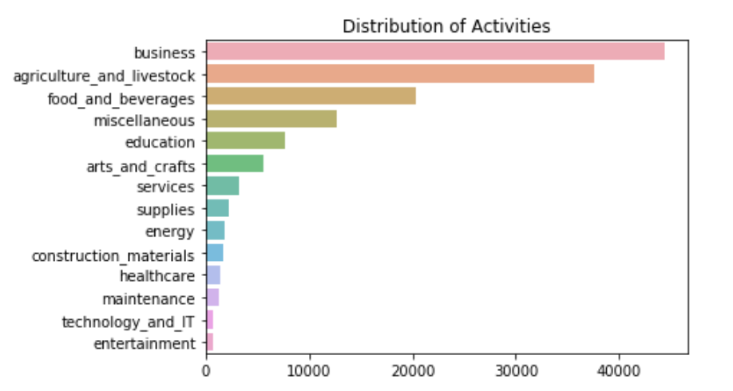
EDA
Feature Variables Cont.

Slide 11
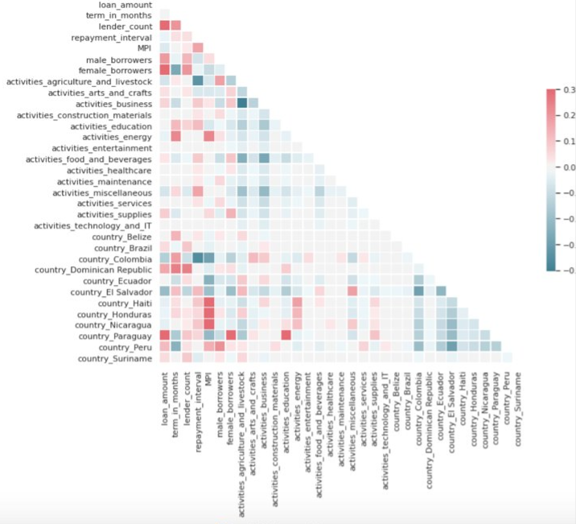
Correlation Plot

Slide 12
Regression
Loan amount
Data preparation: removed all the rows with outliers in the target value
Models: Decision Tree Regressor, Random Forest Regressor and MLP Regressor
Hyperparameter Tuning
Calculated the Negative Mean Squared Error

Slide 13

Best score | Best parameter | Best Estimator
-46771.35 | Min samples leaf: 1 Min samples split: 20 | Random Forest Regressor
-47037.97 | Learning rate: 0.01 Alpha: 0.0001 | MLP Regressor
-48428.85 | Max depth: 25 Min samples leaf: 30 Min samples split: 100 | Decision Tree Regressor

Slide 14
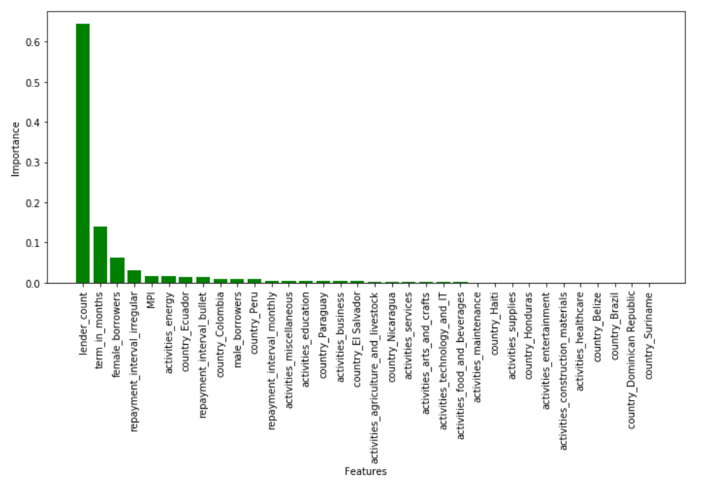
Regression: feature importance

Slide 15
Regression: Analysis of the Results
Why it did not work properly?
The explanatory power of most of the features is low.
The dataset might contain poor-quality data (i.e. corrupt data, inaccurate data, or incomplete data).
Hyperparameters might not have been fine-tuned in the most efficient way.
Some Potential Solutions to Improve the Model:
Use the whole dataset to build the model.
Merge the main dataset with other dataset to increase the number of features.
Refine the fine-tuning strategies.
Turn the model into a classification model.

Slide 16
Classification
Repayment Interval as target (3 classes: mothly, bullet, irregular)
Data preparation: encoding and scaling
Models: Logistic Regression, Decision Tree, Random Forest, HGBC, XGBC, MLPC
Hyperparameter Tuning: GridSearchCV
Feature Importance

Slide 17
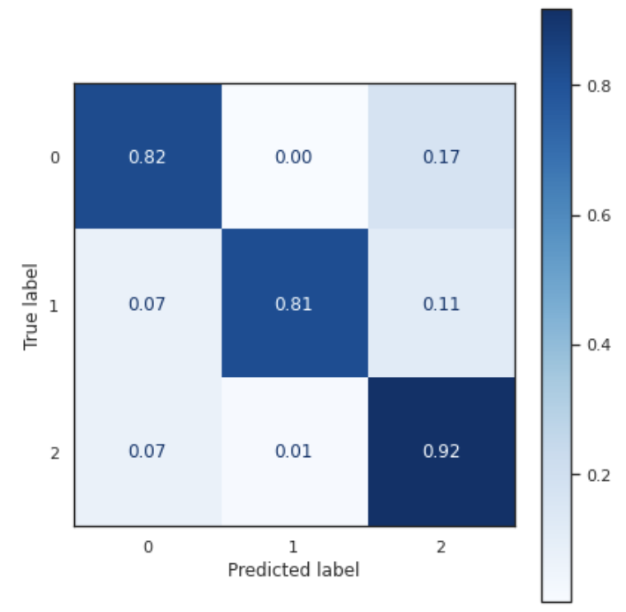
Classification: Results
Best score | Best parameter | Best Estimator
0.873133 | Learning rate: 0.1 Min samples leaf: 20 | Hist Gradient Boosting Classifier
0.852161 | Eta: 0.0001 Gamma: 10 Lambda: 0.0001 | XGB Classifier
0.849966 | Min samples leaf: 1 Min samples split: 20 | Random Forest
0.845943 | Alpha: 0.001 Learning rate: 0.01 | MLP Classifier
0.840456 | Max depth: 10 Min samples leaf: 1 Min samples split: 30 | Decision Tree
0.706334 | C grids: 10 Tol grids: 1e-6 | Logistic Regression
Bullet
Bullet
Irregular
TRUE CLASS
Monthly
Bullet
Irregular
Monthly
PREDICTED CLASS
Notes:
'bullet': 0, 'irregular': 1, 'monthly': 2

Slide 18
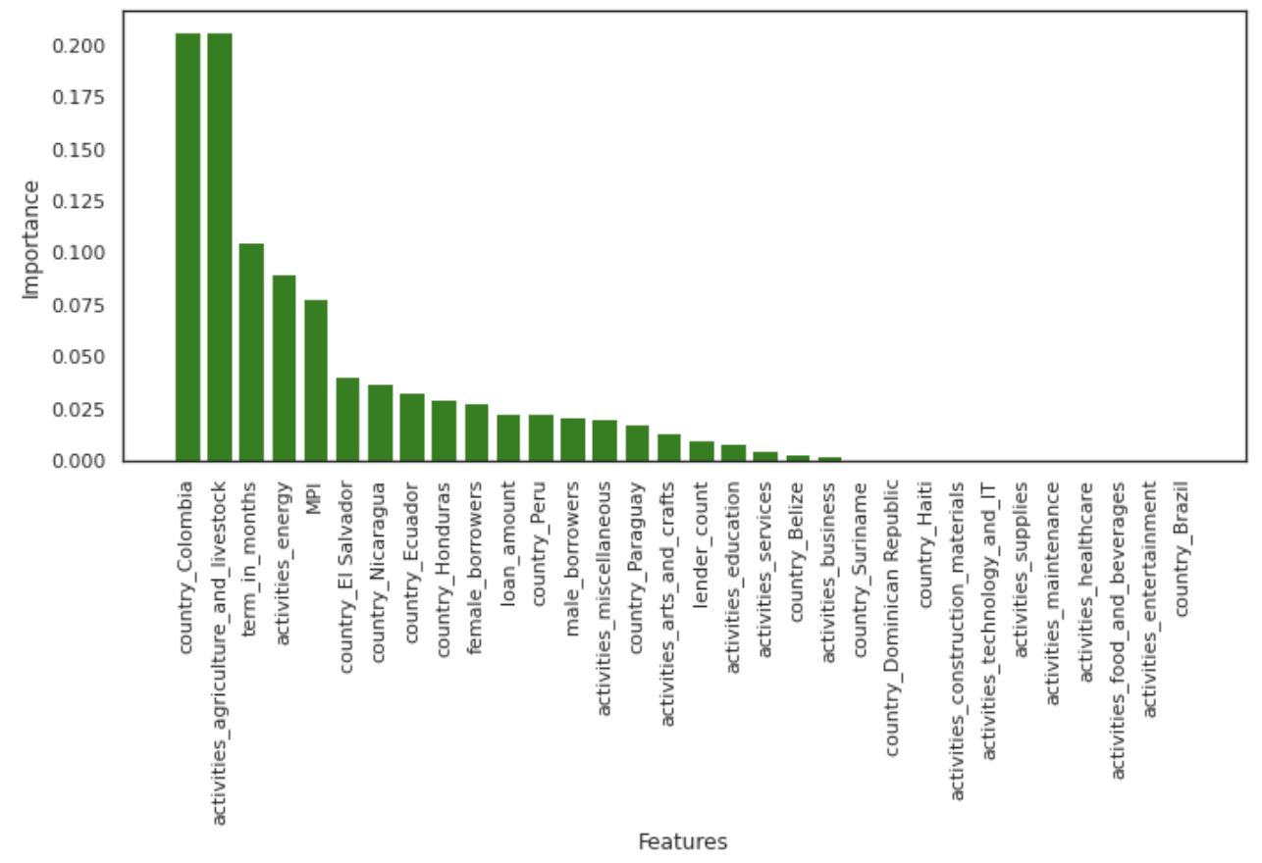
Classification: feature importance

Slide 19
Multi-Target Classification and Prediction
Selected two targets: repayment interval and activities
Split the entire data based on features and targets
Generated dummies for features data set
Generated custom labels for target data set
Implemented KNN and Random Forest
Used user input to predict repayment interval and activities

Slide 20
Conclusions
We were able to successfully pre-process the data and perform EDA
Regression models had low accuracies, the reason for this may be the nature of features chosen
The next best models were Random Forest and MLP
Lastly, we performed multi-target classification and performed prediction using user input
The classification models performed well; the best classification model was HGB with the best score of 0.874

Slide 21
Further, explore multi-target classification by splitting data into testing and training for the analysis
Calculate the accuracies for multi-target prediction
Explore merging additional datasets to improve results
Further Steps

Slide 22
References
https://www.kaggle.com/kiva/data-science-for-good-kiva-crowdfunding
http://hdr.undp.org/en/data
https://scikit-learn.org/stable/modules/model_evaluation.html

