Slide 1


Design Thinking and Innovation
Pneumonia Detection using Computer Vision
PDuCV
Created By:
Anwesh Badapanda
Tarun L. Lunia
Tanuj Sharma
Mentor
Deepak Garg
(E19CSE058)
(E19CSE004)
(E19CSE147)

Slide 2

1. Introduction
The idea was derived from a brainstorming session with our team. Our main focus was to solve a social problem, should be able to generate revenue as a business, and tech used in the project should be within our horizon.
Many ideas popped during the session like :
• Creating a platform keeping in mind about “Made in India” movement
• The idea of PDuCV.

Slide 3

2. Problem Statement
Currently, the world is dealing with a virus that no one had heard or seen before. In such situations, there was very little time to waste. Instead of doctors having to invest time analyzing the X-rays themselves, we proposed a platform that does this for them in no time and stores the results, to provide them with the convenience to have a check later and instantly recommend whether quarantine measures must be enforced on a particular person or not.
In the ideal world, we would use a dataset containing chest x-ray images of people who have either tested positive or negative for COVID19 but the amount of data available isn’t ideal and would lead to overfitting, thus we have chosen to utilize a dataset with x-rays of people who have tested either positive or negative to pneumonia

Slide 4

3. Objectives
The objective is to provide an automated alternative to the problems of pneumonia detection faced in daily life by suffering patients so that the required steps can be taken before any mishappening.

Slide 5
4. Innovation
Deploying multiple models with high accuracy and prioritizing getting less false negatives. Getting lesser false negatives is important because if we incorrectly diagnose a person with pneumonia as not having one it can lead to serious consequences, possibly even setting off a butterfly effect. As compared to false negatives, false positives are not as bad because if we diagnose someone not having pneumonia as having pneumonia, the overall effect is not as bad. Either way, getting good accuracy is still important.
Deep Learning Models and especially computer vision ones are large because of the parameters included in them. Deploying them on platforms with fewer resources can be challenging. To tackle this problem, we will be pruning the models before we deploy them. This will remove the insignificant weights from the neural network thus resulting in a smaller neural network which eases our task of deploying the model.
Our final innovation will be deploying multiple models instead of one. The previously mentioned innovation has a significant role in this since deploying multiple models can be computationally expensive. Deploying multiple models will improve our accuracy on the data we have never seen before.

Slide 6

5. Role of each group member
Anwesh Badapanda: Handling the machine learning work related to the project, pruning three different models for more accuracy, and the one that came up with the idea.
Tanuj Sharma: Major contribution in the Back-end side of the platform like handling the Database side based on the Flask framework and helped in the non-technical part of the project..
Tarun Lunia: Major contribution in the Front-end and designing part of the project and also taken part in completion of the documentation of the project.

Slide 7

6. Proposed Methodology
When the doctor comes to the platform, he has to sign up using the Active membership account from where he/she will be taken to the scan submission page wherein, he/she has to submit the X-ray scans and after a few seconds, the Machine learning models will pass the results to the website and show the results on the screen that whether the patient is diagnosed or not. After completing the above procedure, he/she can sign out and can revisit the records whenever it is required, because the result will be saved in our database for future references.

Slide 8

7. Features of our project
Accessible through most of the web browsers, with attractive UI/UX.
Pneumonia detection using Machine learning.
Stores all the previously entered data so that the user can access the records whenever necessary.

Slide 9

8. Tools and technology
Hardware — NVIDIA GPU for training the model
Dataset — Dataset of images of lung x-rays
Frameworks — Tensor Flow 2 for deep learning and Flask for web design.

Slide 10


9.Software
1.Git for version control
2. Python for back-end design and making the model.
3.HTML, CSS, and JavaScript for front-end Design, Adobe XD for UI/UX design.

Slide 11

10. System/User Requirement
An up-to-date browser(Safari, Chrome, Firefox etc)
An active internet connection
Images of X-Ray scan
An account in the website

Slide 12

11. Snapshot of System

Slide 13
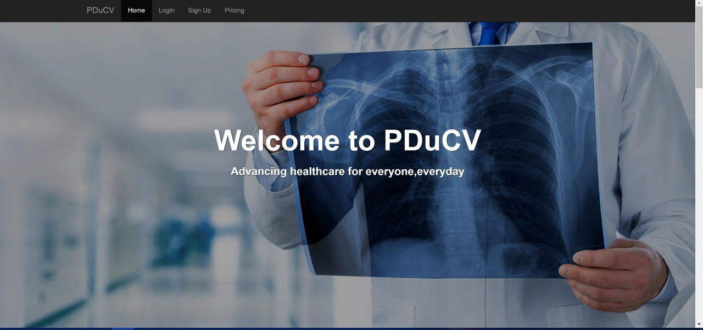

Slide 14
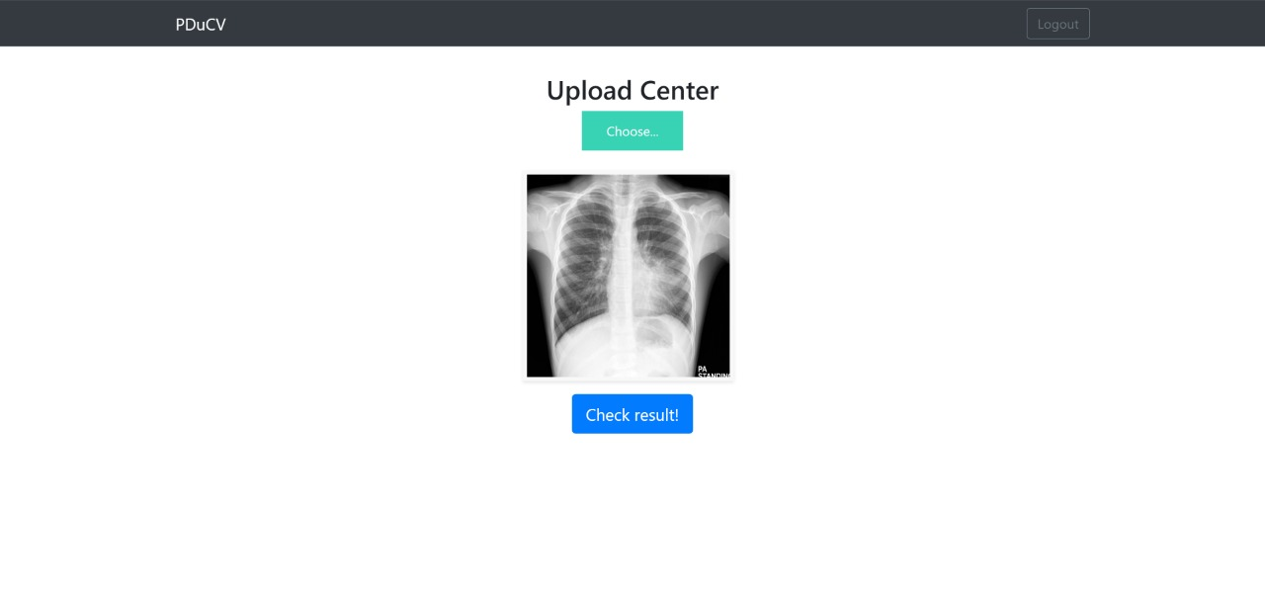

Slide 15
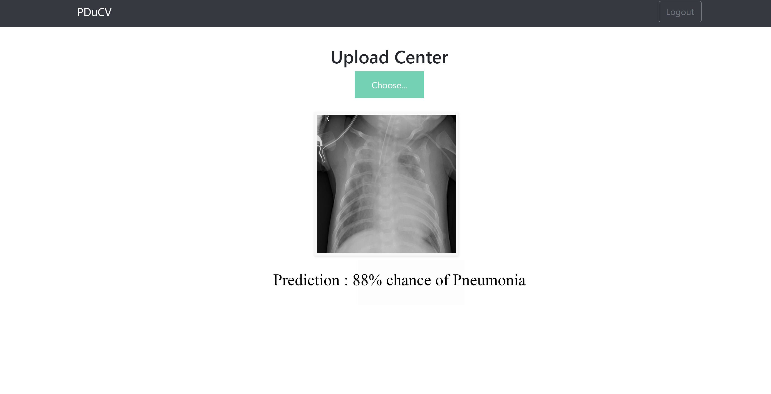

Slide 16

12. Results
We have reached the main goal behind the project of providing a Machine learning-based platform that detects pneumonia in the provided entry and after providing the findings from the input, stores it in the dataset for later access, it helps in providing an alternative to human error while also increasing the overall accuracy and confidence in the medical field.

Slide 17

13. Future Scope
Better accuracy that will be more aesthetically convincing.
For a better UI/UX experience we can add more features and services.
Increase the availability of the project for different operating systems.
Launch an App related to the project for both IOS and Android.

Slide 18

Thank You

