Slide 1



Slide 2
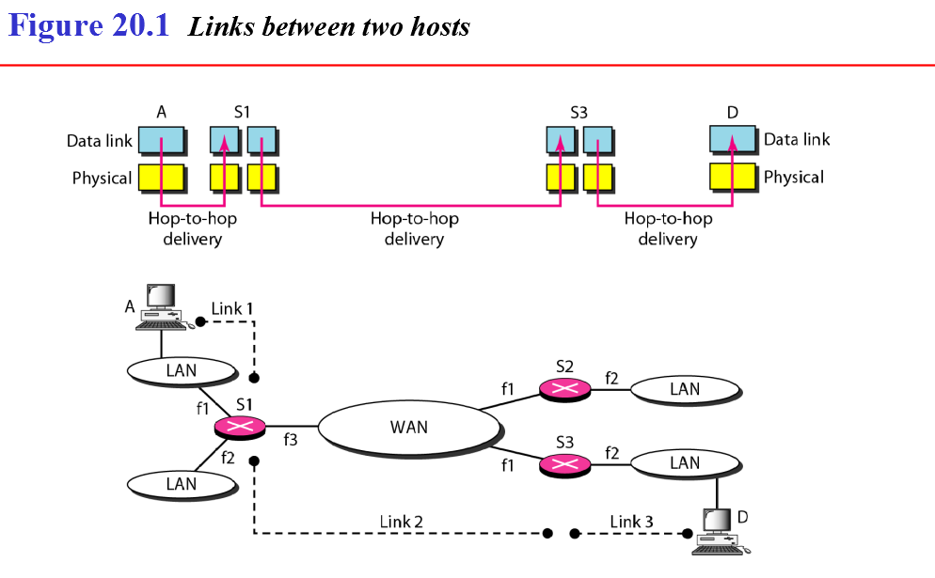
Internetworking

Slide 3
Need for network layer
The physical and data link layers of a network operate locally. These two layers are jointly responsible for data delivery on the network from one node to the next
This internetwork is made of five networks: four LANs and one WAN.
If host A needs to send a data packet to host D, the packet needs to go first from A to R/S1 (a switch or router), then from R/S1 to R/S3, and finally from R/S3 to host D. We say that the data packet passes through three links. In each link, two physical and two data link layers are involved. However, there is a big problem here. When data arrive at interface fl ofR1, how does R1 know that interface f3 is the outgoing interface? There is no provision in the data link (or physical) layer to help R1 make the right decision. The frame does not carry any routing information either. The frame contains the MAC address ofA as the source and the MAC address ofRl as the destination. For a LAN or a WAN, delivery means carrying the frame through one link, and not beyond
To solve the problem of delivery through several links, the network layer (or the inter network layer, as it is sometimes called) was designed. The network layer is responsible for host-to-host delivery and for routing the packets through the routers or switches.

Slide 4
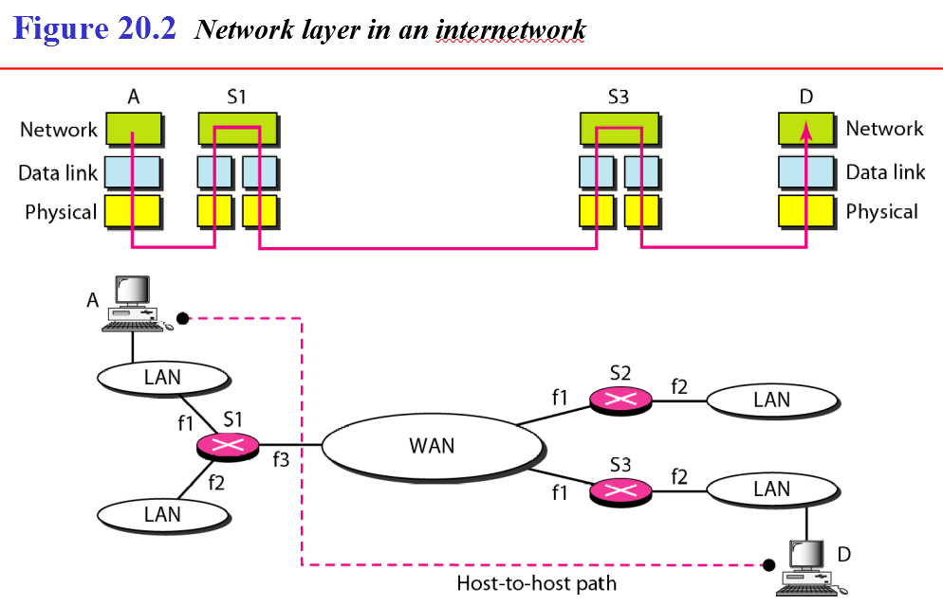

Slide 5
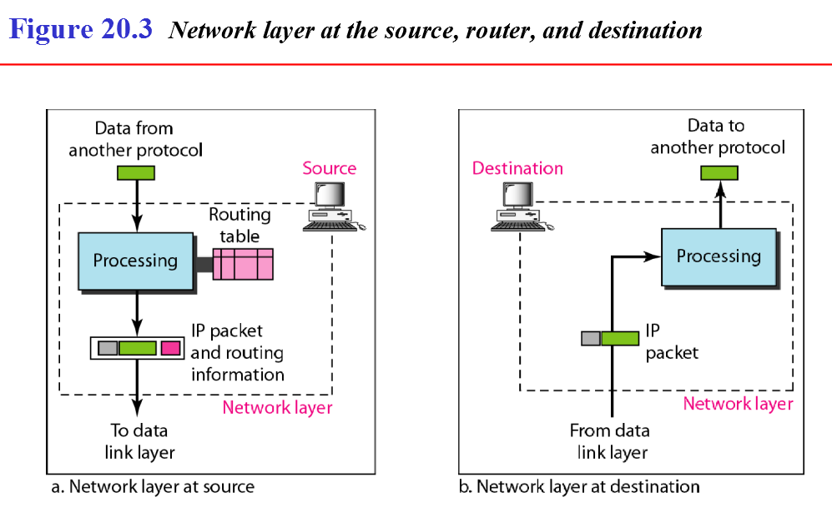

Slide 6
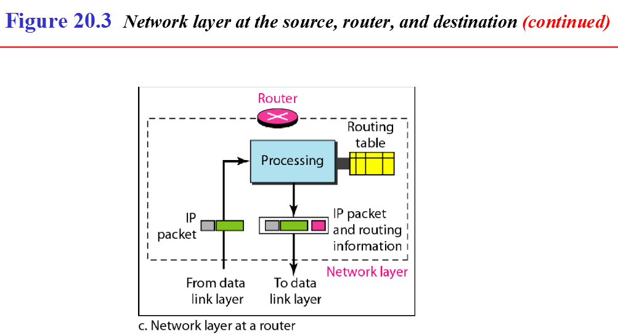

Slide 7
Switching at the network layer in the Internet uses the datagram approach to packet switching.
Communication at the network layer in the Internet is connectionless.

Slide 8
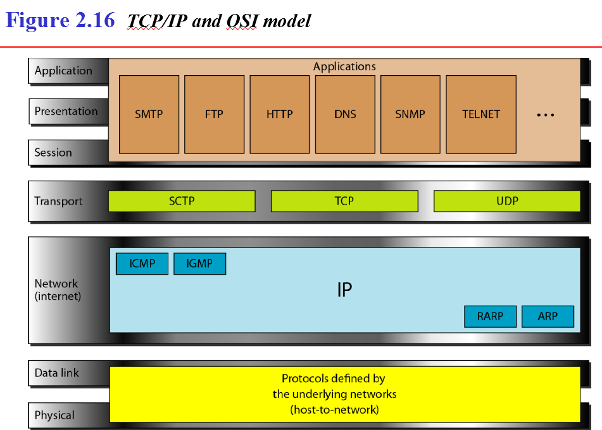

Slide 9
Network layer protocols
Internet Control Message Protocol (ICMP)
Internet Group Management Protocol (IGMP)
Address Resolution Protocol (ARP)
Reverse Address Resolution Protocol (RARP)
Internet Protocol
IPv4.
IPV6
Frame format
Extension headers in IPv6

Slide 10
Drawbacks of IPV4
The Internet must accommodate real-time audio and video transmission. This type of transmission requires minimum delay strategies and reservation of resources not provided in the IPv4 design.
The Internet must accommodate encryption and authentication of data for some applications. No encryption or authentication is provided by IPv4.

Slide 11
Advantages of IPV6
Larger address space. An IPv6 address is 128 bits long. Compared with the 32-bit address of IPv4, this is a huge (296 ) increase in the address space.
Better header format. simplifies and speeds up the routing process
Newoptions. IPv6 has new options to allow for additional functionalities.
Allowance for extension. IPv6 is designed to allow the extension of the protocol if required by new technologies or applications.
Support for resource allocation. In IPv6, the type-of-service field has been removed, but a mechanism (called flow label) has been added to enable the source to request special handling of the packet. This mechanism can be used to support traffic such as real-time audio and video.
Support for more security. The encryption and authentication options in IPv6 provide confidentiality and integrity of the packet.

Slide 12
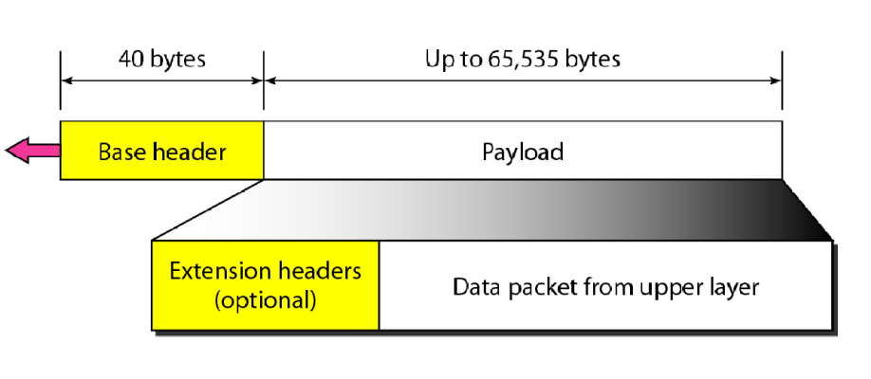
IPV6 Packet Format

Slide 13
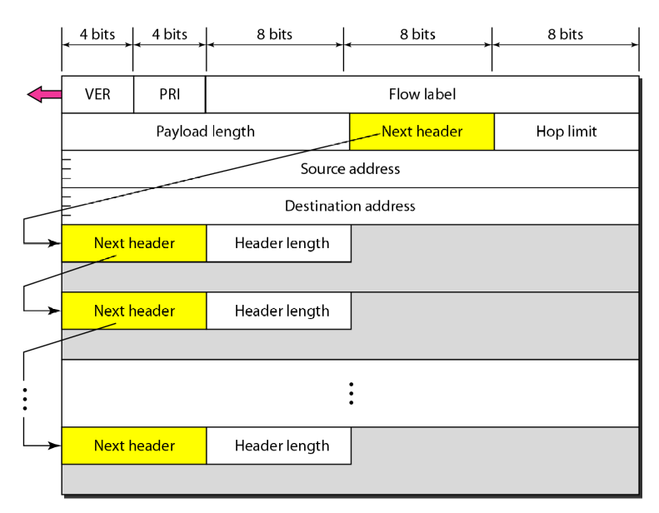
IPV6 Header details

Slide 14
Version
This 4-bit field defines the version number of the IP. For IPv6, the value is 6.

Slide 15
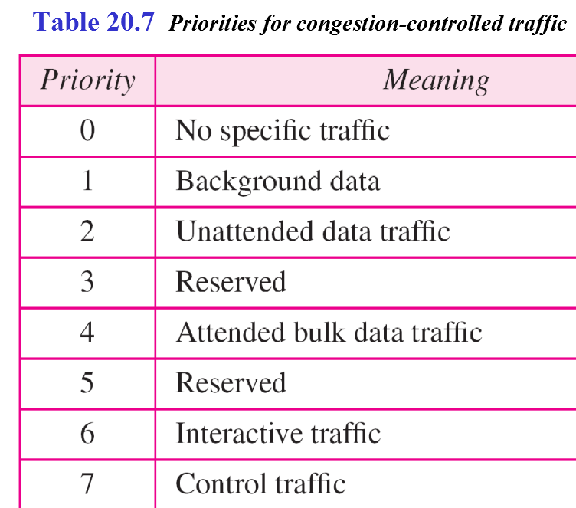
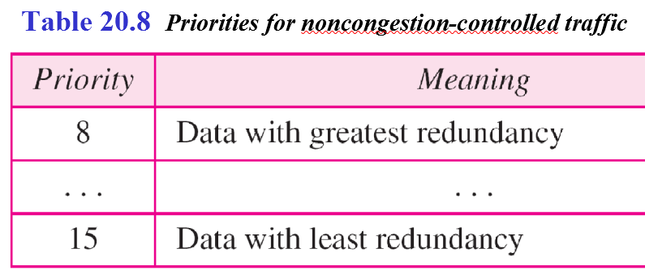
Priority.
The 4-bit priority field defines the priority of the packet with respect to traffic congestion.
IPv6 divides traffic into two categories: congestion-controlled and non congestion-controlled.
congestion-controlled traffic: If a source adapts itself to traffic slow down when there is congestion,
non congestion-controlled: source does not adapt itself to congestion. Real-time audio and video are examples of this type of traffic.

Slide 16
Priorities in Congestion controlled traffic
No specific traffic. A priority of 0 is assigned to a packet when the process does not define a priority.
Background data. priority 1 defines data that are usually delivered in the background. Delivery of the news is a good example.
Unattended data traffic. If the user is not waiting (attending) for the data to be received, the packet will be given a priority of 2. E-mail belongs to this group.
Attended bulk data traffic. A protocol that transfers data while the user is waiting (attending) to receive the data (possibly with delay) is given a priority of 4. FTP and HTTPbelong to this group.
Interactive traffic. Protocols such as TELNET that need user interaction are assigned the second-highest priority (6)
Control traffic. Control traffic is given the highest priority (7). Routing protocols such as OSPF and RIP and management protocols such as SNMP have this priority.

Slide 17
Flow label
The flow label is a 3-byte (24-bit) field that is designed to provide special handling for a particular flow of data.
three rules have been defined:
1. The flow label is assigned to a packet by the source host. The label is a random number between 1and 2²⁴- 1. A source must not reuse a flow label for a new flow while the existing flow is still active.
2. Ifa host does not support the flow label, itsets this field to zero. Ifa router does not support the flow label, it simply ignores it.
3. All packets belonging to the same flow have the same source, same destination, same priority, and same options.

Slide 18
Payload length. The 2-byte payload length field defines the length of the IP datagram excluding the base header.

Slide 19
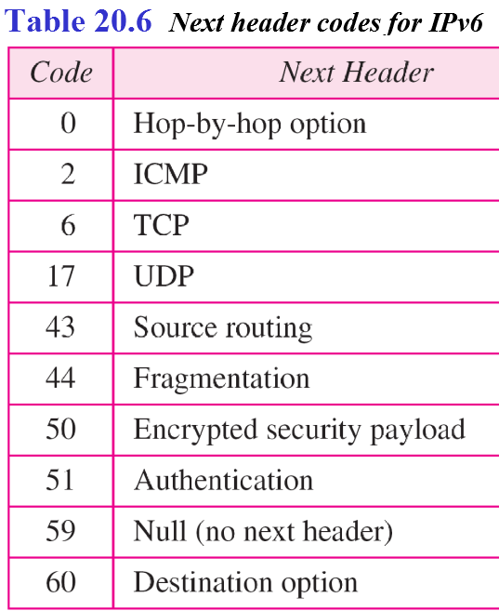
Next header
Next header is an 8-bit field defining the header that follows the base header in the datagram. The next header is either one of the optional extension headers used by IP or the header of an encapsulated packet such as UDP or TCP. Each extension header also contains this field.

Slide 20
Hop limit. This 8-bit hop limit field serves the same purpose as the TTLfield in IPv4. (TTL or Time To Live)
is an 8-bit field found in the header of IPv6 packets that is used to prevent packets from looping forever within an IP network
Source address. The source address field is a 16-byte (128-bit) Internet address that identifies the original source of the datagram.
Destination address. The destination address field is a16-byte(128-bit) Internet address that usually identifies the final destination of the datagram. However, if source routing is used, this field contains the address of the next router.

Slide 21
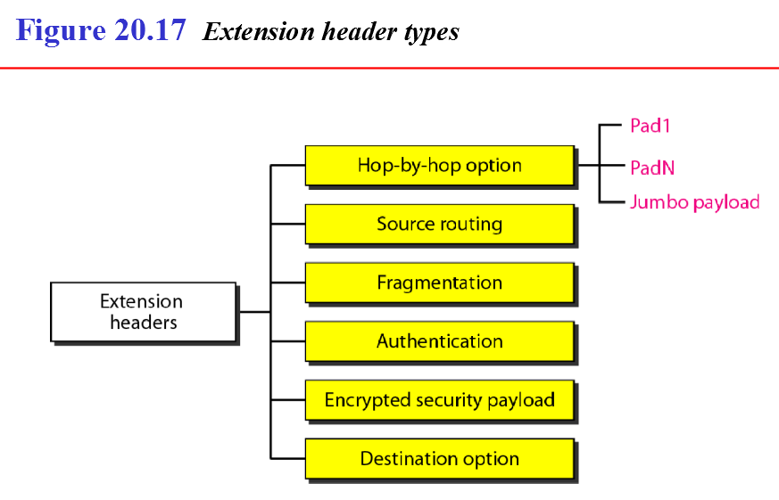
Extension headers in IPV6
additional functionalities are handled using Extension Headers.

Slide 22
Hop-by-Hop Option
carries information that must be examined by every router along the packet’s path.
Pad1 Ensures correct byte alignment of options in Hop-by-Hop
Used when only one byte of padding is needed.
PadN is similar in concept to Pad1. The difference is that PadN is used when 2 or more bytes is needed for alignment.
Jumbo payload option is used to define a payload longer than 65,535 bytes.
The Hop-by-Hop header must be processed by every router along the path before forwarding the packet. Since every router must process this header, it can slow down packet forwarding.

Slide 23
Source Routing
Source Routing in IPv4 and IPV6 is a technique that allows the sender of a packet to specify the route the packet should take through the network, rather than leaving the routing decision to intermediate routers.
1. Loose Source Routing (LSR)
The sender specifies a list of routers that the packet must pass through, but other routers can be used in between.
Provides some flexibility while ensuring the packet reaches specific intermediate nodes.
Strict Source Routing (SSR)
The sender specifies an exact list of routers that the packet must pass through.
No intermediate routers are allowed apart from those explicitly mentioned.
More restrictive than Loose Source Routing.

Slide 24
Fragmentation
IPv4, where routers perform fragmentation when a packet exceeds the Maximum Transmission Unit (MTU),
IPv6 routers do not fragment packets. Instead, fragmentation is performed only by the sender (source device).

Slide 25
Authentication
The authentication extension header has a dual purpose:
it validates the message sender
ensures the integrity of data.

Slide 26
Encrypted Security Payload
encrypted security payload (ESP) is an extension that provides confidentiality and guards against eavesdropping (secret listening).

Slide 27
Destination Option
The destination option is used when the source needs to pass information to the destination only. Intermediate routers are not permitted access to this information.

Slide 28
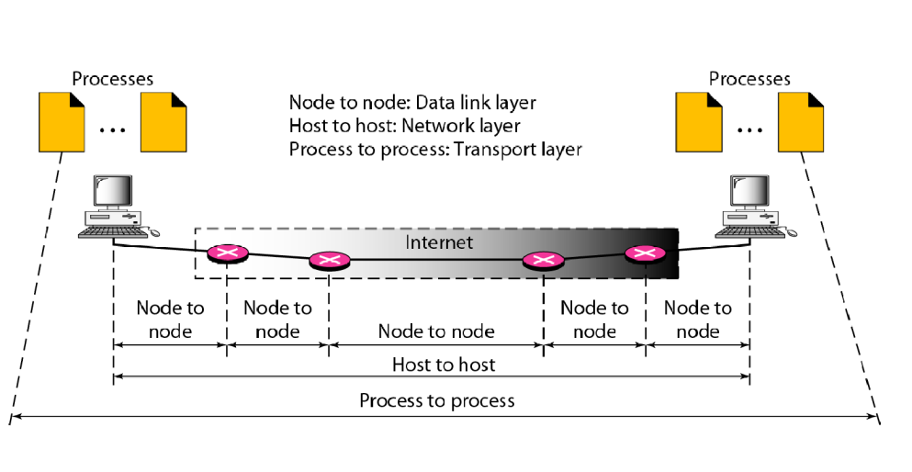
Transport Layer
Transport layer is responsible for process-to-process delivery—the delivery of a packet, part of a message, from one process to another.

Slide 29
Transport Layer protocols
Transport layer protocol can be either connectionless or connection-oriented.
UDP-Connectionless protocol-Simple
TCP-Connection oriented protocol-Complex
SCTP( Stream Control) -Connection oriented protocol-Designed for Multimedia application

Slide 30
Transport Layer message format ----segment
Transport layer a message is normally divided into transmittable segment.
UDP treats each segment separately
TCP creates a relationship between the segments using sequence numbers

Slide 31
Transport layer service (reliable or unreliable)
○ If the application layer program needs reliability, TCP & SCTP protocol will implement flow and error control at the transport layer. But it is slower and more complex service.
○ If the application layer program does not need reliability, it means most real-time application does not demand flow and error control,but it demand fast service. So unreliable protocol UDP is used.

Slide 32
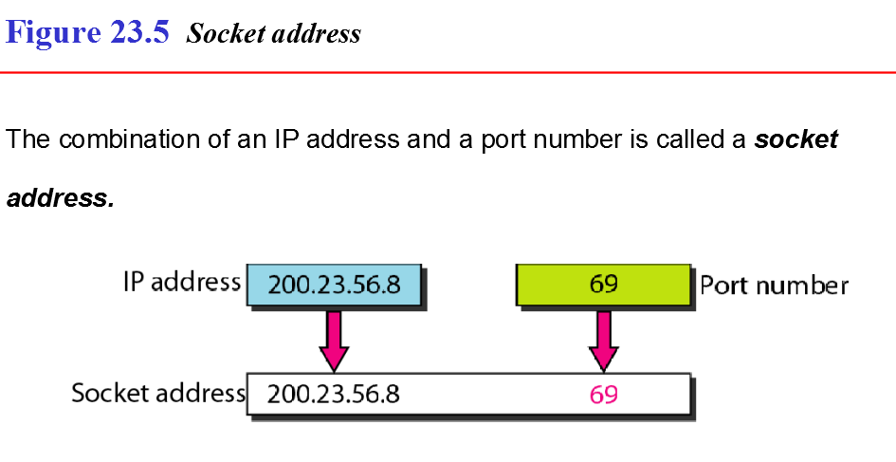
Addressing in transport layer
client socket address defines the client process uniquely
server socket address defines the server process uniquely

Slide 33


Slide 34
UDP
A connectionless transport layer treats each segment as an independent packet and delivers it to the transport layer at the destination machine.
The packets are not numbered; they may be delayed or lost or may arrive out of sequence.
There is no acknowledgement
UDP is connectionless

Slide 35
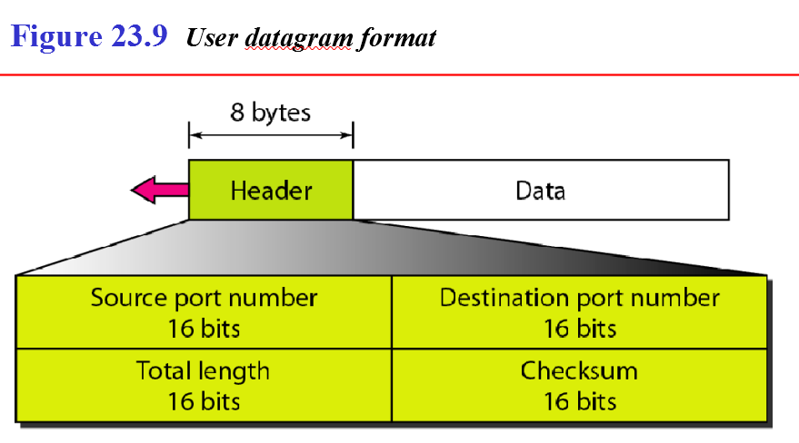
UDP
UDP packets, called user datagrams,

Slide 36
UDP Operation
1. Connectionless service
2. Flow and Error Control
no flow control and hence no window mechanism. The receiver may overflow with incoming messages. There is no error control mechanism in UDP except for the checksum.
3. Encapsulation and Decapsulation To send a message from one process to another, the UDP protocol encapsulates and decapsulates messages in an IP datagram.

Slide 37
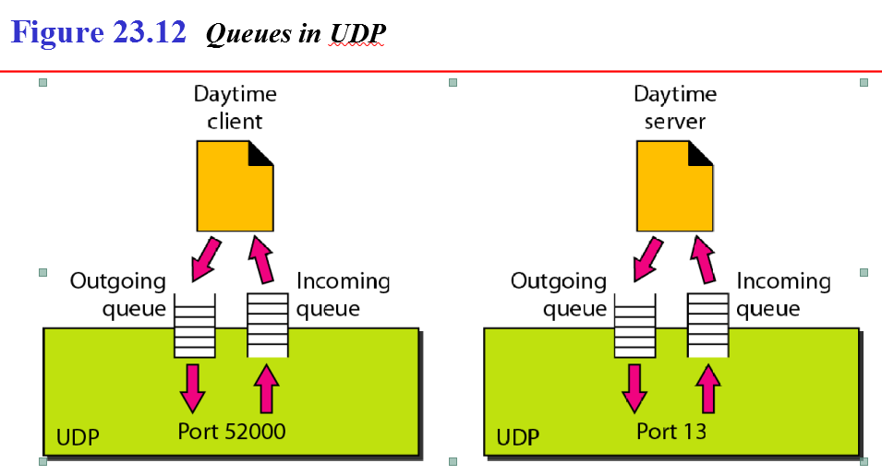
4. Queues
Port 13 is used for the Daytime Protocol, which is a service that allows a client to request the current date and time from a server. It is a well-known port that can use either the Transmission Control Protocol (TCP) or User Datagram Protocol (UDP)
In UDP, queues are associated with ports

Slide 38
TCP
A connection oriented transport layer makes a connection with the transport layer at the destination machine first before delivering the packets.
After all the data is transferred, the connection is terminated.
TCP and SCTP are Connection oriented.
TCP uses flow and error control mechanisms at the transport level.
TCP services
TCP Segment format
TCP connection, establishment, data transfer and connection termination

Slide 39
TCP services
Process-to-Process Communication
Stream Delivery Service
Sending and Receiving Buffers
Segments
Full-Duplex Communication
TCP offers full-duplex service, in which data can flow inboth directions at the same time
Connection-Oriented Service
1. The two TCPs establish a connection between them. 2. Dataare exchanged in both directions. 3. The connection is terminated.
Reliable Service
TCP is a reliable transport protocol. It uses an acknowledgment mechanism to check the safe and sound arrival ofdata.

Slide 40
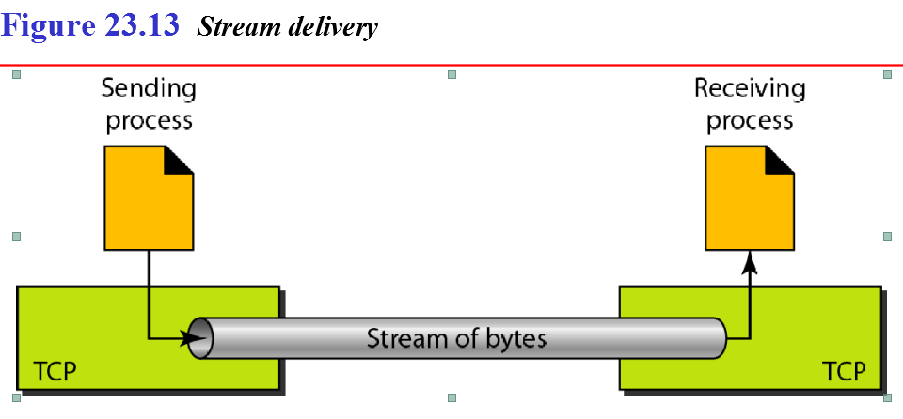

Slide 41
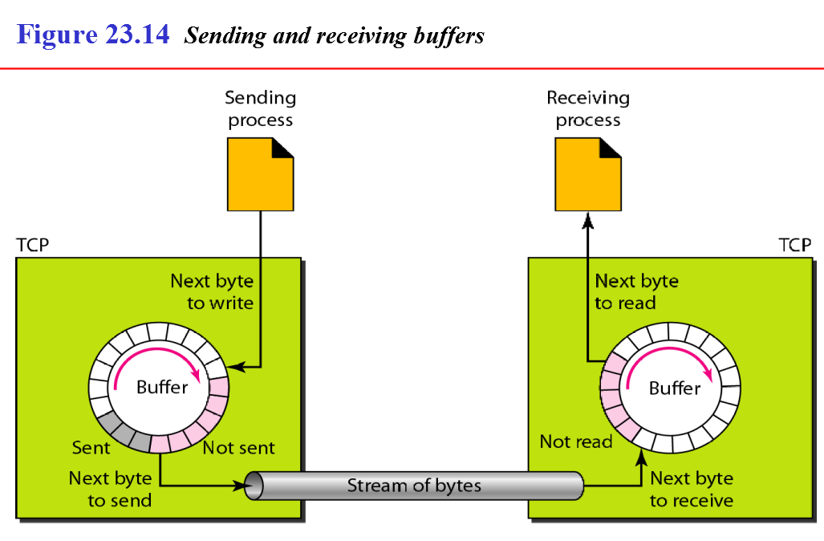
TCP buffers---3 chambers (white section empty slots, Grey sent waiting for ack, pink---not sent)

Slide 42
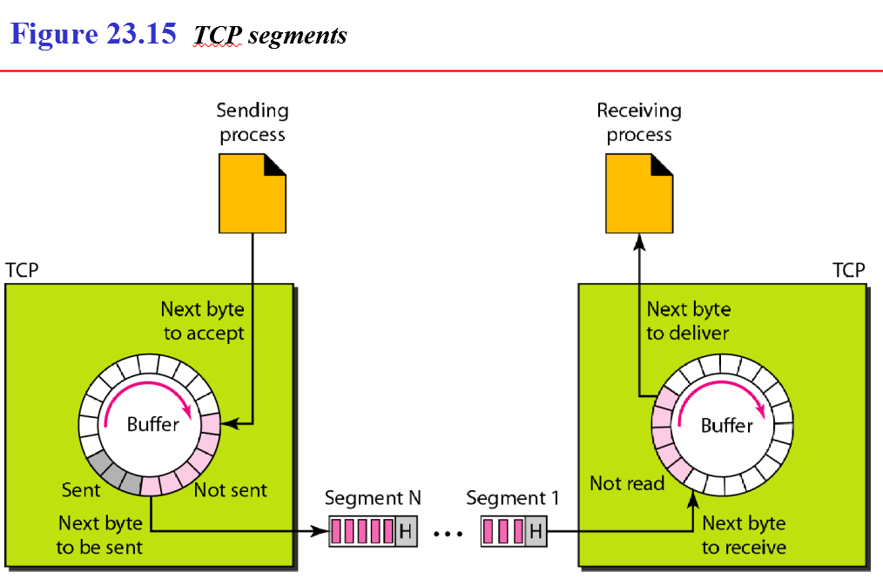
TCP segment ---creation process

Slide 43
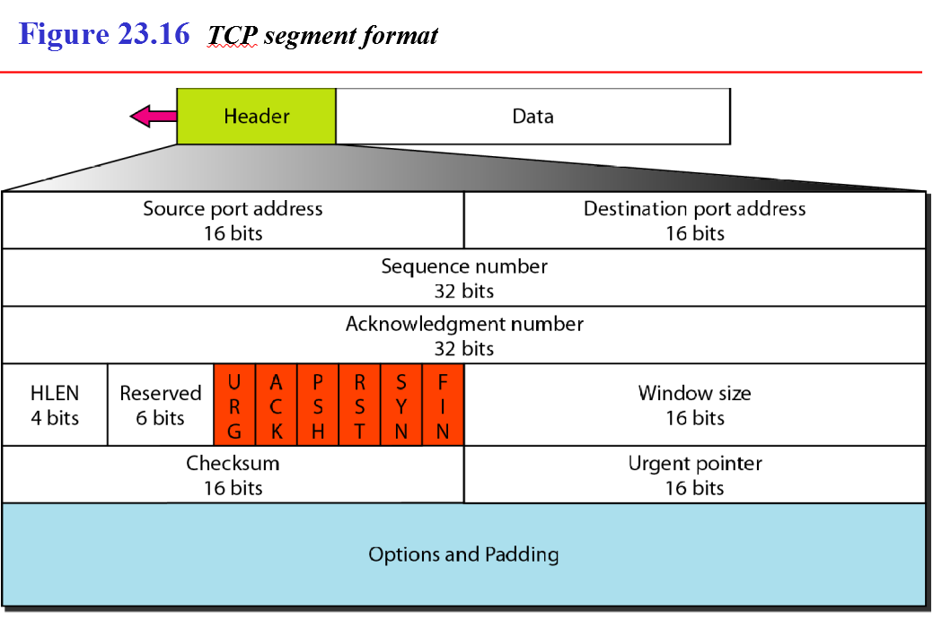

Slide 44
Source port address.
16-bit field that defines the port number of the application program in the host that is sending the segment.
Destination port address.
16-bit field that defines the port number ofthe application program in the host that is receiving the segment.
Sequence number.
32-bit field defines the number assigned to the first byte of data contained in this segment. TCP is a stream transport protocol.
Acknowledgment number.
32-bit field defines the byte number that the receiver of the segment is expecting to receive from the other party. Acknowledgment and data can be piggybacked together.

Slide 45
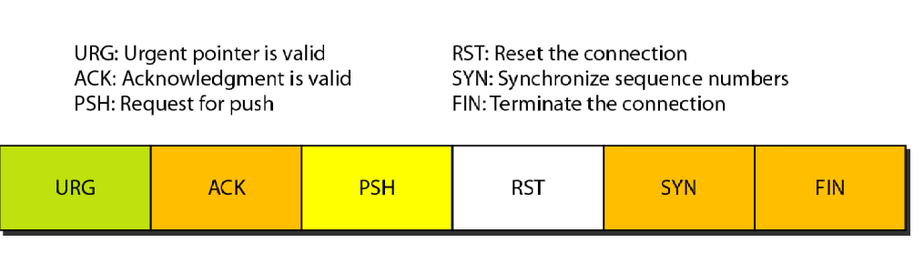
Header length.
4-bit field indicates the number of 4-byte words in the TCP header.
Reserved. This is a 6-bit field reserved for future use.
Control. This field defines 6 different control bits or flags

Slide 46
Window size.
defines the size of the window, in bytes, that the other party must maintain. maximum size of the window is 65,535 bytes.
Checksum.
16-bit field contains the checksum.
Urgent pointer.
16-bit field, which is valid only if the urgent flag is set, is used when the segment contains urgent data.
Options.
There can be up to 40 bytes of optional information in the TCP header.

Slide 47


Slide 48
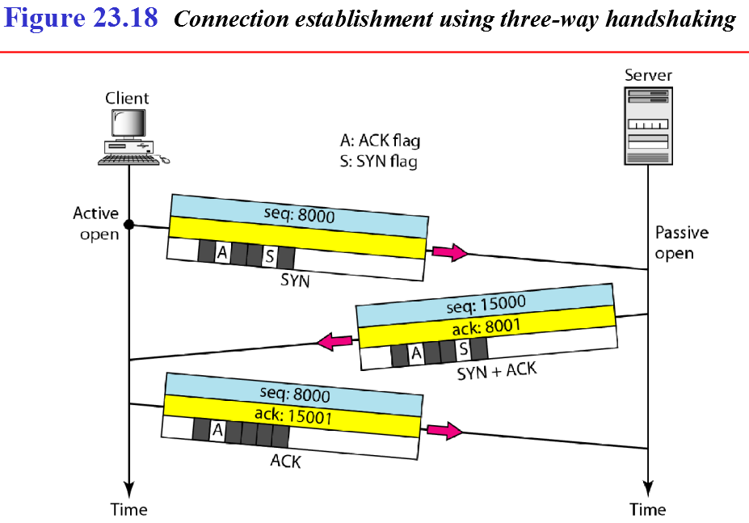
TCP Connection
client program issues a request for an active open.
server program tells its TCP that it is ready to accept a connection. This is called a request for a passive open
client sends the first segment, a SYN segment, in which only the SYN flag is set
server sends the second segment, a SYN +ACK segment, with 2 flag bits set: SYNandACK
client sends the third segment ACK segment

Slide 49
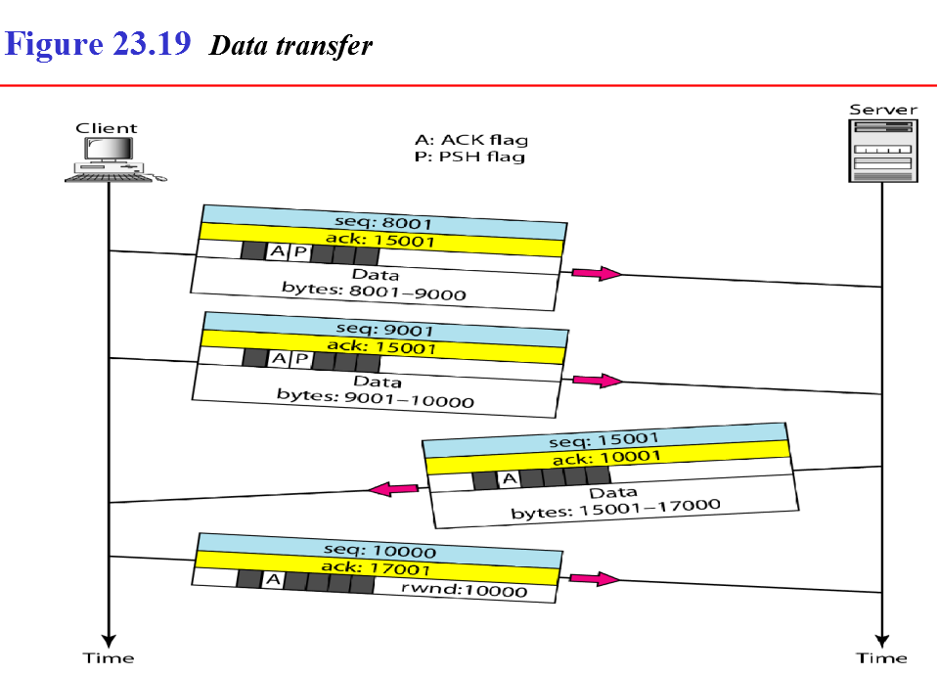
Example
client sends 2000 bytes of data in two segments.
server then sends 2000 bytes in one segment.
client sends one more segment (last segment) carries only an acknowledgment because there are no more data to be sent.
The data segments sent by the client have the PSH (push) flag set so that the server TCP knows to deliver data to the server process as soon as they are received.

Slide 50
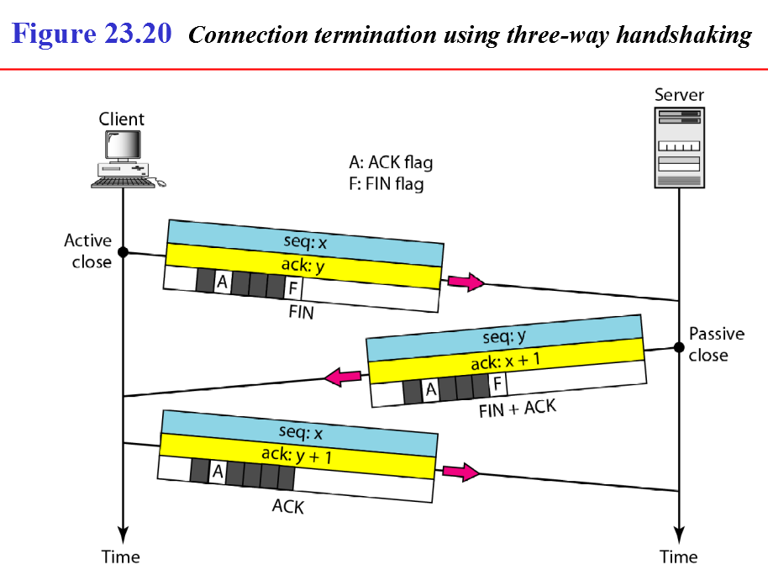
TCP client TCP, after receiving a close command from the client process, sends the first segment, a FIN segment in which the FIN flag is set.
TCP server, after receiving the FIN segment, sends the second segment, a FIN +ACK segment, to confirm the receipt ofthe FIN segment from the client and at the same time to announce the closing of the connection in the other direction
TCP client sends the last segment, an ACK segment, to confirm the receipt of the FIN segment from the TCP server.

Slide 51
Flow control Vs Congestion
Flow Control – Regulates data between sender and receiver to avoid overwhelming the receiver.
Congestion Control – Manages the overall network traffic to prevent congestion.

Slide 52
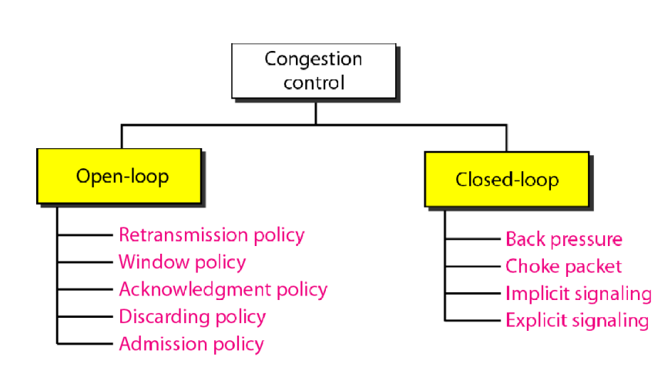
Congestion
Congestion in a network may occur if the load on the network (the number of packets sent to the network) is greater than the capacity of the network (the number of packets a network can handle).
Congestion control refers to the mechanisms and techniques to control the congestion and keep the load below the capacity
Congestion control refers to techniques and mechanisms that can either prevent congestion, before it happens, or remove congestion, after it has happened.
open-loop congestion control (prevention)
closed-loop congestion control (removal)

Slide 53
open loop
Retransmission Policy
a good retransmission policy can prevent congestion.
retransmission policy and the retransmission timers must be designed to optimize efficiency and at the same time prevent congestion.
Window Policy
The type of window at the sender may also affect congestion.
Selective Repeat window is better than the Go-Back-N
Acknowledgment Policy
A receiver may send an acknowledgment only if it has a packet to be sent or a special timer expires.
A receiver may decide to acknowledge only N packets at a time.

Slide 54
Discarding Policy
A good discarding policy by the routers may prevent congestion and at the same time may not harm the integrity of the transmission
Example: audio transmission
Admission Policy
prevent congestion in virtual-circuit networks.
Switches in a flow first check the resource requirement of a flow before admitting it to the network.
A router can deny establishing a virtual circuit connection if there is congestion in the network or if there is a possibility of future congestion.

Slide 55
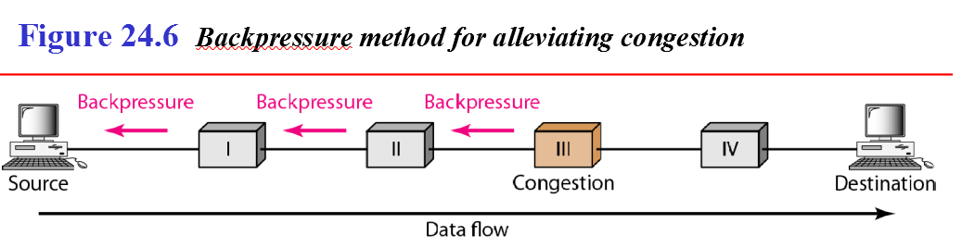
Closed loop ---Back pressure
a congested node stops receiving data from the immediate upstream node or nodes.
This may cause the upstream node or nodes to become congested, and they, in turn, reject data from their upstream nodes or nodes. And so on.
Backpressure is a node-to-node congestion control that starts with a node and propagates, in the opposite direction of data flow, to the source.
used in virtual circuit networks, in which each node knows the upstream node from which a flow of data is corning.

Slide 56
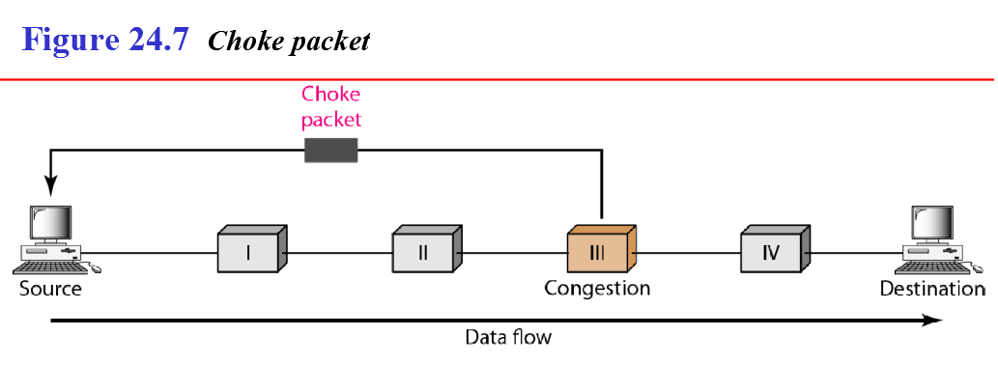
Closed loop ---Choke packet
A choke packet is a packet sent by a node to the source to inform it of congestion.
difference between the backpressure and choke packet methods.
In backpressure, the warning is from one node to its upstream node, although the warning may eventually reach the source station.
In the choke packet method, the warning is from the router, which has encountered congestion, to the source station directly.

Slide 57
Implicit Signaling
there is no communication between the congested node or nodes and the source.
source guesses that there is a congestion somewhere in the network from other symptoms.
example, when a source sends several packets and there is no acknowledgment for a while, one assumption is that the network is congested.
delay in receiving an acknowledgment is interpreted as congestion in the network; the source should slow down.

Slide 58
Explicit Signaling
The node that experiences congestion can explicitly send a signal to the source or destination.
The explicit signaling method, however, is different from the choke packet method.
In the choke packet method, a separate packet is used for this purpose
in the explicit signaling method, the signal is included in the packets that carry data.
Explicit signaling can occur in either the forward or the backward direction.
Backward Signaling
A bit can be set in a packet moving in the direction opposite to the congestion. This bit can warn the source that there is congestion and that it needs to slow down to avoid the discarding of packets.
Forward Signaling
A bit can be set in a packet moving in the direction of the congestion. This bit can warn the destination that there is congestion. The receiver in this case can use policies, such as slowing down the acknowledgments, to alleviate the congestion.

