Slide 1

Go, change the world
ADAPTIVE SMART NAVIGATION ROBOT WITH DYNAMIC SPEED CONTROL & PROXIMITY ALERT USING STM32

Slide 2
PROBLEM STATEMENT
Indoor and public spaces often face safety risks due to blind spots, poor visibility, and the lack of adaptive navigation systems. Existing robots typically lack real-time obstacle detection, rear sensing, and dynamic speed control. There is a strong need for a smart, responsive robot that can navigate safely in dynamic and cluttered environments.

Slide 3
Project Overview: Adaptive Smart Navigation Robot
Designed to navigate indoor environments safely using real-time obstacle detection.
Uses STM32F7 microcontroller and ultrasonic sensor (HC-SR04) for distance measurement.
Controls motor speed using PWM based on proximity to obstacles.
Speed logic:
  <10 cm: Stop + Buzzer alert
  10–20 cm: Slow down
  20 cm: Full speed
Programmed in Embedded C using STM32CubeIDE.
Buzzer provides proximity alerts to increase safety.
Inspired by DTL survey, addressing navigation issues in public spaces.
Applicable in hospitals, malls, airports, and for assistance in crowded areas.
Future scope includes voice alerts, multi-sensor support, and AI navigation.

Slide 4
Go, change the world
OBJECTIVES
To design a smart navigation robot capable of detecting obstacles in real-time and avoiding collisions.
To implement automatic speed reduction based on proximity to obstacles, enhancing safety.
To trigger a buzzer alert system when the robot gets too close to an obstacle.
To use STM32F7 microcontroller for efficient real-time control and processing.
To integrate ultrasonic sensors for accurate distance measurement and path planning.

Slide 5
Go, change the world
HARDWARE COMPONENTS
Component | Purpose
STM32F7 Microcontroller | Main controller for processing sensor data and controlling peripherals
Ultrasonic Sensors (HC-SR04) | Obstacle detection and distance measurement
DC Motors / Gear Motors | Robot movement (forward, backward, turning)
Motor Driver (L298N) | Interface between STM32 and motors
Speed Sensors / Encoders | Measure wheel rotation to adjust and reduce speed accordingly
Buzzer | Alert when obstacles are too close
Power Supply (Li-ion Battery / Power Bank) | Powers the microcontroller and peripherals
Voltage Regulator (AMS1117) | Steps down voltage to STM32-safe levels if needed
Wheels and Chassis | Physical structure and mobility
Switch / Button Module | To start or reset the system manually
LEDs | Status indicators (e.g., power, detection status)
Wires / Connectors | For making connections between all components
Breadboard or PCB | For making connections

Slide 6
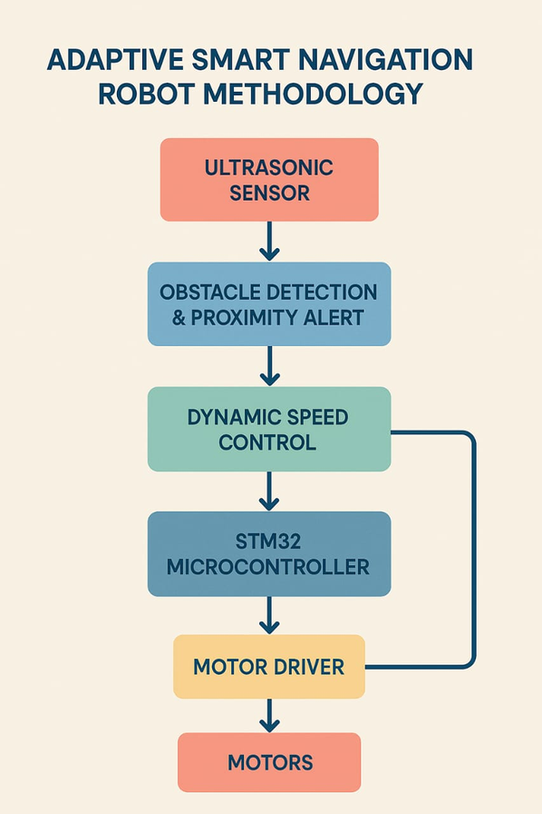
Go, change the world
METHODOLOGY
Assemble the robot chassis by mounting motors, wheels, STM32F7 board, motor driver, and battery.
Attach the ultrasonic sensor (HC-SR04) at the front and wire it to STM32F7’s GPIO pins.
Configure GPIO and Timer peripherals in STM32CubeIDE for sensor triggering and pulse measurement.
Generate a 10 µs trigger pulse from a GPIO pin to initiate distance sensing

Slide 7
METHODOLOGY
Go, change the world
Measure echo pulse duration using a timer or polling loop to determine object distance.
Calculate the distance using the formula:
distance_cm = pulse_time × 0.034 / 2
Control motor speed using PWM by adjusting the duty cycle based on proximity.
Activate the buzzer when the distance falls below a critical threshold (e.g., 10 cm).
if (dist < 10) stop(); buzzer_on();
else if (dist < 20) slow(); buzzer_off();
else full_speed(); buzzer_off();

Slide 8
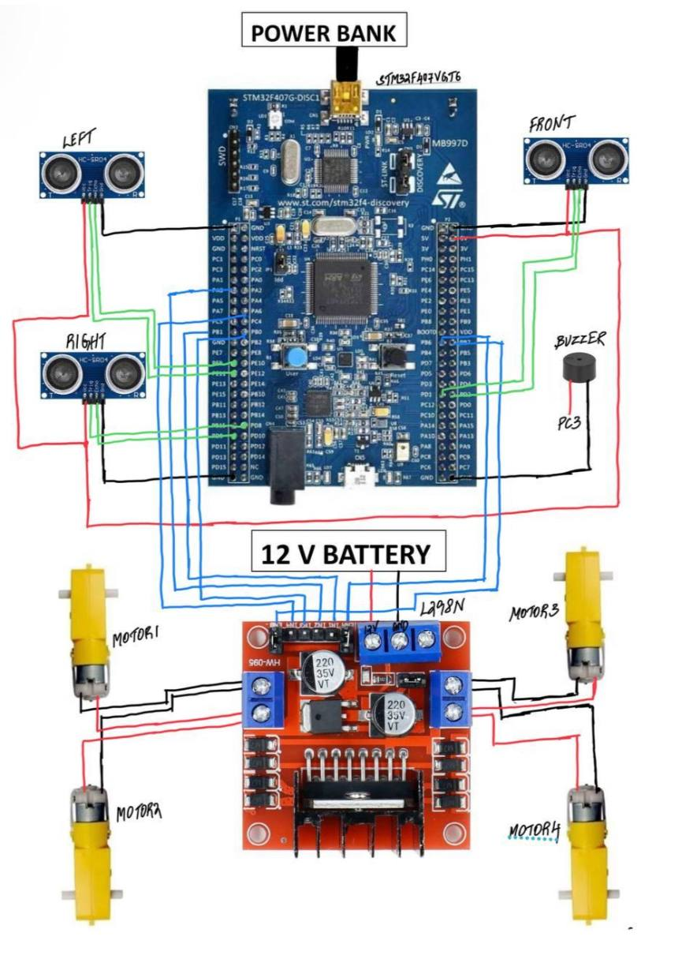
Go, change the world
CIRCUIT
DIAGRAM

Slide 9
Go, change the world
RESULTS
The robot detects obstacles accurately using a single ultrasonic sensor.
It reduces speed automatically as it approaches an obstacle, enhancing safety.
When very close to an object (e.g., <10 cm), a buzzer alert is triggered.
The system demonstrates real-time response using STM32F7 and embedded C programming.
The project validates distance-based speed control logic with minimal hardware.

Slide 10
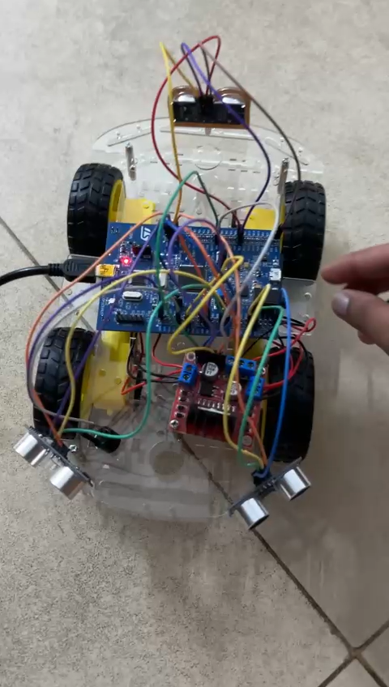
VIDEO OF WORKING MODEL

Slide 11
REFERENCES
https://www.ijraset.com/fileserve.php?FID=27347
https://www.ijareeie.com/upload/2019/july/31_Proximity.pdf
https://academicanswers.waldenu.edu/faq/73215
https://columbiacollege-ca.libguides.com/c.php?g=713274&p=5228078

Slide 12

Go, change the world
THANK YOU

