Slide 1

PROJECT BASED LEARNING Frequency Division Multiplexing
Go, change the world

Slide 2
INTRODUCTION
Go, change the world
Modern communication systems demand secure and efficient transmission, especially for analog signals.
Analog signals are prone to interception, distortion, and unauthorized access.
Traditional analog systems lack encryption and are vulnerable in shared channels.
Frequency Division Multiplexing (FDM) allows multiple signals to share a channel without interference.
Encryption using pseudo-random phase modulation (PRPM) adds a security layer before transmission.
The project simulates a secure analog communication model using MATLAB Simulink R2024b.
Focus: Clarity, simplicity, and effectiveness for educational and low-complexity systems.

Slide 3
Problem Statement
Go, change the world
Traditional analog systems lack built-in security, making them vulnerable to eavesdropping, distortion, and unauthorized access during transmission.
There is a need for a system that provides encryption, multiplexing, and accurate recovery to ensure secure, interference-free, and simultaneous transmission of multiple analog signals.

Slide 4
🎯OBJECTIVES
Go, change the world
Achieve secure and simultaneous transmission of multiple analog signals over a single channel.
Ensure signal-level encryption using pseudo-random phase modulation to protect message confidentiality.
Enable interference-free communication through Frequency Division Multiplexing (FDM).
Ensure accurate demodulation and recovery of original signals at the receiver using synchronized keys.

Slide 5
System Overview
Go, change the world
The system simulates a complete analog communication chain with encryption and FDM.
Transmitter Side:
Generate analog signals
Encrypt each using
pseudo-random phase modulation
Modulate with distinct carriers (DSB-SC)
Combine via FDM
Receiver Side:
Demultiplex using synchronized carriers
Decrypt using matching pseudo-random sequences
Apply low-pass filtering to recover original signals
Ensures secure, simultaneous, and interference-free signal transmission and recovery.

Slide 6
Encryption Technique
Go, change the world
Each analog signal is encrypted using pseudo-random phase modulation.
A PN Sequence Generator produces a binary stream (0s and 1s).
The binary values are mapped to phase shifts: 0 → 0 rad, 1 → π rad.
These phase shifts are added to the carrier signal's phase.
The resulting phase-modulated carrier is multiplied with the analog message signal.
This masks the original signal in the phase domain, ensuring it cannot be understood without the correct PN sequence.

Slide 7
FDM & Modulation Process
Go, change the world
Each encrypted signal is modulated using Double Sideband Suppressed Carrier (DSB-SC) modulation.
Carrier frequencies are assigned to each signal to ensure spectral separation.
Modulated signals are combined using a summation block to form a single composite signal.
This process enables simultaneous transmission without interference between signals.
Frequency spacing is critical to prevent overlap and cross-talk during transmission.

Slide 8
Receiver Demodulation and Decryption
Go, change the world
The received FDM signal is first multiplied with the synchronized PRPM-modified carrier for each branch.
This step simultaneously performs decryption and coherent demodulation, bringing each signal to baseband.
After that, the signal is demultiplexed into separate branches using matched carrier frequencies.
Each path uses the same pseudo-random sequence and carrier as the transmitter for accurate phase reversal.
The output is passed through low-pass filters to recover the original analog signals.
Precise synchronization of carrier phase and PN sequence is critical for successful recovery.

Slide 9
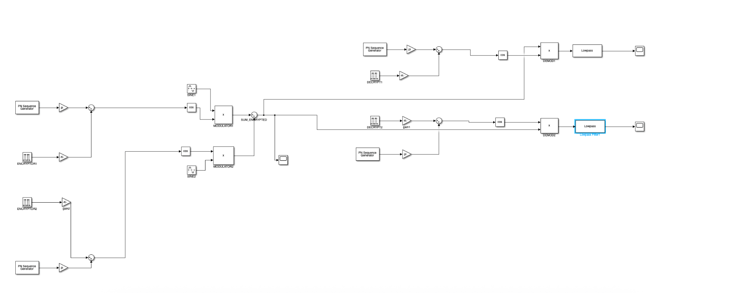
Go, change the world

Slide 10
Tools and Techniques Used
(Designed on MATLAB Simulink)
Go, change the world
Simulink R2024b used for designing and simulating the entire communication system using graphical blocks.
Signal Generation:
Two Sine Wave blocks generate independent analog message signals.
Encryption:
PN Sequence Generator → Gain block (×π) → Sum block to shift carrier phase (0 or π).
Trigonometric Function (cos) generates carrier; multiplied with message to produce encrypted signal.
Modulation & FDM:
Encrypted signals are modulated with distinct high-frequency carriers using Product blocks.
A Sum block combines the modulated outputs into one FDM signal.
Receiver Decryption & Demodulation:
Each branch uses synchronized PRPM-modified carriers for coherent demodulation

Slide 11
Results and Observations
Go, change the world
Encrypted signals appeared as distorted and unintelligible waveforms on the scope, confirming successful masking.
Recovered signals after decryption and filtering closely matched the original sine waves in amplitude, phase, and shape.
No noticeable delay or distortion, indicating proper synchronization between transmitter and receiver.
Carrier frequencies were set at 1000 Hz and 2000 Hz, providing enough spectral separation to avoid overlap and cross-talk.
Correct PN sequence synchronization was essential—any mismatch led to failed decryption or noise-like output.
The system performed efficiently using only standard Simulink blocks with low computational complexity.

Slide 12
Conclusion and Future Scope
Go, change the world
Successfully simulated a secure analog communication system using pseudo-random phase modulation and FDM in Simulink.
Achieved simultaneous, interference-free transmission of multiple signals over a single channel.
Encryption ensured that signals were unrecoverable without the correct phase key and synchronization.
Demonstrated that a simple and lightweight system can offer effective security in analog domains.
Future scope includes:
*Extending to more than two signals
*Exploring digital modulation techniques
*Adding channel noise and delays to test real-world robustness.

