Slide 1
GeoAI Agricultural Plastic Cover Mapping with Satellite Imagery A Project Report Submitted to Nokia
Student Name | USN | Email-ID
Anwitha Vishwanath | 1RV23ET010 | anwithav.et23@rvce.edu.in
S Shreya | 1RV23ET037 | sshreya.et23@rvce.edu.in

Slide 2
Project Overview
Developed a unified machine learning model for plastic cover detection.
Applied to datasets from Kenya, Spain, and Vietnam.
Used ensemble learning: Random Forest, Gradient Boosting, and Logistic Regression.
Feature engineering: interaction terms & mean-encoding.
Achieved 99.43% cross-validation accuracy.
Scalable pipeline for agriculture and remote sensing applications.

Slide 3
Objectives
Develop a Unified Classification Model
Build a single machine learning model capable of accurately detecting plastic cover across three diverse countries — Kenya, Spain, and Vietnam — using satellite- derived features.
Ensure Cross-Country Generalization
Create a robust pipeline that generalizes well across varying environmental, climatic, and feature conditions without requiring separate models for each region.
Leverage Ensemble Learning for High Accuracy
Utilize a stacking ensemble with Random Forest and Gradient Boosting as base learners and Logistic Regression as the meta-classifier to boost prediction performance.
Achieve High Model Performance and Reproducibility
Optimize the pipeline for accuracy (targeting >99%) using Stratified K-Fold Cross- Validation, while maintaining a modular and reusable code structure for future use.

Slide 4
Dataset Description
This project utilizes structured geospatial datasets sourced from the FAO GeoAI 2024 Challenge, which provides satellite-derived features for plastic cover classification across three countries: Kenya, Spain, and Vietnam.
Common Columns in Each File
Column Name | Description
ID | Unique identifier for each record
Lat, Lon | Geographic coordinates (not used in training)
TARGET | Target label to be predicted (1 or 2)
Other | 30–40 satellite-derived continuous features

Slide 5
Data Characteristics
All datasets contain numerical features derived from remote sensing and environmental indices.
TARGET is a binary label :
Class 1 → mapped to 0
Class 2 → mapped to 1
Feature distributions vary across countries, requiring scaling and preprocessing.
Some features have low variance or missing values, filtered before model training.

Slide 6
Data preprocessing
🔹 Label Mapping
Converted TARGET values from {1, 2} to {0, 1} to make it compatible with binary classification models.
🔹 Column Dropping
Removed non-informative columns like ID, Lat, Lon, lon, lat which do not help in prediction.
🔹 Low Variance Filtering
Eliminated features with very low variance (threshold = 0.015) to reduce noise and overfitting.
🔹 Standardization
Applied StandardScaler to normalize features — ensures fair weightage across models, especially in logistic regression and boosting.

Slide 7
Feature enginerring
🔹 Interaction Features
Generated 20 new features by multiplying top feature pairs to capture hidden non-linear relationships between variables.
🔹 Mean Encoding
Mean-encoded the two most correlated features using the average TARGET values, adding class-level signal to the data
🔹 Feature Correlation Analysis
Used correlation scores with TARGET to identify the most informative features for encoding and interaction.
🔹 Cross-Dataset Compatibility
Ensured the new features (interaction and encoded) were consistently created across Kenya, Spain, and Vietnam datasets.

Slide 8
Model Architecture
🔹 Stacking Ensemble Approach: Combined multiple models in layers — two base learners and one meta-learner — to improve predictive accuracy and generalization.
🔹 Base Learners: Used Random Forest (500 trees, max depth 20) and Gradient Boosting (300 estimators, depth 4) to capture both broad and focused patterns in the data.
🔹 Meta-Learner: Used Logistic Regression as the final decision layer to combine base outputs with regularization and prevent overfitting.
🔹 Stratified K-Fold Integration: Implemented 5-fold stratified cross-validation inside the stacking model to ensure robustness and maintain class balance during training.

Slide 9
Model | Type | Strengths | Role in Stacking
Random Forest | Ensemble (Bagging) | Handles noisy features, reduces overfitting, works well on large datasets | Captures broad patterns with low variance
Gradient Boosting | Ensemble (Boosting) | Learns from previous errors, excellent for fine-tuning complex relationships | Focuses on hard-to-classify samples
Logistic Regression | Linear Classifier | Interpretable, regularized, fast and effective on scaled data | Final decision layer to combine base model predictions

Slide 10
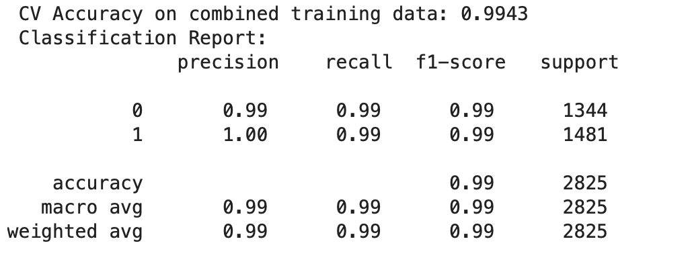
Result
Precision: Out of all predicted positives, how many were actually correct.
Recall: Out of all actual positives, how many did the model correctly catch.
F1-score: The balanced average of precision and recall.
Support: The actual number of samples belonging to each class.

Slide 11
THANK YOU

