Slide 1

Forta Knight
Making the Blockchain a Safer Place
Company: Forta
Mentor: Christian Seifert
Team: Nicholas Brown, John Lin, Andy Wu, Khalid Mihlar, Alejandro Rojas Rodriguez

Slide 2
What is The Blockchain?
Decentralized
Powerful
High Risk for Abuse
Funds and protocols are not controlled by a centralized entity
Anyone can design blockchain protocols and even create new tokens
Limited regulations and safety practices to ensure the safety of users

Slide 3
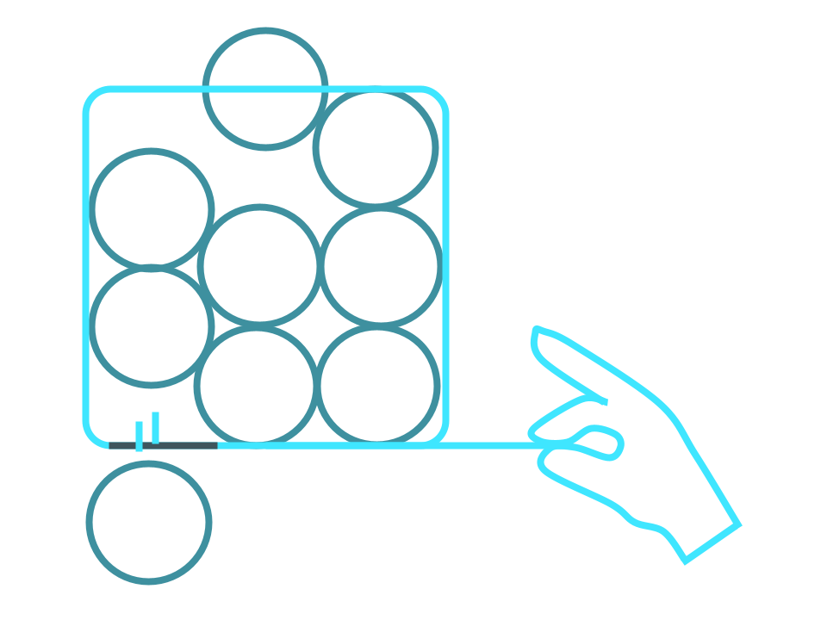
Rug Pulls
Scammers create seemingly lucrative tokens to get users to invest
These tokens contain malicious functions to steal tokens from users or manipulate the token’s price
This allows them to make money at the expense of other users

Slide 4
Why Should We Care?
From Sept-Dec 2022:
$11 Billion
> 200,000
99%
Solidus Labs. “The 2022 Rug Pull Report.” The Rug Pull Report, Dec. 2022, p. 4.
Value of ETH withdrawn and deposited by scammers from centralized exchanges
Scam tokens that are not detected using traditional approaches
Number of scam tokens deployed

Slide 5
Current Approaches
Internet Postings
Transaction Analysis
Users research the legitimacy of a token online, but the scams aren’t known until it’s too late
Rug pulls are usually identified by looking at price/transaction history, but these only reveal the scams once users have lost money

Slide 6
How We Can Help
Static Analysis
Forta
We analyze the source code of new tokens to look for malicious code
Allows us to write a bot that monitors Blockchain transactions and alerts on suspicious activity
Alerts
We send out alerts to inform users about potentially malicious tokens
Forta Knight
Our bot looks for token deployments on the Ethereum and Polygon networks
ZenGo Wallet Integration
Forta’s integration with ZenGo wallet allows users to get warnings when interacting with suspicious contracts

Slide 7
Why Are We Better?
Speed
Static Analysis allows us to detect potential scams before they actually happen
Ease of Use
Forta has integrations with the ZenGo wallet which can inform users about alerts when they interact with a scam contract

Slide 8
Our Detection Strategies
 | Strategy | DESCRIPTION
01 | Hidden Mint Detection | Hidden mints can be used to create additional tokens for the scammer.
02 | Burn Function Detection | Hidden burn functions can be used to remove tokens from the circulation.
03 | Self Destruct Detection | Self destruct functions can be used to steal all the money in a contract.

Slide 9
Demo Time!

Slide 10
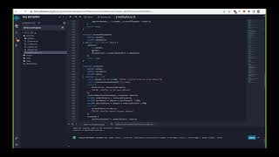

Slide 11

Ideas For Further Development
Improve static analysis detectors to include control flow and value flow analysis
Use detector results as input to a machine learning model to improve precision of alerts
Create more detectors to detect other rug pull strategies

Slide 12
Accomplishments
1.45s
Detector | Recall | False Positive Rate
Mint Function Detector | 35/38 | 3/21
Burn Function Detector | 29/32 | 0/12
Self Destruct Detector | 3/3 | 0/46
Average time to run analysis on a token after its source code has been downloaded

Slide 13

Don’t Get Scammed, use Forta Knight!

Slide 14

THANKS!
Any questions?
Please keep this slide for attribution

