Slide 1
Quantifying Gerrymandering via Recombination Markov Chain and the Score Function
Professor Vigoda’s Group
Andy Wu, Nicolas Johnson

Slide 2
What is Gerrymandering:
Most states in the U.S. are divided into a number of districts, and the total votes in each district elects a single elector or congressman.
States can create an imbalance in demographics (republicans, democrats, minorities, etc.) in each district and influencing the results of votes.
Unfortunately, some states purposely draw biased redistricting plans to elect representatives of a particular political party.
This practice undermines U.S democracy
Your vote may be of less value than someone’s vote in another district, and this could be on purpose in theory because of your race, age, political affiliations, religion etc.

Slide 3
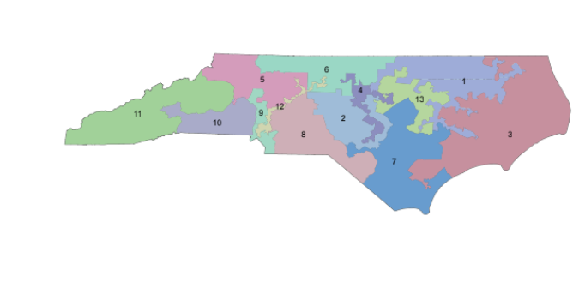

Slide 4
Solution to fight Gerrymandering: THE MCMC
Markov Chain Monte Carlo:
Randomly generates a large collection of redistricting plans than can be compared with actual government district plans.
The large sample of randomly generated redistricting plans will converge to a non-partisan, normal distribution. This makes them ideal for comparisons.
If the real district plans do not occur frequently in the distribution, then there may be signs of gerrymandering in the actual government district plans.

Slide 5
Past Research:
The Score function - Jonathan C. Mattingly and Christy Vaughn. Redistricting and the will of the people. 2014.
constrain the population size and shape of a district for better representation of non-partisanship when generating redistricting plans
helps sample randomly generated redistricting plans that are better suited for comparisons with real district plans.

Slide 6
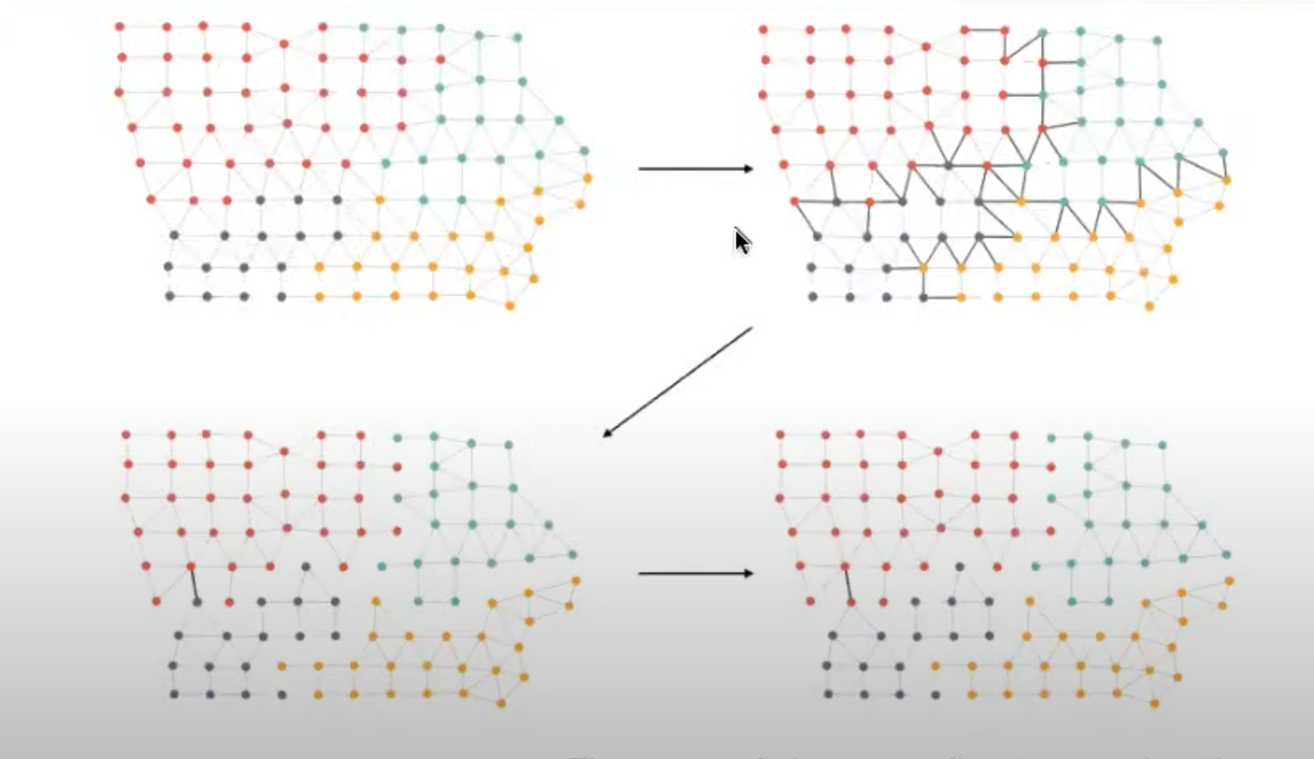
Past Research:
Flip Markov Chain Approach
Implements the score function.
Gregory Herschlag, Han Sung Kang, Justin Luo, Christy Vaughn Graves, Sachet Bangia, Robert Ravier, and Jonathan C. Mattingly. Quantifying gerrymandering in north carolina. 2018.

Slide 7
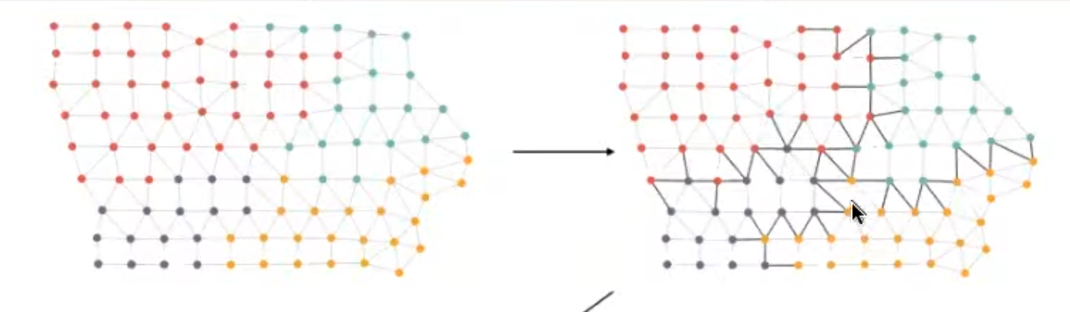
Flip Markov Chain
Step 1: Group the precincts into the districts, draw edges between neighboring precincts, and find the conflicting edges.

Slide 8
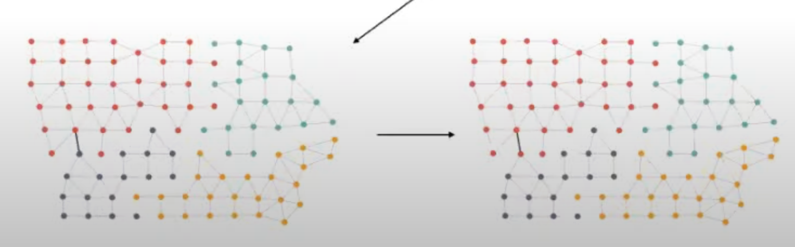
Flip Markov Chain
Step 2: Randomly select one of the conflicting edges.
Step 3: Switch what district that the precinct belongs to.

Slide 9
Past Research (ctd)
The Flip Markov Chain is relatively slow, so more recent studies have created faster algorithms:
Graph-Cut Approach
Takes into account equal population, but is difficult to use with other constraints.
Recombination Markov Chain
Has not been used with the score function either, but implementing the score function is more plausible.
-Benjamin Fifield, Michael Higgins, Kosuke Imai, and Alexander Tarr. Automated redistricting simulation using markov chain monte carlo. Journal of Computational and Graphical Statistics, 2020.
-Daryl DeFord, Moon Duchin, and Justin Solomon. Recombination: A family of markov chains for redistricting. Harvard Data Science Review, 2021

Slide 10
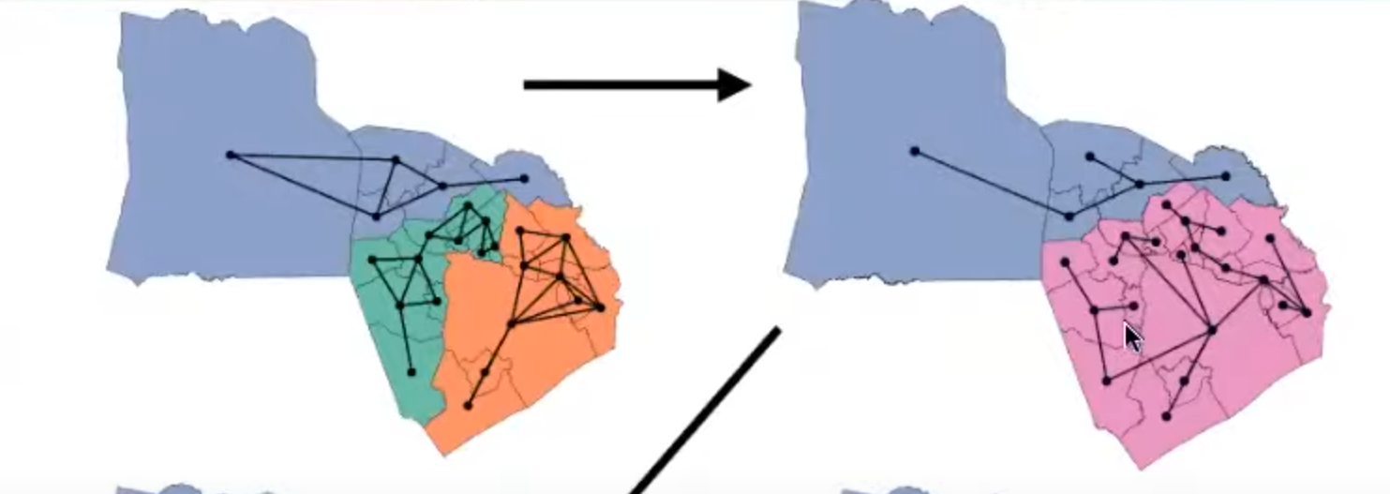
Recombination Markov Chain
Step 1: Merge two neighboring districts into a spanning tree. A spanning tree is just points connected by edges in a way so that if an edge is cut, the tree will split into exactly two pieces.

Slide 11
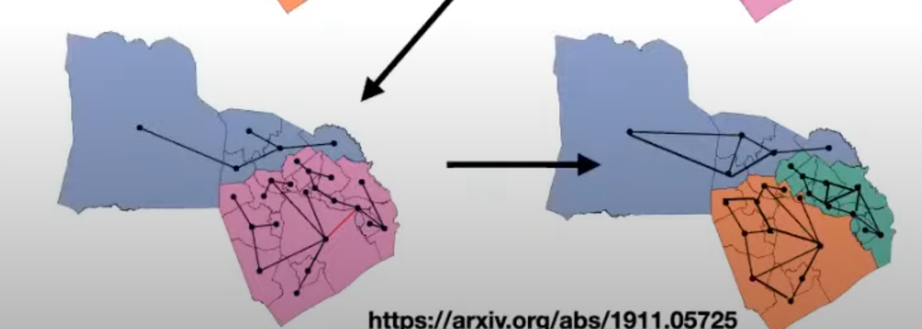
Recombination Markov Chain
Step 2: Select a random edge of the spanning tree and cut it. The spanning tree is split into two, and this creates two new districts and a new redistricting plan.

Slide 12
Problem Statement
The Recombination Markov Chain is a relatively fast algorithm that has not yet been implemented with the score function.
However, implementing the score function with the Recombination approach would make the MCMC algorithm generate better non-partisan redistricting plans that are more useful for comparisons.
Implementing the score function is important for giving judicial courts more confidence in the MCMC if it’s being used for evidence against gerrymandering.

Slide 13
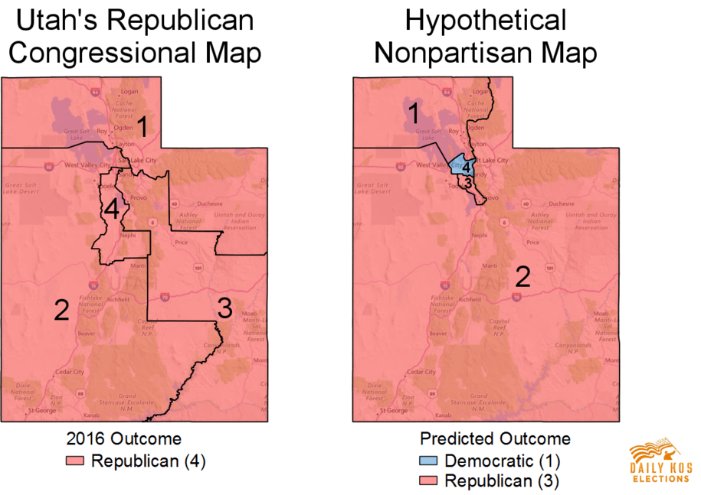
Proposed Solution
One state that has been overlooked by many past studies is Utah.
Utah voted consistently Republican
In 2016 election, Republicans won 46% and Democrats won 27% of votes

Slide 14
Proposed Solution (ctd)
Utah has a rectangular shape, making it easy to implement MCMC on.
Having only 4 districts makes implementing MCMC much more flexible

Slide 15
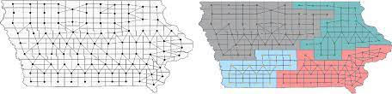
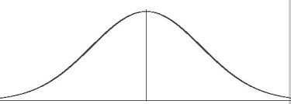
Methods/Processes
Obtaining and cleaning voting data
Implement Recombination Markov Chain
Generate large sample of redistricting plans
Compare Utah election results with generated redistricting plans

Slide 16
Evaluation
Methods of Evaluating non-partisanship:
Obtaining a third-party, non-partisan redistricting plan and comparing it to the collection of generated redistricting plans
Redistribution of votes to 50% Republican and 50% Democrat. Then, running MCMC on Utah to see if expected results is non-partisan

