Slide 1
Part 1 – Introduction

Slide 2
An Introduction to Data Science Using Python
Topics Covered:
What is and Why Data Science
Tools for doing Data Science in Python
Real-world Data Science example
Summary and conclusions

Slide 3
Data Science and Big Data
2 hot buzzwords in Technology today
What is Data Science ? Big Data ?
Why are they important ?

Slide 4
Defining Data Science
Wikipedia: Data Science is the extraction of knowledge from often large volumes of data that is structured or unstructured.
Structured Data : Data within a fixed field in a record e.g. spreadsheet, csv file or database
Unstructured Data : Data that is free-form and not easily extracted, such as emails, videos, social-media data and other user-generated content.

Slide 5
What Data Science Involves
Define the problem at hand
Finding data sources to help solve the problem and extracting this data
Writing programs to process, sort, clean and refine the data
Writing programs and algorithms to extract knowledge and insights from the data, all within hardware, software and bandwidth constraints

Slide 6
Data Science is derived from :
Mathematics, statistics and probability, information theory, computer science – incl. subfields.
Techniques involving Big Data are an area of huge interest in Data Science, although Data Science is much more than just Big Data.
Data Science makes use of data preparation and cleansing, and statistical analysis to investigate problems in many diverse fields such as meteorology, fraud detection, marketing optimization, energy exploration, health information services etc.
Notes:
Computer science subfields – data mining, database and data engineering, statistical
learning, predictive analytics, pattern recognition, visualization, high performance computing

Slide 7
Applications of Data Science
Signal processing
Image reconstruction
Machine Learning
Weather prediction
Financial Services

Slide 8
What is Big Data ?
General definition: the phenomenon where the amount of data exceeds the capability of the recipients to process it.
Practical definition - data that is too large to fit into working memory.
Current working memory limits for commodity hardware are in the tens of Terabytes, if at all. More typical values are in the 100s of Gigabytes. The largest shared memory system as of Nov 2014 provided up to 256 TB, but this can't be classified as commodity hardware
Source : http://bit.ly/1Q6EO3y

Slide 9
Sources of Big Data
Sources include : finance, social networks, video, seismic, sensors, email, medical imaging, text, voice, 3D
The reason why data is growing is that storing it becomes exponentially cheaper over time. This is illustrated by the graphic in the next slide.

Slide 10
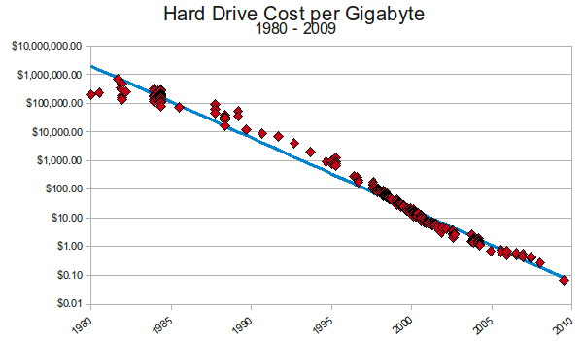
Storage Costs of Big Data
http://www.mkomo.com/assets/hd-cost-graph-small.png

Slide 11
The 4 V's of Big Data
Volume – Size of the data which is huge, for example 350 million photos are uploaded to Facebook every day which together with other user content amounts to 500TB of data.
Velocity – Throughput of the data, or how fast it is coming in and being processed.
Variety – The multiplicity of data sources that generate the data, and the different formats of the data that are produced.
Veracity – The correctness of the data or whether it represents the truth.

Slide 12
Part 2 – Tools of the Trade

Slide 13
Python Data Science stack
Python distributions – quite a few: Official CPython, ActivePython, Enthought, Anaconda. Anaconda – just use it !!. Seamlessly installs, and provides the entire Data Science stack.
Python modules: provide a toolkit for Data Science
NumPy : general-purpose array functionality with emphasis on numeric computation
Pandas : data analysis module using R-like data frames and Series
SciPy : Numerical computing
Matplotlib : provides graphing and plotting capabilities.
Scikit-learn : machine-learning package

Slide 14
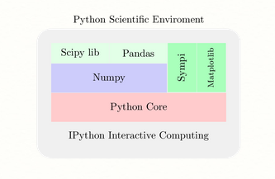
Python Data Science stack

Slide 15
Anaconda Installation
As easy as 1-2-3.
Visit : http://continuum.io/downloads
Follow the instructions which are very straightforward.
Installs seamlessly on Unix/Linux, Mac OS/X and Windows platforms.

Slide 16
Interactive Python (IPython)
Vital part of toolset for Data Science
Provides interactive environment for the user to type in Python commands and see the result instantly.
Essential for the exploratory and discovery phase of the Data Science life cycle.
The notebook version is even more useful. It is browser-based and embedded rich text, code, mathematics and figures. It provides a platform to support reproducible research, since all inputs and outputs may be stored in a one-to-one way in notebook documents.

Slide 17
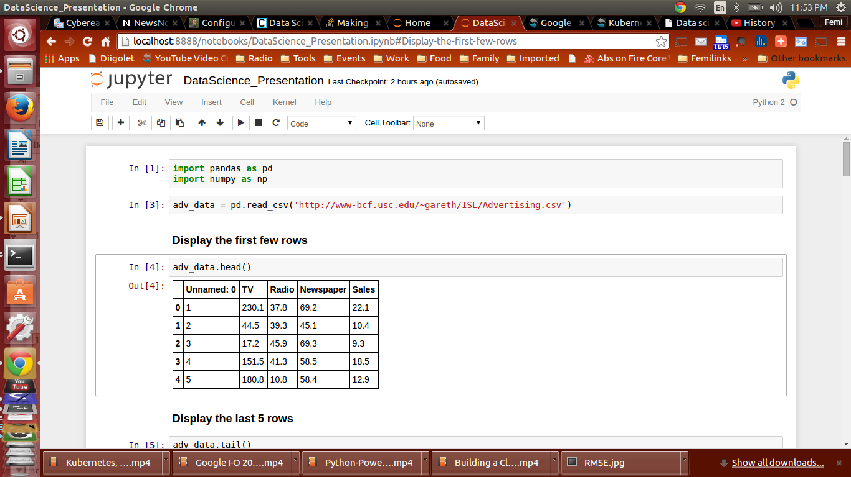
IPython

Slide 18

Offers the type numpy.ndarray , a homogenous multidimensional array
Access to numerous mathematical functions – linear algebra, statistics,and so on
Ability to integrate C, C++, and Fortran code
Foundation module for SciPy, Pandas

Slide 19

Offers functionality for numeric and scientific computing – statistics, optimization, signal processing.
Built on top of NumPy
Foundation for add-on packages referred to as scikits. The most well-known is scikit-learn, used for machine learning and data mining.
To learn about other scikits, see: http://scikits.appspot.com/sckits

Slide 20

Provides rich visualization and graphing functionality
Can display graphics inline within IPython or in a separate external window
Built on plotting functionality available in Matlab

Slide 21
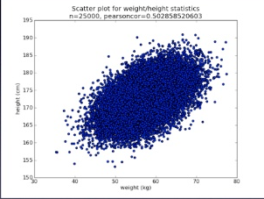
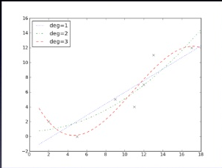



Slide 22
NumPy + SciPy + matplotlib + IPython
Provide an environment similar to the Matlab toolbox for numeric and scientific computing
Invoking IPython and importing these modules : ipython notebook - #Invoke Ipython
[1]: import numpy as np
[2]: import scipy as sc
[3]: import matplotlib.pyplot as plt

Slide 23
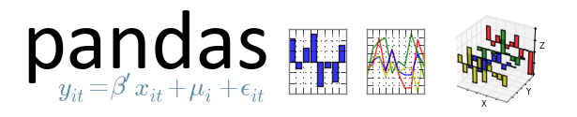
High-performance open source library for data analysis in Python
Key Features:
Process data in different formats
Can load data from varied sources – CSV, SQL.
Can perform many operations on data sets – slicing, sub-setting, filtering, merging, grouping etc.
Can handle missing data.
Integrates well with other Python data libraries
Delivers fast performance

Slide 24
Provides 2 key data structures:
Series - Really a 1D NumPy array under the hood. It consists of a NumPy array coupled with an array of labels.
DataFrame - 2-dimensional labeled array. Its column types can be heterogeneous. Conceptually analogous to a table or spreadsheet of data.

Slide 25
Import module
import pandas as pd
Read csv file into DataFrame
weather_df = pd.read_csv('./weather.csv')
Create Series and DataFrame
prices_day1 = pd.Series({'AMZN' : 200.0, 'AAPL': 100.0, 'FB' : 96.7})
prices_day2 = pd.Series({'AMZN' : 197.8, 'AAPL': 99.2, 'FB' : 99.75})
all_prices = pd.DataFrame([prices_day1,prices_day2])
print all_prices
AAPL AMZN FB
0 100.0 200.0 96.70
1 99.2 197.8 99.75

Slide 26
Machine Learning
Yet another buzzword associated with Data Science.
Other synonyms are statistical learning, data mining.
Simply put : Machine Learning means programming computers to 'learn from data'

Slide 27
Types of Machine Learning
Machine Learning programs are written to solve learning problems.
Learning problems take a dataset of m samples with n features and produce an output which in most cases is a prediction.
2 types of learning problems:
Supervised Learning
Unsupervised Learning

Slide 28
Supervised Learning
The input to the learning problem is a dataset consisting of labeled data. By labeled data we mean we have inputs and corresponding outputs whose values are known.
Example: learning data for a spam identifier. This data would consist of examples of spam and non-spam messages or text with output indicating whether the text is spam or not. The program would use this data to “learn” how to identify spam.
Supervised learning problems include the following:
Classification: The learned attribute is categorical (nominal) or discrete
Regression: The learned attribute is numeric/continuous

Slide 29
Unsupervised Learning
The learning program is fed inputs but no corresponding outputs. This input data is unlabeled. The program's goal is to learn or decipher the hidden label.
Such problems include the following:
Clustering : grouping similar items in dataset
Dimensionality reduction : reducing the number of variables or dimensions under consideration in order to easier visualize or explain the data.

Slide 30
Applications of Machine Learning
Content classification e.g. web page classification
Spell correction and word completion
Search ranking
Email spam detection
Handwriting recognition
Predicting Emergency room waiting times
Recommendation engines

Slide 31
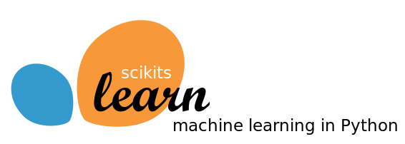
The scikit-learn library provides machine learning functionality.
It has provides an extensive set of algorithms that can be used to create adaptive programs that learn from data inputs.
It is is one of the scikit packages built on top of SciPy.

Slide 32
Part 3 – Illustrative Example

Slide 33
Sales - Advertising channel attribution
Suppose you're the analyst on the marketing team for an organization that has decided to go on a large marketing campaign to boost the sales of a new product.
The marketing campaign decides to use 3 different channels for advertising: TV, radio and newspaper each with separate budgets.
You're presented with advertising and sales data of the product for the marketing campaign across 200 markets.
Your Task: Develop a model that can be used to predict sales based on the budgets of the 3 advertising channels.

Slide 34
Modeling the problem - I
What we need here is a predictive model.
A predictive model is a mathematical algorithm that predicts a target variable from a number of factor/input variables.
In this case, we pass in what are
Input variables: the 3 advertising budgets - TV, radio, newspapers. We try to predict the :
Target/Output Variables: Sales of the product

Slide 35
Modeling the problem - II
This predictive model can also be cast as a machine Learning problem and when that is done we refer to our input variables as features and our output variable as the response.
In Machine Learning there are many models to choose from. In this case we will model the problem using Linear Regression

Slide 36
Linear Regression
Well known model used in statistics
Model our response variable by means of a linear equation
Basic linear regression model looks like the following: y = b₀ + b₁*X₁ + b₂*X₂ + b₃*X₃ + ... + b_{n}*X_{n} where y is the response, X_{i} are the input variables. The b₀...b_{n} values are called the linear regression model coefficients.

Slide 37
Linear Regression
Linear regression models are fitted using the method of least squares, and the “line of best” fit is calculated.
The 'line of best fit' is the line that minimizes the sum of squared distances or mean-squared error of all points in the data to the line. Simply put – it is the best 'closest' line to all the points when the data is plotted.

Slide 38
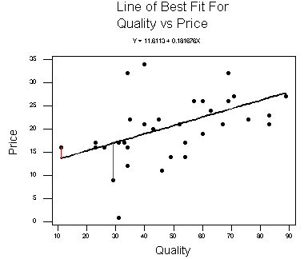
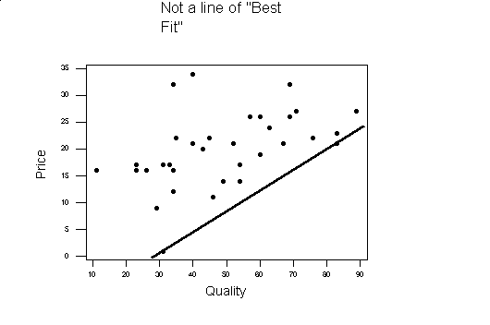
Line of best fit

Slide 39
Application of LR to the problem
Applying linear regression to our problem, the model now becomes: Sales = b₀ + b₁ * TV + b₂ * Radio + b₃ * Newspaper
One downside to Linear Regression is that it doesn't always produce the best predictive accuracy because it assumes a linear relationship between the input features and the response.
Given that we now understand the model, let us fire up IPython and start our analysis.

Slide 40
Summary
So what have we learned today ?
Introduced the concepts of Data Science and Big Data and why they're important
Looked at the Python stack for doing Data Science and where each module fits in.
Understood the field of Machine Learning and some of the concepts.
Walked through a concrete example that uses some of the Python tools in the stack – pandas, scikit-learn, NumPy, matplotlib.

Slide 41
Useful References
Pandas
Online resource: http://pandas.pydata.org/pandas-docs/stable/
Books
Mastering Pandas - Femi Anthony - http://amzn.to/1GljMsq
Python for Data Analysis - Wes McKinney
Learning Pandas - Michael Heydt

Slide 42
References
Scikit-Learn
Online resource: http://scikit-learn.org/stable/
Books
Mastering Machine Learning with Scikit-learn - Gavin Hackeling
Learning scikit-learn: Machine Learning in Python - Garreta and Monchechi
scikit-learn cookbook - Trent Hauck

Slide 43
Femi Anthony
Twitter: @DataPhanatik
Email: femibyte@gmail.com
Github: https://github.com/femibyte/intro_datascience_python
Mastering Pandas book: http://amzn.to/1RvGOSB

