Slide 1
导航，Menu

Slide 2
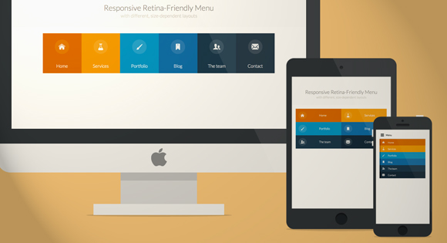
Responsive Retina-Ready Menu http://tympanus.net/codrops/2013/05/08/responsive-retina-ready-menu/

Slide 3
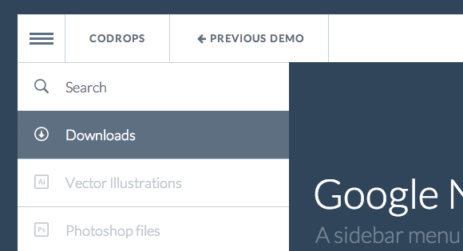
Google Nexus Website Menu http://tympanus.net/codrops/2013/07/30/google-nexus-website-menu/

Slide 4

Building a Circular Navigation with CSS Transforms http://tympanus.net/codrops/2013/08/09/building-a-circular-navigation-with-css-transforms/

Slide 5
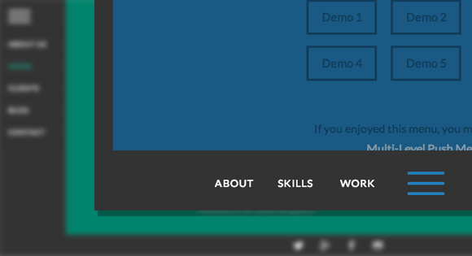
Animated Border Menus http://tympanus.net/codrops/2013/09/30/animated-border-menus/

Slide 6
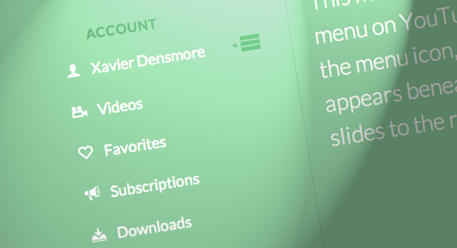
Simple YouTube Menu Effect http://tympanus.net/codrops/2013/04/25/simple-youtube-menu-effect/

Slide 7

CSS-Only Responsive Layout with Smooth Transitions http://tympanus.net/codrops/2012/06/12/css-only-responsive-layout-with-smooth-transitions/

Slide 8
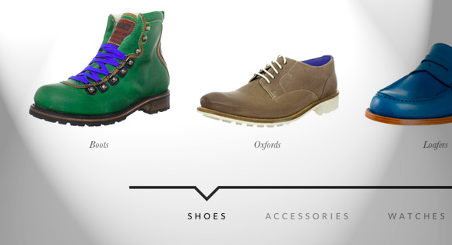
How to Create a Simple Multi-Item Slider http://tympanus.net/codrops/2012/12/31/how-to-create-a-simple-multi-item-slider/

Slide 9
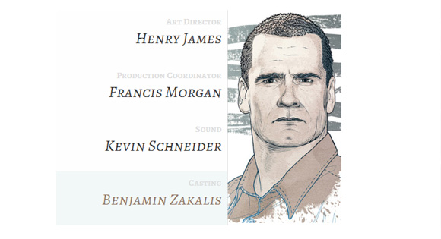
How to spice up your menu with CSS3 http://tympanus.net/codrops/2012/01/22/how-to-spice-up-your-menu-with-css3/

Slide 10

Responsive Content Navigator with CSS3 http://tympanus.net/codrops/2012/03/23/responsive-content-navigator-with-css3/

Slide 11
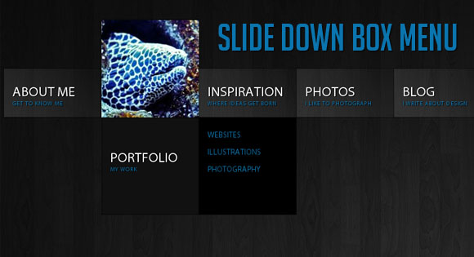
Slide Down Box Menu with jQuery and CSS3 http://tympanus.net/codrops/2010/07/16/slide-down-box-menu/

Slide 12
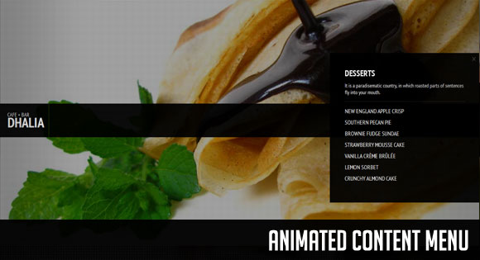
Animated Content Menu with jQuery http://tympanus.net/codrops/2011/03/09/animated-content-menu/

Slide 13

Overlay Effect Menu with jQuery http://tympanus.net/codrops/2010/11/25/overlay-effect-menu/

Slide 14

Expanding Image Menu with jQuery http://tympanus.net/codrops/2011/03/16/expanding-image-menu/

Slide 15

Blur Menu with CSS3 Transitions http://tympanus.net/codrops/2011/10/19/blur-menu-with-css3-transitions/

Slide 16
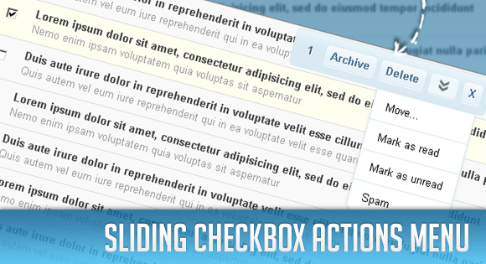
Sliding Checkbox Actions Menu with jQuery http://tympanus.net/codrops/2010/05/31/sliding-checkbox-actions-menu-with-jquery/

Slide 17
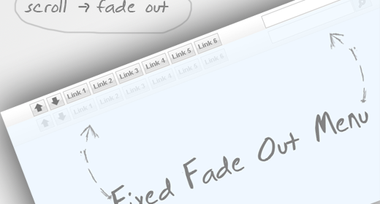
Fixed Fade Out Menu: A CSS and jQuery Tutorial http://tympanus.net/codrops/2009/12/11/fixed-fade-out-menu-a-css-and-jquery-tutorial/

Slide 18
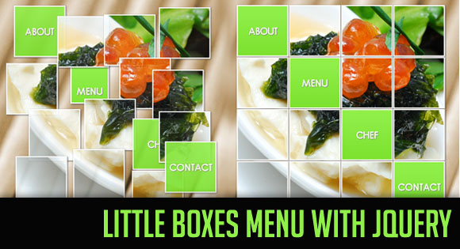
Little Boxes Menu with jQuery http://tympanus.net/codrops/2010/05/18/little-boxes-menu-with-jquery/

Slide 19

Awesome Cufonized Fly-out Menu with jQuery and CSS3 http://tympanus.net/codrops/2010/06/28/awesome-cufonized-fly-out-menu/

Slide 20
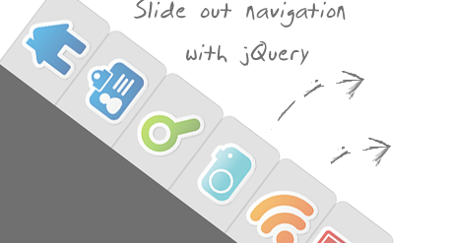
Beautiful Slide Out Navigation http://tympanus.net/codrops/2009/11/30/beautiful-slide-out-navigation-a-css-and-jquery-tutorial/

Slide 21
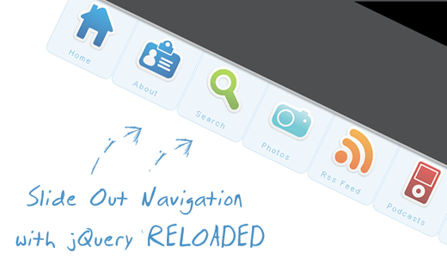
Beautiful Slide Out Navigation Revised http://tympanus.net/codrops/2009/12/08/beautiful-slide-out-navigation-revised/

Slide 22

Rocking and Rolling Rounded Menu with jQuery http://tympanus.net/codrops/2010/04/30/rocking-and-rolling-rounded-menu-with-jquery/

Slide 23

Awesome Bubble Navigation with jQuery http://tympanus.net/codrops/2010/04/29/awesome-bubble-navigation-with-jquery/

Slide 24
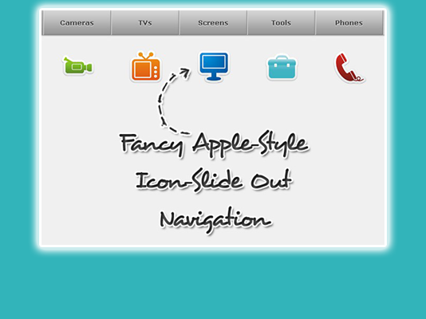
Fancy Apple-Style Icon Slide Out Navigation http://tympanus.net/codrops/2010/01/17/css-and-jquery-tutorial-fancy-apple-style-icon-slide-out-navigation/

Slide 25

Stunning Circular Motion Effect with jQuery http://tympanus.net/codrops/2010/05/07/stunning-circular-motion-effect/

Slide 26

A Fresh Bottom Slide Out Menu with jQuery http://tympanus.net/codrops/2010/03/09/a-fresh-bottom-slide-out-menu-with-jquery/

Slide 27
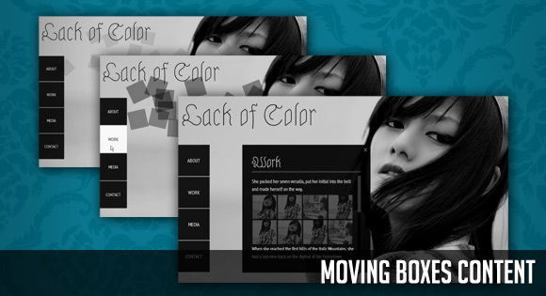
Moving Boxes Content with jQuery http://tympanus.net/codrops/2011/03/28/moving-boxes-content/

Slide 28
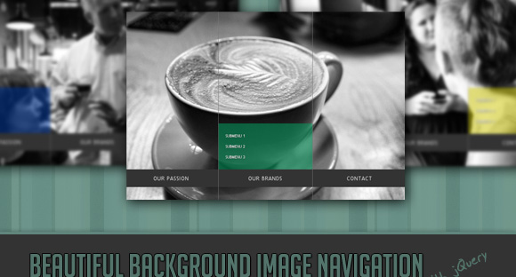
Beautiful Background Image Navigation with jQuery http://tympanus.net/codrops/2010/05/05/beautiful-background-image-navigation-with-jquery/

Slide 29
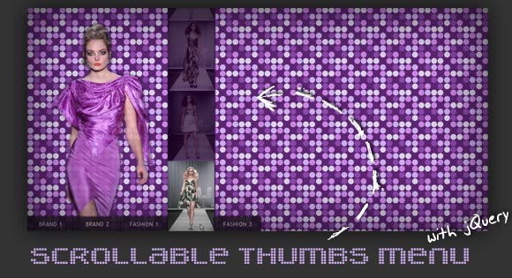
Scrollable Thumbs Menu with jQuery http://tympanus.net/codrops/2010/05/10/scrollable-thumbs-menu/

Slide 30
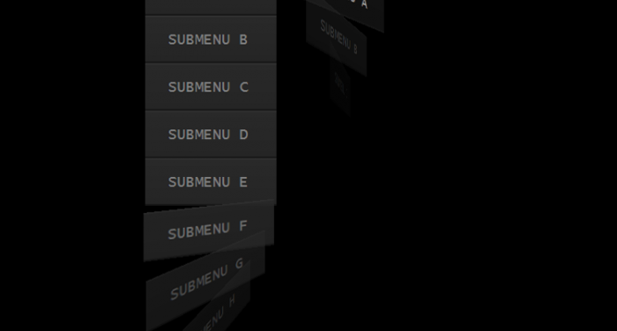
Whirling CSS3 dropdown menu https://www.script-tutorials.com/whirling-dropdown-menu/

Slide 31

CSS3 Minimalistic Navigation Menu http://tutorialzine.com/2010/06/css3-minimalistic-navigation-menu/

Slide 32
Line Menu Icon https://css-tricks.com/line-menu-icon-menu/

Slide 33
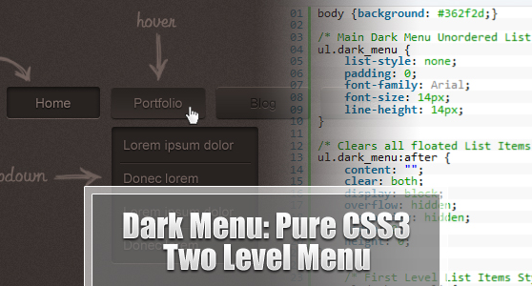
Dark Menu http://www.ahmadhania.com/2011/06/dark-menu-pure-css3-two-level-menu-tutorial.html

Slide 34
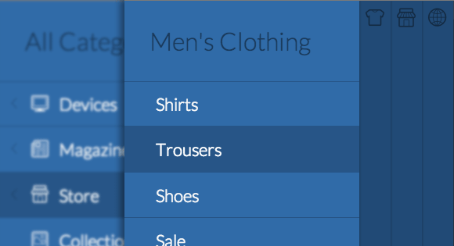
Multi-Level Push Menu http://tympanus.net/codrops/2013/08/13/multi-level-push-menu/

Slide 35
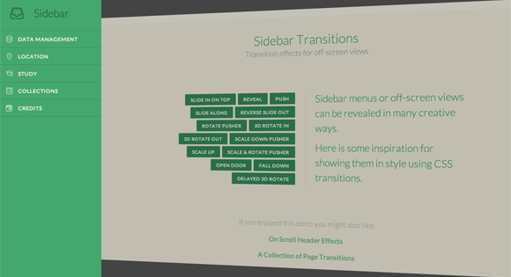
Transitions for Off-Canvas Navigations http://tympanus.net/codrops/2013/08/28/transitions-for-off-canvas-navigations/

Slide 36
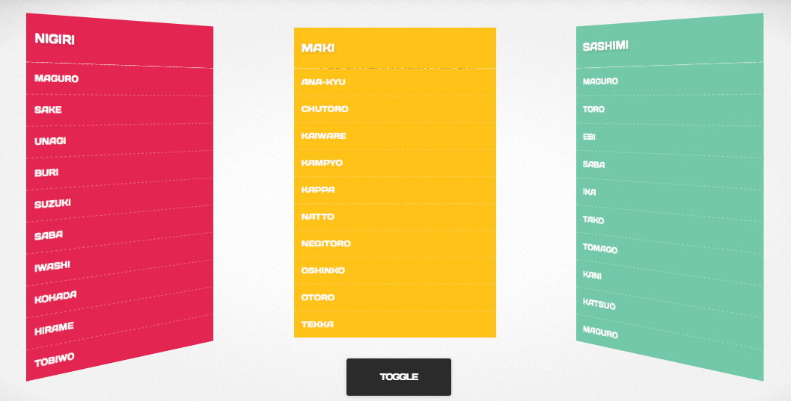
Makisu https://github.com/soulwire/Makisu

Slide 37
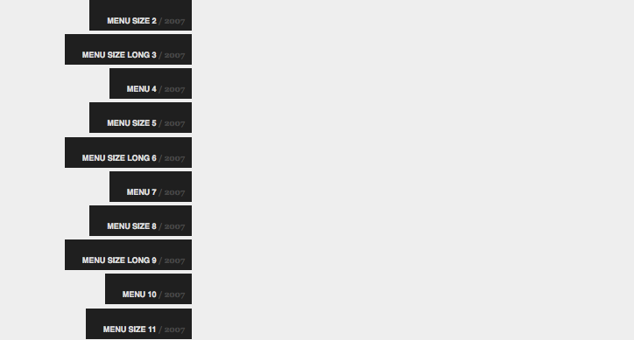
Scroll Menu with jQuery Tutorial http://www.queness.com/resources/html/scrollmenu/index.html

Slide 38
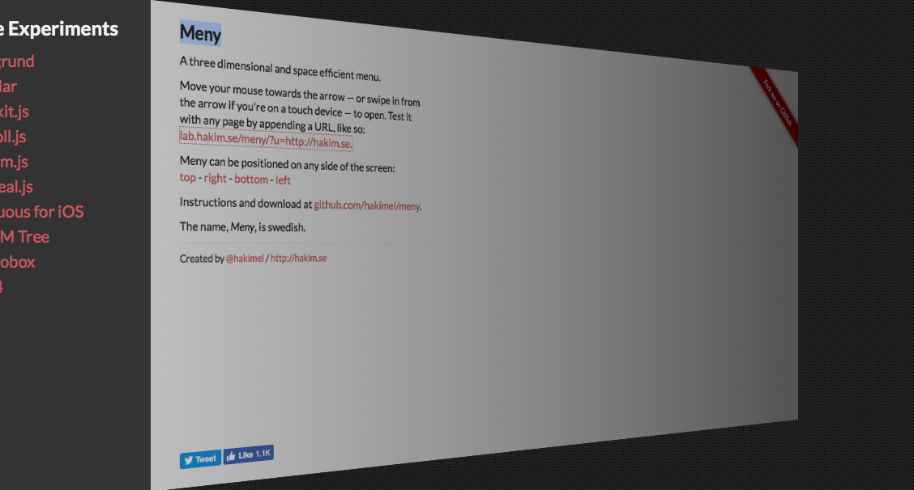
Meny http://lab.hakim.se/meny/

Slide 39
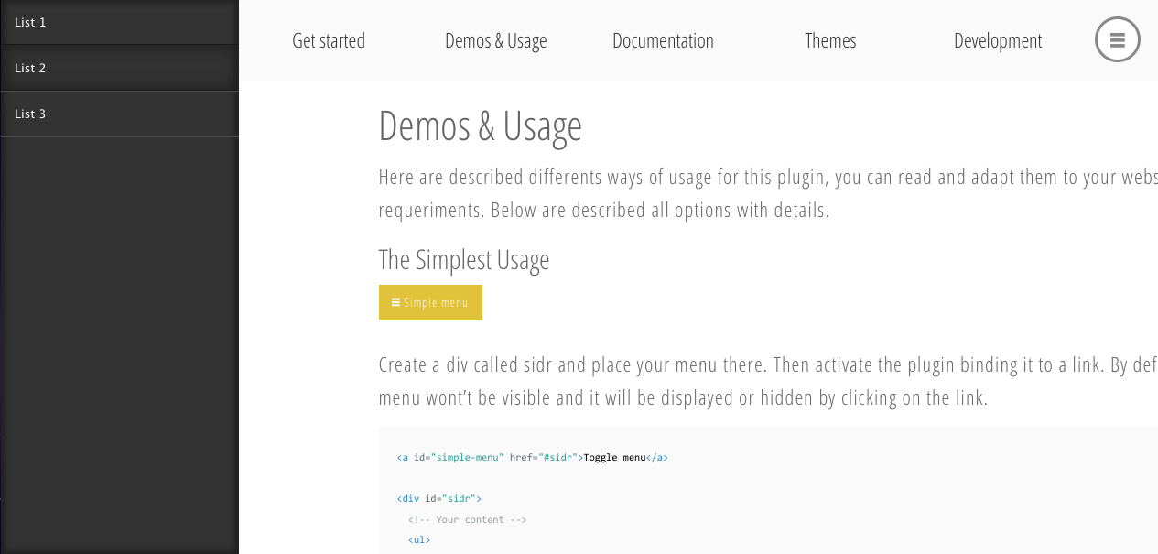
Sidr https://www.berriart.com/sidr/

Slide 40

Swatch Book with CSS3 and jQuery http://tympanus.net/codrops/2012/07/02/swatch-book-with-css3-and-jquery/

Slide 41
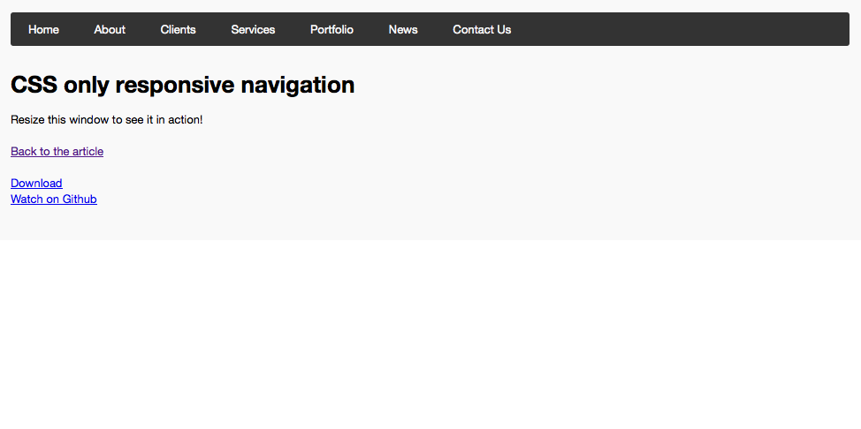
CSS only responsive navigation http://www.valdelama.com/demo/css-responav#

Slide 42
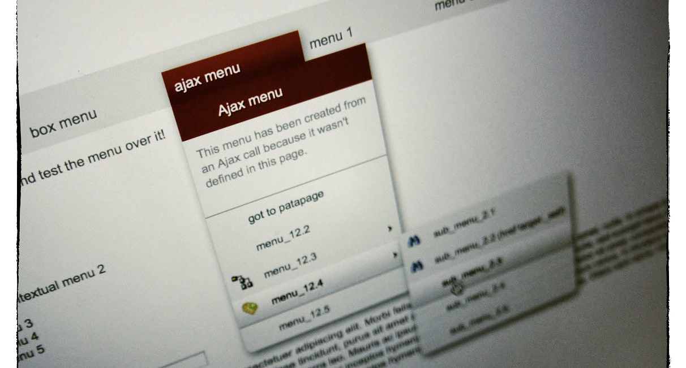
jquery mb.menu http://pupunzi.open-lab.com/mb-jquery-components/mb-_menu/

Slide 43

AutoSprites http://www.newmediacampaigns.com/blog/autosprites-jquery-menu-plugin

Slide 44
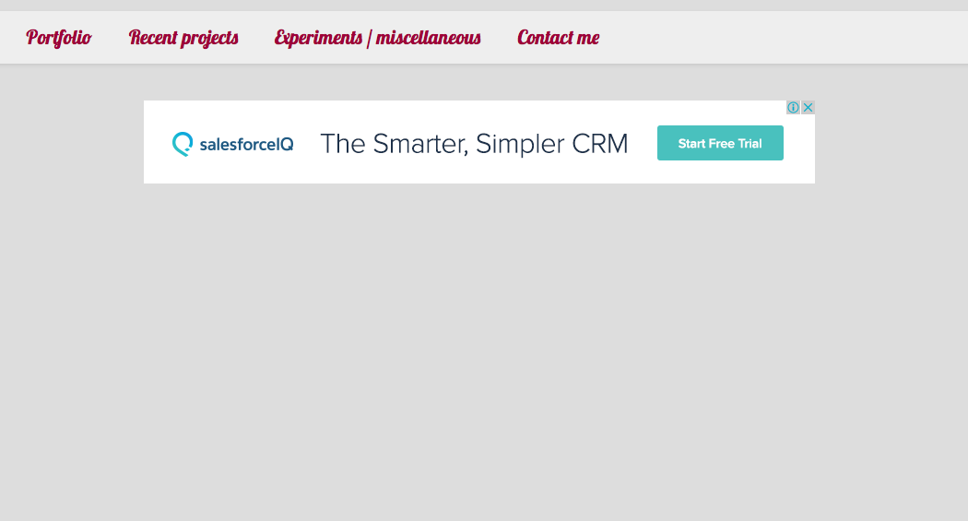
jQueryCSS3Menu http://js.itivy.com/jQueryCSS3Menu/index.html

Slide 45
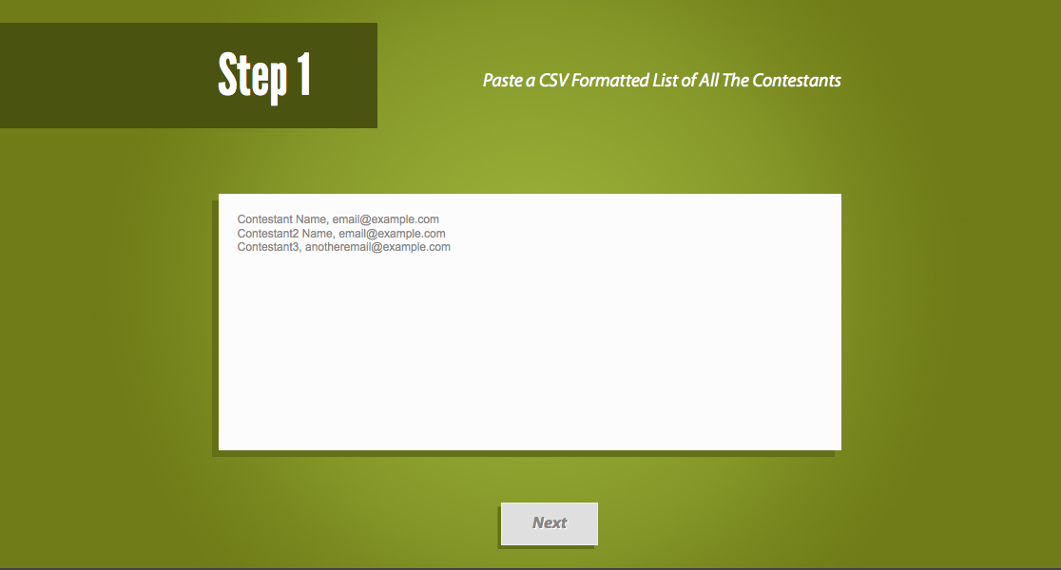
randomizer http://tutorialzine.com/2010/09/giveaway-randomizer-app-jquery/

Slide 46
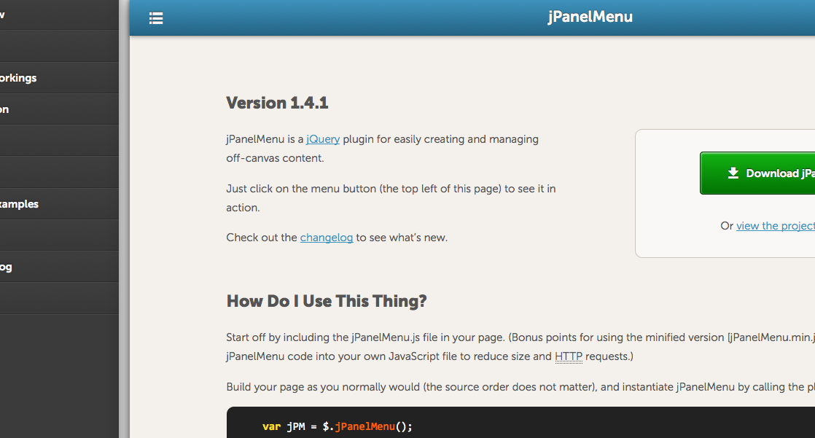
Jpanelmenu http://jpanelmenu.com/

Slide 47
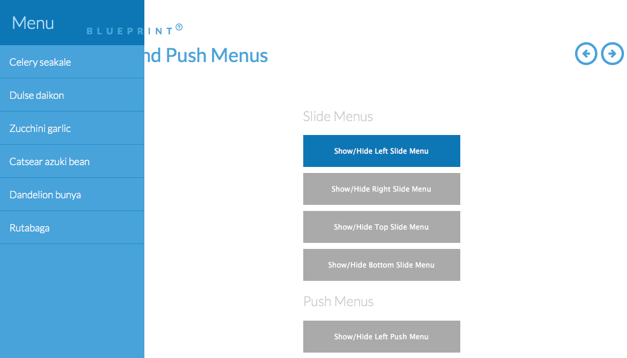
SlidePushMenus http://tympanus.net/Blueprints/SlidePushMenus/#

