Slide 1
How many stars will I give? Predicting ratings of Amazon reviews
Tonia Chu
Under the mentorship: Srdjan Santic
For the course: Data Science Career Track (Springboard)

Slide 2
Content
Introduction
Deeper dive into the data set
Pre-processing
Feature Engineering
Modeling and Machine learning
Results and Discussion
Future Work

Slide 3
Introduction
Many consumers are effectively influenced by online reviews when making their purchase decisions.
The star-rating, i.e. stars from 1 to 5 on Amazon, gives a quick overview of the product quality.
The purpose of this project is to develop models that are able to predict the user rating from the text review.

Slide 4
Deeper dive into the data set
We get dataset from Amazon product data, which contains product reviews and metadata from Amazon, including 142.8 million reviews spanning May 1996 ~ July 2014.
In this project, we use 5-core dataset of Clothing and Shoes, which is subset of the data in which all users and items have at least 5 reviews.

Slide 5
Sample review
"reviewerID": "A2SUAM1J3GNN3B",
"asin": "0000013714",
"reviewerName": "J. McDonald",
"helpful": [2, 3],
"reviewText": "I bought this for my husband who plays the piano. He is having a wonderful time playing these old hymns. The music is at times hard to read because we think the book was published for singing from more than playing from. Great purchase though!",
"overall": 5.0,
"summary": "Heavenly Highway Hymns",
"unixReviewTime": 1252800000,
"reviewTime": "09 13, 2009"

Slide 6
Summary of the dataset
Number of reviews: 278677
Number of unique reviewers: 39387
Prop of unique reviewers: 0.141
Number of unique products: 23033
Prop of unique products: 0.083
Average rating score: 4.245

Slide 7
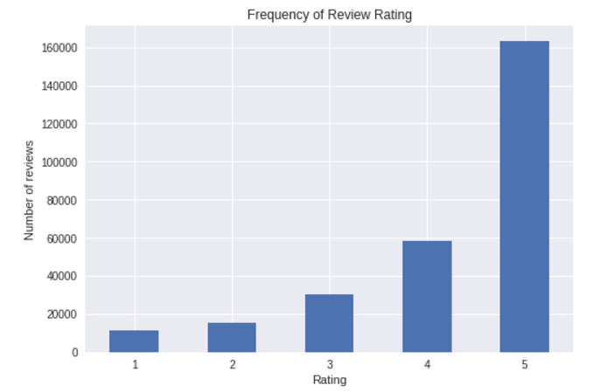
Distribution of rating score

Slide 8
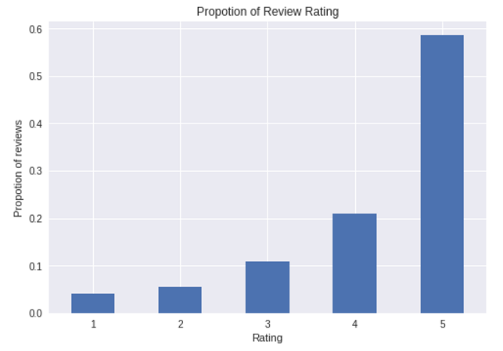
Distribution of rating proportion

Slide 9
Subset data
We select the first 30,000 reviews as our sub dataset.
Distribution of the ratings is as following:
Rating
1 1070
2 1541
3 2842
4 6042
5 18505

Slide 10
Pre-processing —— Text Normalization
Cleaning Text
Tokenizing Text
Removing Special Characters
Expanding Contractions
Case Conversions
Removing Stopwords
Correcting Words
Stemming
Lemmatization
Notes:
Text normalization is defined as a process that consists of a series of steps that should be followed to wrangle, clean, and standardize textual data into a form that could be consumed by other NLP and analytics systems and applications as input. Besides tokenization, various other techniques include cleaning text, case conversion, correcting spellings, removing stopwords and other unnecessary terms, stemming, and lemmatization. Text normalization is also often called text cleansing or wrangling.

Slide 11
1. Expanding Contractions
Contractions are shortened version of words or syllables. They exist in either written or spoken forms. Shortened versions of existing words are created by removing specific letters and sounds. In case of English contractions, they are often created by removing one of the vowels from the word.
By nature, contractions do pose a problem for NLP and text analytics because, to start with, we have a special apostrophe character in the word. Ideally, we can have a proper mapping for contractions and their corresponding expansions and then use it to expand all the contractions in our text.

Slide 12
2. Removing Special Characters
One important task in text normalization involves removing unnecessary and special characters. These may be special symbols or even punctuation that occurs in sentences.
This step is often performed before or after tokenization. The main reason for doing so is because often punctuation or special characters do not have much significance when we analyze the text and utilize it for extracting features or information based on NLP and ML.

Slide 13
3. Tokenizing Text
Tokenization can be defined as the process of breaking down or splitting textual data into smaller meaningful components called tokens.
Sentence tokenization is the process of splitting a text corpus into sentences that act as the first level of tokens which the corpus is comprised of. This is also known as sentence segmentation , because we try to segment the text into meaningful sentences.
Word tokenization is the process of splitting or segmenting sentences into their constituent words. A sentence is a collection of words, and with tokenization we essentially split a sentence into a list of words that can be used to reconstruct the sentence.

Slide 14
4. Removing Stopwords
Stopwords are words that have little or no significance. They are usually removed from text during processing so as to retain words having maximum significance and context.
Stopwords are usually words that end up occurring the most if you aggregated any corpus of text based on singular tokens and checked their frequencies. Words like a, the , me , and so on are stopwords.

Slide 15
5. Correcting Words
Correcting Repeating Characters
Correcting Spellings
Notes:
One of the main challenges faced in text normalization is the presence of incorrect words in the text. The definition of incorrect here covers words that have spelling mistakes as well as words with several letters repeated that do not contribute much to its overall significance.

Slide 16
6. Lemmatization
The process of lemmatization is to remove word affixes to get to a base form of the word.
The base form is also known as the root word, or the lemma, will always be present in the dictionary.

Slide 17
Feature Engineering —— Feature Extraction
Feature engineering is the process of using domain knowledge of the data to create features that make machine learning algorithms work. Feature engineering is fundamental to the application of machine learning, and is both difficult and expensive.
In ML terminology, features are unique, measurable attributes or properties for each observation or data point in a dataset. Features are usually numeric in nature and can be absolute numeric values or categorical features that can be encoded as binary features for each category in the list using a process called one-hot encoding.
The process of extracting and selecting features is both art and science, and this process is called feature extraction or feature engineering.

Slide 18
Feature-extraction techniques
Bag of Words model
TF-IDF model
Averaged Word Vectors
TF-IDF Weighted Averaged Word Vectors

Slide 19
1. Bag of Words Model
The Bag of Words model is perhaps one of the simplest yet most powerful techniques to extract features from text documents.
The essence of this model is to convert text documents into vectors such that each document is converted into a vector that represents the frequency of all the distinct words that are present in the document vector space for that specific document.

Slide 20
2. TF-IDF Model
TF-IDF stands for Term Frequency-Inverse Document Frequency, a combination of two metrics: term frequency and inverse document frequency.
Mathematically, TF-IDF is the product of two metrics and can be represented as tfidf = tf * idf, where term frequency(tf) and inverse-document frequency(idf) represent the two metrics.

Slide 21
3. Averaged Word Vectors
In this technique, we will use an average weighted word vectorization scheme, where for each text document we will extract all the tokens of the text document, and for each token in the document we will capture the subsequent word vector if present in the vocabulary.
We will sum up all the word vectors and divide the result by the total number of words matched in the vocabulary to get a final resulting averaged word vector representation for the text document.

Slide 22
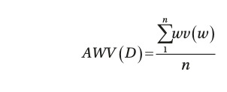
3. Averaged Word Vectors
AVW(D) is the averaged word vector representation for document D, containing words w1, w2, ..., wn,
wv(w) is the word vector representation for the word w.

Slide 23
4. TF-IDF Weighted Averaged Word Vectors
Now we use a new and novel technique of weighing each matched word vector with the word TF-TDF score and summing up all the word vectors for a document and dividing it by the sum of all the TF-IDF weights of the matched words in the document.
This would basically give us a TF-IDF weighted averaged word vector for each document.
Notes:
Our previous vectorizer simply sums up all the word vectors pertaining to any document based on the words in the model vocabulary and calculates a simple average by dividing with the count of matched words.

Slide 24
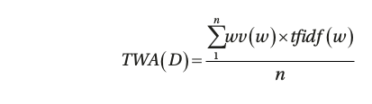
4. TF-IDF Weighted Averaged Word Vectors
TWA(D) is the TF-IDF weighted averaged word vector representation for document D, containing words w1, w2, ..., wn,
wv(w) is the word vector representation,
tfidf(w) is the TF-IDF weight for the word w.

Slide 25
Modeling and Machine learning
Classification Models
Evaluating Classification Models
Confusion Matrix of Models
Hyperparameter Tuning

Slide 26
Classification Models
Logistic Regression
Multinomial Naive Bayes
Linear Support Vector Classification
SGD Classifier
Random Forest Classifier

Slide 27
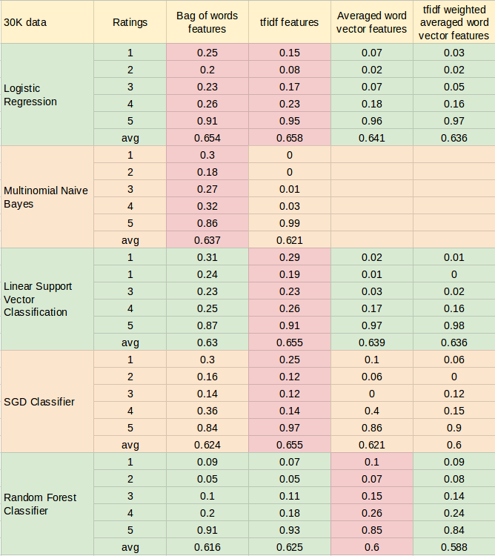
Evaluating Classification Models
Notes:
From the above form, we can get following results:
Among the four kinds for features, tfidf is the best feature. It can get the highest accuracy while save time for training models. And bag of words is the second best feature. tfidf weighted averaged word vector is the worst feature because of the lowest accuracy and longest training time.
Among the five cllasification models, Logistic Regression is the best one and Linear Support Vector Classification is the second best one. Random Forest Classifier is the worst one.
Among the five levels ratings, rating 5 have the best predicting result while rating 1 have the worst result. Accuracy of predicting rating 5 is very high for each model. But accuracy of predicting rating 1, 2 and 3 are very low. One reason for this may be that most records have rating 5 and least records have rating 1. More training data can get better model.
The models marked in pink color are relatively best models. We will work on them with hyperparameter Tuning.

Slide 28
Confusion Matrix of Models
A confusion matrix is a table that is often used to describe the performance of a classification model (or "classifier") on a set of test data for which the true values are known.
Each row of the matrix represents the instances in an actual class while each column represents the instances in a predicted class.

Slide 29
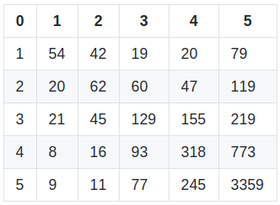
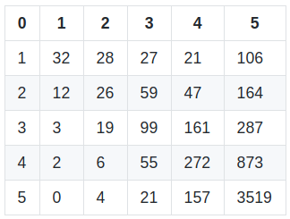
Confusion Matrix of Models
Logistic Regression using Bag of words features
Logistic Regression with Tfidf features

Slide 30
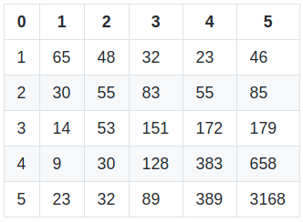
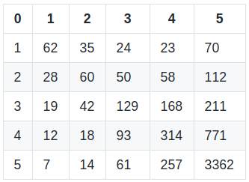
Confusion Matrix of Models
Multinomial Naive Bayes using Bag of words features
Linear Support Vector Classification using Tfidf features

Slide 31
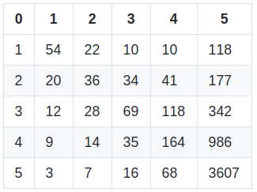
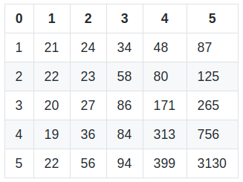
Confusion Matrix of Models
SGD Classifier using Tfidf features
Random Forest Classifier using Averaged word vector features
Notes:
From the matrixes, we can see that many reviews of rating 1-4 are predicted as rating 5. This is the main reason for models' not high accuracy.

Slide 32
Hyperparameter Tuning
Hyperparameters are parameters whose values are set prior to the commencement of the learning process. By contrast, the values of other parameters are derived via training. Given these hyperparameters, the training algorithm learns the parameters from the data.
Hyperparameter tuning is the problem of choosing a set of optimal hyperparameters for a learning algorithm. The same kind of machine learning model could require different constraints, weights or learning rates to generalize different data patterns. These measures are called hyperparameters, and have to be tuned so that the model can best solve the machine learning problem.
Notes:
Usually a metric is chosen to measure the algorithm's performance on an independent data set and hyperparameters that maximize this measure are adopted. Often cross-validation is used to estimate this generalization performance.
Hyperparameter tuning is performed by searching the hyper-parameter space for the best cross validation score. A search consists of:
an estimator (regressor or classifier);
a parameter space;
a method for searching or sampling candidates;
a cross-validation scheme;
a score function.

Slide 33
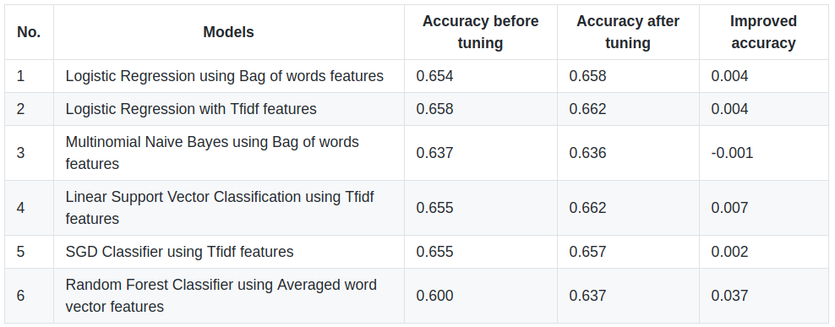
Hyperparameter tuning result
Notes:
From the tuning result, we can see that most models' accuracy are improved by 0.2~0.7%, especially for RFC, accuracy improved by 3.7%. So hyperparameter tuning is a good method to improve the models. Also, after hyperparameter tuning, we get 6 models with about 66% accuracy.

Slide 34
Results and Discussion
We can improve the models by following attempts:
Train the models with bigger dataset and more data.
Set ngram_range to (1,2) and (1,3) to extract better features.
Use Summary texts as well as review texts to predict the rating scores.
Create the hyperparameter grid with more parameters and bigger search space.
Notes:
In this project, we tried to develope models to predict Amazon review ratings from the review texts. Before training the models with machine learning methods, we performed Text Normalization and Feature Engineering to process natural language and extracte features for machine learning. Then we developed the models by using six cllasification models with four different kinds of features respectively. Last, we used hyperparameter tuning to improve the models.
NLP(Natural Lanuage Processing) is a very useful topic. But it is also a CPU intensive and time consuming job. We can only make a prototype in this project because of the limitation of computational power and time.

Slide 35

Future Work
Use full datasets of different categories, such as Books, Electronics or Movies and TV.
Develop models to predict ratings with review texts and summary.
Evaluate models with data from other categories or other websites beside Amazon.
Use advanced modern NLP tech in text preprocessing.

Slide 36

Thank You!

