Slide 1

Passvault : Password Manager
Project Members :
Anas Khan (70), Ayesha Nagdawala (72), Ninad Naik (73)
Project Mentor : Dr. Arun Kulkarni (H.O.D. IT & Vice Principal)

Slide 2

Why have we chosen a Password Manager?

Slide 3

Data privacy & Security
September 2022: Alleged TikTok Breach
August 2022: 130+ Companies Compromised in 0ktapus Phishing Breach
August 2022: Apple Identifies Two Security Vulnerabilities
July 2022: Hacker Posts Data on 5.4 Million Twitter Users For Sale
July 2022: Neopets Data Breach Exposes Data on 69 Million Accounts
July 2022: Marriott Confirms 20 GB Data Breach
June 2022: Up to 2 Million Affected By Shields Health Care Group Breach
June 2022: Former Amazon Employee Convicted for Capital One Breach
May 2022: Texas Department of Insurance Data Leak Comes to Light

Slide 4

older adults more at risk for online scams

Slide 5
Why passwords?
The number one reason why people’s accounts get stolen is because they use the same password across multiple places. Any security researcher would strongly disregard this move.
In order to keep your passwords secure, they all have to be unique and difficult to crack. In truth, the best passwords are the ones that you don’t need to remember at all.

Slide 6
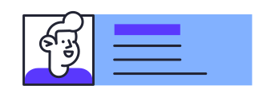
Hence, PASSVAULT Was BORN!
For the before mentioned reasons, we decided to make a password manager for everyone to use. This will create a unique password for every single account of yours and remembers with for you.
It reminds you to periodically change password so you never have to worry about your account and privacy being compromised ever again.

Slide 7

Features of pASSvAULT
Intuitive and easy way to secure your accounts.
Store username, password and login URLs.
Generate strong alpha-numeric passwords
Periodic reminders to change passwords
Cross platform (windows, linux and macos supported)
Secure vault to store all your passwords!

Slide 8

pASSVAULT Interface

Slide 9
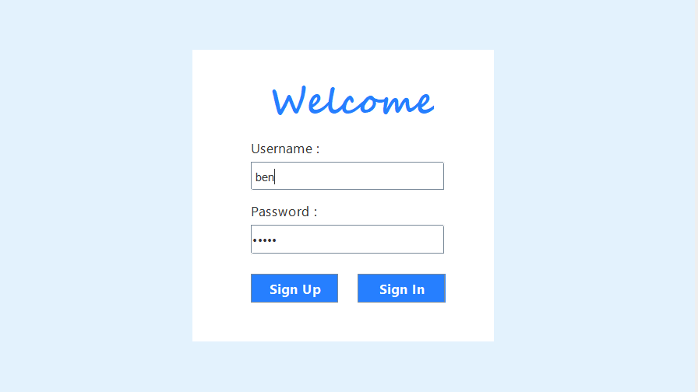
User Interface

Slide 10
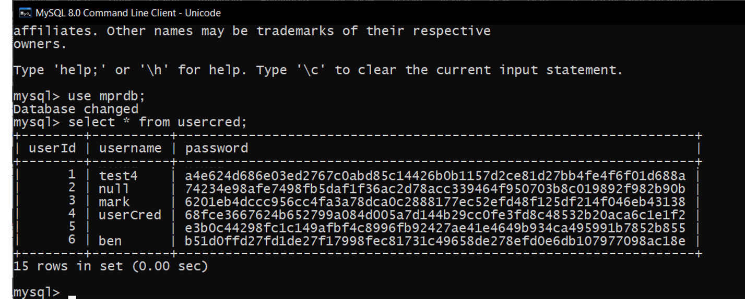
Hashed passwords at backend

Slide 11
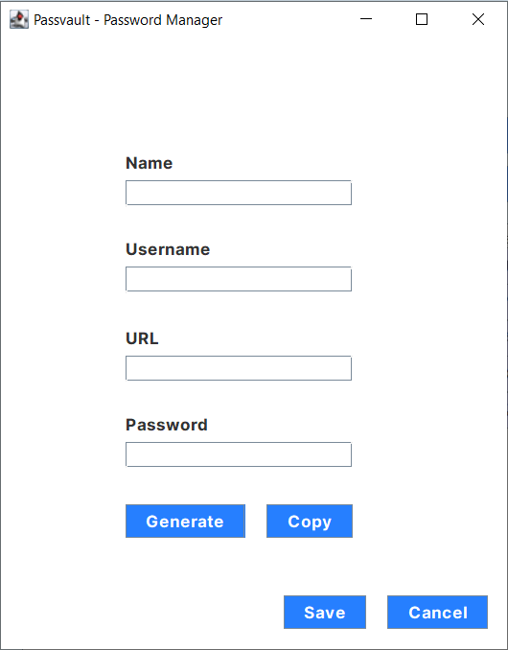
User Interface

Slide 12
User Interface
Generates a random 16 digit alpha numeric key!

Slide 13
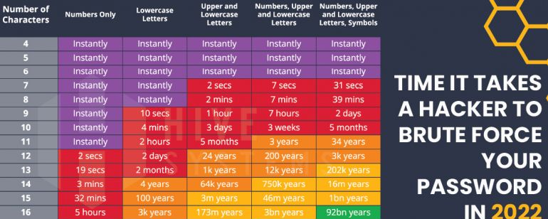
Why a 16 digit alpha numeric
The possible combinations are 95¹⁶
Which is 52040292466647269602037015248896
Even the smartest computer will require 92 billion years to bruteforce.

Slide 14
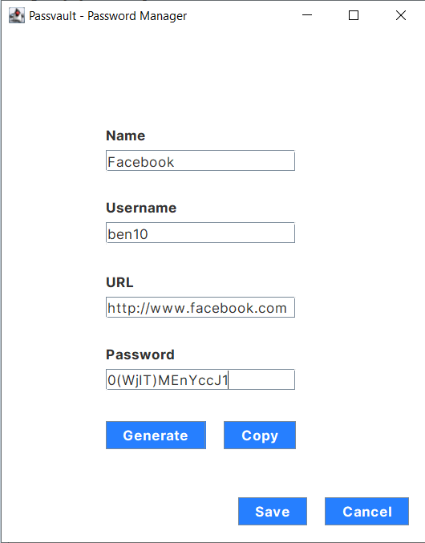
Adding an item

Slide 15
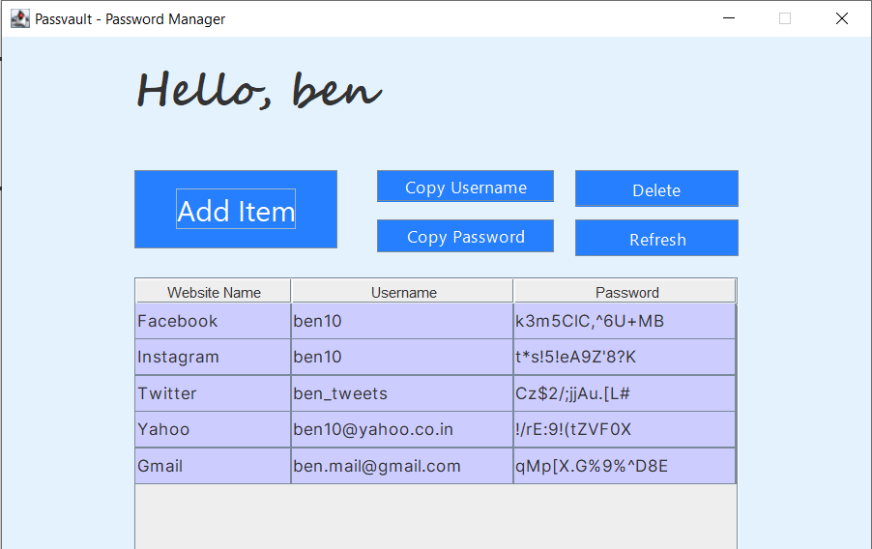
User Dashboard

Slide 16
One more thing…

Slide 17
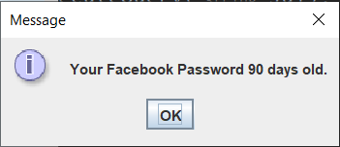
Another safety feature
Password reminders

Slide 18

Tech Stack Used

Slide 19
Tech Stack Used
Front End : Java Swing
Backend: Java, MySQL Databases
Packages: Standard Java, Swing Packages and MySQL Packages
Development Environment : Netbeans IDE
Additional Team Stack: Git and GitHub

Slide 20
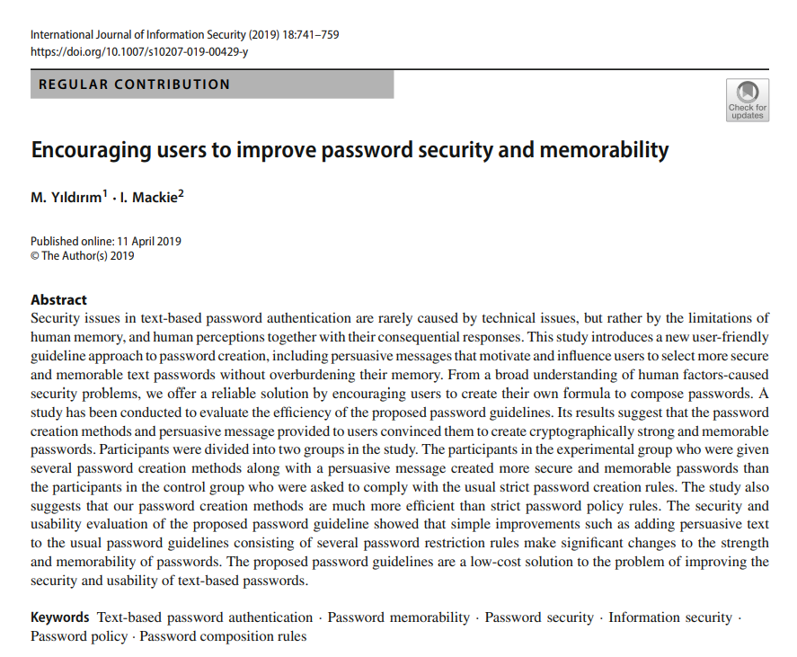
Resources Referred
Wikipedia
SHA256 Hashing
Encouraging users to improve password security and memorability By M. Yıldırım, I. Mackie
International Journal of Information Security (2019) 18:741–759

Slide 21

Any Questions

