Slide 1
MINOR PROJECT · DEPARTMENT OF COMPUTING TECHNOLOGIES
Vision Transformer with Physics-Informed Graph Learning for Crop Disease Forecasting
Predicting crop disease risk 1–7 days before symptoms appear
Animesh Gupta · Apurva Singh · Aastha Hotwani · Harsh Khetan

Slide 2
01
The problem
Why existing crop-disease apps are not enough
• Today's apps only tell you what a leaf already has
• By the time symptoms are visible, the damage is done
• They ignore weather — yet weather is what drives infection
• They look at one field at a time, as if it stood alone
A farmer does not need a diagnosis. A farmer needs a warning.

Slide 3
02
Our idea in one line
Do not just identify the disease — forecast where it is going
Look at the leaf
A vision transformer recognises the disease from the photo
Check the weather
Real temperature, humidity, rainfall and leaf wetness at that farm
Look at the neighbours
Nearby farms are linked in a network; wind carries spores
Predict the next week
Disease risk at 1, 3, 5 and 7 days ahead

Slide 4
03
How it works
The same four steps, as the system runs them
STEP 1
STEP 2
STEP 3
STEP 4
Leaf photo
Weather
Farm graph
Forecast
→
→
→
A frozen vision transformer turns the image into 384 numbers
Real ERA5 data becomes leaf wetness, VPD, growing degree days
Nearby farms connected, with extra links pointing downwind
Disease risk at 1, 3, 5 and 7 days, plus an advisory

Slide 5
04
What we built it on
Everything below is real, measured data
54,305
41,662
37
1–7
Leaf photographs
Days of weather
Farm districts
Day forecast
38 diseases across 14 crops
Real ERA5 reanalysis, zero gaps
Srinagar to Munnar, real coordinates
Four horizons, not just today

Slide 6
05
Being honest about the data
What is real, and what we had to construct
Component
Where it comes from
Status
54,305 leaf images
PlantVillage dataset
REAL
41,662 days of weather
Open-Meteo ERA5 archive
REAL
37 farm locations
Indian production districts
REAL
Which photo belongs to which farm
We assigned it, using real weather
CONSTRUCTED
PlantVillage has no GPS and no dates. We placed each leaf at a farm that grows that crop, on a date when the real weather suited that disease.

Slide 7
06
Why weather is the whole point
Different diseases want opposite conditions
Late blight → cool and wet
Peaks at 17 °C with long leaf wetness
Powdery mildew → humid, but rain kills it
Free water bursts its spores
Spider mites → hot and dry
Thrives at 31 °C in dry air
A model that only looks at pixels cannot use any of this. Ours can.

Slide 8
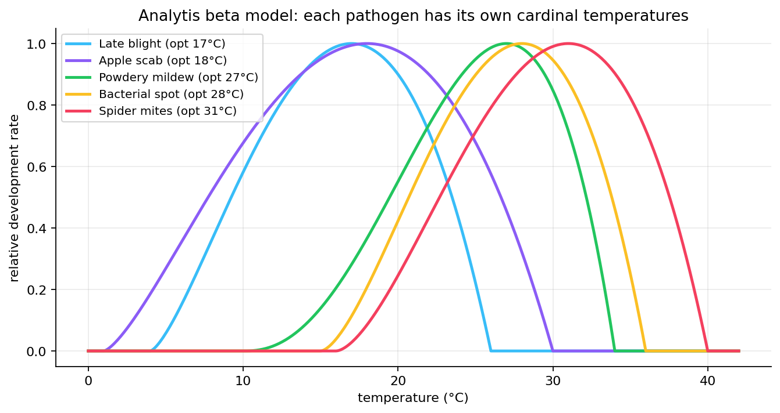
07
Every pathogen has its own temperature window
Published cardinal temperatures, encoded in the model
Each curve is zero outside the organism's survivable range and peaks at its optimum.

Slide 9
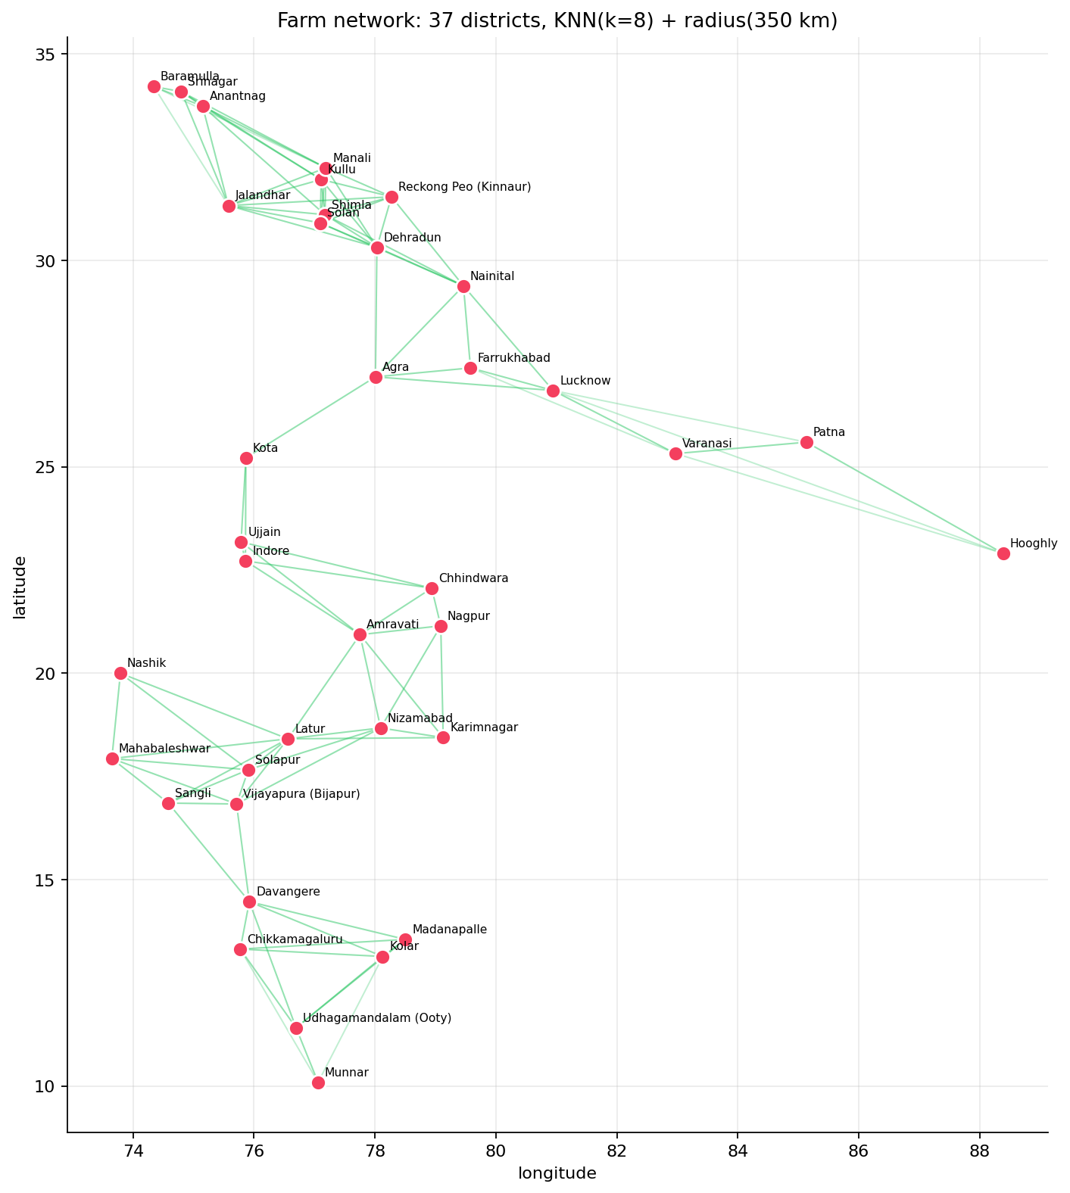
08
The farm network
37 real districts, connected by proximity and wind
Lines are the graph edges along which the model passes information between farms.

Slide 10
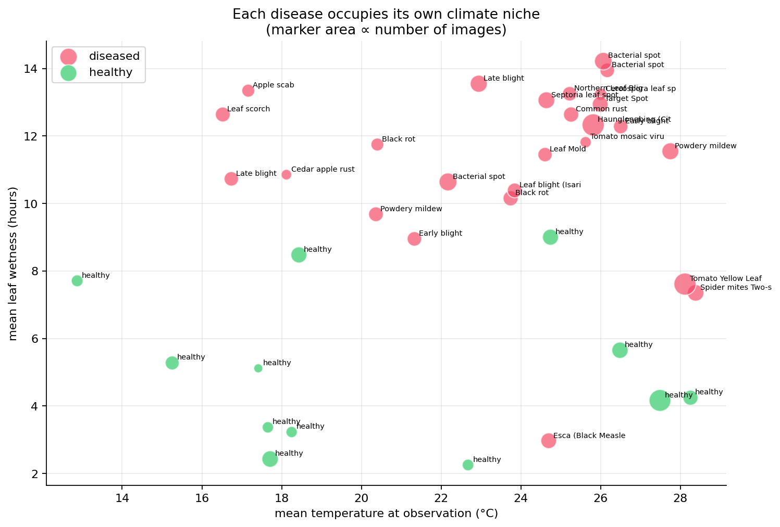
09
Each disease sits in its own climate niche
This is the signal the weather branch learns
Cool-wet diseases at the top left, hot-dry pests at the bottom right. Nothing forced this.

Slide 11
10
Results
Measured on leaves the model had never seen
98.8%
0.983
0.78
0
Diagnosis accuracy
Macro-F1
Forecast R²
Data leakage
38-class problem
Balanced across all classes
Averaged over 1–7 days
Leaf-disjoint splits

Slide 12
11
We compared four transformers
Identical pipeline; only the image model changes
Model
Size
Feature quality
Full system
Forecast R²
VIT
768
0.962
0.961
0.701
SWIN
768
0.971
0.955
0.698
DINOV2
384
0.977
0.950
0.706
DEIT
384
0.940
0.926
0.694
DINOv2 gives the best features for its size; ViT-B/16 wins once the full system is trained on top.

Slide 13
12
What each part actually contributes
Measured by removing it and retraining
Remove the leaf image → F1 drops 0.98 to 0.51
Vision does the diagnosis
Remove the weather → forecast R² drops 0.14
Climate does the forecasting
Remove the graph → scores go UP slightly
An honest negative result
Each stream earns its place, except one. We report that rather than hide it.

Slide 14
13
The finding we did not expect
The farm graph does not improve accuracy here
• Replacing it with a simple layer gives slightly better scores
• Reproducible: 2 datasets, 5 sparsity levels, 2 graph types
• Why: the image model is already ~98.8% right — no headroom left
• Why: a farm's own state already predicts its own future well
We kept the graph, measured its cost, and said so. That is a stronger position than a claim nobody checked.

Slide 15
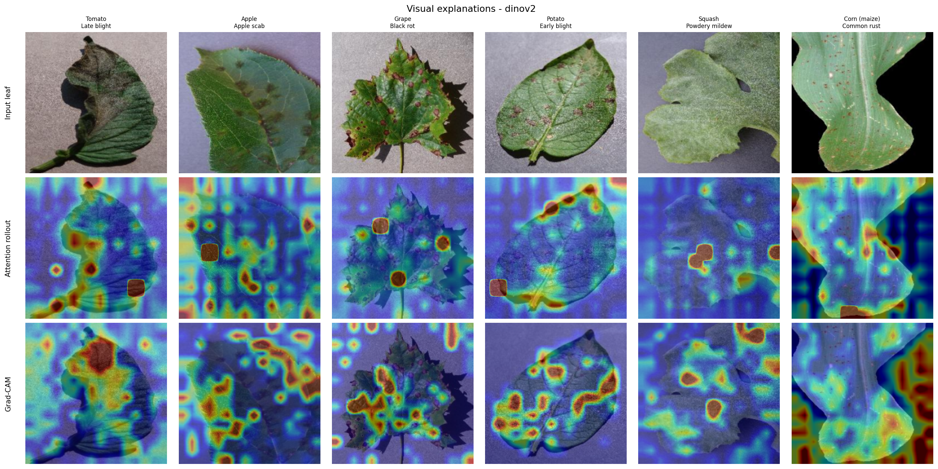
14
We can see what the model looks at
Grad-CAM and attention over real leaves
The heat lands on the actual lesions — not the background, not the leaf edge.

Slide 16
15
A problem we found in the dataset
And fixed, before it flattered our numbers
• PlantVillage photographs the same leaf 2.65 times on average
• A normal random split puts copies of one leaf on both sides
• That affects 35,246 of 54,305 images — 65% of the data
• We split by leaf instead, so no leaf appears twice
Our numbers are lower than a naive split would give. They are also real.

Slide 17
16
How the code fits together
Six scripts, run in order
STEP 1
STEP 2
STEP 3
STEP 4
STEP 5
01 Build data
02 Extract
03 · 04 Train
05 · 07 Explain
06 Serve
→
→
→
→
Downloads leaves, fetches weather, joins them
Runs all four transformers once, caches the result
Benchmarks models, trains the final one, runs ablations
Grad-CAM, SHAP and every figure in this deck
Starts the website

Slide 18
17
See it running
One command, then a browser
python scripts/06_serve.py
Then open http://127.0.0.1:8000
Literature Survey
18 papers, each with a live Run demonstration button
Live System
Upload a leaf from tests/, pick a farm and date, get a forecast
Risk Map
Every farm coloured by risk, with the graph drawn on top
23 ready-to-use demo images are in tests/, with a suggested farm and date for each.

Slide 19
18
Where this goes next
What we would build with more time
• Drone and satellite imagery instead of a single leaf photo
• Live weather forecasts instead of historical records
• Field sensors measuring leaf wetness directly
• Validation against real recorded outbreaks

Slide 20
Thank you
Animesh Gupta · Apurva Singh · Aastha Hotwani · Harsh Khetan
github.com/anxmeshhh/Physics-Informed-ViT-Graph-for-Crop-Disease-Forecasting
Run it: python scripts/06_serve.py → http://127.0.0.1:8000

