Slide 1
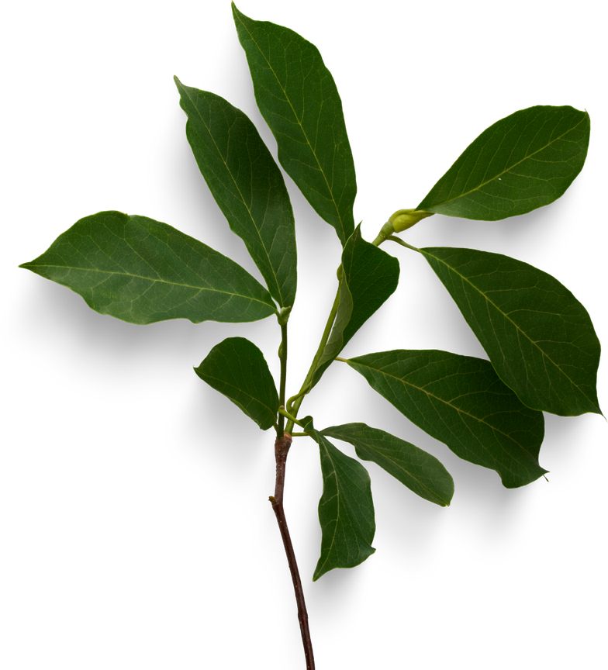




VISION TRANSFORMER WITH PHYSICS-INFORMED GRAPH LEARNING FOR CLIMATE-ADAPTIVE CROP DISEASE FORECASTING
ANIMESH GUPTA RA2311026010375
APURVA SINGH RA2311026010376
AASTHA HOTWANI RA2311026010389
HARSH KHETAN RA2311026010421

Slide 2

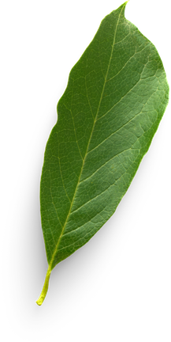
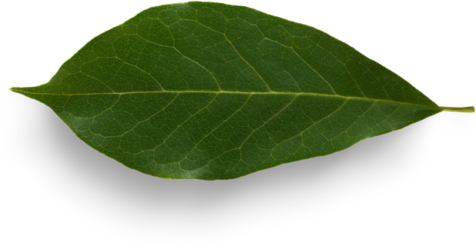

WHY IS CROP DISEASE FORECASTING IMPORTANT?
Agriculture plays a vital role in global food production, but crop diseases cause significant losses every year. These diseases reduce crop yield, affect food quality, and increase the use of pesticides.
Climate change has made disease outbreaks more unpredictable because factors like temperature, humidity, rainfall, and wind directly influence disease development and spread.
Therefore, there is a need for intelligent systems that can forecast crop diseases early rather than detecting them only after visible symptoms appear.
Key Points
Crop diseases reduce agricultural productivity.
Climate change increases disease outbreaks.
Early forecasting helps farmers take preventive actions.
AI can assist in making more accurate predictions.

Slide 3

PROBLEM STATEMENT
Most existing crop disease detection systems rely mainly on image classification using Convolutional Neural Networks (CNNs). While these models perform well in recognizing visible symptoms, they have several limitations.
Limitations
Detect diseases only after symptoms become visible.
Ignore climate factors such as humidity and rainfall.
Cannot model disease spread between neighboring farms.
Limited ability to adapt to changing environmental conditions.
Proposed Solution
Develop a framework that combines:
Vision Transformer for image understanding
Graph Learning for spatial relationships
Physics-Informed Learning for climate knowledge

Slide 4
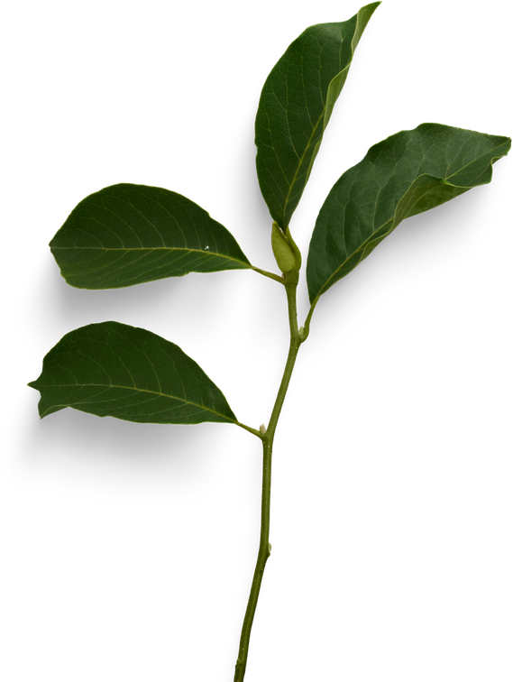
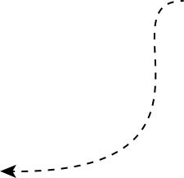

Input Image
VISION TRANSFORMER
Image Preprocessing (Resize & Normalize)
Vision Transformer (ViT) is a deep learning model that applies the Transformer architecture, originally developed for Natural Language Processing, to image analysis.
Instead of processing the entire image at once, ViT divides the image into smaller patches. Each patch is converted into an embedding, and the Transformer uses self-attention to learn relationships among all image patches.
Advantages
Learns global image features.
Captures long-range relationships.
Performs better on complex image datasets.
Handles irregular disease patterns effectively.
Image Patch Generation
Patch Embedding + Positional Encoding
Vision Transformer Encoder (Self-Attention Layers)
Physics-Informed Graph Learning & Climate-Adaptive Disease Forecast

Slide 5
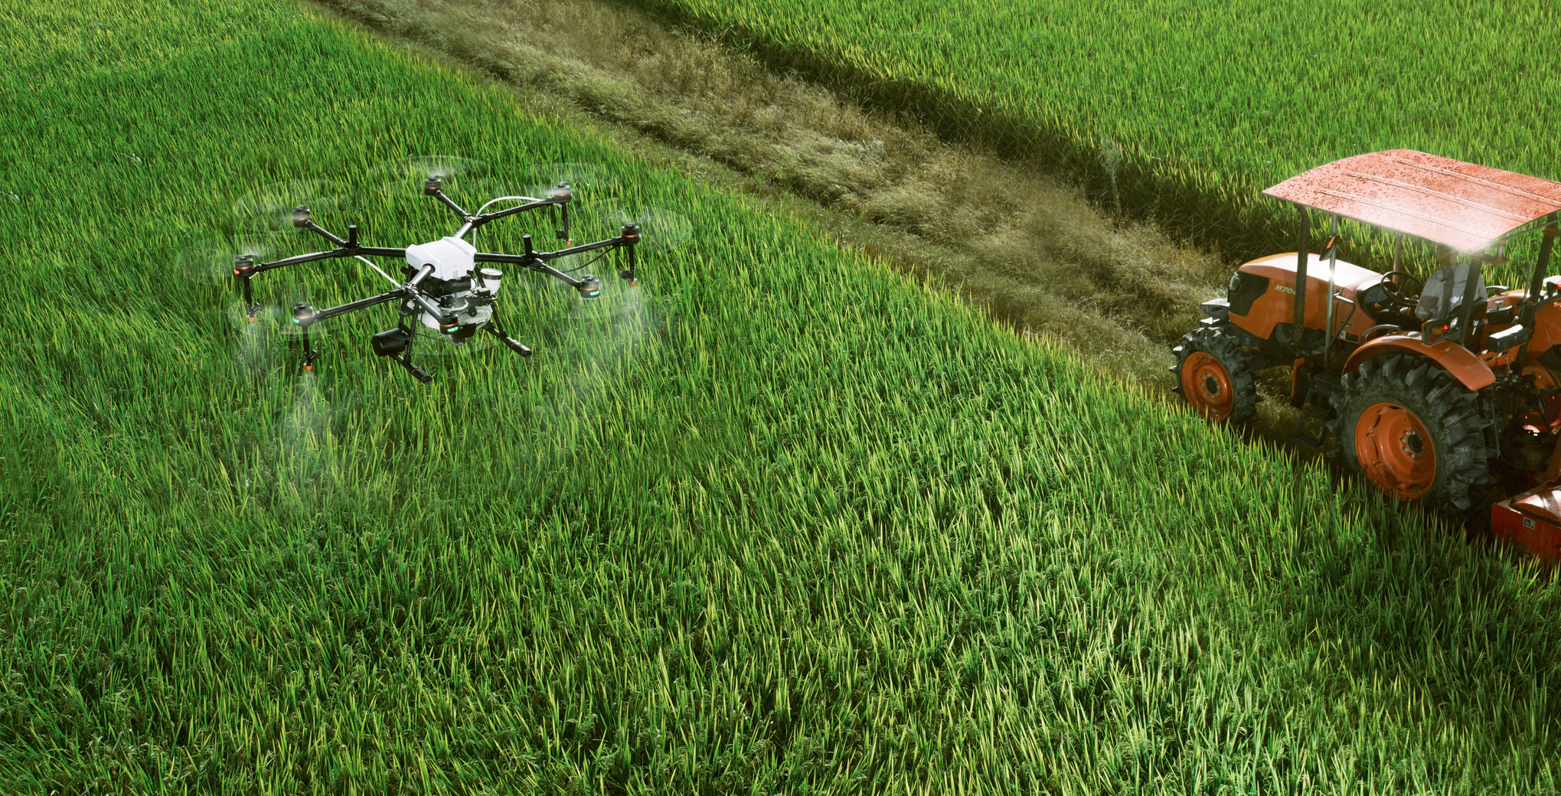
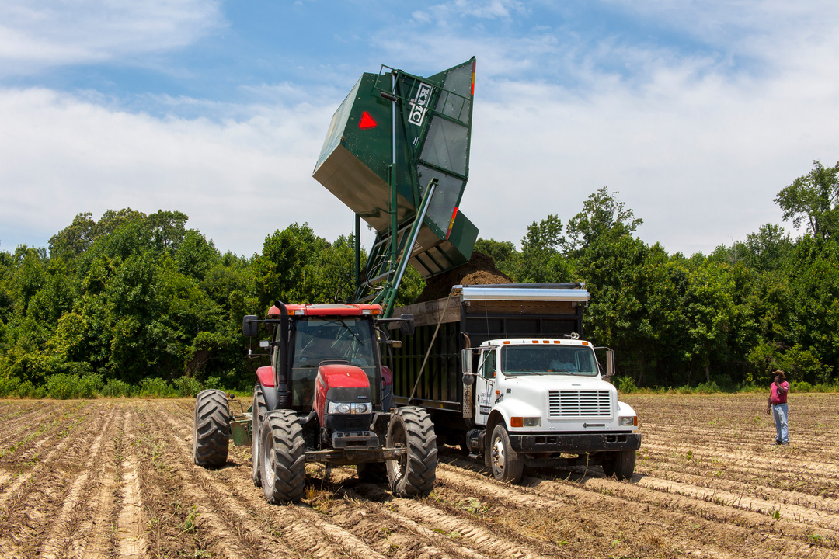
PHYSICS-INFORMED GRAPH LEARNING
Physics-Informed Graph Learning combines Graph Neural Networks with scientific knowledge.
A graph consists of nodes and edges.
In agriculture:
Nodes represent farms or crop fields.
Edges represent relationships such as geographical proximity, wind direction, water flow, or humidity.
Physics-informed learning introduces environmental rules into the training process.
Instead of learning only from data, the model also considers known scientific relationships.
Examples
High humidity increases fungal disease risk.
Heavy rainfall may accelerate disease spread.
Wind can carry spores from one field to another.
This allows the model to produce predictions that are more consistent with real-world agricultural conditions.

Slide 6
S.No. | Paper | Method / Approach | Key Contribution | Research Gap / Limitation
1 | Plant Disease Detection using Vision Transformers on Multispectral Natural Environment Images | Vision Transformer on multispectral plant images | Demonstrates transformer-based plant disease recognition under natural environmental conditions | Focuses on visual disease detection; does not model inter-field spatial relationships or climate-informed disease forecasting
2 | Real-Time Plant Disease Identification: Fusion of Vision Transformer and Conditional Convolutional Network | ViT + conditional CNN + C3GAN augmentation | Improves real-time plant disease identification using hybrid visual learning and augmentation | Primarily image-based identification; does not model disease propagation across farms or incorporate physics-informed climate constraints
3 | Crop Disease and Pest Classification Using Swin Transformer and Dual-Attention Multi-Scale Fusion Network | Swin Transformer + dual-attention multi-scale fusion | Improves crop disease and pest classification through multi-scale feature learning | Classification-oriented; does not perform spatial, climate-adaptive disease forecasting
4 | Lightweight Vision Transformer with Lite-AVPSO Hyperparameter Optimization for Agricultural Disease Recognition | Lightweight ViT + hyperparameter optimization | Improves efficiency of transformer-based agricultural disease recognition | Focuses on efficient recognition rather than climate variables, graph relations, or early disease-spread forecasting
5 | Plant Disease Detection Using an Innovative Swin-Axial Transformer | Swin + Axial Transformer | Uses advanced transformer architecture for plant disease detection | Mainly image-based disease detection; lacks spatial field interaction and environmental disease modelling
6 | CycleGAN-Based Data Augmentation with CNN and Vision Transformers for Maize Leaf Disease Classification | CycleGAN augmentation + CNN + ViT | Enhances maize disease classification by generating additional training images | Addresses data scarcity and classification but not climate conditions or disease transmission between fields
7 | A Comparison of Two Transformers in the Study of Plant Disease Classification | Comparative transformer analysis | Evaluates transformer models for plant disease classification | Limited to comparison/classification; no graph-based spatial reasoning or climate-aware forecasting
8 | Abnormal Image Classification Using Vision Transformer for Smart Agriculture | Vision Transformer | Demonstrates use of ViT for agricultural abnormal-image classification | Does not incorporate environmental factors or relationships among farms/fields
9 | AI Based Hybrid CNN-LSTM Model for Crop Disease Prediction | CNN + LSTM | Performs crop disease prediction using combined spatial and temporal deep-learning features | Does not use transformer-based visual features, graph learning, or physics-informed environmental knowledge
10 | Physics-Informed Data-Driven Model for Short-Term Precipitation Prediction | Physics-informed data-driven learning | Integrates physical knowledge with data-driven modelling for precipitation prediction | Targets weather prediction rather than crop disease forecasting; lacks plant imagery and agricultural graph structure
11 | Intracity Temperature Estimation by Physics-Informed Neural Network Using Meteorology and Multispectral Satellite Imagery | PINN + meteorological data + multispectral imagery | Demonstrates integration of physics, meteorological forcing and imagery | Focuses on temperature estimation, not crop disease risk or disease spread across agricultural regions
12 | Precipitation Nowcasting with Graph Neural Network and Gated Recurrent Units | GNN + GRU | Models spatial relationships between weather stations for precipitation forecasting | Graph is used for weather stations, not farms/crop fields; does not combine plant image features with disease-spread modelling

Slide 7
RESEARCH GAP
EXISTING CROP DISEASE SYSTEMS MAINLY FOCUS ON IMAGE-BASED DISEASE DETECTION AND CLASSIFICATION.
CLIMATE FACTORS SUCH AS TEMPERATURE, HUMIDITY, RAINFALL, AND WIND ARE OFTEN NOT INTEGRATED WITH VISUAL DISEASE FEATURES.
EXISTING MODELS GENERALLY DO NOT CAPTURE DISEASE SPREAD BETWEEN GEOGRAPHICALLY CONNECTED FARMS OR FIELDS.
PHYSICS-INFORMED KNOWLEDGE IS RARELY INTEGRATED WITH VISUAL AND SPATIAL DISEASE PREDICTION IN A UNIFIED FRAMEWORK.
MOST SYSTEMS PROVIDE CURRENT DISEASE IDENTIFICATION, RATHER THAN 1–7 DAY FUTURE DISEASE-RISK FORECASTING.
EXISTING APPROACHES GENERALLY LACK GEOSPATIAL VISUALIZATION OF PREDICTED AFFECTED AREAS.
THEREFORE, THERE IS A NEED FOR AN INTEGRATED FRAMEWORK COMBINING DINOV2-BASED VISUAL FEATURES, CLIMATE DATA, GRAPH NEURAL NETWORKS, PHYSICS-INFORMED LEARNING, MULTI-HORIZON FORECASTING, AND GEOSPATIAL DISEASE-RISK MAPPING.

Slide 8
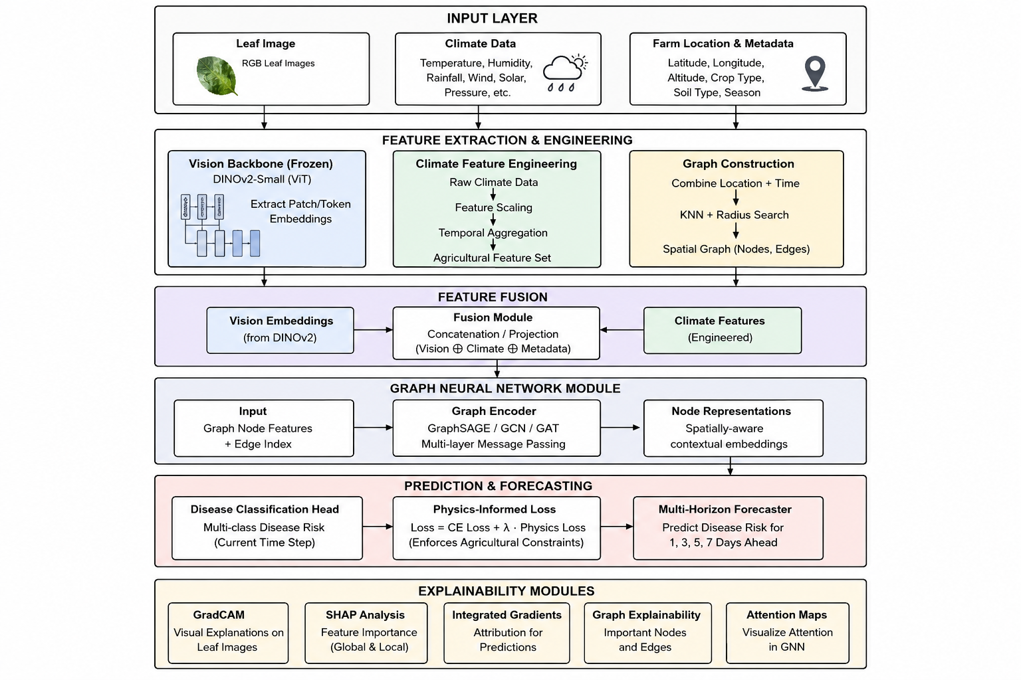
ARCHITECHTURE DIGRAM

Slide 9
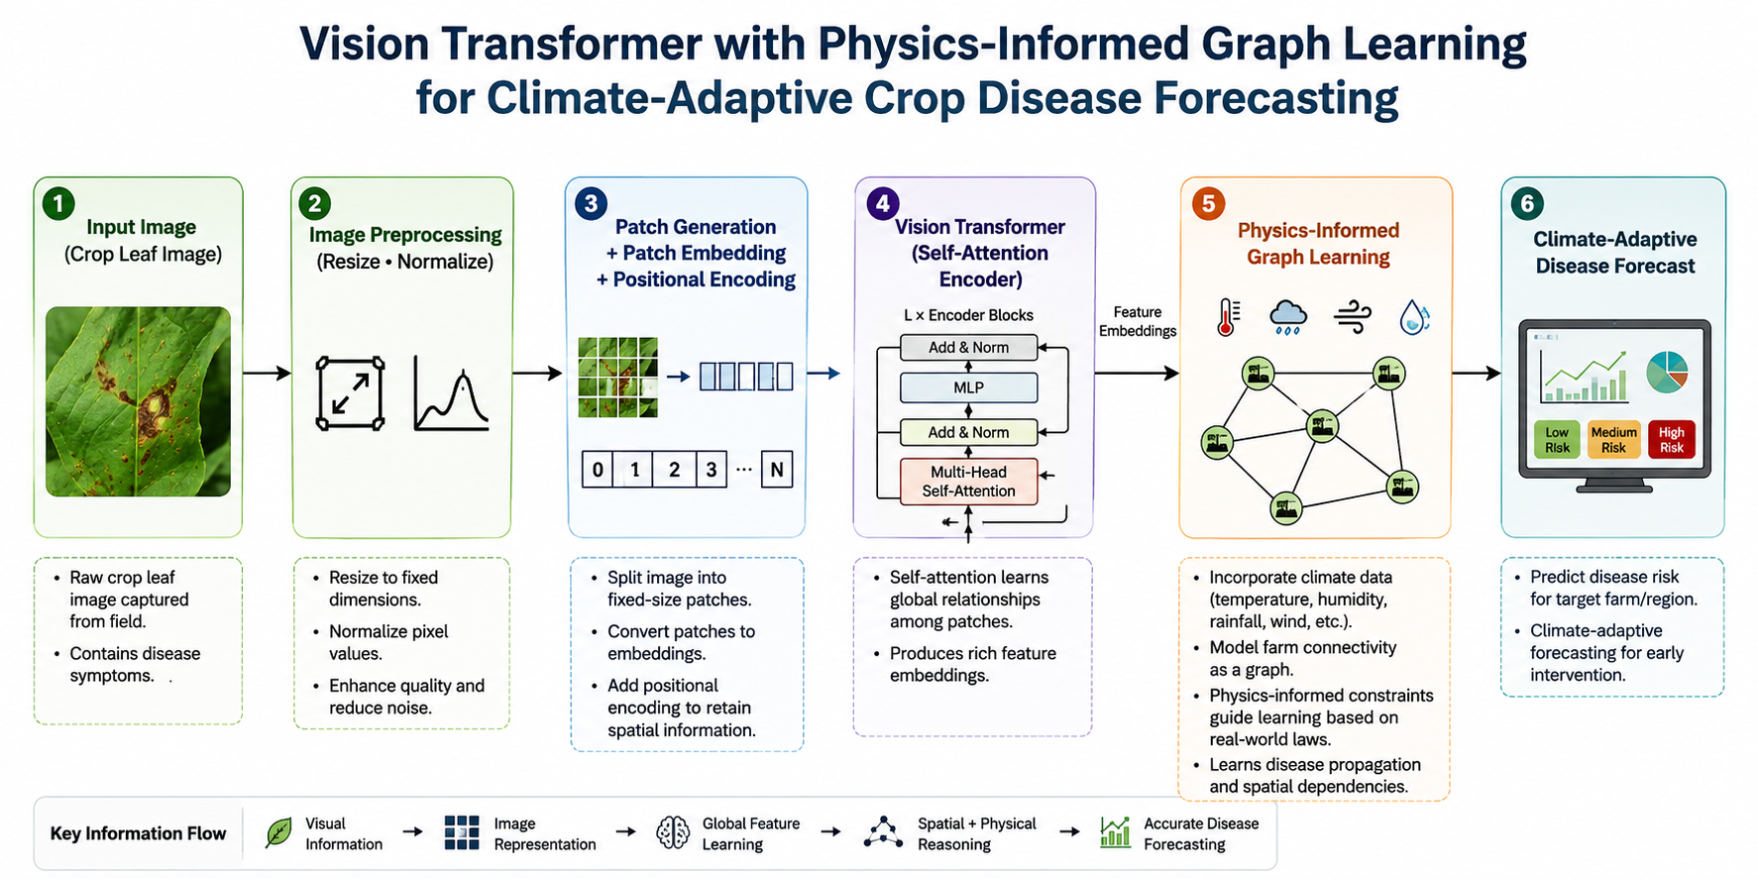
WORKFLOW

Slide 10

ADVANTAGES AND APPLICATIONS
Advantages
Better image feature extraction.
Global understanding of disease symptoms.
Incorporates climate information.
Models disease spread across multiple farms.
Supports early disease forecasting.
Can reduce unnecessary pesticide use.
Helps improve crop productivity.
Applications
Smart agriculture
Precision farming
Crop monitoring
Agricultural decision support systems
Government crop surveillance
IoT-based farming systems

Slide 11

CONCLUSION & FUTURE SCOPE
Conclusion
Vision Transformer provides powerful image feature extraction through self-attention.
Graph Learning captures relationships among farms and neighboring regions.
Physics-Informed Learning integrates scientific knowledge related to climate and disease spread.
The combination of these technologies has the potential to improve climate-adaptive crop disease forecasting and support sustainable agriculture.
Future Scope
Integration with drones and satellite imagery.
Real-time weather monitoring.
IoT sensor-based disease prediction.
Explainable AI for better decision-making.
Deployment in smart farming systems.

Slide 12
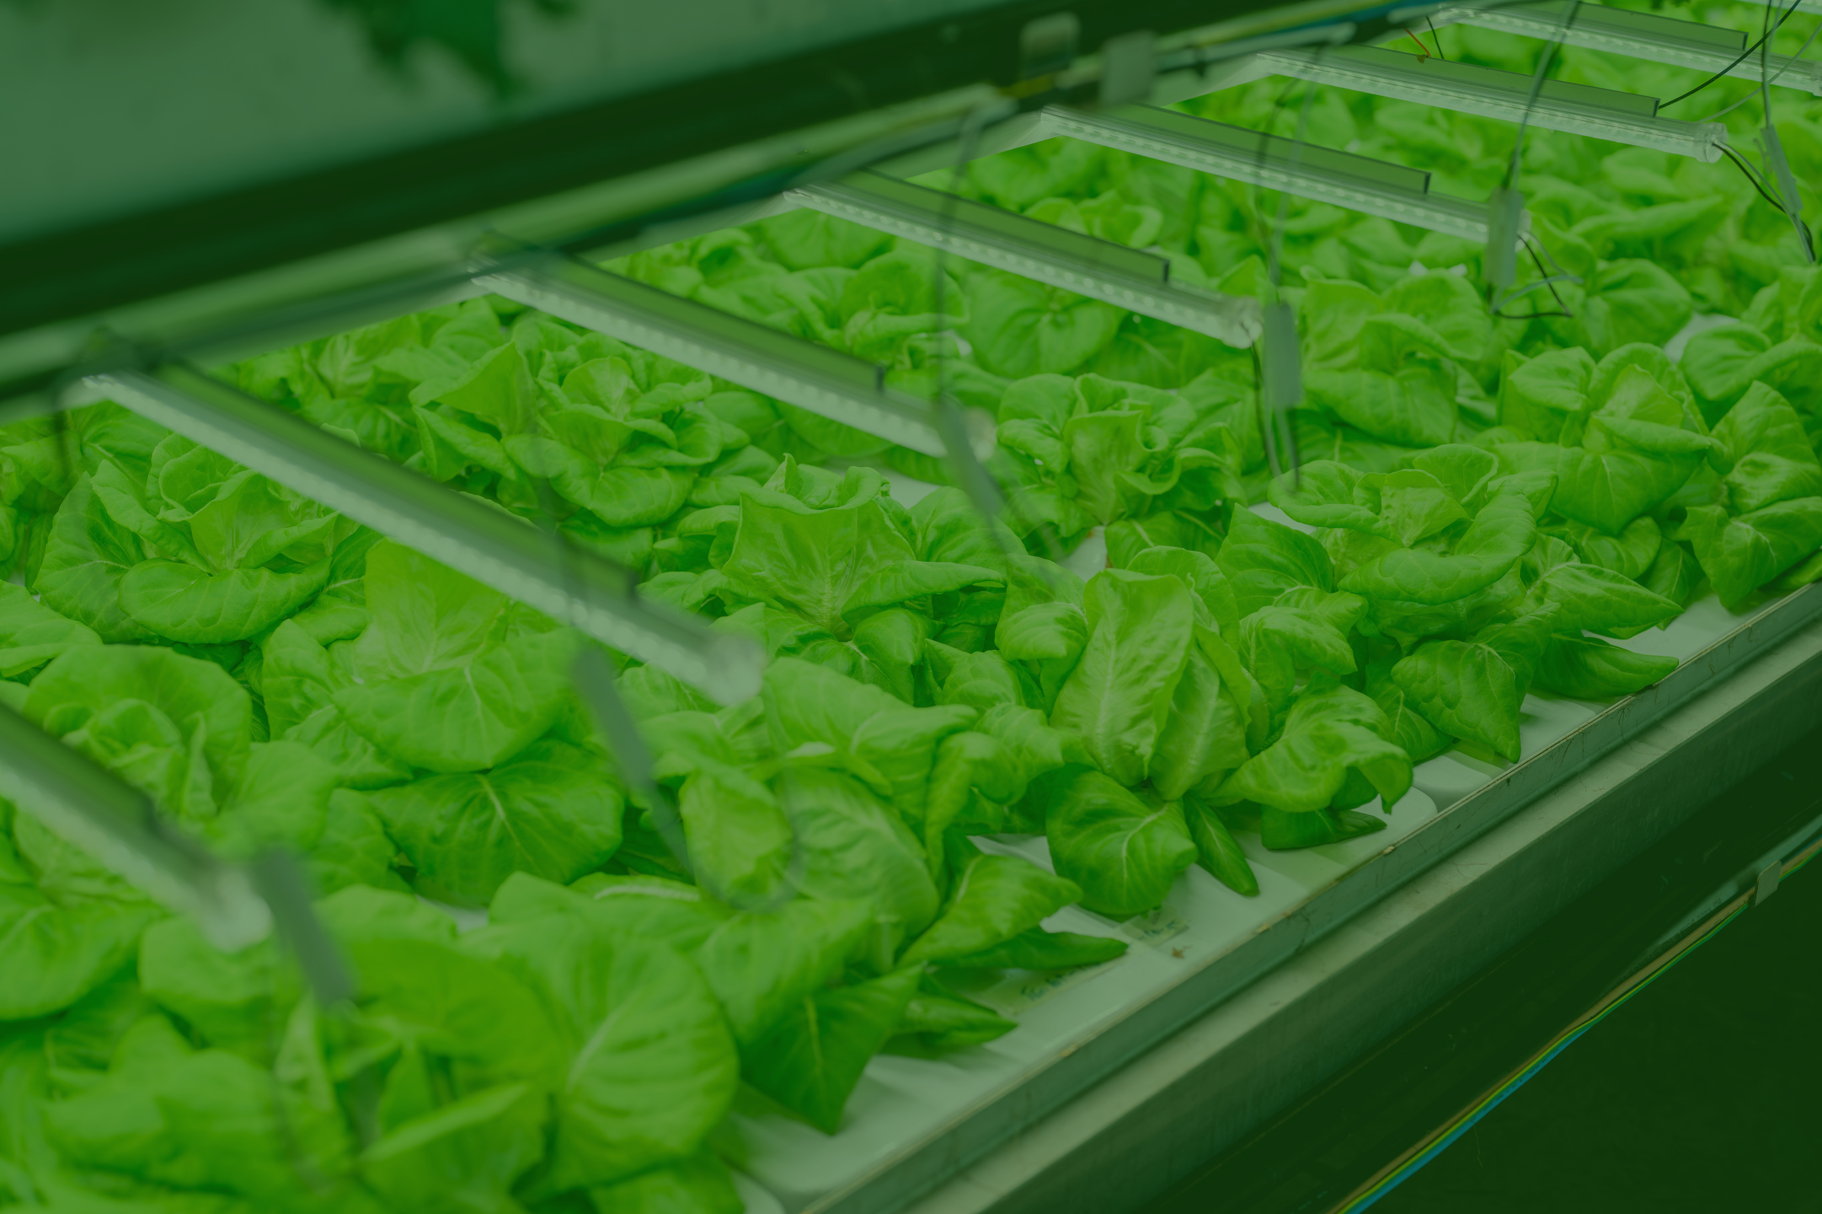
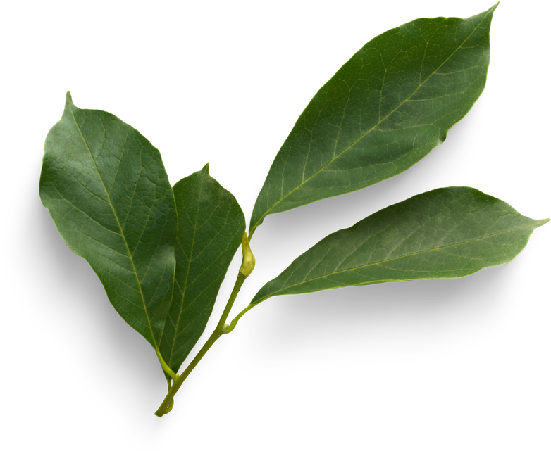
THANK YOU

Slide 13
S.No. | Paper | Author(s) | Method / Approach | Key Contribution | Research Gap / Limitation
13 | Applying Graph Neural Networks to Predict Fungal Disease Occurrences in Precision Agriculture | Samson, Lord, Carisse & Makarenkov (2026) | Graph Convolutional Network on plant-level spatial graphs with weather-derived node features | Shows GNNs outperform traditional ML/DL baselines for fungal disease occurrence and stay robust under missing or noisy field data | Uses spatial-proximity graphs within single fields only; no visual ViT features, physics-informed climate constraints, or multi-day forecast horizon
14 | PlantPlotGAN: A Physics-Informed Generative Adversarial Network for Plant Disease Prediction | Lopes, Sagan & Esposito (2023) | Physics-informed GAN generating synthetic multispectral plot imagery with realistic vegetation indices | Improves early disease-prediction accuracy by augmenting limited UAV multispectral datasets with physically realistic synthetic imagery | Limited to single-plot synthetic imagery generation; no inter-field spatial/graph modelling of disease spread or climate-adaptive forecasting
15 | MMST-ViT: Climate Change-Aware Crop Yield Prediction via Multi-Modal Spatial-Temporal Vision Transformer | Lin, Crawford, Guillot, Zhang et al. (2023) | Multi-modal Vision Transformer fusing satellite imagery with short- and long-term meteorological data | First ViT-based model jointly capturing growing-season weather variation and long-term climate change for county-level crop forecasting | Targets crop yield, not disease forecasting; lacks graph-based modelling of disease transmission between farms and physics-informed constraints
16 | Resource-Efficient Few-Shot Plant Disease Classification via Quantized Low-Rank Adapters in Vision Transformers | Bayat Toksoz & İşık (2026) | DINOv2 self-supervised ViT backbone with a Prototypical Network fine-tuned via QLoRA | Achieves accurate few-shot disease classification while tuning under 1% of parameters, suited to resource-constrained field deployment | Purely image-based classification; no climate variables, inter-farm graph relationships, or future disease-risk forecasting
17 | Stimator: A Method in Agriculture CPS Framework to Estimate Severity of Plant Diseases using Graph Neural Network | Kethineni, Mohanty & Kougianos (2023) | Graph Neural Network over a farmland graph of diseased locations to estimate severity and spread | Introduces a combined severity metric of affected area and spread area, estimated through graph-based learning over farmland | Graph nodes encode disease locations only, without visual transformer features, climate/weather variables, or future-horizon forecasting
18 | Spatio-Temporal Prediction of Crop Disease Severity for Agricultural Emergency Management Based on Recurrent Neural Networks | Xu, Wang & Chen (2018) | Spatio-temporal RNN with ensemble learning on remote-sensing, bioclimatic, topographic and soil data | Models spatial and temporal dependence in wheat yellow-rust severity to support agricultural emergency management decisions | Relies on RNN rather than transformer/graph architectures; no ViT features, physics-informed learning, or explicit inter-field graph relationships

