Slide 1
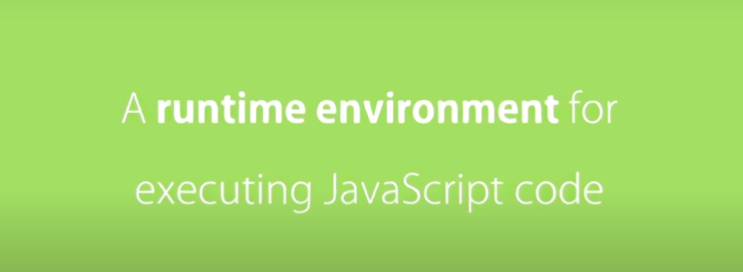
NODEJS

Slide 2


Slide 3
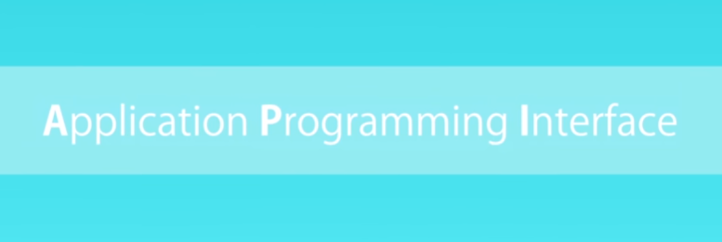

Slide 4
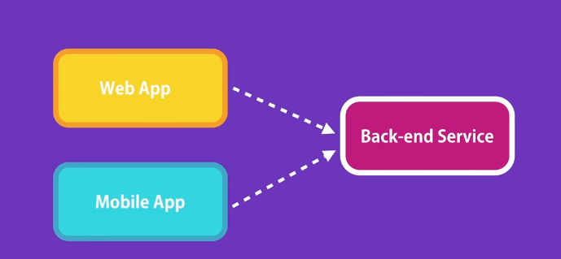

Slide 5
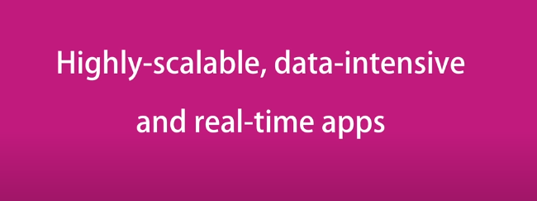

Slide 6
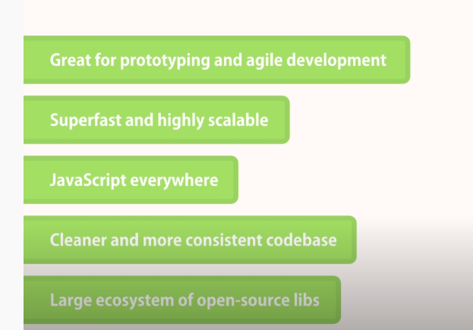

Slide 7


Slide 8
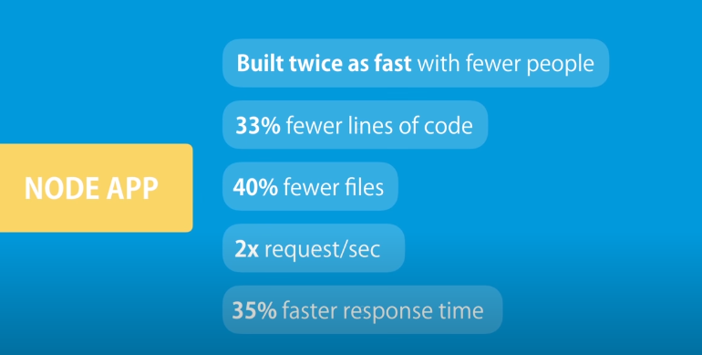

Slide 9
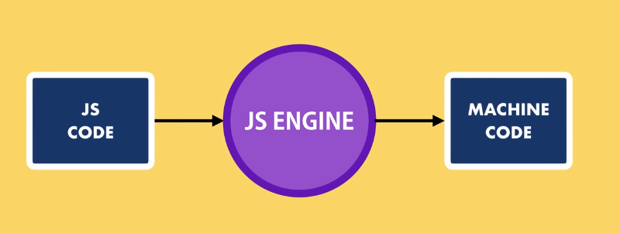

Slide 10
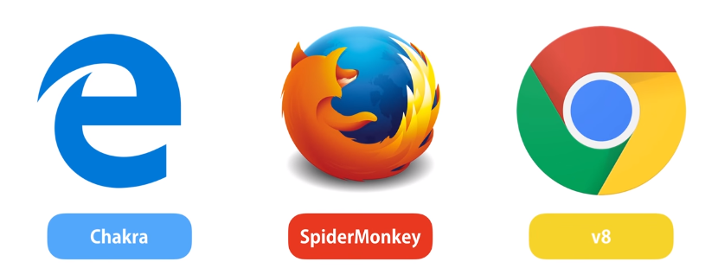

Slide 11
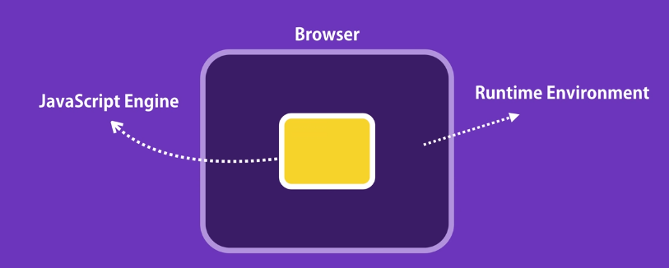

Slide 12
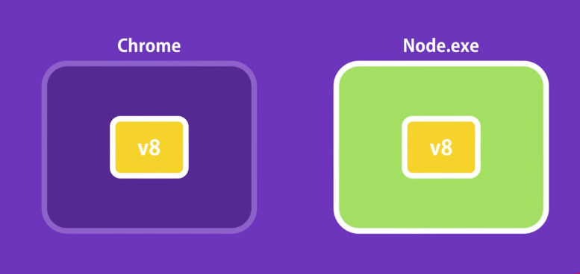

Slide 13
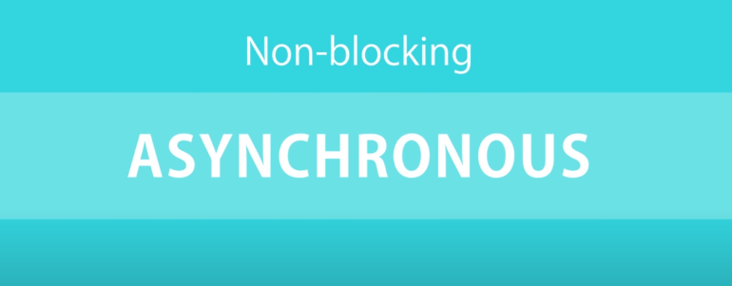

Slide 14
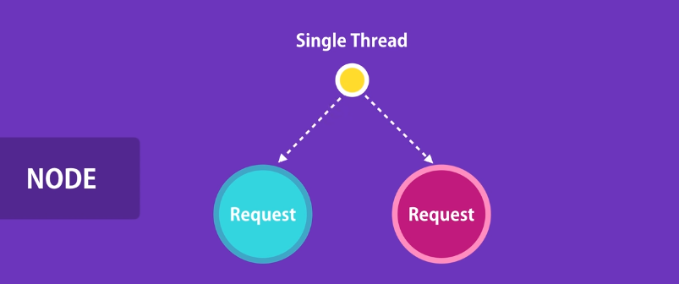

Slide 15
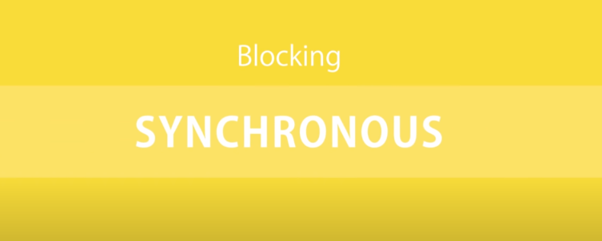

Slide 16
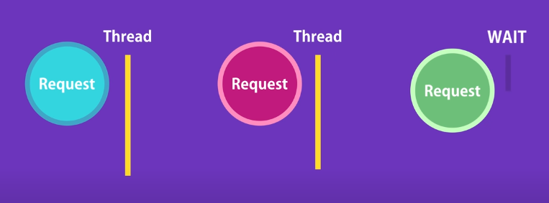

Slide 17
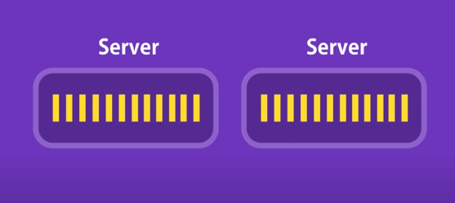

Slide 18
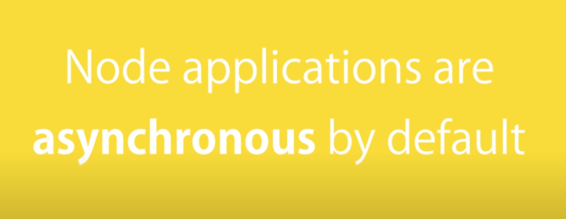

Slide 19
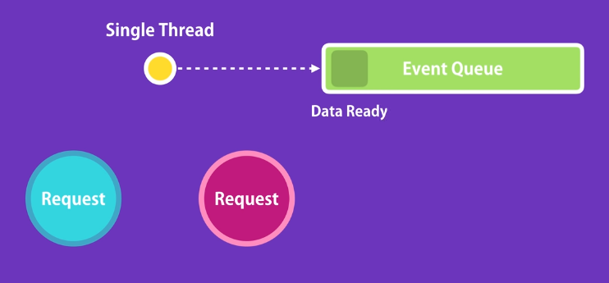

Slide 20
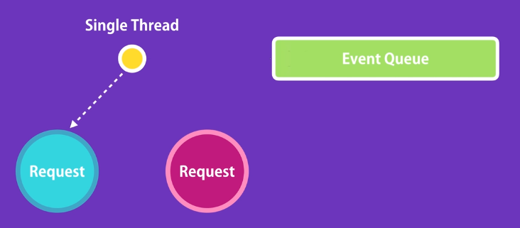

Slide 21
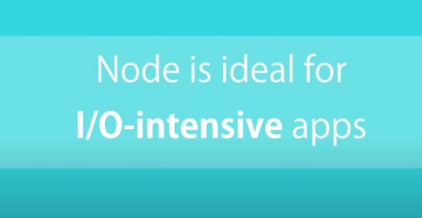

Slide 22
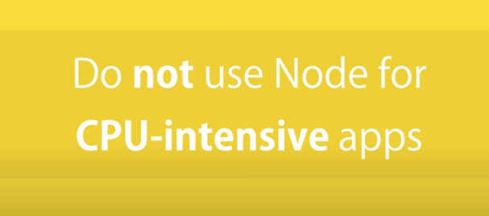

Slide 23
Let’s Start with Node JS…

Slide 24
Step 1: Download Node.js Installer
1.Download the Windows installer from http://nodejs.org
2.Run the installer (the .msi file you downloaded in the previous step.)
3.Follow the prompts in the installer (Accept the license agreement, click the NEXT button a bunch of times and accept the default installation settings).
4.Restart your computer.
You won’t be able to run Node.js until you restart your computer.

Slide 25
Step 2: Test it!- Verify Installation
Make sure you have Node and NPM installed by running simple commands to see what version of each is installed:
Open a command prompt (or PowerShell), and enter the following: node –v
The system should display the Node.js version installed on your system. You can do the same for NPM: npm-v

Slide 26
What is NPM? (NODE PACKAGE MANAGER)
The npm Registry is a public collection of packages of open-source code for Node.js,
NPM is also a software Package Manager and Installer.
The registry contains over 800,000 code packages.
Open-source developers use npm to share software.
Many organizations also use npm to manage private development.

Slide 27
Installing Packages
Syntax to install any package in node.js using npm:
$ npm install <Module Name>

Slide 28
DOWNLOAD EDITOR :
Visual Studio Code is a lightweight but powerful source code editor which runs on your desktop and is available for Windows, macOS and Linux.
It comes with built-in support for JavaScript, TypeScript and Node.js and has a rich ecosystem of extensions for other languages.
Download link: https://code.visualstudio.com/download

Slide 29
Node.js utility modules:
There are several utility modules available in Node.js module library.
These modules are very common and are frequently used while developing any Node based application.
Eg. OS module, DNS module etc.
Lets us see OS module….

Slide 30
var os = require("os");
// Endianness
console.log('endianness : ' + os.endianness());
// OS type
console.log('type : ' + os.type());
// OS platform
console.log('platform : ' + os.platform());
// Total system memory
console.log('total memory : ' + os.totalmem() + " bytes.");
// Total free memory
console.log('free memory : ' + os.freemem() + " bytes.");
Save as: osdemo.js
Run: node osdemo.js

Slide 31
Node.js web modules:
A Web Server is a software application which handles HTTP requests sent by the HTTP client, like web browsers, and returns web pages in response to the clients.
Node.js provides an http module which can be used to create an HTTP client of a server.

Slide 32
Let us create a “hello world” program in Node js:

Slide 33
var http=require(“http”);
http.createServer( function (req,res){
res.send (“hello world in browser”);
});
console.log (“hello world in console”);
Save as : hello.js
Run : node hello.js

Slide 34
Nodemon
Nodemon is used instead of node to run your code, and now your process will automatically restart when your code changes.
To install, get node.js, then from your terminal run:
npm install -g nodemon

