Slide 1
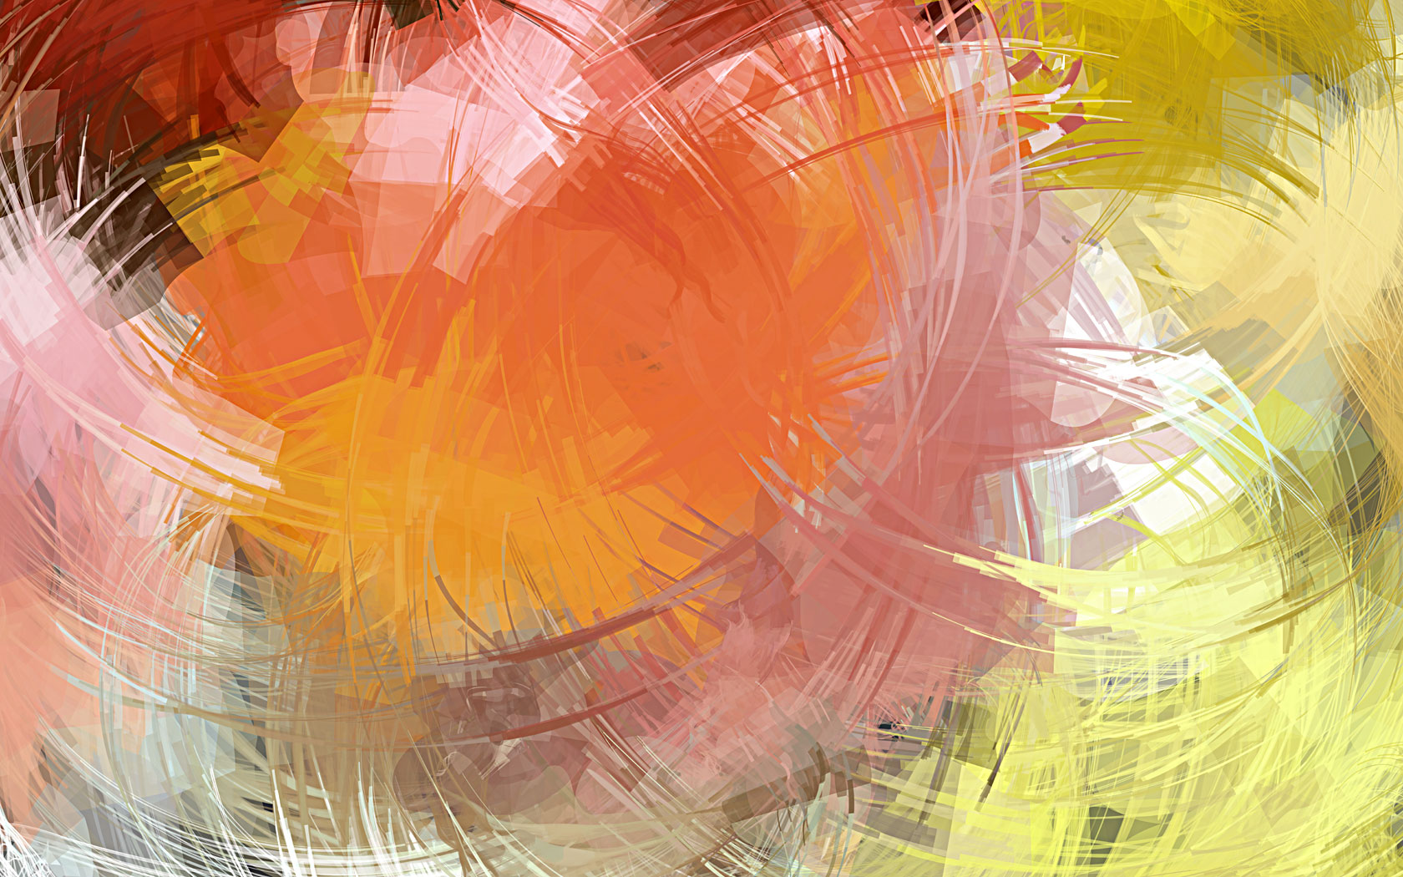
KEEPING ART
3. Preservation and Restoration
• Because art is valuable, enormous human efforts and financial resources are devoted to preserving art from the ravages of time, the environment, industrial-by-product, and even any other human being.

