Slide 1
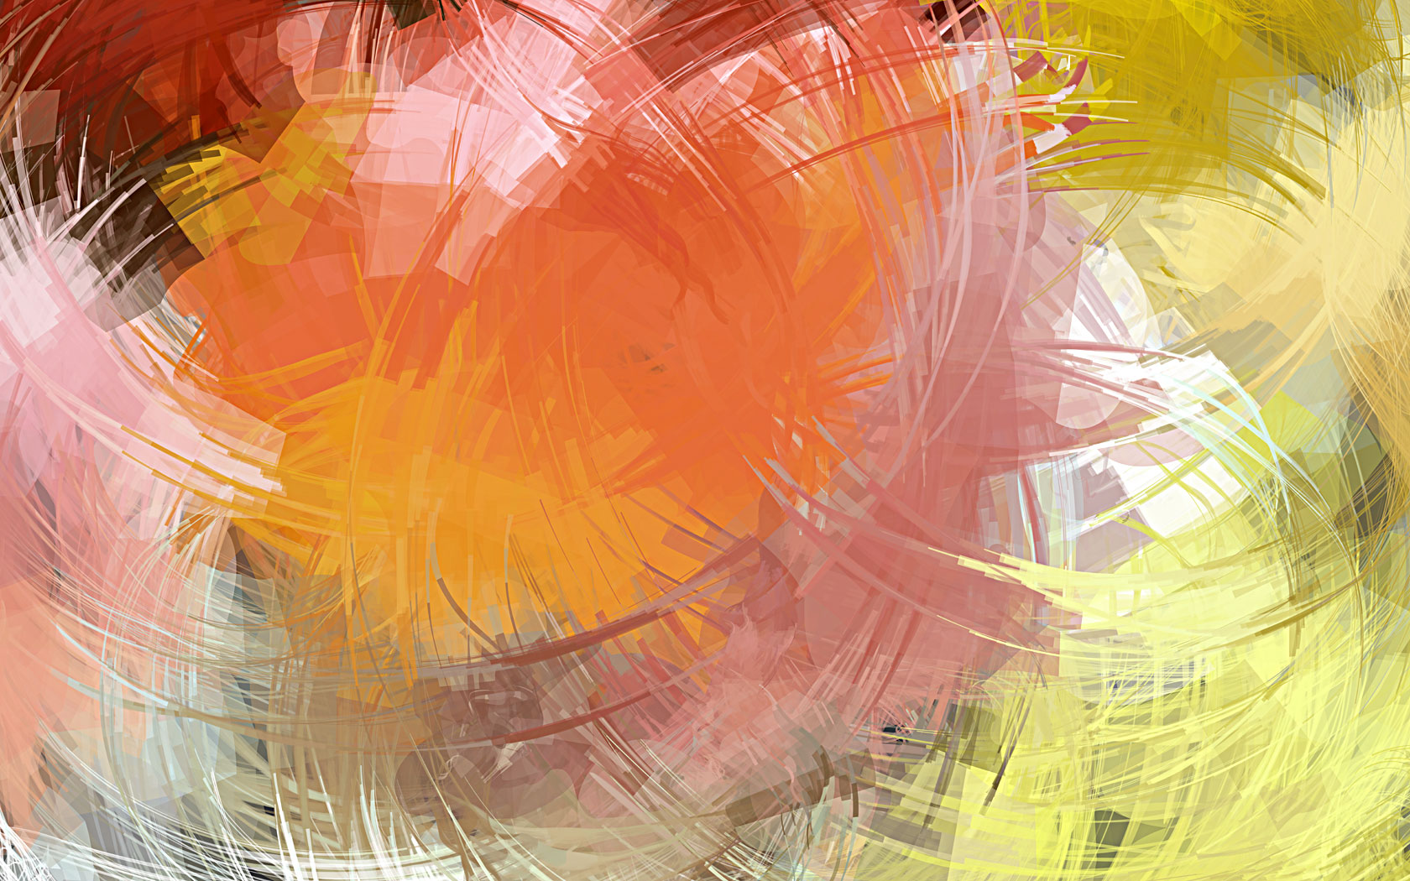
References:
1. Garces, J.C., Inoc, D.S., Inocian, R.B., Labajo, O.P., Rama, F., Tiempo, A.Y., & Un, J.L. 2021. *Modular Approach to Art Appreciation*. Lorimar Publishing Inc. 2. Casaul, J.A., Caslib Jr. B.N., & Garing, D.C. 2018. *Art Appreciation*. Rex Bookstore, Inc.

