Slide 1

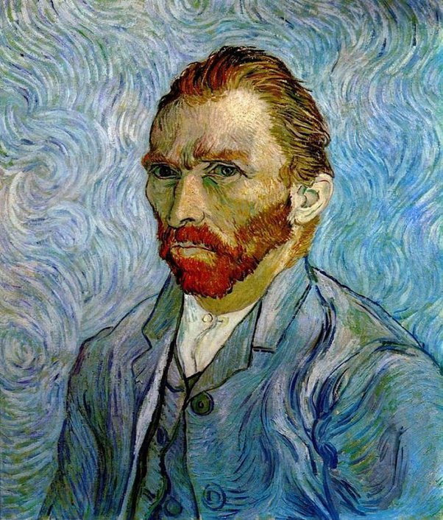
The Subject and Content of Art
Representational or Objective Art
Self-portrait of Van Gogh

