Slide 1
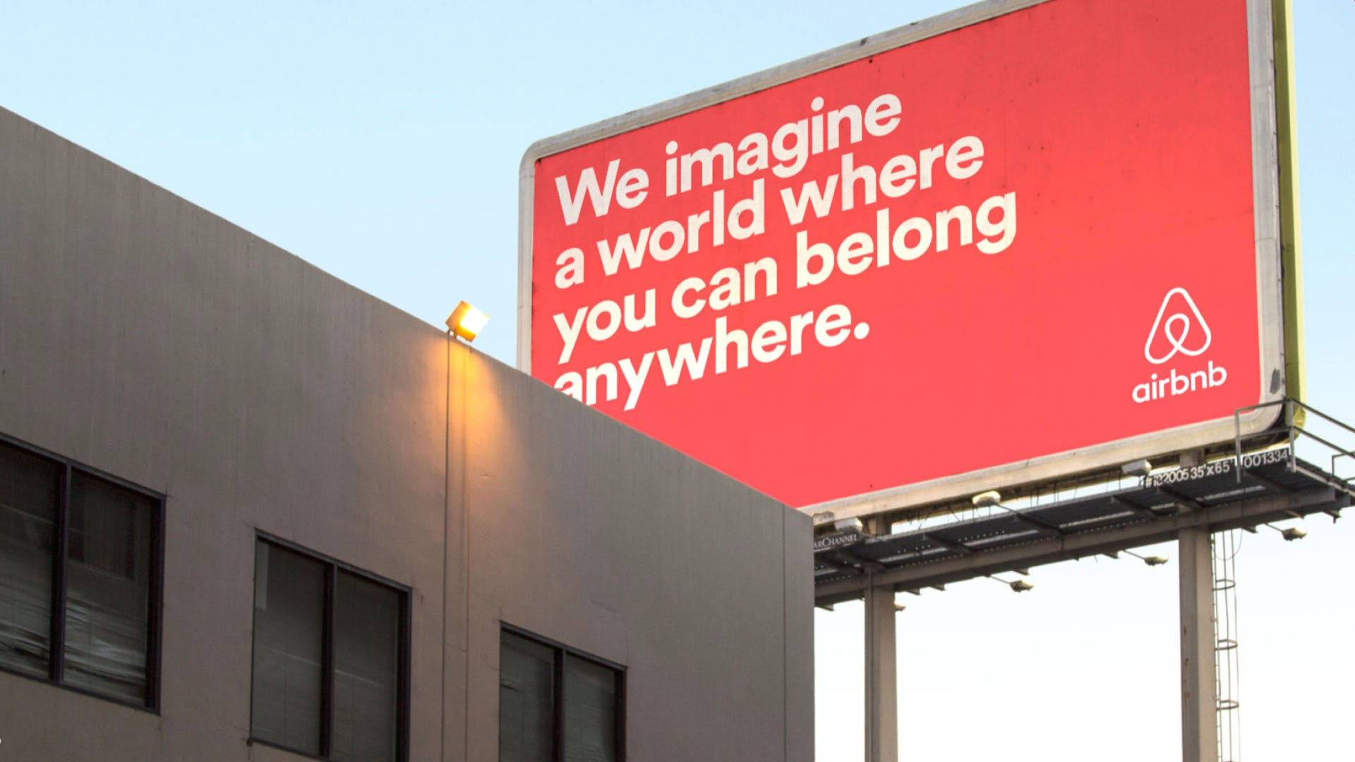
We imagine a world where you can belong anywhere.

