Slide 1
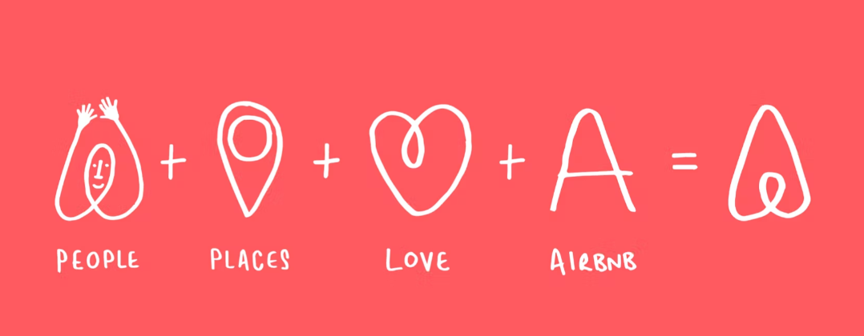
Branding
'Belong Anywhere’ became our compass. The ‘Belo’ symbol - a sort of heart/drop pin hybrid that can be drawn by anyone - transcends language and culture in an ode to Airbnb’s welcoming spirit, while a warm and welcoming new colour palette reflects the open heartedness of its people. Source: Airbnb and Design Studio, 2017
'Belong Anywhere’ became our compass. The ‘Belo’ symbol - a sort of heart/drop pin hybrid that can be drawn by anyone - transcends language and culture in an ode to
Airbnb
’s welcoming spirit, while a warm and welcoming new colour palette reflects the open heartedness of its people. Source: Airbnb and Design Studio, 2017

