Slide 1

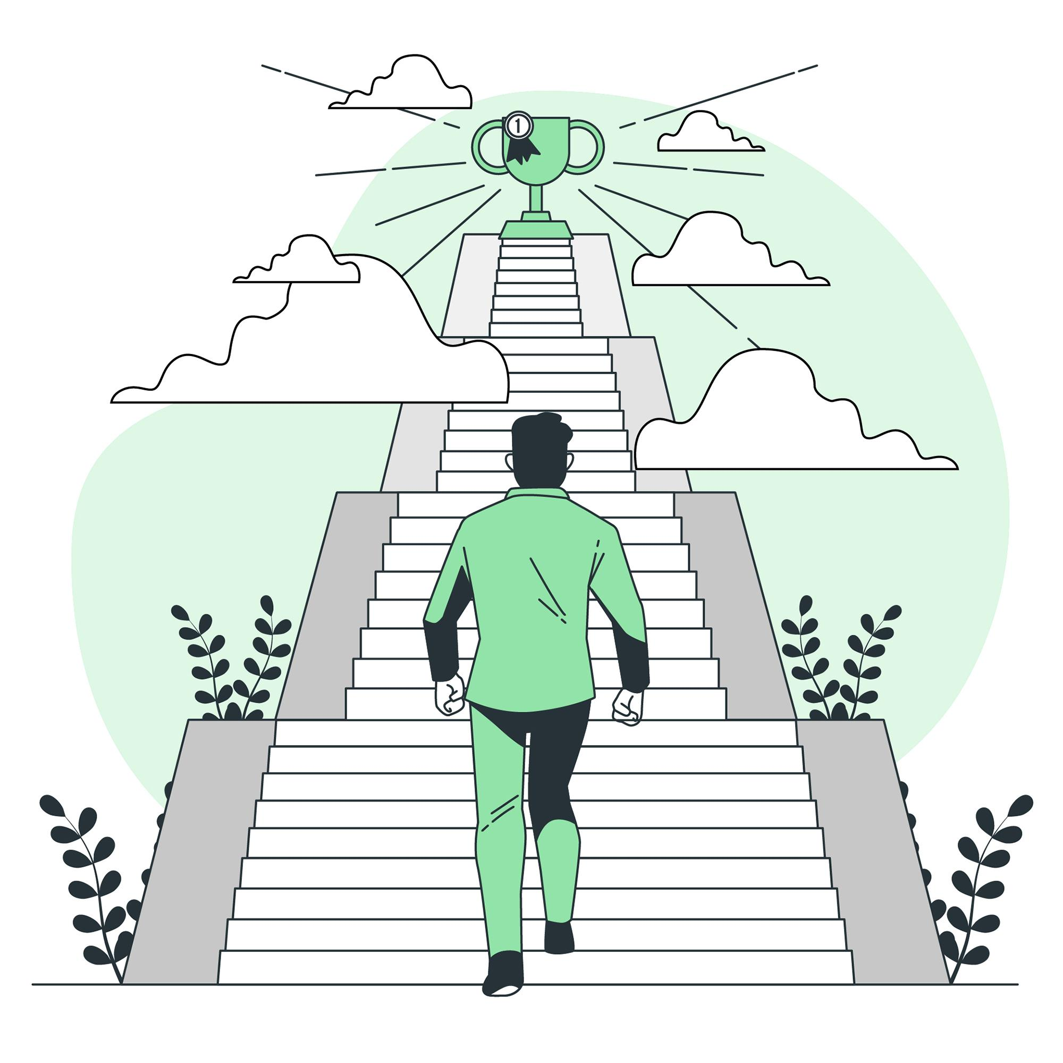
Conclusion
To Download Visit www.topicsforseminar.com
In today’s world top grades are valuable but they are not the only path to success. Balance is the Key. Pursue your interests and passions with a holistic approach to personal and professional development. Focus on your unique strengths and define your own paths to success.

