Slide 1
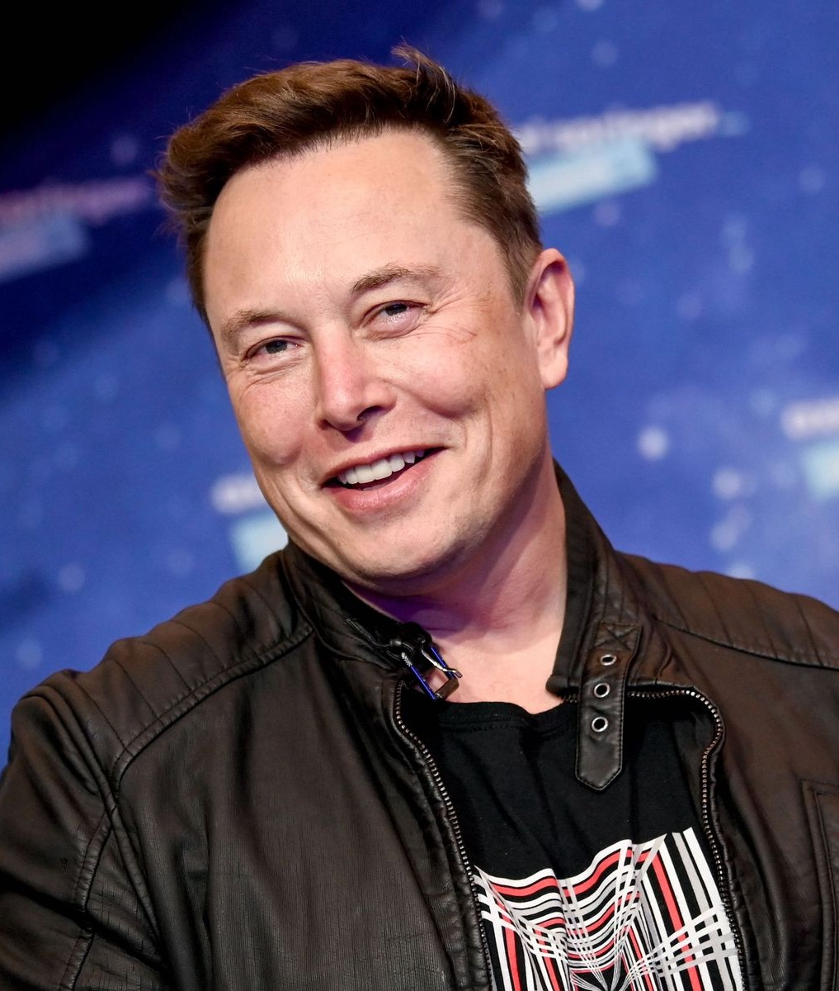
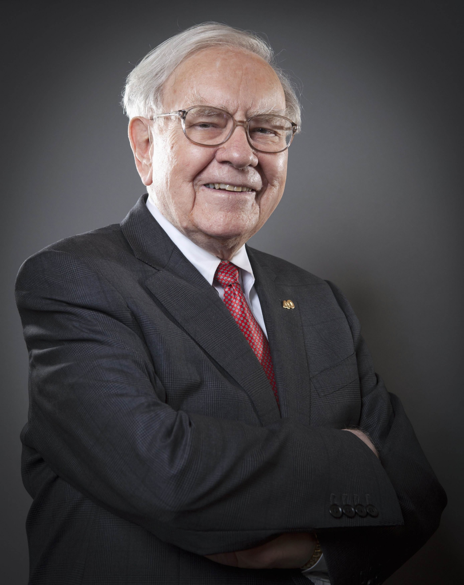
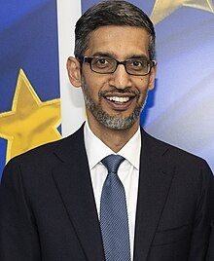
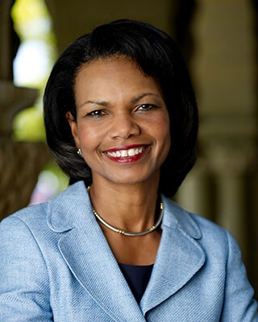
SUCCESSFUL INDIVIDUALS WITH TOP ACADEMIC RECORDS
ELON MUSK
CEO of SpaceX and Tesla
Education
University of Pennsylvania
Bachelor of Science in Physics
Bachelor of Arts in Economics
WARREN BUFFETT
Business magnate, investor, and philanthropist
Education
University of Pennsylvania
University of Nebraska-Lincoln (BS)
Columbia University
SUNDAR PICHAI
CEO of Alphabet and Google
Education
IIT Kharagpur
Stanford University (MS)
University of Pennsylvania (MBA)
CONDOLEEZZA RICE
Former U.S. Secretary of State
Education
University of Denver (BA, PhD)
University of Notre Dame (MA)

