Slide 1
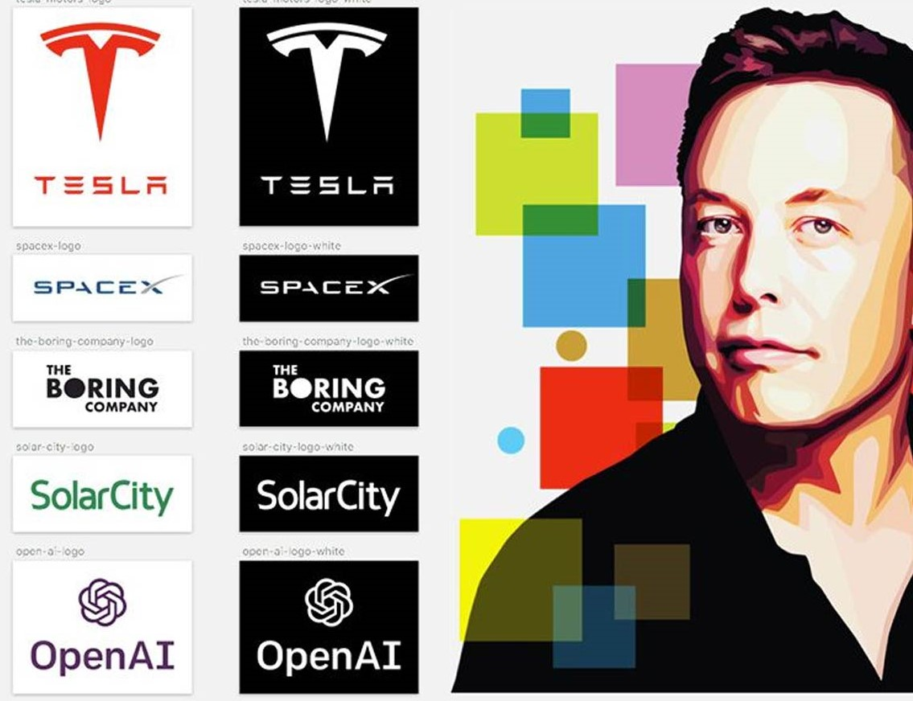
Elon Musk Current Stage
CEO and Chief Engineer at SpaceX
CEO and Product Architect of Tesla
Founder of The Boring Company
Cofounder of Neuralink
Cofounder of OpenAI

