Slide 1
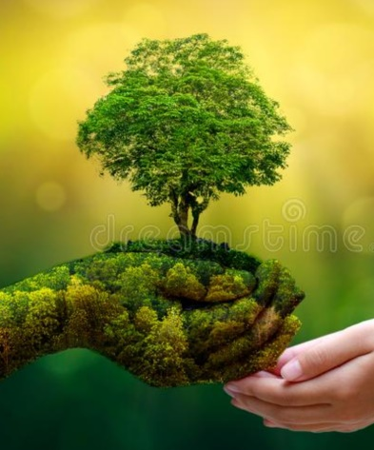
ENVIRONMENT
• Everything around us is known as environment.
• It includes every living and non living thing.
• Everything which we see in our surroundings such as sunlight, atmosphere, land, water, minerals, humans, plants, animals, insects, air etc. comes in environment.
• It is the sum of all surroundings which we see.

