Slide 1
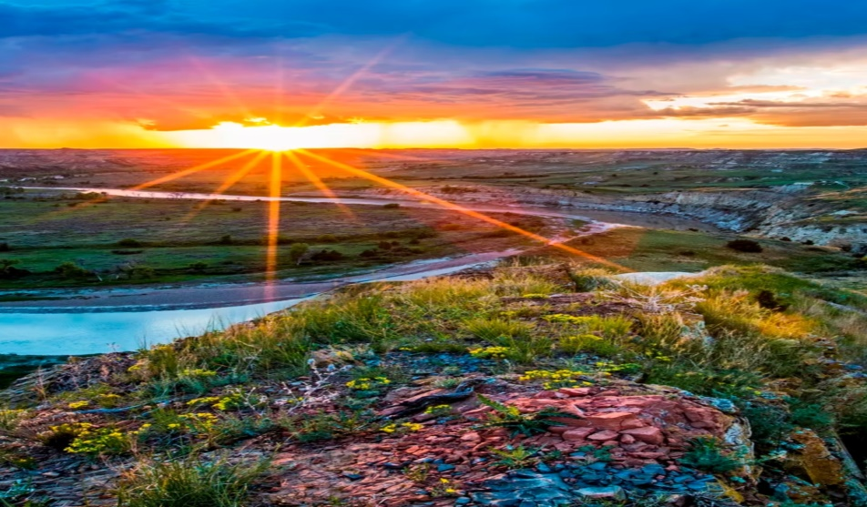
Human impact or influence on environment.
We are living in this environment so we have definitely gave an impact on environment. So lets see some positive and negative impact of humans on environment.

