Slide 1
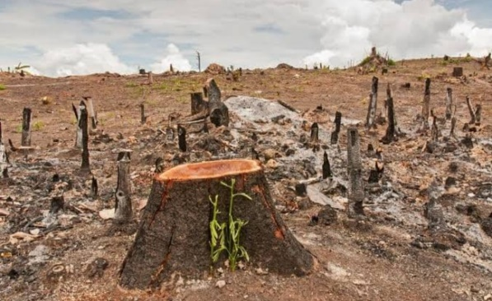
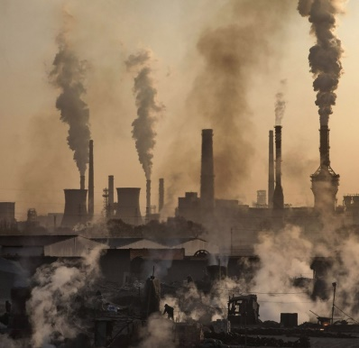
NEGATIVE IMPACT
Humans are continuously cutting down trees and littering have a negative impact on environment..
Pollution is everywhere, from the trash thrown out on the free way to the millions of metric tons of pollution pumped into the atmosphere every year.
Burning fossil fuels is the prime culprit for climate change. When oil gas and coal are burned they release carbon dioxide and other harmful gases which trap heat in atmosphere and cause it to warm up.
The increasing use of fertilizers and pesticides to protect crops have damaged the fertility of land.
Food wastage is a huge issue with an estimated one third of all food produced globally is being wasted.

