Slide 1

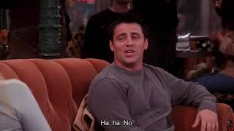
PART 3
Choose true (T), false (F), or not given (N) according to the information in the video.
Phoebe sarcastically says that Sarah is a monster for her etiquette. | ✔️
Joey prefers eating French fries with his fingers. |  | ✔️
Rachel is surprised to hear about Joey’s food sharing rule. |  |  | ✔️
Check your answers
Viewing Activity

