Slide 1
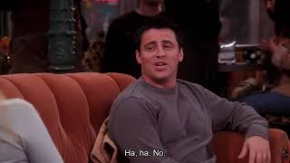
PART 4
List the events in Joey’s second date with Sarah in order from 2 - 6. The first one has been done as an example.
☐ Sarah leaves the table for a phone call.
☐ Joey doesn’t like the dessert he orders and tries to order a different one.
☐ Joey refuses to apologize when Sarah returns.
☐ Joey apologizes for getting angry that Sarah took his food on the first date.
☐ Joey is unable to control himself and eats all of Sarah’s dessert.
☐ The waiter arrives with their desserts.
Check your answers
VIEWING ACTIVITY

