Slide 1
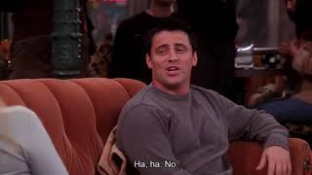
PART 4
List the events in Joey’s second date with Sarah in order from 2 - 6. The first one has been done as an example.
1. Sarah leaves the table for a phone call.
2. Joey doesn’t like the dessert he orders and tries to order a different one.
3. Joey refuses to apologize when Sarah returns.
4. Joey apologizes for getting angry that Sarah took his food on the first date.
5. Joey is unable to control himself and eats all of Sarah’s dessert.
6. The waiter arrives with their desserts.
VIEWING ACTIVITY

