Slide 1
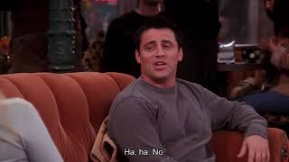
PART 4
List the events in Joey’s second date with Sarah in order from 2 - 6. The first one has been done as an example.
2. The waiter arrives with their desserts.
3. Joey doesn’t like the dessert he orders and tries to order a different one.
4. Sarah leaves the table for a phone call.
5. Joey is unable to control himself and eats all of Sarah’s dessert.
6. Joey refuses to apologize when Sarah returns.
VIEWING ACTIVITY

