Slide 1
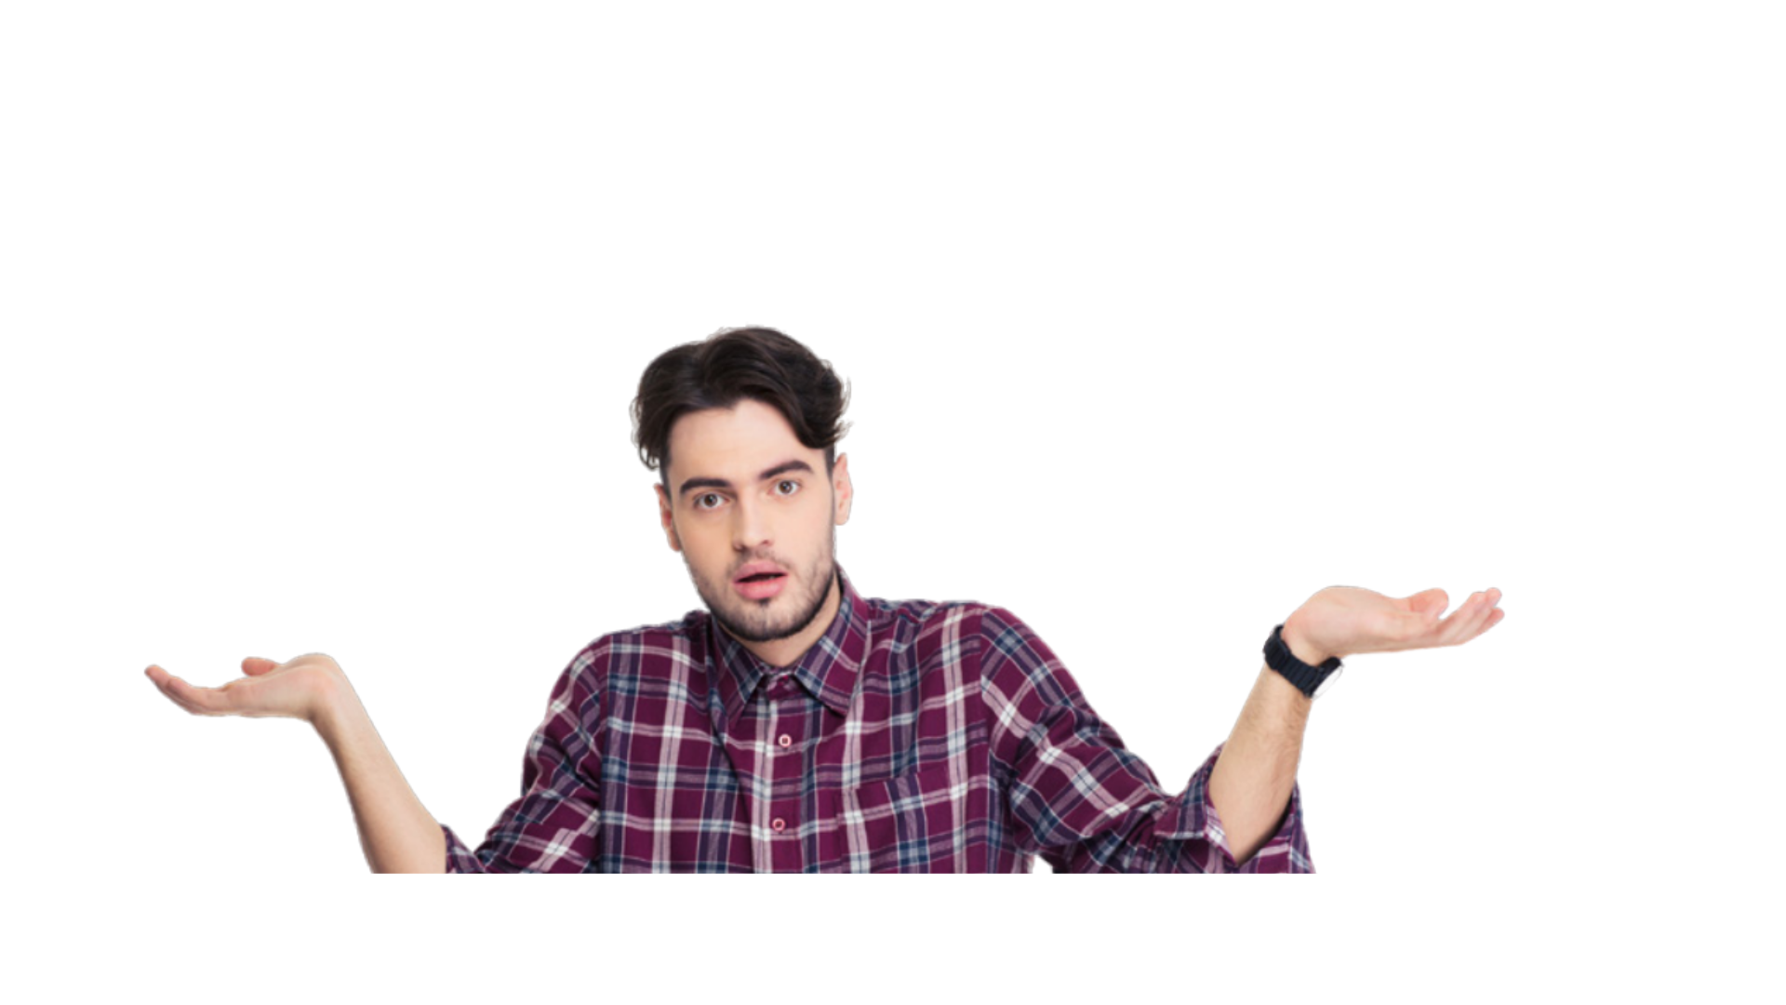
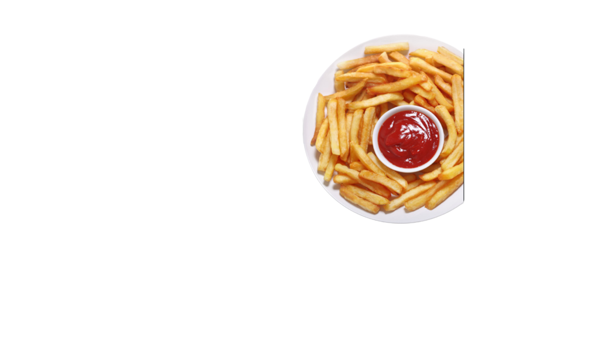
PART 3
Imagine you went to a restaurant for a first date. Something went wrong involving French fries. Imagine you’re telling the story to a friend. Use the prompt below to start your story.
We were out to dinner, we were getting along, having a really nice time, I was thinking she was really cool, but then, out of nowhere, ...
PREVIEW ACTIVITY

